Slide 1


Virtual Research Environment in Southeast Europe and the Eastern Mediterranean
Luka Filipović
Univerzitet Crne Gore
lukaf@ac.me

Slide 2

O projektu
VI-SEEM: Virtual Research Environment for regional interdisciplinary communities in Southeast Europe and the Eastern Mediterranean
VRE za regionalnu multidisciplinarnu zajednicu jugoistočne Evrope i istočnog Mediterana
H2020-EINFRA-2015-1: e-Infrastructures for virtual research environments (VRE)
Start 01.10.2015
Trajanje 36 mjeseci
EC finansiranje: 3.3 M euro – 715 PMs

Slide 3
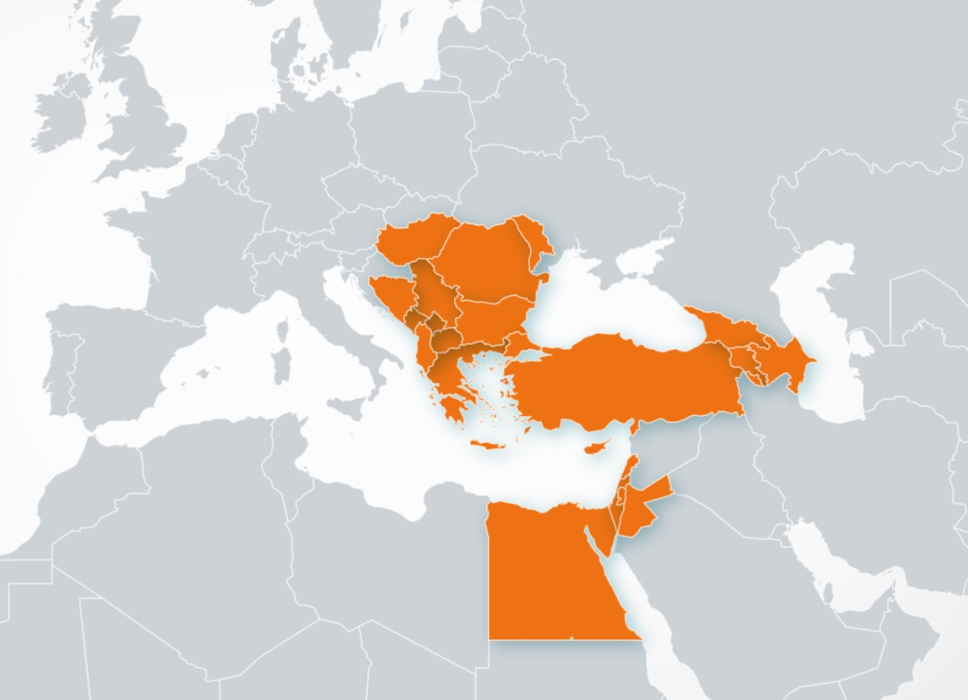
Učesnici
Povezivanje SEE i EM regiona
Prethodni projekti :
SEE: network SEEREN1-2, SEE-GRID-1/2/SCI, HPC HP-SEE
EM: HPC LinkSCEEM1-2
Participant no. | Participant organisation name | Part. short name | Country
1 (Coord) | GREEK RESEARCH AND TECHNOLOGY NETWORK S.A. | GRNET | Greece
2 | THE CYPRUS INSTITUTE | CyI | Cyprus
3 | INSTITUTE OF INFORMATION AND COMMUNICATION TECHNOLOGIES – BULGARIAN ACADEMY OF SCIENCES | IICT-BAS | Bulgaria
4 | INSTITUTE OF PHYSICS BELGRADE | IPB | Serbia
5 | NATIONAL INFORMATION INFRASTRUCTURE DEVELOPMENT INSTITUTE | NIIF | Hungary
6 | WEST UNIVERSITY OF TIMISOARA | UVT | Romania
7 | POLYTECHNIC UNIVERSITY OF TIRANA | UPT | Albania
8 | UNIVERSITY OF BANJA LUKA | UNI BL | Bosnia and Herzegovina
9 | SS CYRIL AND METHODIUS UNIVERSITY OF SKOPJE | UKIM | FYR of Macedonia
10 | UNIVERSITY OF MONTENEGRO | UOM | Montenegro
11 | RESEARCH AND EDUCATIONAL NETWORKING ASSOCIATION OF MOLDOVA | RENAM | Moldova
12 | INSTITUTE FOR INFORMATICS AND AUTOMATION PROBLEMS OF THE NATIONAL ACADEMY OF SCIENCES OF THE REPUBLIC OF ARMENIA | IIAP-NAS-RA | Armenia
13 | GEORGIAN RESEARCH AND EDUCATIONAL NETWORKING ASSOCIATION | GRENA | Georgia
14 | BIBLIOTHECA ALEXANDRINA | BA | Egypt
15 | INTER UNIVERSITY COMPUTATION CENTER | IUCC | Israel
16 | SYNCHROTRON-LIGHT FOR EXPERIMENTAL SCIENCE AND APPLICATIONS IN THE MIDDLE EAST | SESAME | Jordan

Slide 4
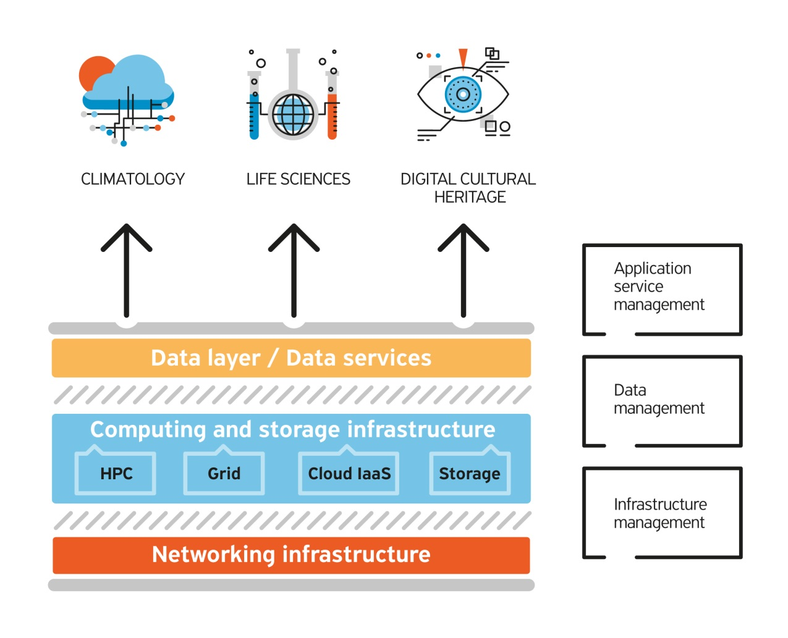
Ciljevi i tehnologija
Ciljevi : Omogućiti user-friendly integrisanu e-Infrastrukturnu platformu za naučnu zajednicu u oblasti Klimatologije, prirodnih nauka i digitalizacije kulturne baštine za SEEM region podjelom računara i podataka kao i vizuelizacijom resursa.
Distribuirani računarski sistemi
Paralelno programiranje
Različite računarske tehnologije
Big data
Servisno orjentisan projekat

Slide 5
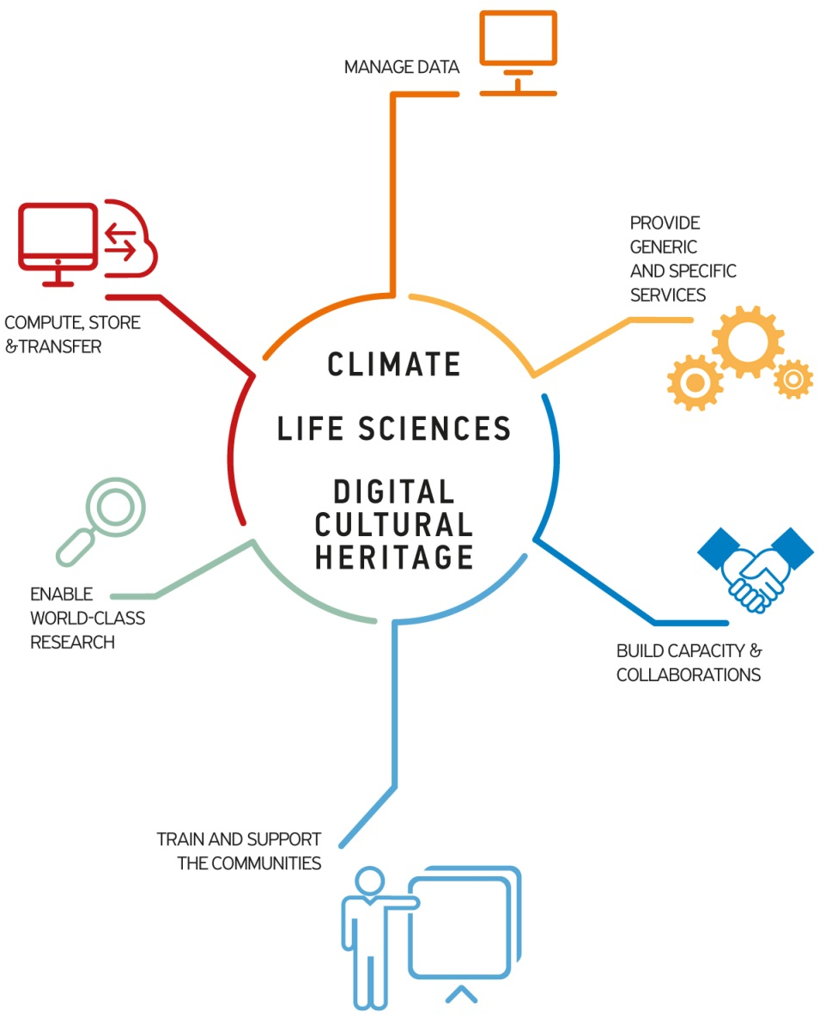
Ciljevi

Slide 6
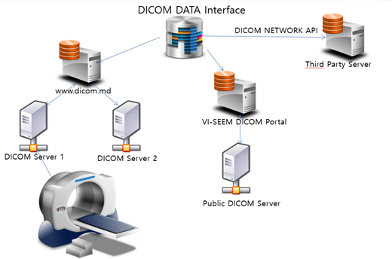
Ključne performanse
VI-SEEM u brojkama :
10+ specificnih servisa,
30 data setova
25 razlicitih kodova
39 aplikacija,
45 istraživačkih timova
100+ publikacija, ..
20+ treninga

Slide 7
e-Infrastruktura
e-Infrastructure
HPC – klasteri i superracunari (razlicite arhitekture hardware-a)
Grid – povezan Grid middleware-om
Cloud – virtualne masine (VMs) namijenjene za servise
Storage – za kratkotrajno i dugotrajno cuvanje podataka
Korištene moderne, najsavremenije tehnologije za obradu podataka, virtuelizaciju i skladištenje dostupne u naučnim zajednicama
Infrastruktura u brojkama :
23,744 CPU-cores, 1,012,736 GPU-cores, 20,496 Xeon Phi-cores
3,112 Grid CPU-cores
14,152 Cloud VM-cores
18 PB of storage space

Slide 8
e-Infrastruktura : Servisi
Servisi grupisani u servis katalog
Servisi vezani za infrastructure i resurse [WP3]
Data/storage servisi [WP4]
Aplikativni servisi [WP5]
https://services.vi-seem.eu/

Slide 9
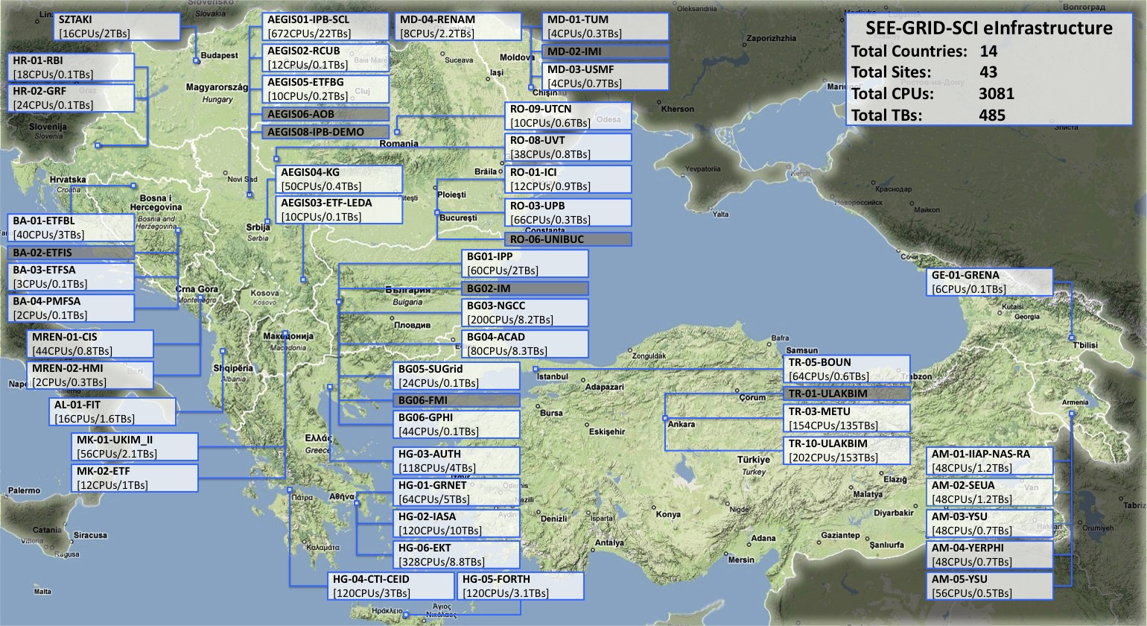
e-Infrastruktura: SEE-GRID
At end of SEE-GRID projects series: 55 sites in production
Podgorica, 23.04.2018.

Slide 10
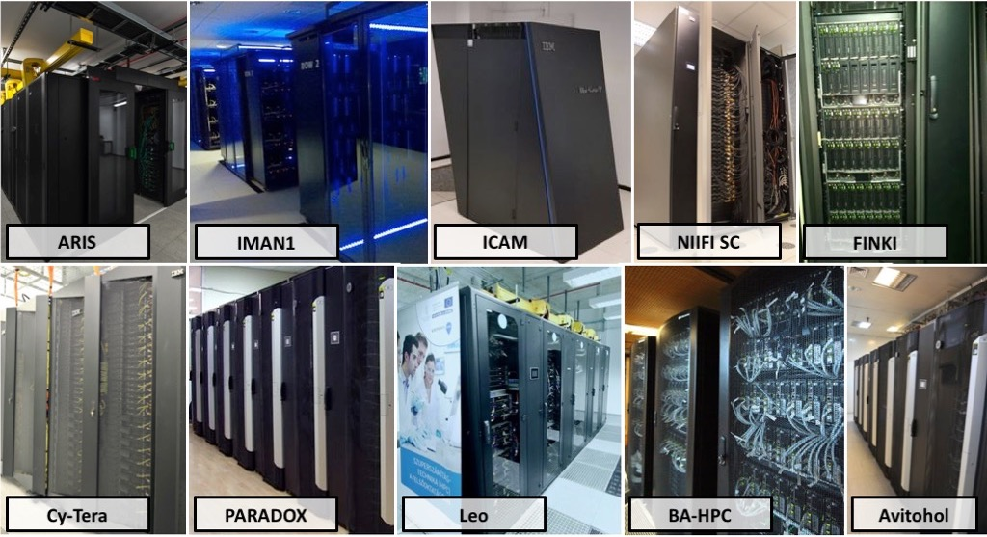
e-Infrastruktura SEE + EM

Slide 11
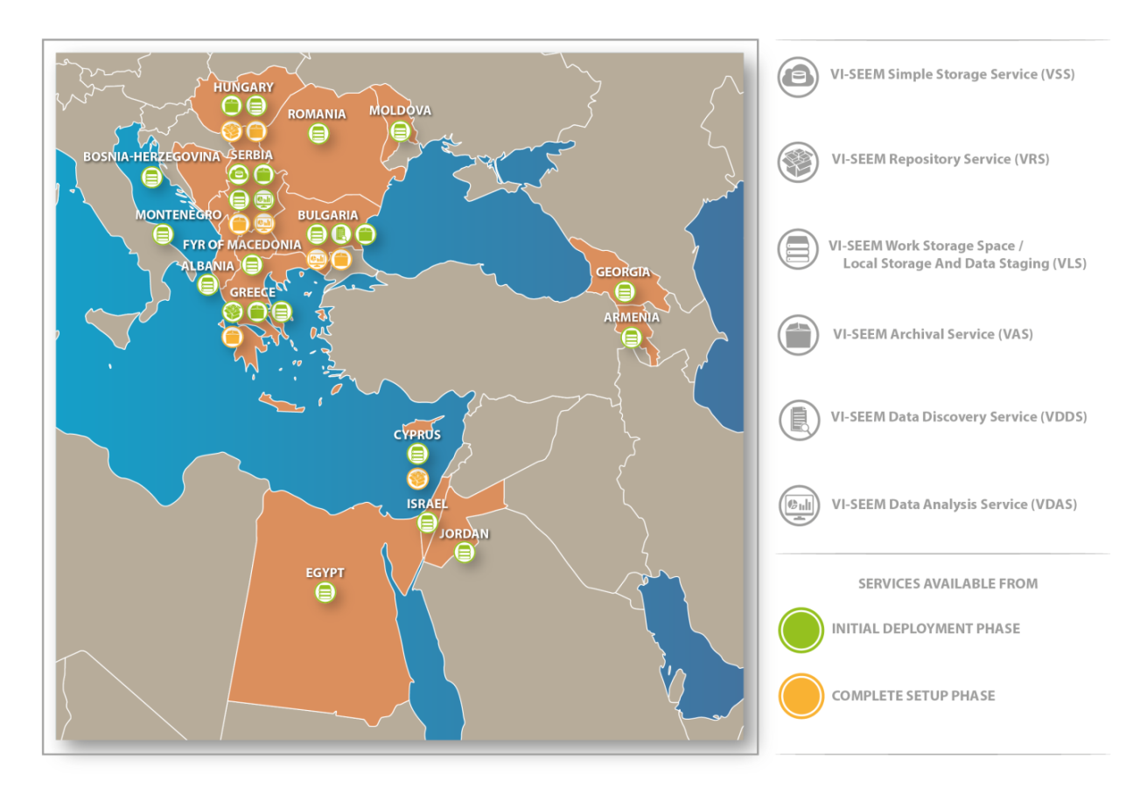
Data servisi

Slide 12
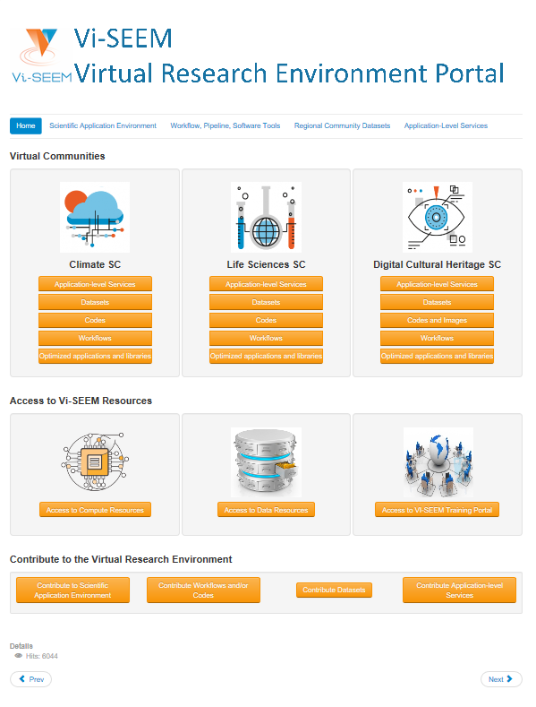



VRE i trening portal
Sve integrisane usluge dostupne preko VRE portala namijenjenog korisinicma : https://vre.vi-seem.eu/
Grupisane po naučnim zajednicama
Klimatologije,
Prirodne nauke
Digitalizacije kulturne baštine
VRE portal :
Applications
Workflows/codes
Datasets
Domain-specific services
VI-SEEM Training Portal : https://training.vi-seem.eu/
materijal za obuku za usluge VI-SEEM projekta.
pristup uslugama e-infrastrukture (HPC, Grid Cloud, Data)
materijal specifičan za domen za korištenje alata, podataka i infrastrukture

Slide 13
Aplikacije : Oblasti istraživanja
Climate | Life Sciences | Cultural Heritage
Regional Climate Modelling | Modeling and Molecular Dynamics (MD) study of important drug targets | Digital Libraries
Global Climate Modelling | Computer-aided drug design | Interactive Visualization Tools
Weather Forecasting | Analysis of Next Generation DNA sequencing data and RNA profiling data | Semantic Referencing
Air Pollution/Quality | Data mining to identify prevalent diseases/mutations in the SEEM region | Image Classification
Model Development | Image processing for biological applications | Modelling of Built Environments and Advanced Representation Techniques
Visualization, Datasets, etc. | Computational simulation of DNA and RNA | Scientific simulation of materiality and systems' properties
Other | Synchrotron data analysis | Geo-referencing Tools
 | Other | Bioarchaeology

Slide 14
Univerzitet Crne Gore @ VI-SEEM
Članice Univerziteta Crne Gore na projektu:
ETF,
PMF
CIS
Aplikacija
PSOMI (life science area).
Analize, Datasetovi, Vizuelizacija, Success story, Web servis
Dronemapper (u saradnji sa BIO-ICT)
Promocija poziva za pristup infrastrukturi/servisima/aplikacijama ..
Promocija nauke, Treninzi, Popularizacija ...

Slide 15
Hvala! Pitanja, ...
VI-SEEM Project Management Office
e-mail: vi-seem-pmo@vi-seem.eu
W: https://vi-seem.eu
T: @vi_seem
L: https://www.linkedin.com/groups/VISEEM-7018941/about

