Slide 1




DICOM Network
Advantages and of using VI-SEEM Platform for "DICOM Network Mobile"
Golubev Alexandr, IMU Workshop, Chisinau 2018

Slide 2
Contents
DICOM NETWORK
  Project Overview
  Services & Features
  Numbers
  Integrations
General Architecture
Integration with HIS
Optimization Problem
Integration into VISEEM Platform
DICOM Network Mobile

Slide 3
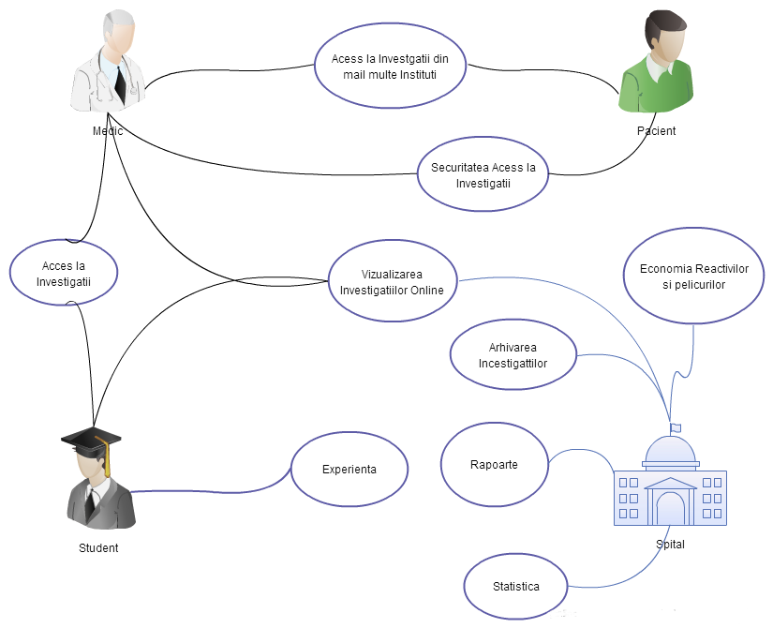
DICOM NETWORK
«DICOM Network» Informational System was planed and developed for Medical and Diagnostically Institutions for collections, processing and visualization of medical images.
This system covers all the workflow for processing and documentation of medical investigations
from collecting investigations from medical equipment to archiving investigation in the patient
medical record.
«DICOM Network» offers necessary functionality for quality medical management and secure investigation access in ONLINE mode. This helps doctors, specialists and penitents to access, save and document Medical Imaging Investigations and help institutions to reduce investigation costs,
enchasing quality of service.

Slide 4
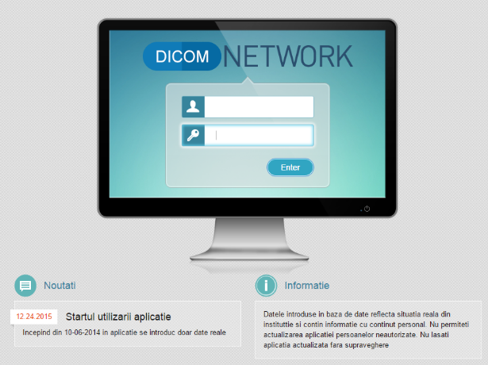
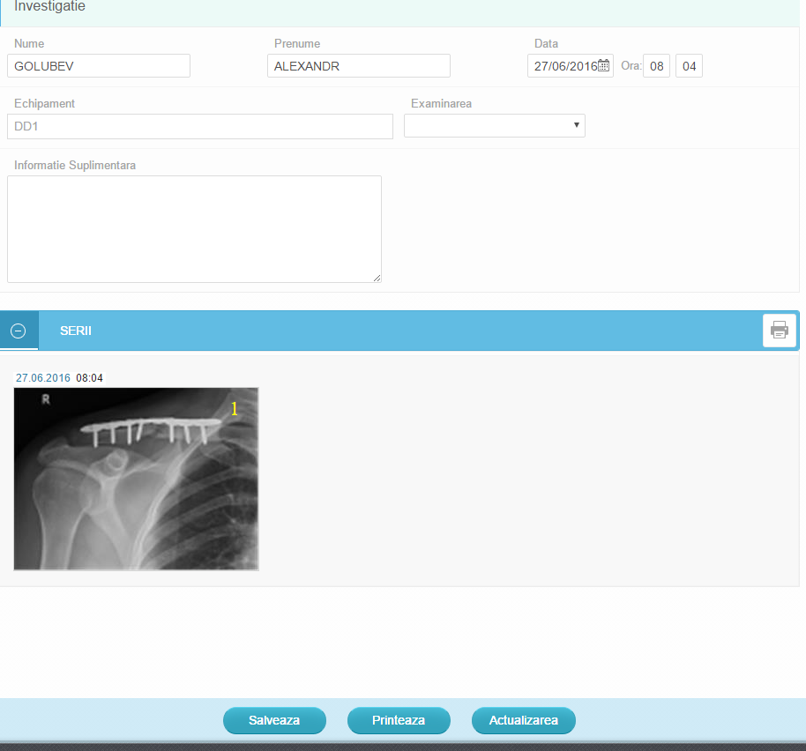
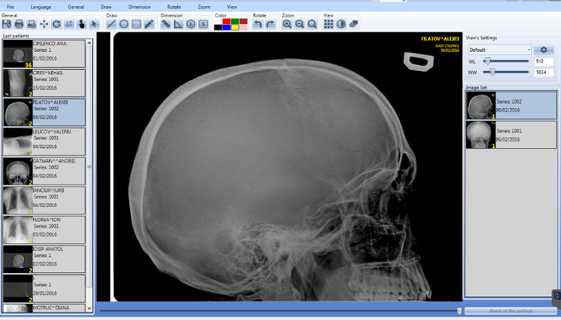
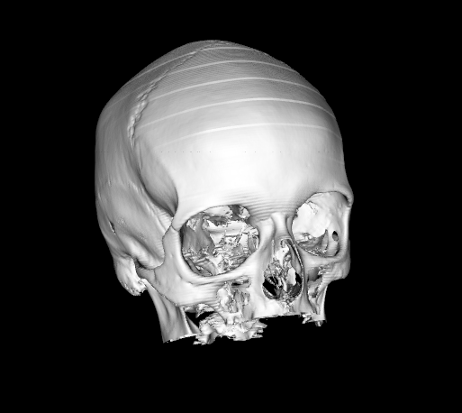
Services & Features
“DICOM Networks” informational system provides full set of functionality for data collection and processing.
Data Collect – import DICOM investigations data from
equipment
Data Archive – full archive of investigations for several years
Data Access – role based access to the investigation online
with reporting and filters features.
Visualization – Visualization of investigations in DICOM Viewer
Data Processing – data preprocess and classification.

Slide 5
Numbers
1’st put into operation information system working in the RM, which offers distributed data collection, processing, access and archiving of medical images
3 DICOM Portals were configured in DICOM Network.
5 DICOM Servers are colleting DICOM data in 24/7 mode.
300 Investigations average per day are collected by the system now.
216 526 Investigations are collected by the system.
496 Doctors have access to their patients investigations from their working place
500 GB of date is collected every month.
1 278 960 MDL 62 098 euro were saved on the print consumables for investigations printing in 2017 thanking to DICOM Network.

Slide 6
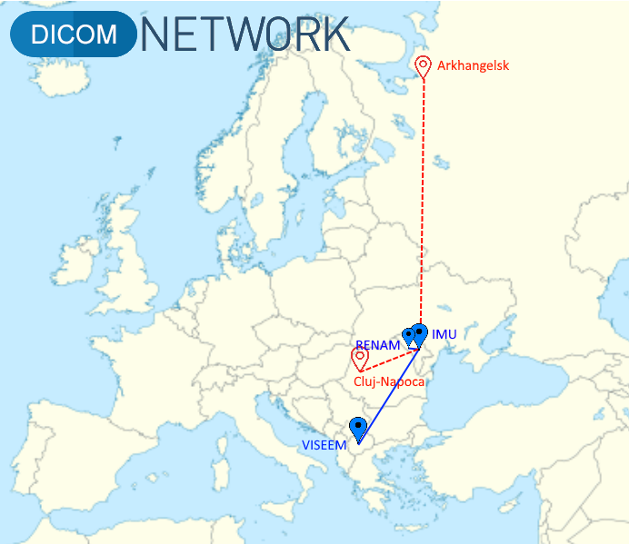
The current state of “DICOM Network”
Installed three DICOM Portals and four DICOM Servers in two countries: Moldova and Macedonia. The clinic from Cluj-Napoca in Romania and Federal University named after
M.V. Lomonosov in Russia expressed their interest to install DICOM Network.
DICOM Portals:
http://dicom.md/
http://renam.dicom.md/
http://viseem.dicom.md/

Slide 7



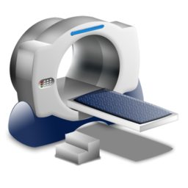
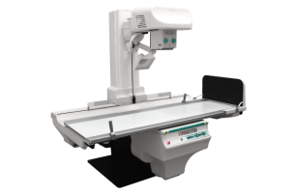
General Architecture
External
Data
Source
DICOM DATA Interface
DICOM NETWORK API
HIS
RENAM DICOM Portal
http://renam.dicom.md/
PACS
Medical Portal
www.dicom.md
VI-SEEM DICOM Portal
http://viseem.dicom.md/
DICOM Server 1
DICOM Server 2
Public RENAM
DICOM Server
Public VISEEM
DICOM Server

Slide 8
Integration with HIS
DICOM Network provides integration with existing
Hospital Informational Systems
DICOM
Patient Data
Images
Preprocess Info
Investigations
Hospital
Informational
System
Diagnostics
Decision
Treatment results
Drugs
Procedures
Results

Slide 9
Integration into VISEEM Platform
“DICOM Network” was selected as pilot application for integration into distributed regional VI-SEEM platform
What “DICOM Network” could contribute to the research community of VI-SEEM Project?
  Archive of anonymized datasets were uploaded to the VI-SEEM server http://viseem.dicom.md/ offered by Macedonian partners.
  Impersonated metadata from integrated HIS.
  Mechanism for sharing the patient personal data, but only on patient approval.
How VI-SEEM could help “DICOM Network”?
  Resources: storage, processors, etc...
  Promotion on international levels.
  Connections with other researches.
What problems were solved for VI-SEEM integration?
  Architecture of the system was changed for fitting into VI-SEEM platform.
  Data anonymization mechanism have to be improved to be configurable on the DICOM Portal and institution level.

Slide 10

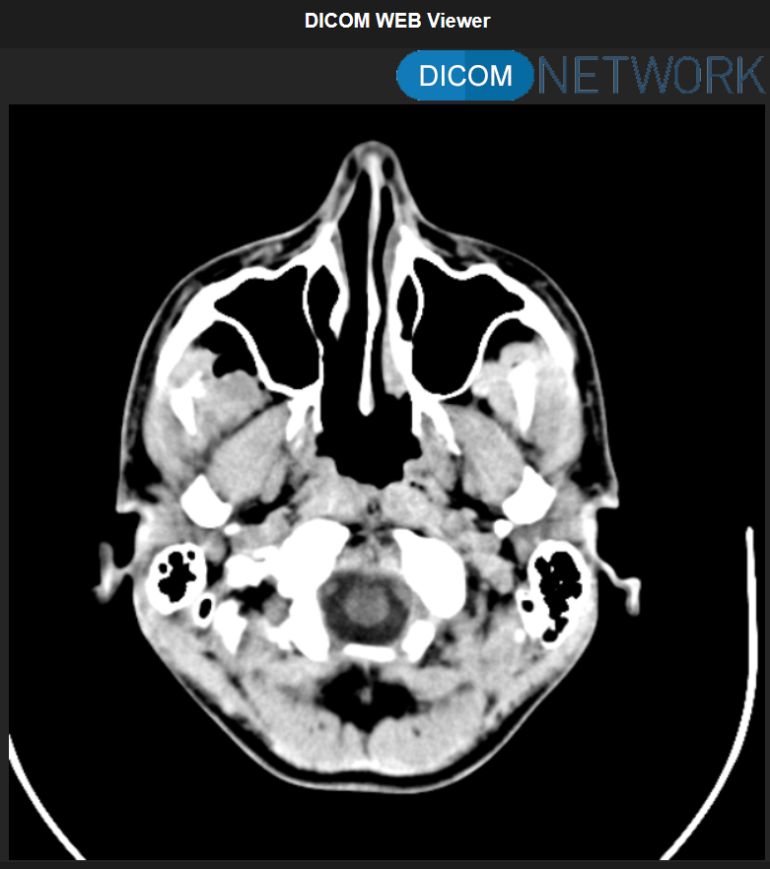




DICOM Network Mobile
DICOM Viewer
DICOM Light Viewer
DICOM Network Mobile – is an assembly of WEB, Mobile and
background applications that make possible to see your
investigations on mobile device from any location from the world.

Slide 11
DICOM Network Mobile Features
Doctor
Mobile Viewer that does not require installation and configuration.
Access to the investigations from any location.
Notifications if new investigation is added.
Possibility to access advanced information like Protocol, Epicrisis, etc..
Patient
Mobile Viewer that does not require installation and configuration and can be used from PC.
Notifications if new investigation is ready.
Limited access to the investigation documentation.

Slide 12

Questions Session
Golubev Alexandr, IMU Workshop, Chisinau 2018

