Slide 1
Introduction to MPI

Slide 2
Message Passing Model
A process may be defined as a program counter and an address space
Each process may have multiple threads sharing the same address space
Message Passing is used for communication among processes
  synchronization
  data movement between address spaces

Slide 3
Message Passing Interface
MPI is a message passing library specification
  not a language or compiler specification
  no specific implementation
Source code portability
  SMPs
  clusters
  heterogeneous networks

Slide 4
Types of communication
Point-to-Point calls
  data movement
Collective calls
  data movement
  reduction operations
  Synchronization (barriers)
Initialization, Finalization calls

Slide 5
MPI Features
Point-to-point communication
Collective communication
One-sided communication
Communicators
User defined datatypes
Virtual topologies
MPI-I/O

Slide 6
Basic MPI calls
MPI_Init
MPI_Comm_size (get number of processes)
MPI_Comm_rank (gets a rank value assigned to each process)
MPI_Send (cooperative point-to-point call used to send data to receiver)
MPI_Recv (cooperative point-to-point call used to receive data from sender)
MPI_Finalize

Slide 7
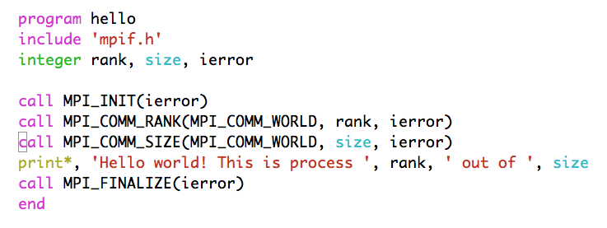
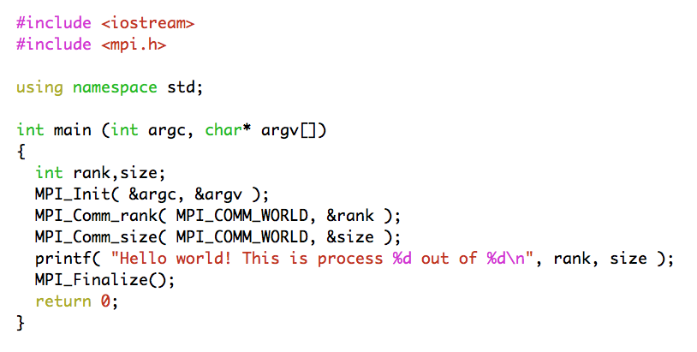
Hello World!

Slide 8

Hello World!
if ( ierror .ne. MPI_SUCCESS ) then
... do error handling as desired ...
end if

Slide 9
Starting and exiting the MPI environment
MPI_Init
  C style: int MPI_Init(int *argc, char ***argv);
    accepts argc and argv variables (main arguments)
  F style: MPI_INIT ( IERROR )
    Almost all Fortran MPI library calls have an integer return code
  Must be the first MPI function called in a program
MPI_Finalize
  C style: int MPI_Finalize();
  F style: MPI_FINALIZE ( IERROR )

Slide 10
Communicators
All mpi specific communications take place with respect to a communicator
  Communicator: A collection of processes and a context
MPI_COMM_WORLD is the predefined communicator of all processes
Processes within a communicator are assigned a unique rank value

Slide 11
A few basic considerations
Q: How many processes are there? A: (N)
  (C) MPI_Comm_size( MPI_COMM_WORLD, &size );
  (F) MPI_COMM_SIZE( MPI_COMM_WORLD, size, ierr)
Q: Which one is which? A: [0,(N-1)]
  (C) MPI_Comm_rank( MPI_COMM_WORLD, &rank );
  (F) MPI_COMM_RANK( MPI_COMM_WORLD, rank, ierr)
  The rank number is between 0 and (size - 1) unique per process

Slide 12
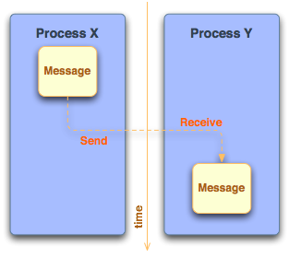
Sending and receiving messages
Questions
  Where is the data?
  What type of data?
  How much data is sent?
  To whom is the data sent?
  How does the receiver know which data to collect?

Slide 13
What is contained within a message?
message data
  buffer
  count
  datatype
message envelope
  source/destination rank
  message tag (tags are used to discriminate among messages)
  communicator

Slide 14
MPI Standard (Blocking) Send/Receive
Syntax
  MPI_Send(void *buffer, int count, MPI_Datatype type, int dest, int tag, MPI_Comm comm);
  MPI_Recv(void *buffer, int count, MPI_Datatype type, int src, int tag, MPI_Comm comm, MPI_Status status);
Processes are identified using dest/src values and the communicator within the message passing takes place
Tags are used to deal with multiple messages in an orderly manner
  MPI_ANY_TAG and MPI_ANY_SOURCE may be used as wildcards on the receiving process

Slide 15
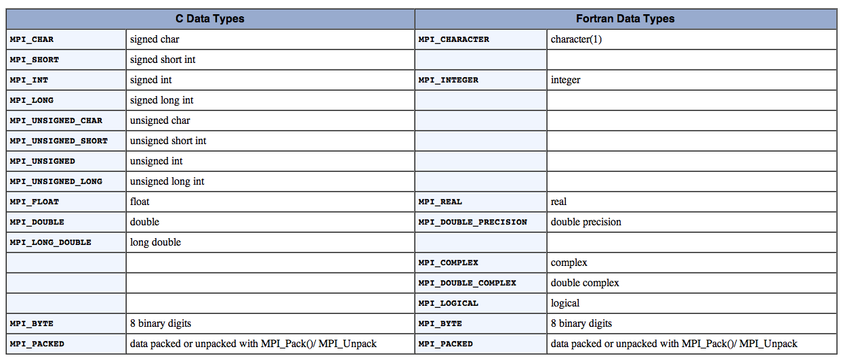
MPI Datatypes

Slide 16
Getting information about a message
Information of source and tag is stored in MPI_Status variable
  status.MPI_SOURCE
  status.MPI_TAG
MPI_Get_count can be used to determine how much data of a particular type has been received
  MPI_Get_count( &status, MPI_Datatype, &count);

Slide 17
A deadlock example (?)
Program Output:
from process 1 using tag 158 buf1[N-1] = 8.1
from process 0 using tag 157 buf0[N-1] = 0.9
double buf0[N], buf1[N];
MPI_Status status;
int tag_of_message, src_of_message;
if( rank == 0 )
{
for(int i=0; i<N; i++) buf0[i] = 0.1 * (double) i;
MPI_Send(buf0, N, MPI_DOUBLE, 1, 157, MPI_COMM_WORLD);
MPI_Recv(buf1, N, MPI_DOUBLE, 1, 158, MPI_COMM_WORLD, &status);
tag_of_message = status.MPI_TAG;
src_of_message = status.MPI_SOURCE;
cout << "from process " << src_of_message << " using tag " <<
tag_of_message << " buf1[N-1] = " << buf1[N-1] << endl;
}
else if ( rank == 1 )
{
for(int i=0; i<N; i++) buf1[i] = 0.9 * (double) i;
MPI_Send(buf1, N, MPI_DOUBLE, 0, 158, MPI_COMM_WORLD);
MPI_Recv(buf0, N, MPI_DOUBLE, 0, 157, MPI_COMM_WORLD, &status);
tag_of_message = status.MPI_TAG;
src_of_message = status.MPI_SOURCE;
cout << "from process " << src_of_message << " using tag " <<
tag_of_message << " buf0[N-1] = " << buf0[N-1] << endl;
}

Slide 18
Blocking communication
MPI_Send does not complete until buffer is empty (available for reuse)
MPI_Recv does not complete until buffer is full (available for use)
MPI uses internal buffers (the envelope) to pack messages, thus short messages do not produce deadlocks
To avoid deadlocks either
  reverse the Send/Receive calls on one end or
  use the Non-Blocking calls (MPI_Isend) followed by MPI_Wait

Slide 19
Communication Types
Blocking: If a function performs a blocking operation, then it will not return to the caller until the operation is complete.
Non-Blocking: If a function performs a non-blocking operation, it will return to the caller as soon as the requested function has been initialized.
Using non-blocking communication allows for higher program efficiency if calculations can be performed while communication activity is going on. This is referred to as overlapping computation with communication

Slide 20
Communication (i.e. Send) Modes
Standard mode (MPI_Send, MPI_ISend)
  Send will complete when buffer is available for use
Synchronous mode (MPI_Ssend, MPI_Issend)
  The send will complete only until a matching receive has been posted and transfer has started
Buffered mode (MPI_Bsend, MPI_Ibsend)
  Send is complete as soon as the user buffer is copied to the system buffer
Ready mode (MPI_Rsend, MPI_Irsend)
  send starts only if a matching receive has been posted

Slide 21
Collective communications
All processes within the specified communicator participate
All collective operations are blocking
All processes must call the collective operation
No message tags are used
Three classes of collective communications
  Data movement
  Collective computation
  Synchronization

Slide 22
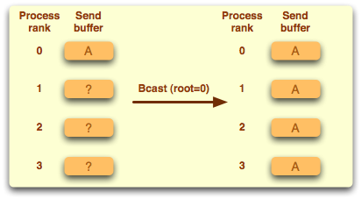
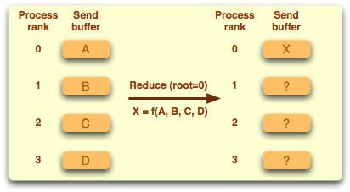
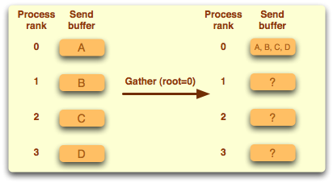
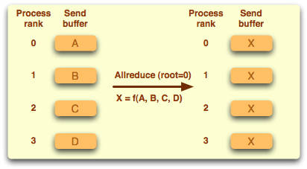
Examples of collective operations

Slide 23
Synchronization
MPI_Barrier ( comm )
Execution blocks until all processes in comm call it
Mostly used in highly asynchronous programs
Notes:
Good point to switch to exercises

Slide 24
Timing using MPI
MPI_Wtime returns number of seconds since an arbitrary point in the past
double mpi_t0,mpi_t1;
if(rank == 0)
{
mpi_t0 = MPI_Wtime();
}
sleep(1);
MPI_Barrier( MPI_COMM_WORLD );
if(rank == 0)
{
mpi_t1 = MPI_Wtime();
printf("# MPI_time = %f\n", mpi_t1-mpi_t0);
}

Slide 25
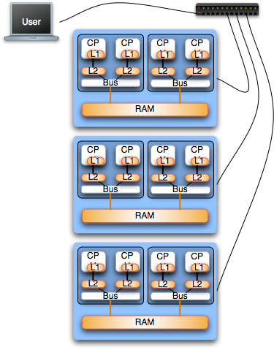
Mixing MPI and OpenMP
Hybrid architectures
  Clusters on SMPs
  HPC Platforms
    IBM BlueGene (i.e. Jugene)
    IBM P6 (i.e. Huygens)
Good starting point
  Mapping of MPI on nodes (interconnection layer)
  Multithreading with OpenMP inside SMPs
Notes:
There do exist situations that are most efficiently solved using a hybrid application of both shared memory and message passing. Often times these situations consist of tightly coupled computations on multiple SMP machines, which communicate (as little as possible) with one another. This is an advanced aspect of parallel programming that will be covered in a more in depth tutorial

Slide 26
Addition of two vectors (OMP)
int main(int argv, char **argv)
{
int n, i;
double *x, *y, *buff;
n = atoi(argv[1]);
x = (double *)malloc(n*sizeof(double));
y = (double *)malloc(n*sizeof(double));
.
.
.
#pragma omp parallel for private(i) shared (x,y)
for (i=0; i<n; i++){
x[i] = x[i] + y[i];
}
}

Slide 27
Addition of two vectors (MPI)
#include “mpi.h”
int main(int argc, char **argv){
int rnk, sz, n, i;
double *x, *y, *buff;
n = atoi(argv[1])
MPI_Init(&argc, &argv);
MPI_Comm_rank(MPI_COMM_WORLD, &rnk);
MPI_Comm_size(MPI_COMM_WORLD, &sz);
chunk = n / sz;
.
.
MPI_Scatter(&buff[rnk*chunk],chunk,MPI_DOUBLE,x,chunk,MPI_DOUBLE,0,MPI_COMM_WORLD);
MPI_Scatter(&buff[rnk*chunk],chunk,MPI_DOUBLE,y,chunk,MPI_DOUBLE,0,MPI_COMM_WORLD);
for (i=0; i<chunk; i++) x[i] = x[i] + y[i];
MPI_Gather(x,chunk,MPI_DOUBLE,buff,chunk,MPI_DOUBLE,0,MPI_COMM_WORLD);
MPI_Finalize();
}

Slide 28
Addition of two vectors (HYBRID)
#include “mpi.h”
int main(int argc, char **argv){
int rnk, sz, n, I, info;
double *x, *y, *buff;
n = atoi(argv[1]);
MPI_Init_thread(&argc, &argv, MPI_THREAD_FUNNELED, &info);
MPI_Comm_size(MPI_COMM_WORLD, &sz);
chunk = n / sz;
MPI_Scatter(&buff[rnk*chunk],chunk,MPI_DOUBLE,x,chunk,MPI_DOUBLE,0,MPI_COMM_WORLD);
MPI_Scatter(&buff[rnk*chunk],chunk,MPI_DOUBLE,y,chunk,MPI_DOUBLE,0,MPI_COMM_WORLD);
#pragma omp parallel for
for (i=0; i<chunk; i++) x[i] = x[i] + y[i];
MPI_Gather(x,chunk,MPI_DOUBLE,buff,chunk,MPI_DOUBLE,0,MPI_COMM_WORLD);
MPI_Finalize(); }

Slide 29
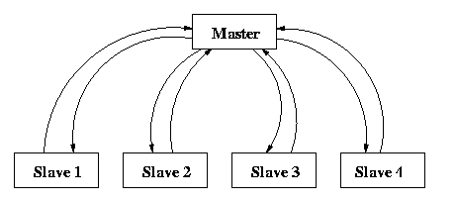
Compile and submit a “mm” job
Master process decomposes matrix a and provides slave processes with input. Each slave process caries ns=nm/sz rows of a and the complete b matrix to carry out computations. Results are sent back to master who prints out timing.

Slide 30


