Slide 1
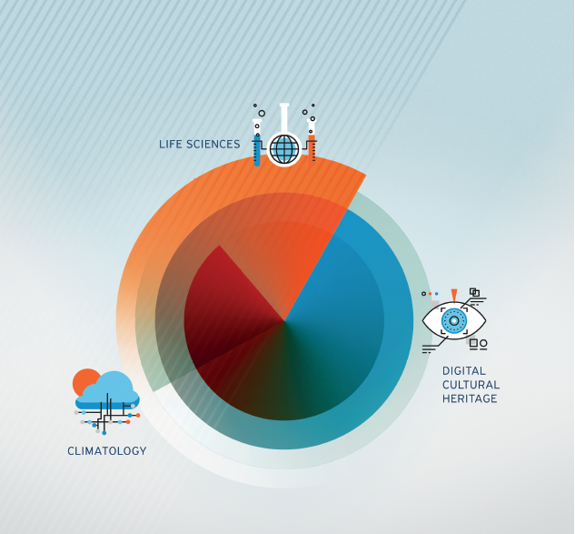
VI-SEEM services and VRE
Anastas Mishev
Associated professor
FCSE-UKIM
National training, Thessaloniki, 11-12 December 2017
The VI-SEEM project initiative is co-funded by the European Commission under the H2020 Research Infrastructures contract no. 675121

Slide 2
Service orientation
Strong recommendation by the EC to have service oriented e-Infrastructures
Introducing the services catalog and the service portfolio
Portfolio – the complete set of services, in production, but also retired services and planned services
Catalog – user facing list of active services
Own implementation of the service catalog/portfolio management system

Slide 3
Service catalog/portfolio
Features
Integration with the VI-SEEM AAI
Read access to the service catalogue, for non-authorizes users
Via RESTful API
Via UI
Read access to the service portfolio, for authorized users
Via RESTful API
Via UI
Write access to the service portfolio, for authorized users
Via customized Django admin module
Via write UI

Slide 4
Service catalog
Service catalogue provides a service discovery and contains all project services
Common services and resources operated by WP3
Storage/data services operated by WP4
Application-level services provided by WP5
Designed to be compatible with the FitSM standards http://fitsm.itemo.org/

Slide 5
Service catalog
Main components of the service catalogue
Web interface (https://services.vi-seem.eu/)
RESTful interface (integration with other components)
Currently in production: 19 services grouped in 5 categories
Fully integrated with project’s AAI

Slide 6
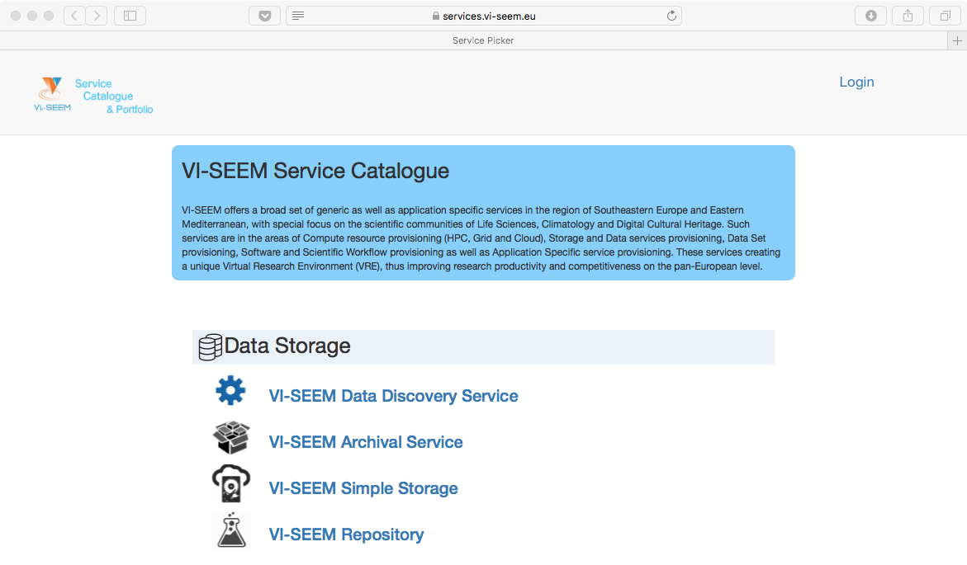
List of services

Slide 7
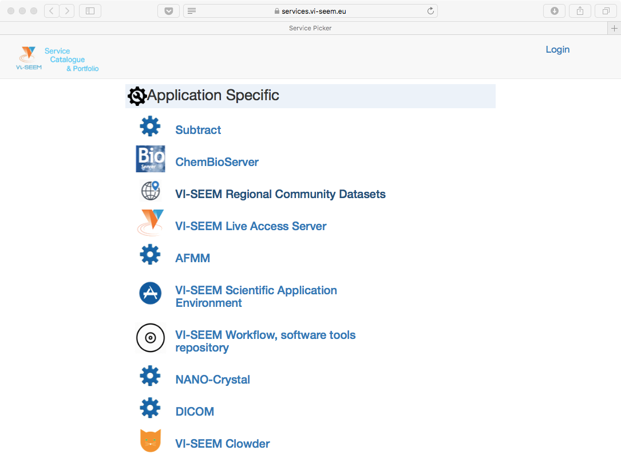
List of services

Slide 8
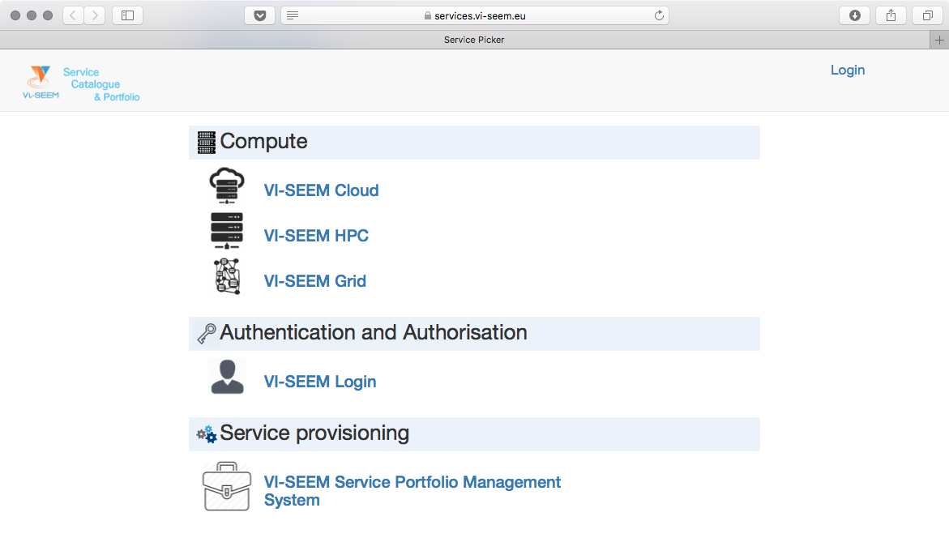
List of services

Slide 9
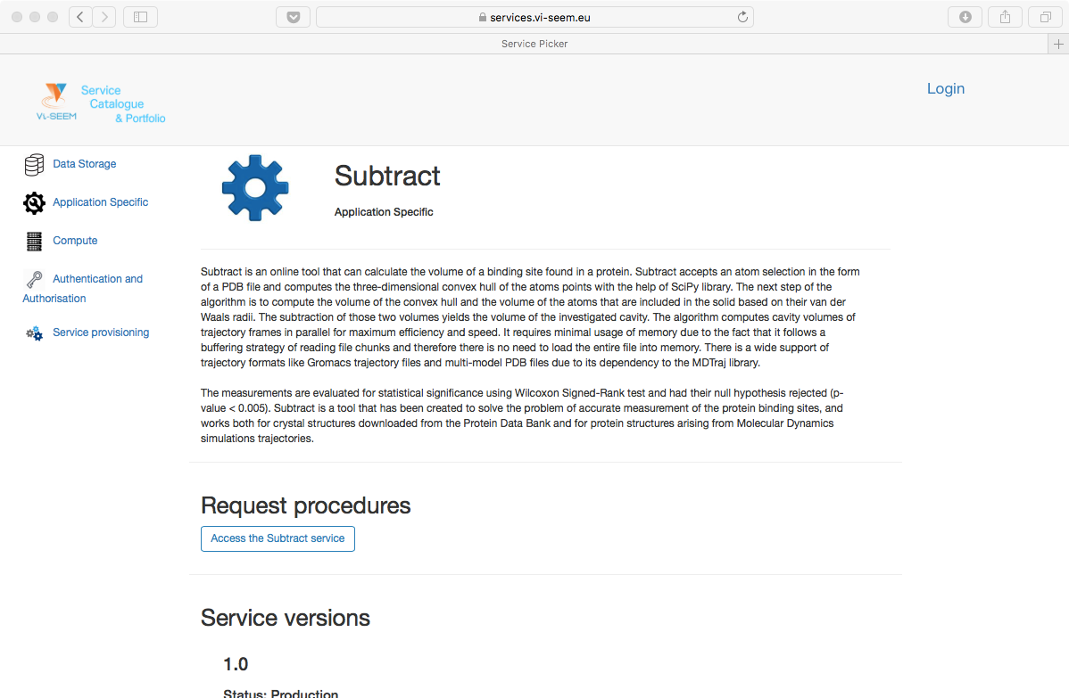
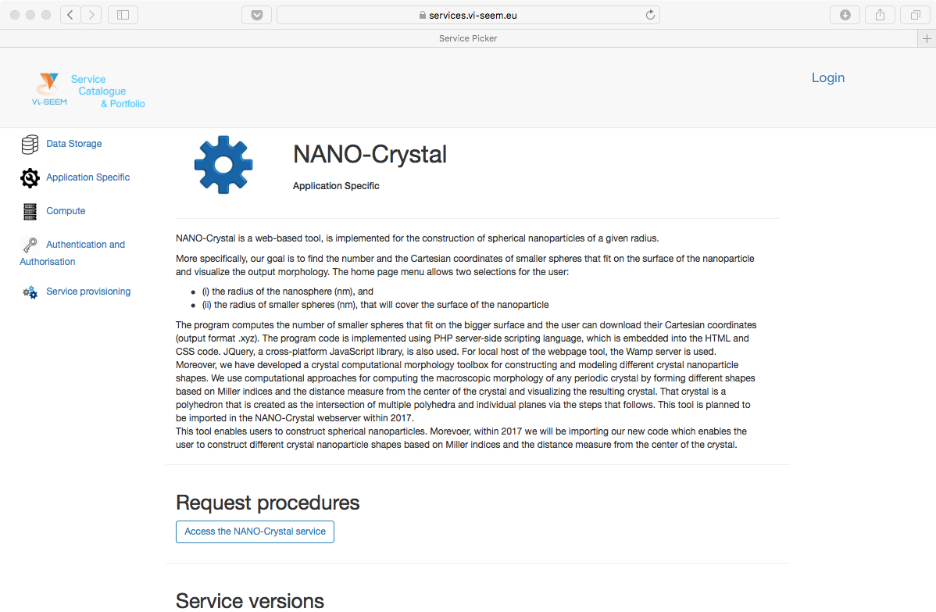
Example services: application specific

Slide 10
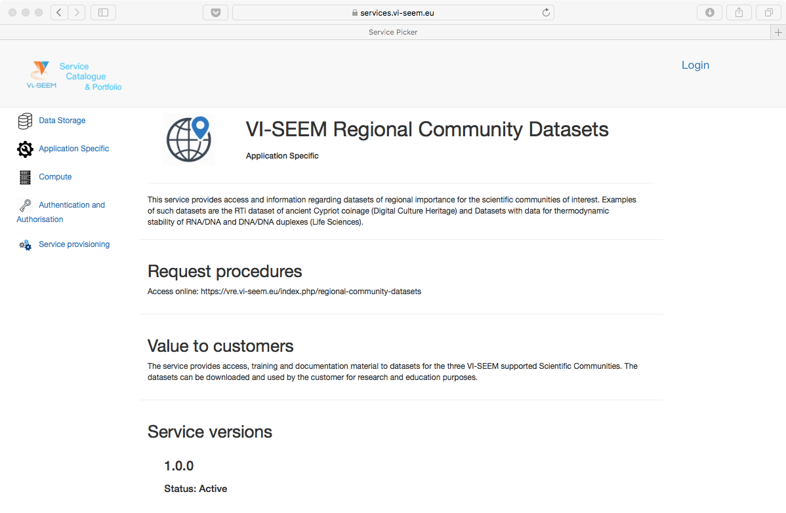
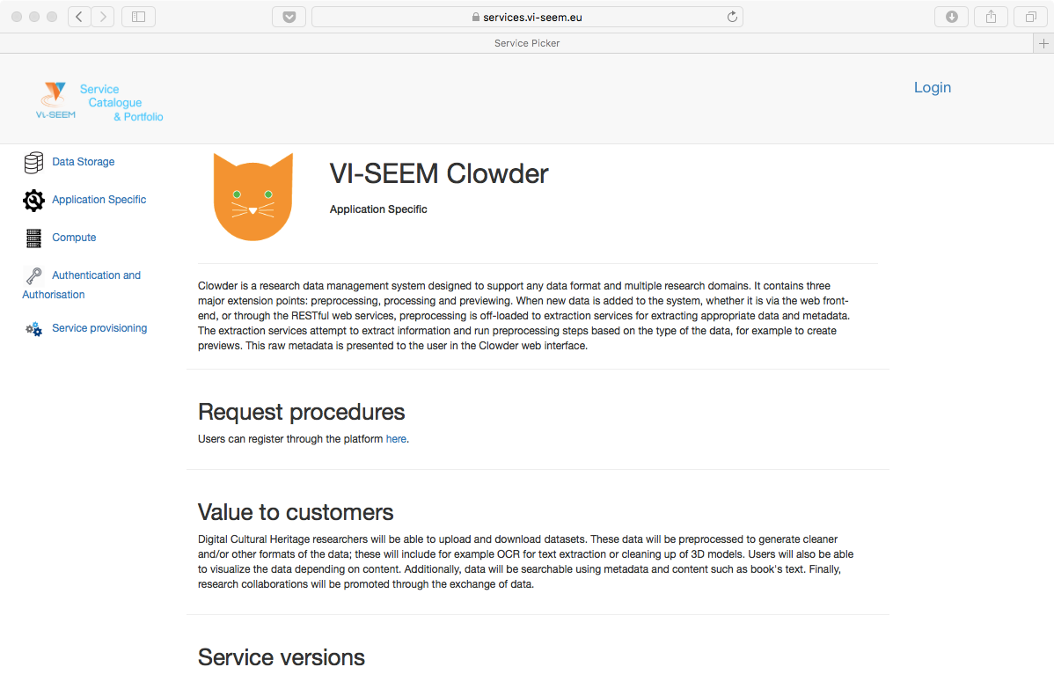
Example services: application specific

Slide 11
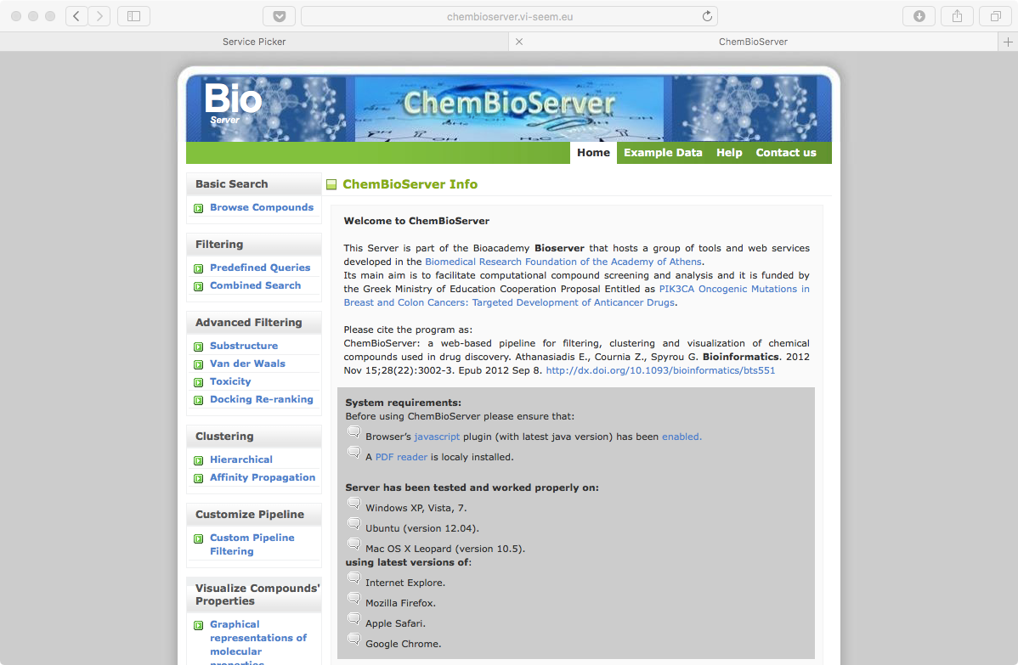
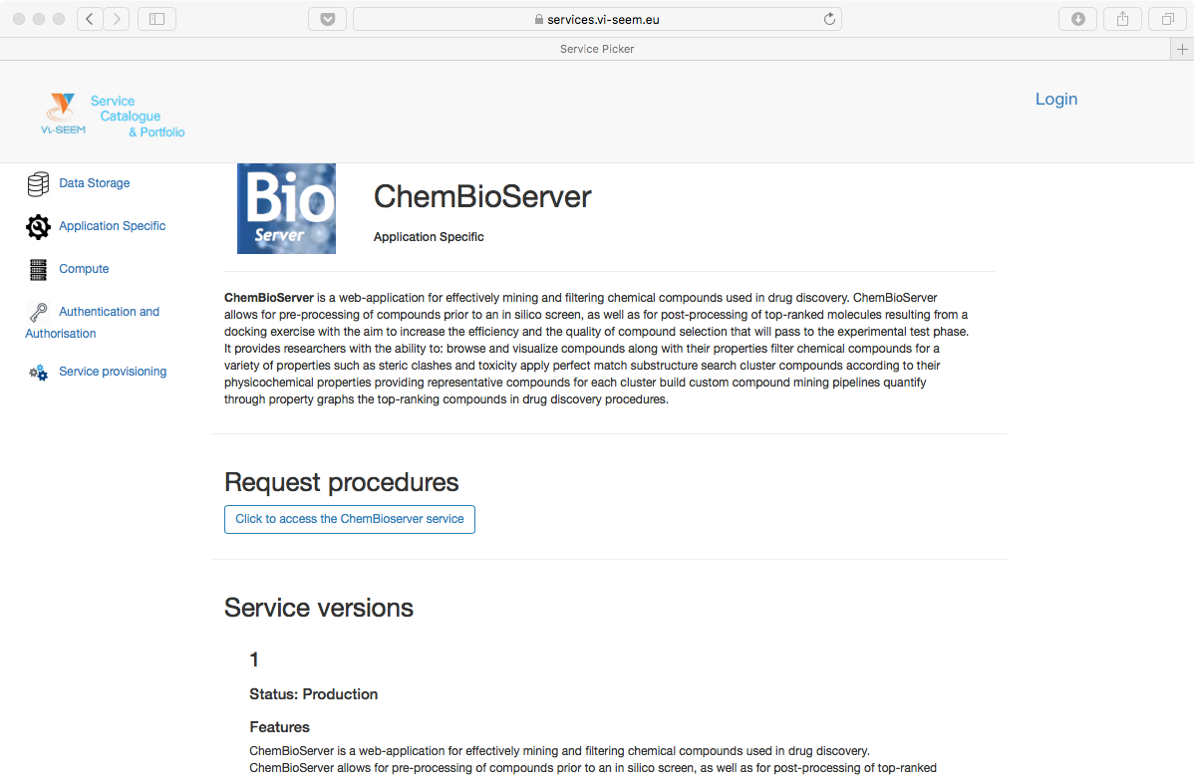
Example services: ChemBioServer

Slide 12
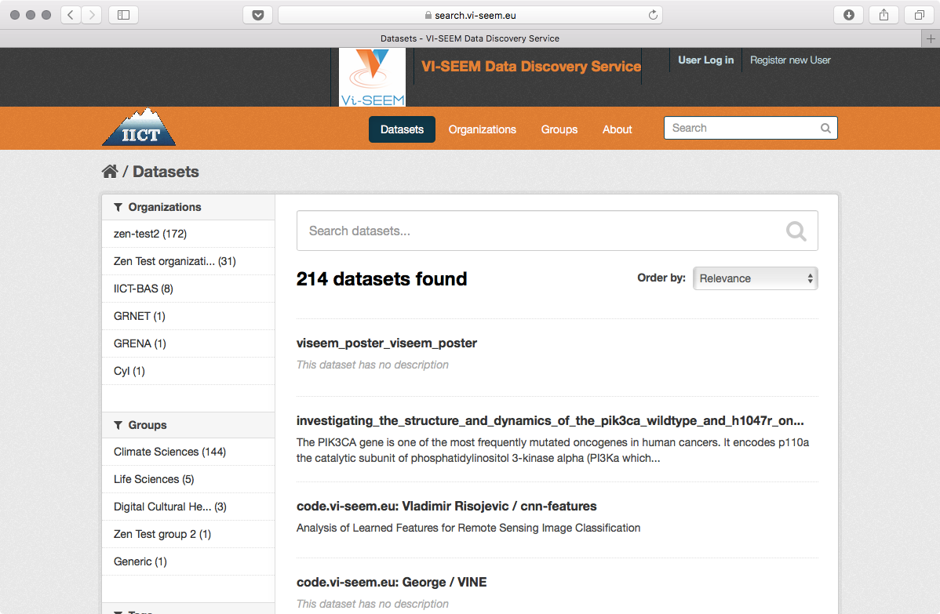
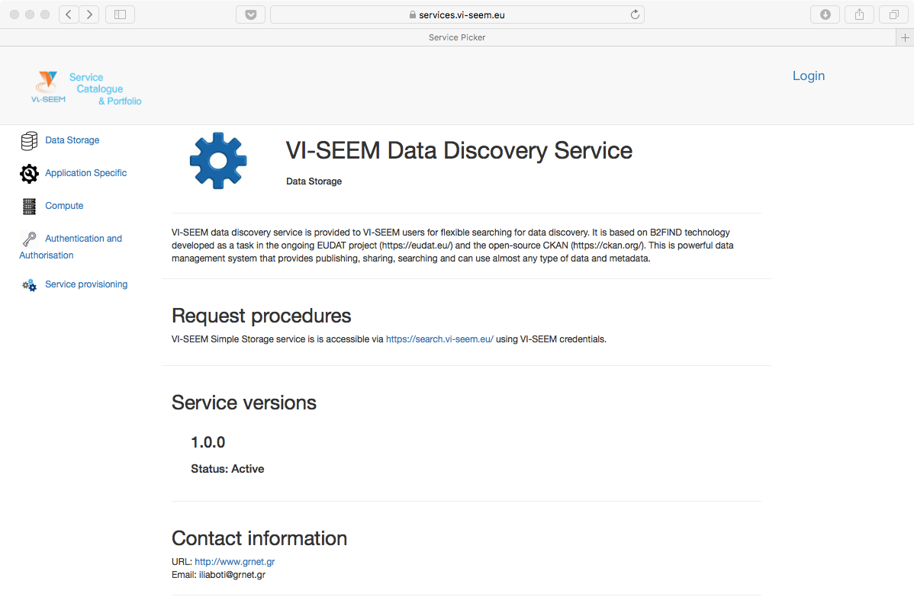
Example services: data discovery

Slide 13

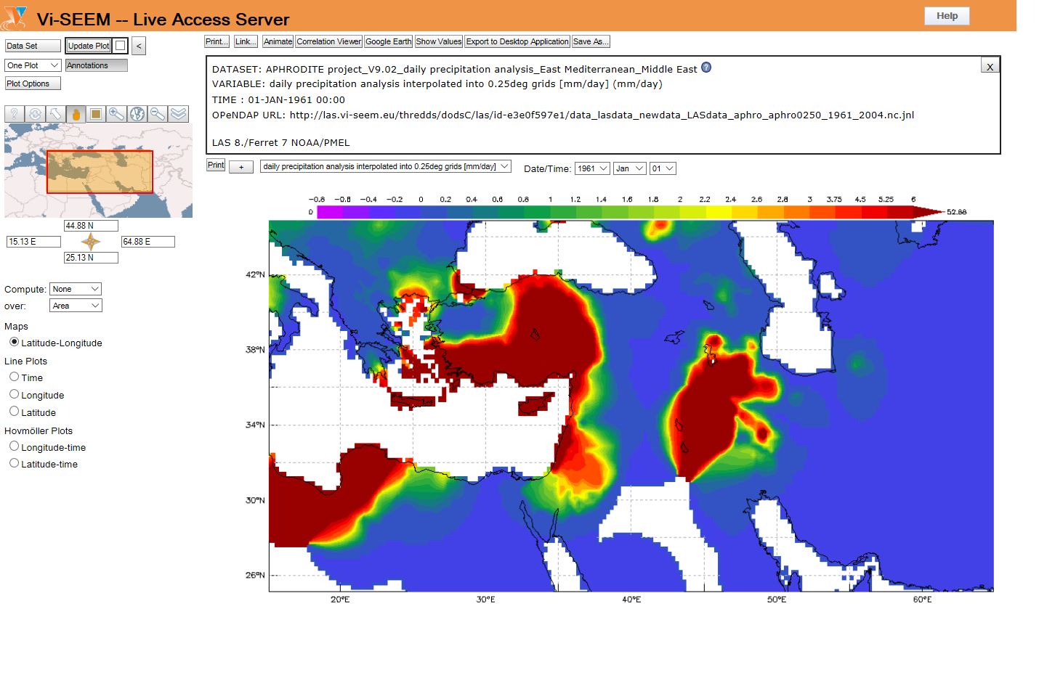
Live Access Server (WP5)
Live Access Server
http://las.vi-seem.eu/las
A web server providing flexible access to geo-referenced scientific data, offering visualization & post-processing capabilities for climate data

Slide 14
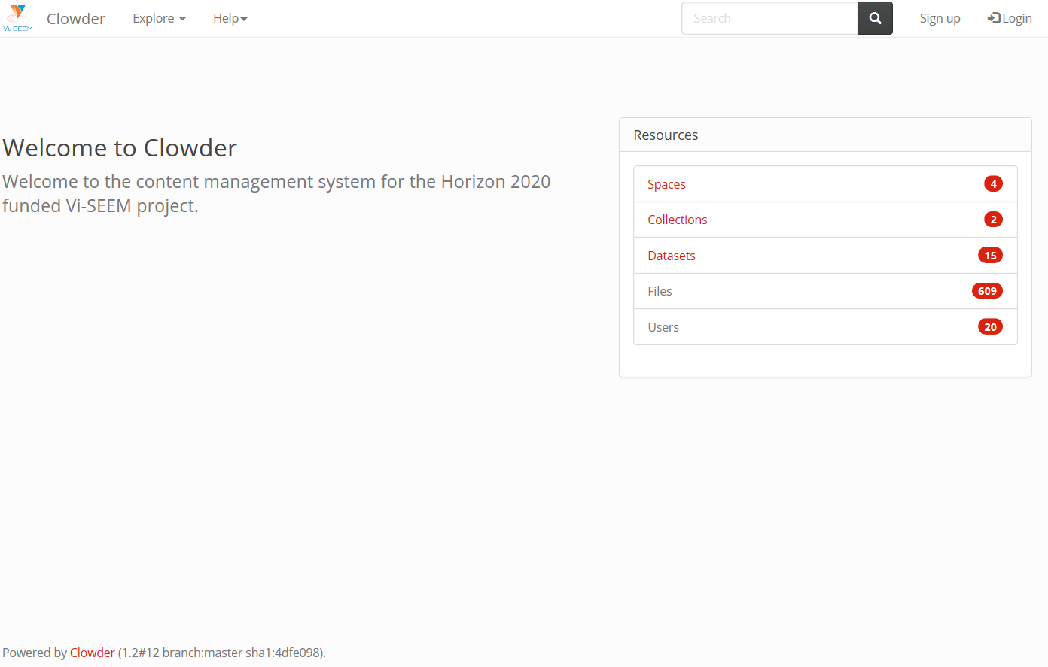
Clowder (WP5)
VI-SEEM Clowder
http://dchrepo.vi-seem.eu/
A Digital Culture Heritage repository which also offers integrated interactive visualization tools

Slide 15
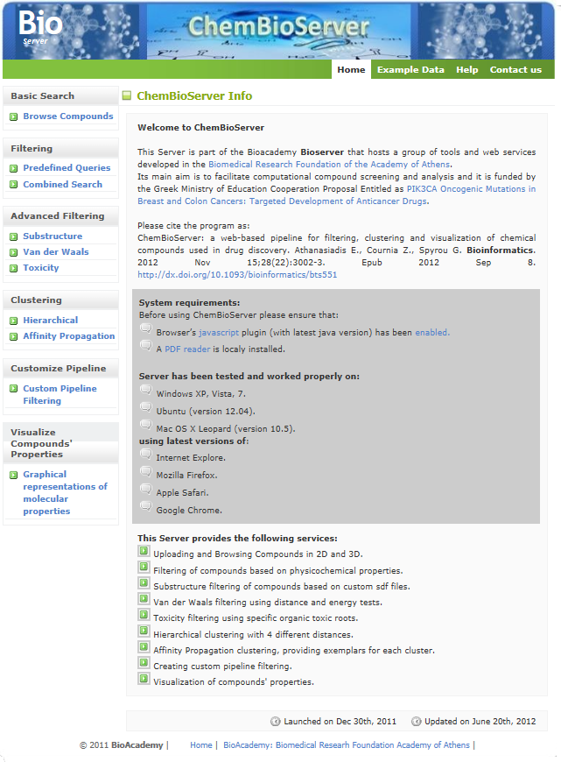
ChemBioServer (WP5)
ChemBioServer
http://bioserver-3.bioacademy.gr
/Bioserver/ChemBioServer/
A web-based pipeline for filtering, clustering and visualization of chemical compounds used in drug discovery

Slide 16
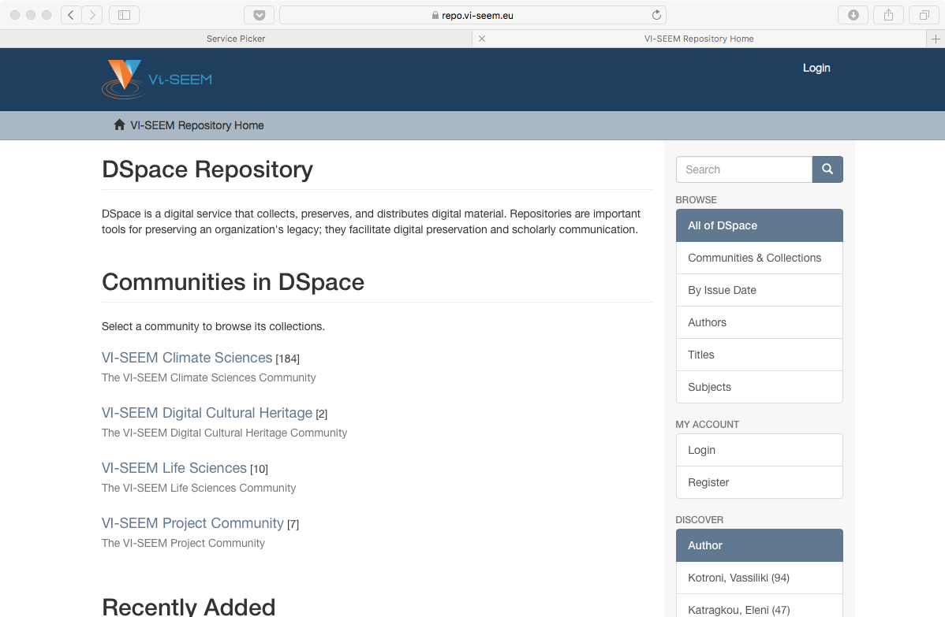
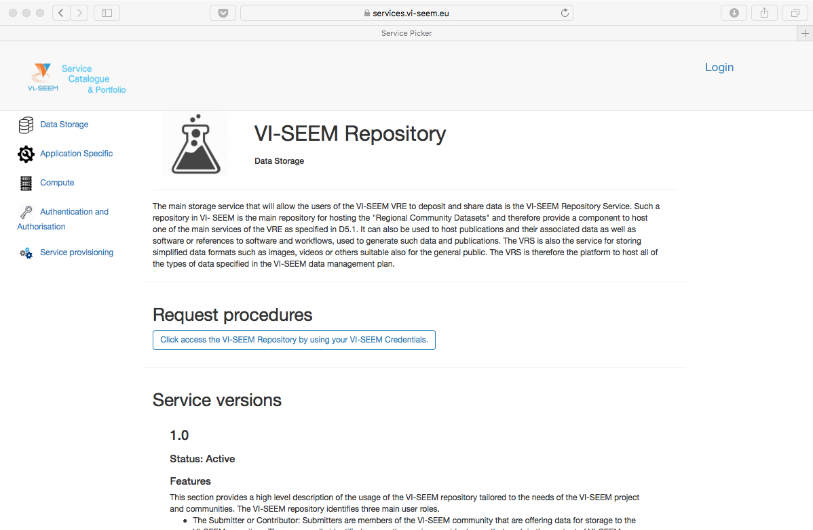
Example services: repository

Slide 17


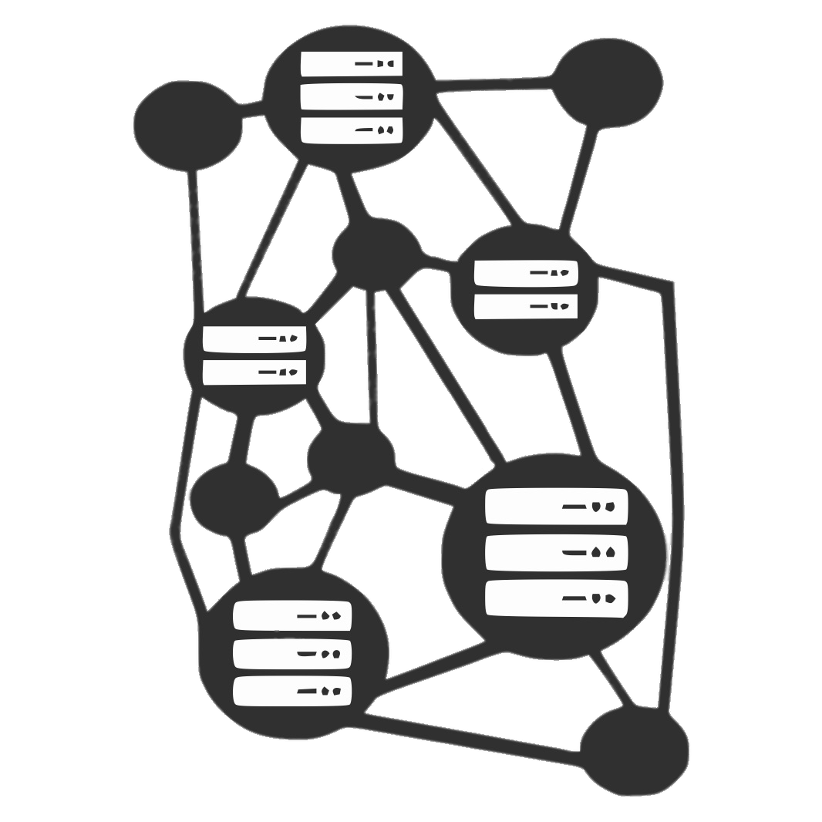
e-Infrastructure Services
10,500 VM cores
HPC RESOURCES
ARIS
Cy-Tera
Avitohol
PARADOX
NIIFI SC
Leo
InfraGRID
ICAM BlueGene/P
UPT-HPC
MK-03-FINKI
Armcluster
BA-HPC
Gamma
Zaina
IMAN1-Booster/King
Okeanos
CyI Cloud Facility
Avitohol
InfraGRID Cloud
UPT-Cloud
ETFBL-CC01
MK-04-FINKI_CLOUD
MD-Cloud
IIAP Cloud
IUCC InfinityCloud
CLOUD RESOURCES
21,500 CPU cores 325,000 GP-GPU cores 18,500 Intel Xeon Phi cores
CLIMATE LIFE SCIENCES
DIGITAL CULTURAL HERITAGE
UVT HPC GPFS
ETFBL-CS01
MK-04-FINK
RENAMstor
IIAP
BA-IA
IUCC-InfinityCloud
ARIS
ONYX, Cy-Tera
Avitohol
PARADOX
NIIFI HSM Service
NIIFI iSCSI Service
GRID
RESOURCES
Hellas Grid
BG01-IPP
AEGIS01-IPB-SCL
MK-03-FINKI
MREN01CIS
MD-GRID
ArmCluster
GE-01-GRENA
11 PB
STORAGE RESOURCES
2,900 CPU cores

Slide 18

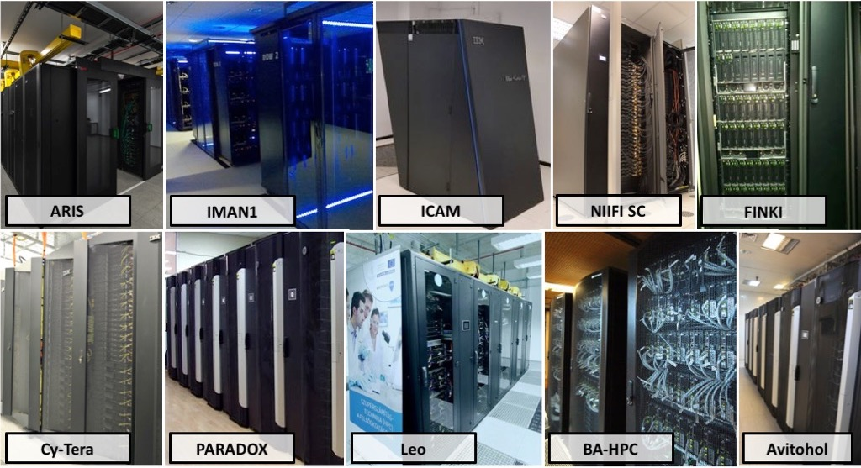
e-Infrastructure example - HPC sites
DI4R, Brussels, 30.11.-01.12.2017

Slide 19
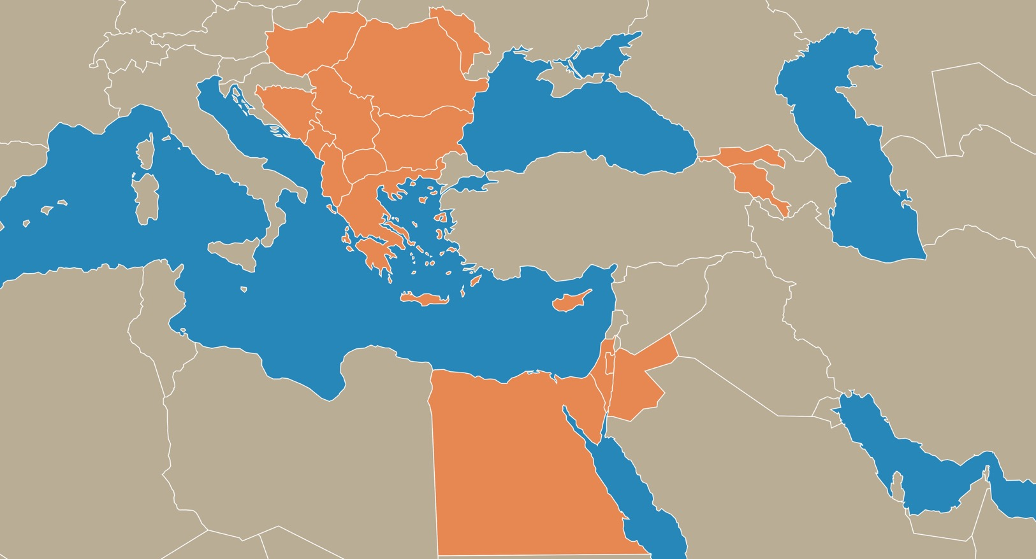
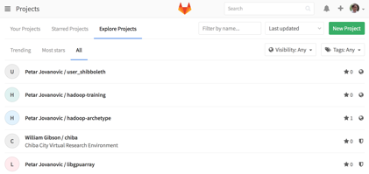
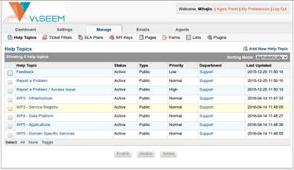
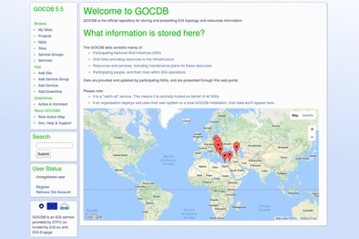
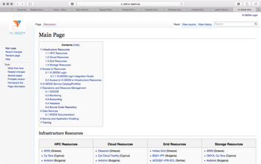
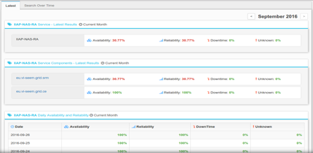
e-Infrastructure operations and resource management
Code Repository, UoBL https://code.viseem.eu/
Helpdesk, UoBL https://support.vi-seem.eu/
Accounting, IICT-BAS https://accounting.vi-seem.eu/
GOCDB, UKIM https://gocdb.vi-seem.eu/
Technical Wiki, CYI https://wiki.vi-seem.eu/
Monitoring, GRNET/UoBL https://mon.vi-seem.eu/
DI4R, Brussels, 30.11.-01.12.2017

Slide 20
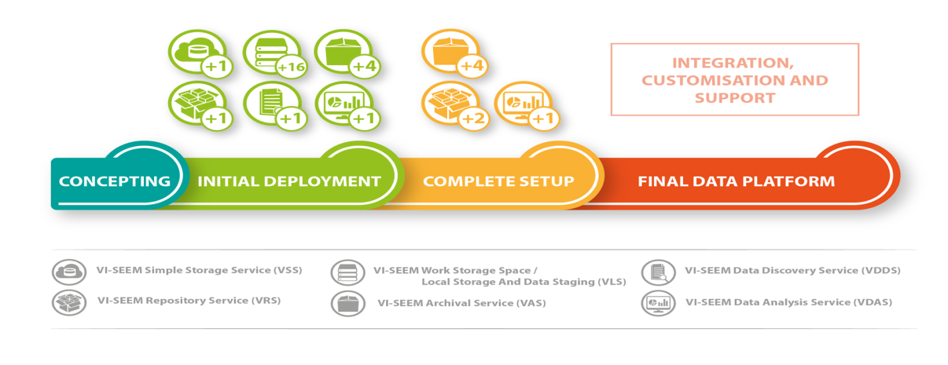
Data management services
Functions allowing for data management for selected Scientific Communities, engage the full data management lifecycle
VSS – Simple Storage Service (simplestorage.vi-seem.eu)
VRS – Repository Service (repo.vi-seem.eu); integrated with PID service
VAS – Archival Service (deployed at 6 sites – GRNET, IPB, IICT-BAS, NIIF, IUCC, BA)
VLS – work storage space / local storage and data staging (at 12 sites)
VDDS – Data Discovery Service (search.vi-seem.eu)
VDAS – Data Analysis Service (hadoop.ipb.ac.rs)
PIDs (handle.grnet.gr)
DI4R, Brussels, 30.11.-01.12.2017

Slide 21
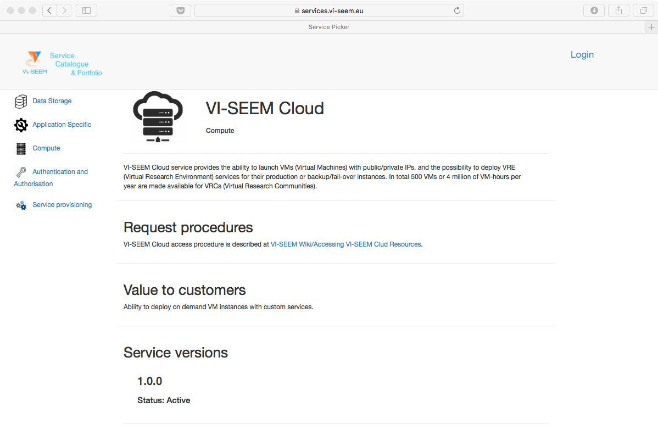
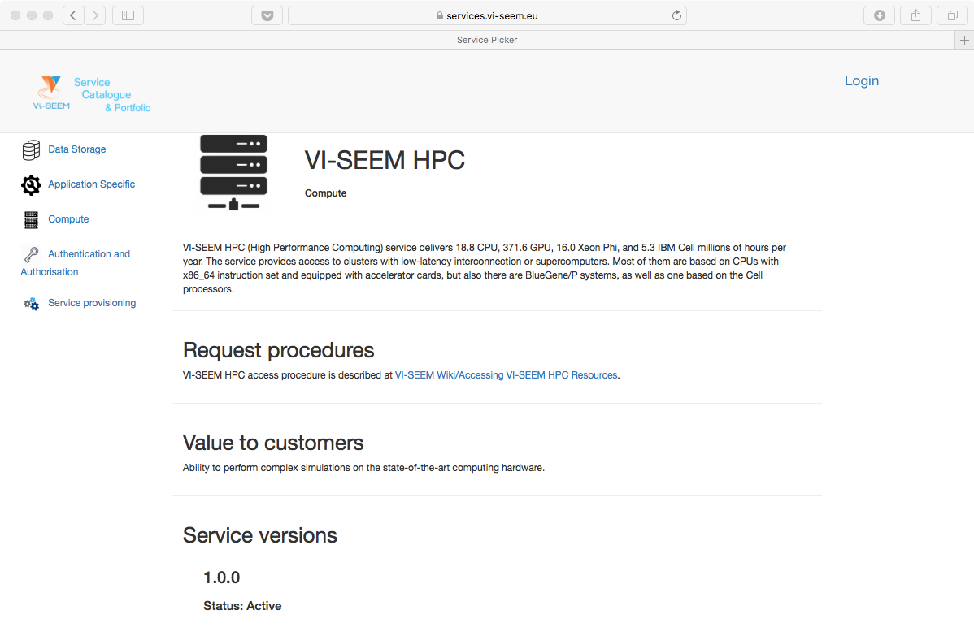
Example services: HPC and cloud

Slide 22
Service level definitions
Service level definitions ensure quality of service
VI-SEEM operational level monitoring procedure describes step-by-step processes for
Service validation (performed by VI-SEEM operational team)
Service registration (GOCDB registration by service enabler)
Service certification (ARGO monitoring by service enabler)
Service monitoring (ARGO monitoring by Operator-On-Duty)
Service level targets (reliability and reliability)
Service level targets for customer created requests
Service level targets for incident handling

Slide 23
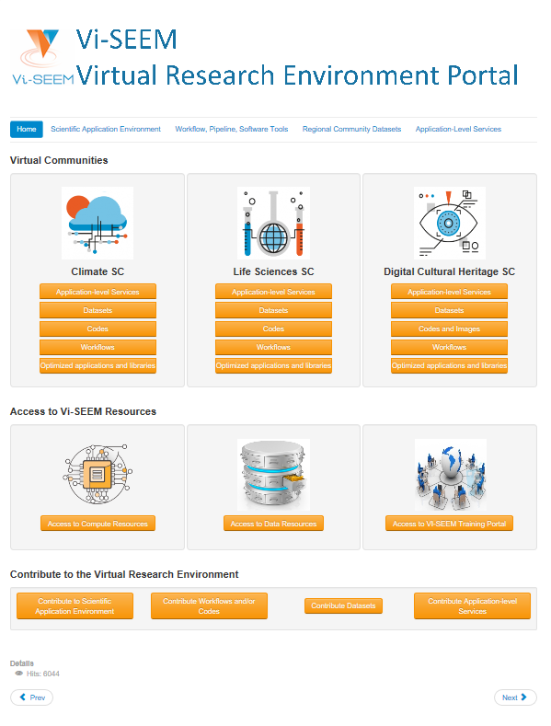



VRE portal
All services integrated through the user-facing VRE portal
https://vre.vi-seem.eu/
Organized per Scientific Community
Climate SC
Life Sciences SC
Digital Cultural Heritage SC
Access to VI-SEEM services and resources: Compute, Data, Domain-specific, Training
Guidelines on how to contribute to
Applications
Workflows/codes
Datasets
Domain-specific services
Domain-specific services integrated in the portal in a series of phases carried out by services enablers and user communities
DI4R, Brussels, 30.11.-01.12.2017

Slide 24



VRE
VRE Scientific Application Environment
Optimized applications and libraries
Virtual Machine (VM) images
Codes from the three scientific communities
Workflow, software tools repository
Regional community datasets
Application level services
Climate
Live Access Server
Digital Cultural Heritage
VI-SEEM Clowder
3DINV
AUTOGR
Life Sciences
ChemBioServer
AFMM
NANO-Crystal
Subtract

Slide 25
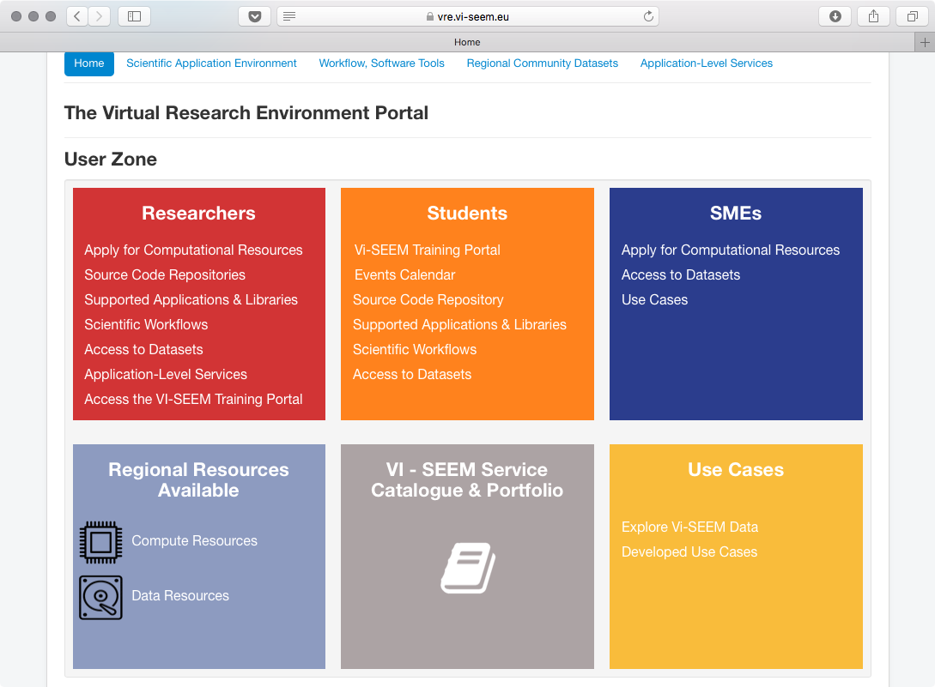
The User Zone

Slide 26
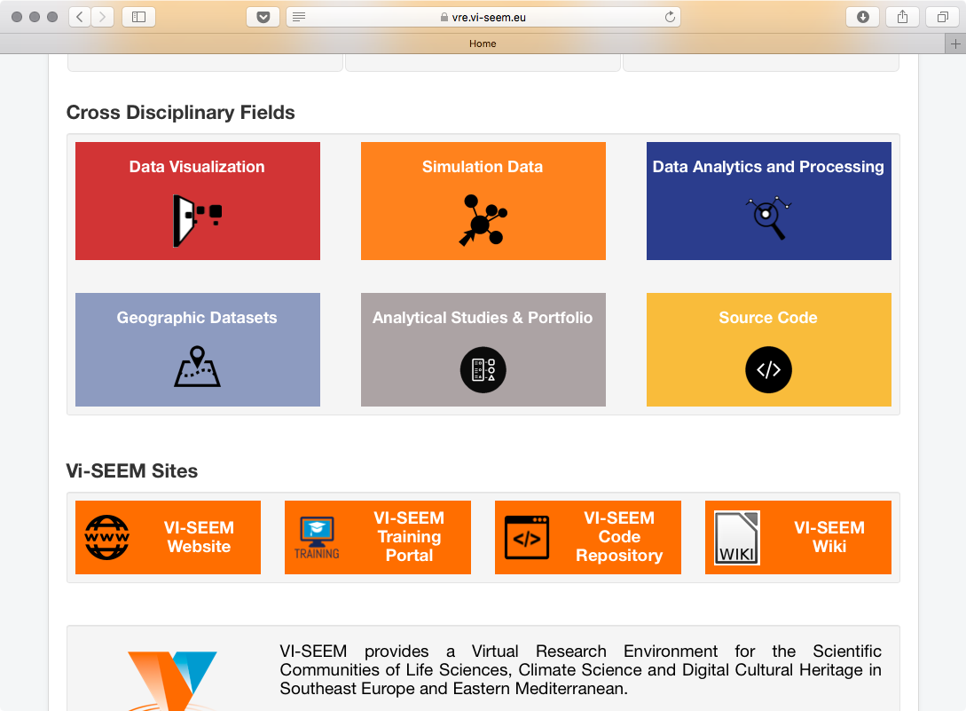
Cross Disciplinary Fields

Slide 27
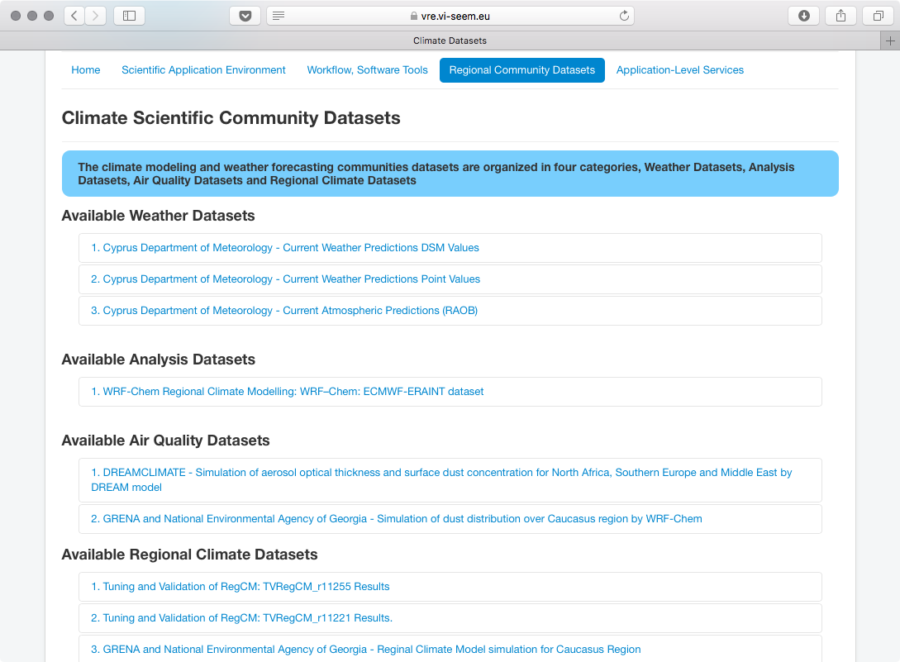
Datasets

Slide 28
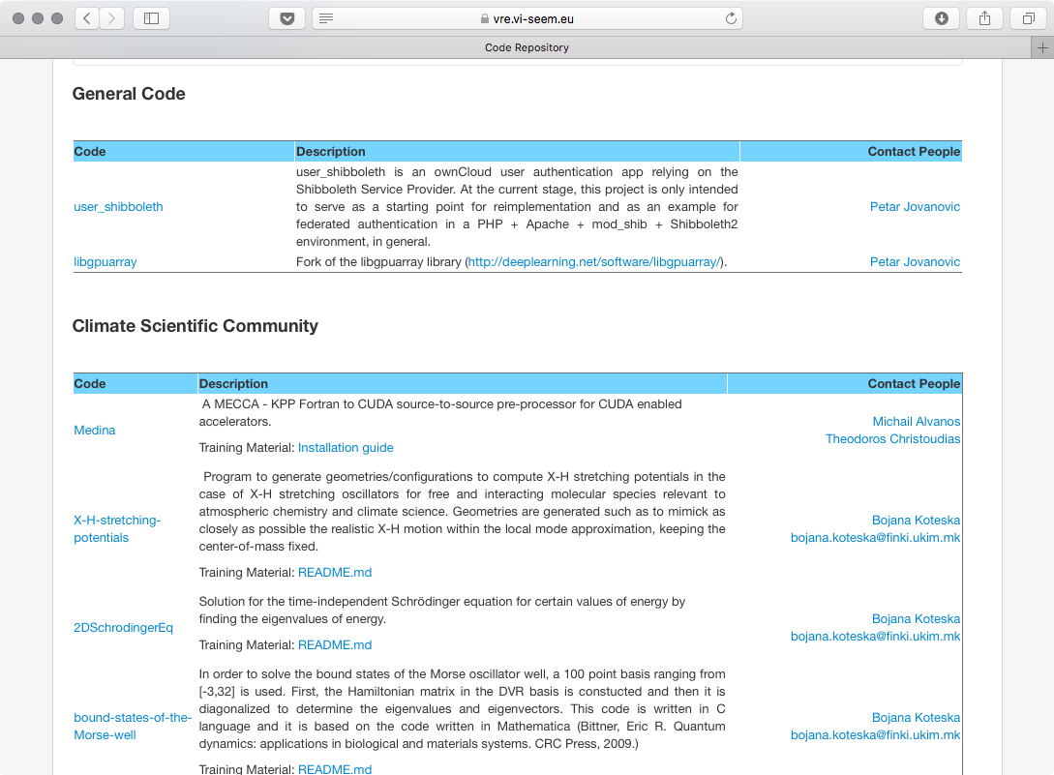
Codes

Slide 29
Access to the VRE
Defined the framework for accessing VI-SEEM services and resources
Opened up the VRE to the widest possible regional communities
Uses a fair, transparent and trusted mechanism for allocation of VRE resources
Facilitates access and deployment of new applications in the VRE
3 calls envisaged
40+ applications have been allocated resources
23 applicants, 21 accepted on the 1st call
14M CPU core hours, 3.4M GPU core hours, 1M Phi core hours provided
18 applicants, 18 accepted on the 2nd call
14 services already available to the users community
15 million CPU core hours, 370 million GPU core hours and 15 million Phi core hours available
DI4R, Brussels, 30.11.-01.12.2017

Slide 30
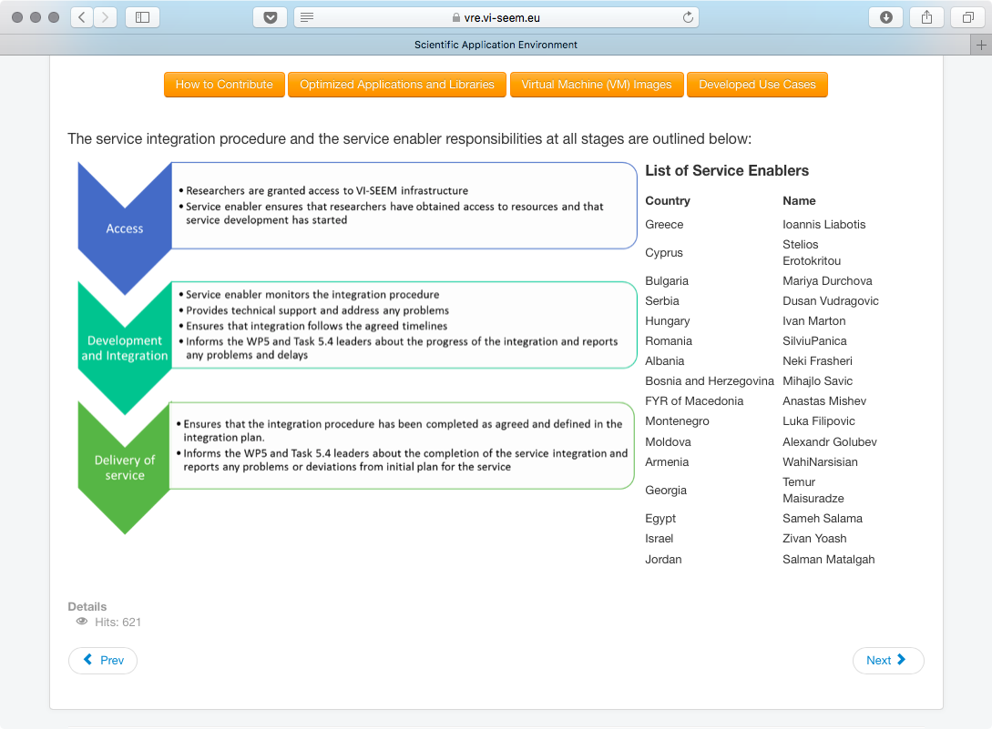
Integration procedure

Slide 31
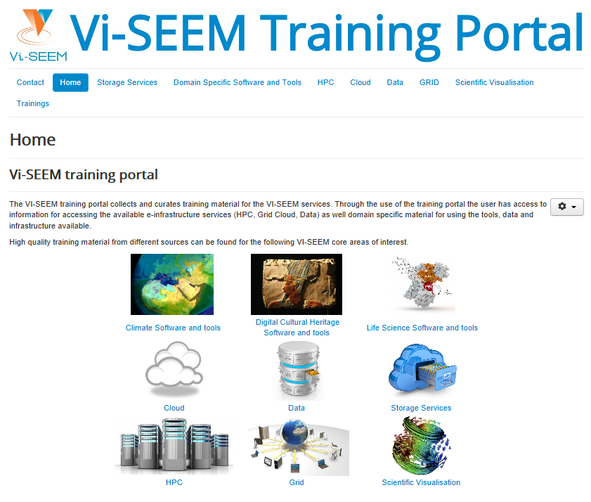








Training portal
VI-SEEM Training Portal
Access via: https://training.vi-seem.eu/
Storage services
Domain-specific software and tools
Climate
Digital Cultural Heritage
Life Sciences
HPC
Cloud
Data
Grid
Scientific visualization
DI4R, Brussels, 30.11.-01.12.2017

Slide 32




Thanks!
https://vi-seem.eu
@vi_seem
VI-SEEM
vi-seem-pmo@vi-seem.eu

