Slide 1
Introduction to parallel computing concepts and technics

Slide 2
Outline
Parallel programming concepts and approaches
Utilities (Makefiles, git, Compilers, Libraries & Tools)
Libraries for HPC parallel programming
  OpenMP
  MPI
Hands-on exercises

Slide 3
Science goes “in-silico”
Exact solutions are not always possible using current theoretical tools and methods
  i.e. most problems we have to solve are non-linear
Numerical integration and simulation technics are providing answers to difficult problems
The more complex the problem the more demanding the solution will be. Hence, high end research requires
  better hardware
  improved software stacks etc

Slide 4
Methods
Monte-carlo (MapReduce in general)
Finite differences, finite volumes (structured grids)
Finite elements (unstructured grids)
Spectral analysis
Dense Linear Algebra
Sparse Linear Algebra
N-body & particles simulations

Slide 5
Fields of application
Astrophysics
Biology
Chemistry
Climate
Economy
Engineering
High energy physics
Nanotechnology
Seismology
Sociology and many many more…

Slide 6
As a field expert you will most likely ask the following..
  “Is it possible to increase the problem size?”
  “Is it possible to reduce the time it takes to solve the problem?”
Your friendly computer engineer will likely respond..
  “Ok, look. We have a new machine on the way and we expect it to be available in a couple of months. If you can wait until then we can try out your code and hopefully it will work the way you want it to” – Hardware specs
  “Well you can try improving your code. What does profiling tell you? Do you overlap computation with communication? And what about I/O? Is that going to be a bottleneck?” – Software refactoring
  “Have you tried linking it with Intel MKL?” – Code re-use

Slide 7
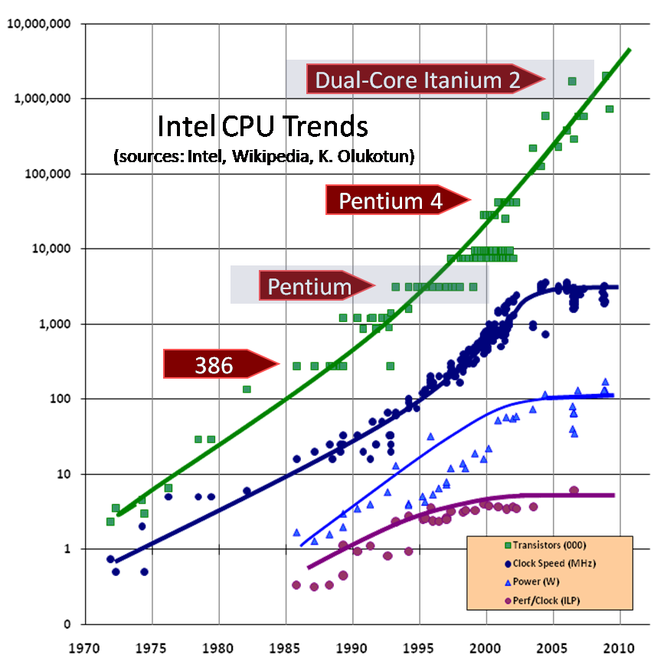
Start off serially and take one step at a time
But don’t get too excited. You are not living in the 90s any more…
  “From 2007 to 2011, maximum CPU clock speed (with Turbo Mode enabled) rose from 2.93GHz to 3.9GHz, an increase of 33%. From 1994 to 1998, CPU clock speeds rose by 300%.”

Slide 8
Parallel programming
Parallel programming may overcome the hardware issues but before doing anything parallel make sure that:
  Your serial code is already optimal! Questions to ask yourself:
    Are you using other people’s computational and I/O libraries?
    Have you tested with other compilers and, if yes, have you tried various optimization flags?
    What does profiling tell you?

Slide 9
Overview of Parallel computing
In parallel computing a program spawns several concurrent processes
  decrease the runtime needed to solve a problem or
  increase the problem size to be solved
The original problem is decomposed into tasks that ideally run independently
Source code development within some parallel programming environment
  hardware platform
  nature of the problem
  performance goals

Slide 10
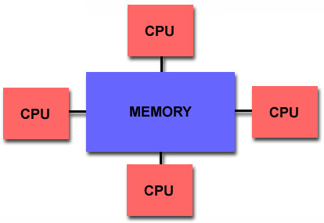
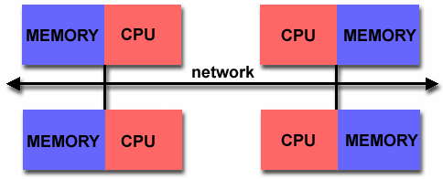
Hardware considerations
Shared memory Distributed memory

Slide 11
Hardware considerations
Shared memory Distributed memory
Each thread shares the same address space with other threads
knowledge of where data is stored is of no concern to the user
Process synchronization is explicit
Not scalable
Each process (or processor) has unique address space
Direct access to another processors memory not allowed
Process synchronization occurs implicitly

Slide 12
Parallel programming models
Shared memory Distributed memory
Thread based programming approach
Compiler directives (i.e. OpenMP)
Message passing may also be used (think hybrid)
Easier (but trickier sometimes) to implement
Developer uses “Message Passing” in order to sync processes and share data among them
Message passing libraries
  MPI being the most common
Difficult to implement

Slide 13
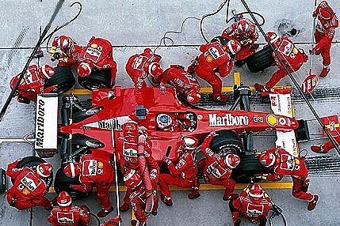


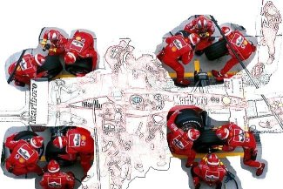

Nature of the problem
Parallel computing
  Embarrassingly parallel (parametric studies)
  Multiple processes concurrently (Domain and/or functional decomposition)

Slide 14
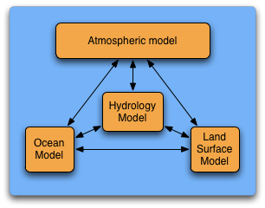

Nature of the problem (examples)
Functional partitioning
Domain decomposition

Slide 15
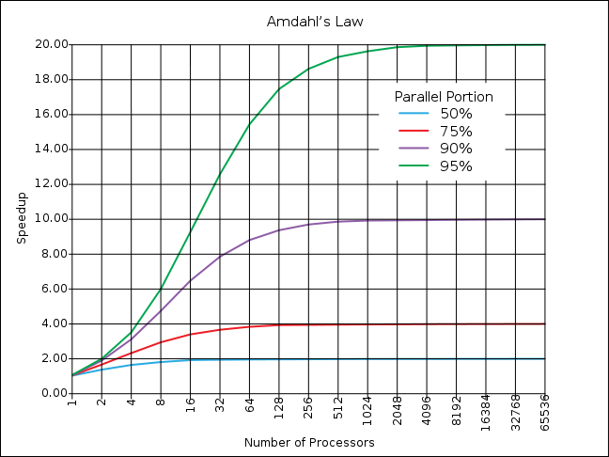
Amdahl’s Law
Amdahl’s law predicts the theoretical maximum speedup when using multiple processors

Slide 16
Does HPC run only on Linux? Why?
It’s stable, lightweight and well documented
It does the job
It supports as many and even more tools for computing
More than 80% of the systems on the Top500 list run Linux

Slide 17
Setting the ground
Anything in Courier usually denotes something you type in a terminal window
Lines starting with ‘#’ or ‘$’ signs usually denote commands you will have to issue
The‘<‘,’>’ marks are used to denote segments you need to change before you type in.
  Stuff in italic is usually also stuff you will need to replace

Slide 18
Hands-on!
$ ssh <username>@login.aris.grnet.gr
Note: The available editors on ARIS are vi, vim and nano. If you are not comfortable using vi or vim please use nano.

Slide 19
Useful commands
Command | Description
$ ls -la | List contents of current working directory (the -la part is optional for long and all listing)
$ mkdir directory | Create a new directory (folder)
$ cd directory | Change the current working directory. Note that cd .. Takes you one folder up.
$ pwd | Print the current working directory (where – on which path – am I)
$ hostname | Print the name of the host (where am I logged onto)
$ whoami | Print my username (who am I)
$ who | Print a list of everyone logged in right now.
$ cat <filename> | Prints out the contents of a file in stdout (terminal session)

Slide 20
Information discovery
Command | Description
$ uname -a | Provides information on architecture and kernel version
$ lsb_release -a | OS name and version (redhat based systems only)
$ sinfo | Provides a list of available resources, their properties and their current state
$ squeue | Displays the submitted list of your jobs
$ sbatch <job> | Sumbits the given job to the ARIS cluster

Slide 21
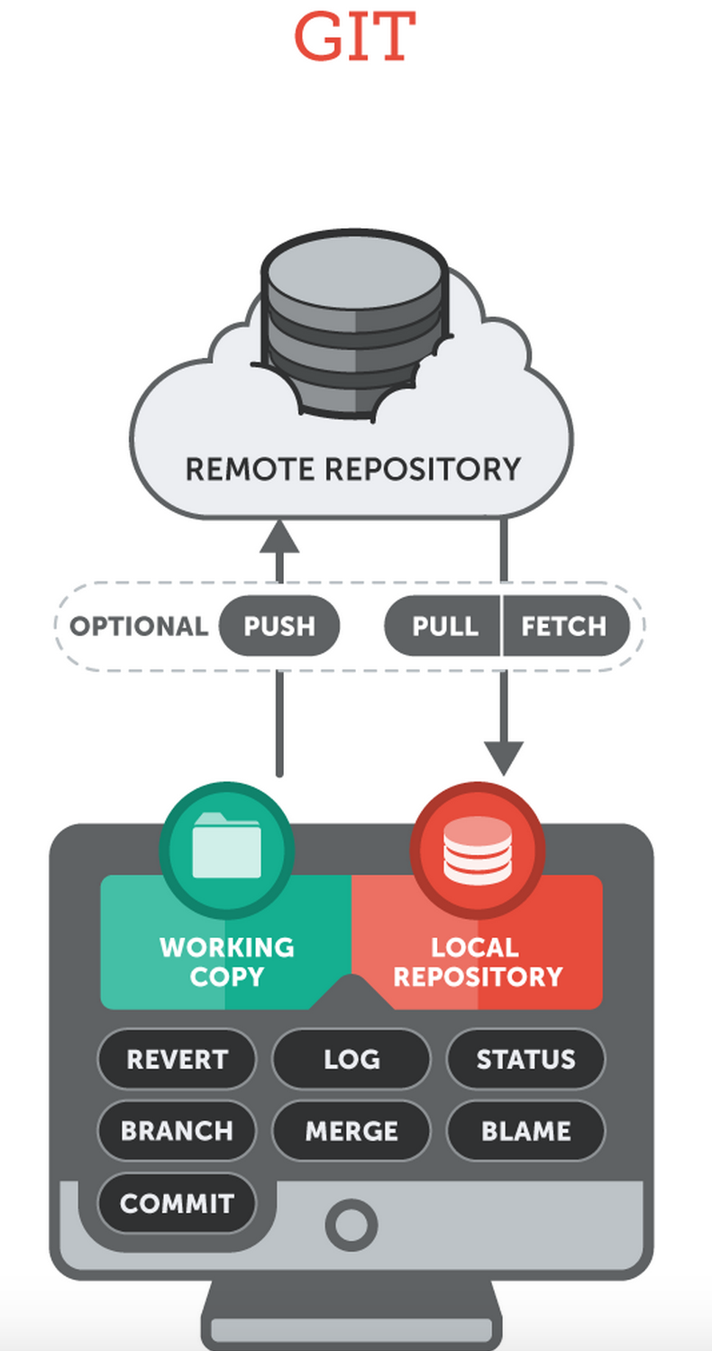
Command | Description
$ git clone <url> | Clone a git repository. The whole remote repository (incl. commits and branches is synced locally). One time operation.
$ git add <files> | Stage files for commit (but don’t commit) within local repository.
$ git commit –m “some message” | Commit all staged changes to the local repository. The message is recorded along with a unique hash (commit id)
$ git push | Push my changes (commits) to the remote repository (the one that was cloned in the beginning).
$ git pull | Pull any changes from the remote repository and merge the remote branch into the current branch if possible.

Slide 22
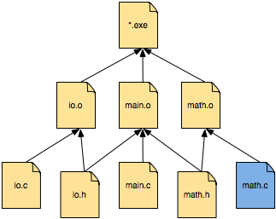
The Makefile
Define a set of rules to follow
  Used mainly for source code compilation
  Helpful during development phase when small changes are made to specific files
math.o: math.c math.h
gcc –c math.c -o math.o

Slide 23

The Makefile
Define a set of rules to follow
  Used mainly for source code compilation
  Helpful during development phase when small changes are made to specific files
target
dependancies
rule
math.o: math.c math.h
gcc –c math.c -o math.o

Slide 24
The Makefile
Define a set of rules to follow
  Used mainly for source code compilation
  Helpful during development phase when small changes are made to specific files
target
dependancies
rule
math.o: math.c math.h
gcc –c math.c -o math.o
or
math.o: math.c math.h
gcc -c $< -o $a

Slide 25
Hands-on!
$ ssh <username>@login.aris.grnet.gr
$ w
$ pwd
$ cd $WORKDIR
$ pwd
$ git clone https://github.com/hpc-grnet-gr/aris-training-sep-2015.git
$ ls –la
$ cd aris-training-sep-2015

Slide 26
Hands-on!
$ ...
$ cd aris-training-sep-2015
$ cd my_first_ARIS_job
$ cat simple

Slide 27
SLURM scripts
#!/bin/bash
#SBATCH --job-name=simple_job
#SBATCH --time=00:01:00
#SBATCH --account=sept2015
#SBATCH --partition=compute
# this is a comment
sleep 30
/bin/hostname

Slide 28
Hands-on!
$ ...
$ cd aris-training-sep-2015
$ cd my_first_ARIS_job
$ cat simple
...
$ sbatch simple
$ squeue
$ ls -lrt

Slide 29
Job script creator
http://doc.aris.grnet.gr/scripttemplate/

Slide 30
Introduction to OpenMP

Slide 31
Overview of OpenMP
Shared vs Distributed memory models (recap)
Why OpenMP
How OpenMP works
Basic examples
How to execute the executable

Slide 32
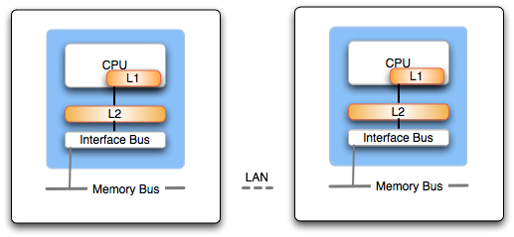
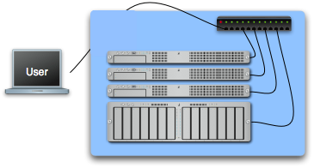
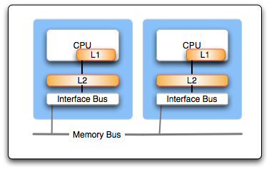
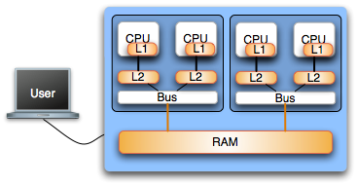
Notes:
Shared memory programming is different from message passing because they rely on two very different means of communication. Shared memory relies on implicit communication, which is facilitated by the shared memory space. This makes shared memory programming much more intuitive for many programmers wishing to parallelize their programs. Unfortunately, because it operates under the assumption of shared memory space, it is susceptible to the inherent scaling limitations of the mechanisms that create this shared view of the memory.Message passing assumes that there is no shared memory and that all communications must be enabled through the sending of explicit messages. It is not intuitive because it requires the programmer to manage the sending, receiving, and coordination among the parallel processes.
Shared memory applications are ideal for use on single SMP systems where all processors and memories are tightly integrated on a hardware level. As CPUs increase the number of cores per chip, shared memory programming will get a lot of attention. It is no silver bullet, however because of the inherent limitations present in scaling up the size of the shared memory systems. At some point, multiple SMP machines must be connected in a network, and coordinating some set of these systems requires explicit message passing due to the fact that their is no physically shared memory. Even if shared memory is emulated among individual SMP machines, it still must be implemented at its lowest level using message passing.

Slide 33
Introduction to OpenMP
Extension to C/C++ and Fortran languages
  Most compilers support OpenMP
    GNU, Intel, PGI, PathScale, Open64 …
Extensively used for writing programs for shared memory architectures over the past decade
Threads communication is implicit and uses variables pointing to shared memory locations; this is in contrast with MPI which uses explicit messages passed among each process

Slide 34
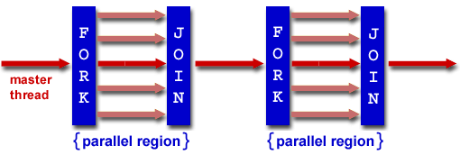
Threaded parallel programming (openMP)
openMP is based on a fork - join model
  Master - worker threads
  Use of directives and pragmas within source code

Slide 35
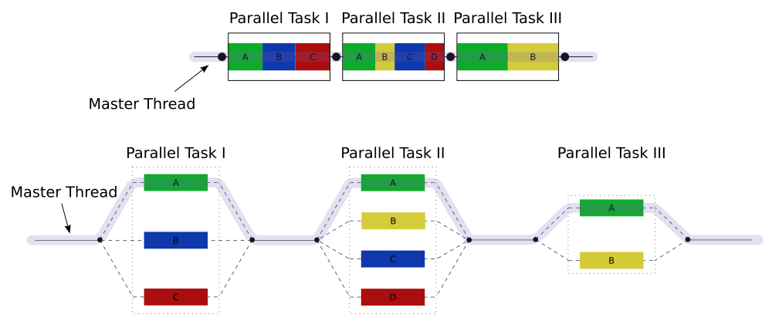
Approach towards parallelism
From serial to parallel with OpenMP

Slide 36
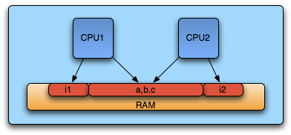
Memory issues
Threads have access to the same address space
  Communication is implicit
Programmer needs to define
  local data
  shared data

Slide 37
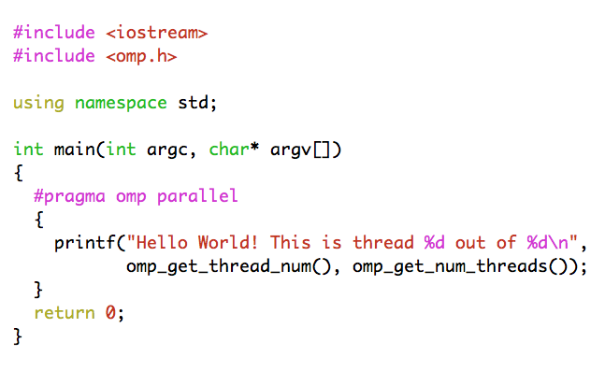

Hello world example
Environment variable
OMP_NUM_THREADS

Slide 38
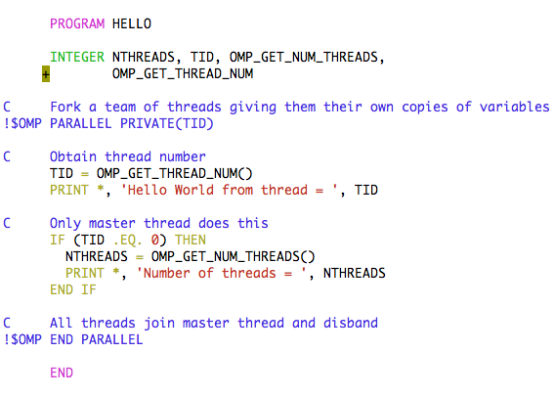
Hello world example

Slide 39
Common calls
Call | Description
int omp_get_num_threads() | Returns the number of threads in the concurrent team
int omp_get_thread_num() | Returns the id of the thread inside the team
int omp_get_num_procs() | Returns the number of processors in the machine
int omp_get_max_threads() | Returns maximum number of threads that will be used in the next parallel region
double omp_get_wtime() | Returns the number of seconds since a time in the past
bool omp_in_parallel() | 1 if in parallel region, 0 otherwise

Slide 40
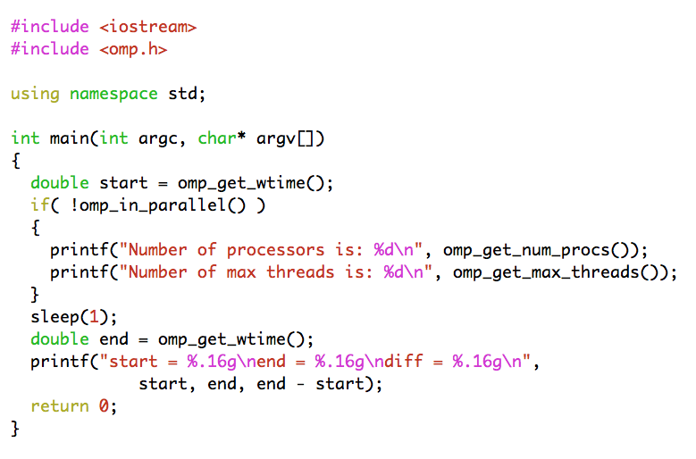
Common calls example

Slide 41
Data scoping
For each parallel region the data environment is constructed through a number of clauses
  shared (variable is common among threads)
  private (variable inside the construct is a new variable)
  firstprivate (variable is new but initialized to its original value)
  lastprivate (variable’s last value is copied outside construct)
  reduction (variable’s value is reduced at the end)

Slide 42
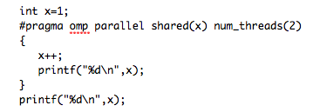
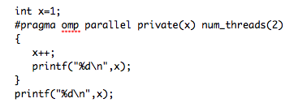
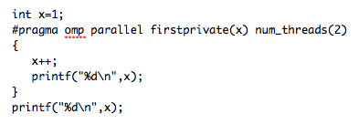
A few examples
x = 3
x = 2
x = 3
x = 2
x = 3
x = 3
or
Will print anything and then x=1
x = 2
x = 2
x = 1
Notes:
Show examples

Slide 43
Synchronization
OpenMP provides several synchronization mechanisms
  barrier (synchronizes all threads inside the team)
  master (only the master thread will execute the block)
  critical (only one thread at a time will execute)
  atomic (same as critical but for one memory location)

Slide 44
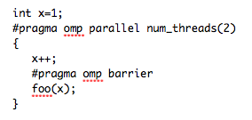
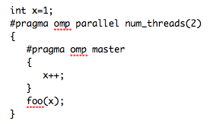
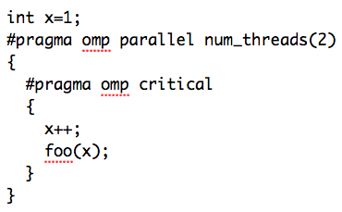
Synchronization examples
foo(3), foo(3)
foo(2), foo(2)
or
foo(1), foo(2)
foo(2), foo(3)
Notes:
Show examples

Slide 45
Data parallelism
Worksharing constructs
  Threads cooperate in doing some work
  Thread identifiers are not used explicitly
  Most common use case is loop worksharing
  Worksharing constructs may not be nested
DO/for directives are used in order to determine a parallel loop region

Slide 46
The for loop directive
#pragma omp for [clauses]
for (iexpr ; test ; incr)
Where clauses may be
  private, firstprivate, lastprivate
  Reduction
  Schedule
  Nowait
Loop iterations must be independent
Can be merged with parallel constructs
Default data sharing attribute is shared

Slide 47
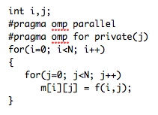
The for loop directive
j must be declared private explicitly
i is privatized automatically
Implicit synchronization point at the end of for loop

Slide 48
The schedule clause
Schedule clause may be used to determine the distribution of computational work among threads
  static, chunk; The loop is equally divided among pieces of size chunk which are evenly distributed among threads in a round robin fashion
  dynamic, chunk; The loop is equally divided among pieces of size chunk which are distributed for execution dynamically to threads. If no chunk is specified chunk=1
  guided; similar to dynamic with the variation that chunk size is reduced as threads grab iterations
Configurable globally via OMP_SCHEDULE
  i.e. setenv OMP_SCHEDULE "dynamic,4"

Slide 49
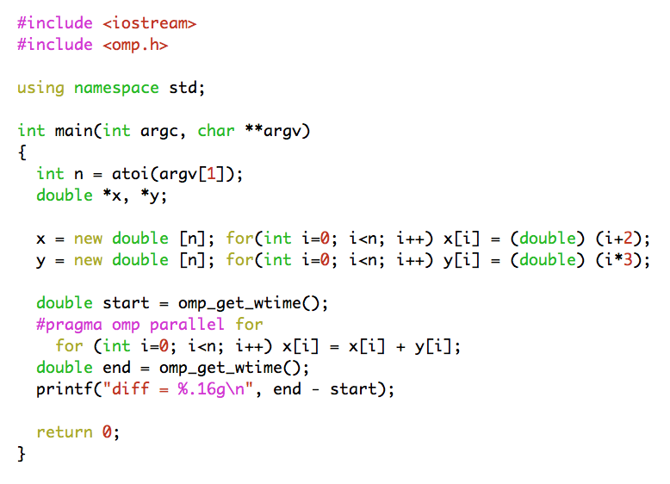
Adding two vectors

Slide 50
Reduction clause
Useful in the case one variable’s value is accumulated within a loop
Using the reduction clause
  A private copy per thread is created and initialized
  At the end of the region the compiler safely updates the shared variable
  Operators may be +, *, -, /, &, ^, |, &&, ||

Slide 51
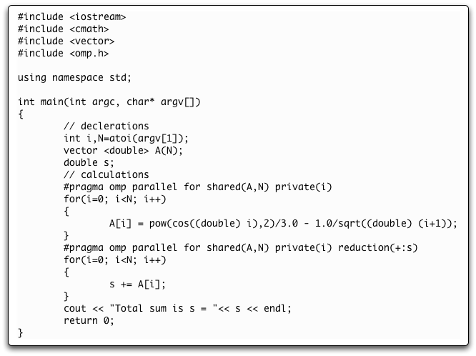
Reduction clause example
Notes:
Good point to switch to openmp exercises

Slide 52
Introduction to MPI

Slide 53
Message Passing Model
A process may be defined as a program counter and an address space
Each process may have multiple threads sharing the same address space
Message Passing is used for communication among processes
  synchronization
  data movement between address spaces

Slide 54
Message Passing Interface
MPI is a message passing library specification
  not a language or compiler specification
  no specific implementation
Source code portability
  SMPs
  clusters
  heterogeneous networks

Slide 55
Types of communication
Point-to-Point calls
  data movement
Collective calls
  data movement
  reduction operations
  Synchronization (barriers)
Initialization, Finalization calls

Slide 56
MPI Features
Point-to-point communication
Collective communication
One-sided communication
Communicators
User defined datatypes
Virtual topologies
MPI-I/O

Slide 57
Basic MPI calls
MPI_Init
MPI_Comm_size (get number of processes)
MPI_Comm_rank (gets a rank value assigned to each process)
MPI_Send (cooperative point-to-point call used to send data to receiver)
MPI_Recv (cooperative point-to-point call used to receive data from sender)
MPI_Finalize

Slide 58
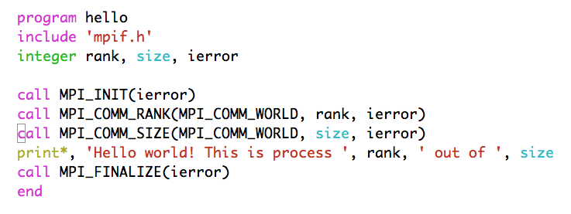
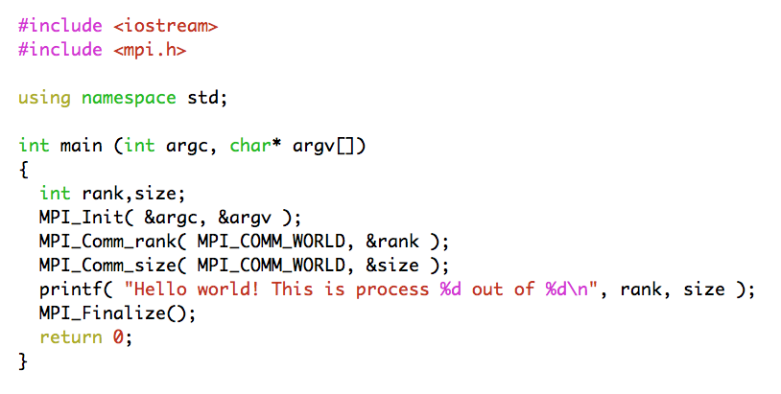
Hello World!

Slide 59
Hello World!
if ( ierror .ne. MPI_SUCCESS ) then
... do error handling as desired ...
end if

Slide 60
Starting and exiting the MPI environment
MPI_Init
  C style: int MPI_Init(int *argc, char ***argv);
    accepts argc and argv variables (main arguments)
  F style: MPI_INIT ( IERROR )
    Almost all Fortran MPI library calls have an integer return code
  Must be the first MPI function called in a program
MPI_Finalize
  C style: int MPI_Finalize();
  F style: MPI_FINALIZE ( IERROR )

Slide 61
Communicators
All mpi specific communications take place with respect to a communicator
  Communicator: A collection of processes and a context
MPI_COMM_WORLD is the predefined communicator of all processes
Processes within a communicator are assigned a unique rank value

Slide 62
A few basic considerations
Q: How many processes are there? A: (N)
  (C) MPI_Comm_size( MPI_COMM_WORLD, &size );
  (F) MPI_COMM_SIZE( MPI_COMM_WORLD, size, ierr)
Q: Which one is which? A: [0,(N-1)]
  (C) MPI_Comm_rank( MPI_COMM_WORLD, &rank );
  (F) MPI_COMM_RANK( MPI_COMM_WORLD, rank, ierr)
  The rank number is between 0 and (size - 1) unique per process

Slide 63
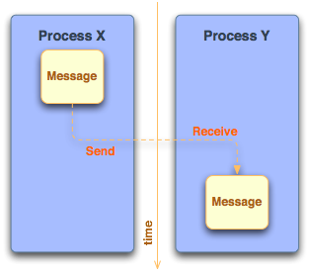
Sending and receiving messages
Questions
  Where is the data?
  What type of data?
  How much data is sent?
  To whom is the data sent?
  How does the receiver know which data to collect?

Slide 64
What is contained within a message?
message data
  buffer
  count
  datatype
message envelope
  source/destination rank
  message tag (tags are used to discriminate among messages)
  communicator

Slide 65
MPI Standard (Blocking) Send/Receive
Syntax
  MPI_Send(void *buffer, int count, MPI_Datatype type, int dest, int tag, MPI_Comm comm);
  MPI_Recv(void *buffer, int count, MPI_Datatype type, int src, int tag, MPI_Comm comm, MPI_Status status);
Processes are identified using dest/src values and the communicator within the message passing takes place
Tags are used to deal with multiple messages in an orderly manner
  MPI_ANY_TAG and MPI_ANY_SOURCE may be used as wildcards on the receiving process

Slide 66
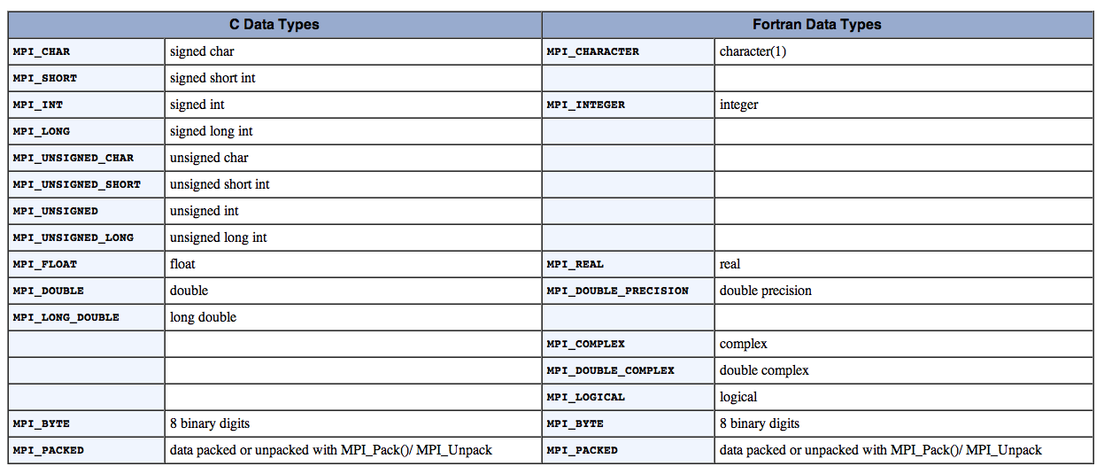
MPI Datatypes

Slide 67
Getting information about a message
Information of source and tag is stored in MPI_Status variable
  status.MPI_SOURCE
  status.MPI_TAG
MPI_Get_count can be used to determine how much data of a particular type has been received
  MPI_Get_count( &status, MPI_Datatype, &count);

Slide 68
A deadlock example (?)
Program Output:
from process 1 using tag 158 buf1[N-1] = 8.1
from process 0 using tag 157 buf0[N-1] = 0.9
double buf0[N], buf1[N];
MPI_Status status;
int tag_of_message, src_of_message;
if( rank == 0 )
{
for(int i=0; i<N; i++) buf0[i] = 0.1 * (double) i;
MPI_Send(buf0, N, MPI_DOUBLE, 1, 157, MPI_COMM_WORLD);
MPI_Recv(buf1, N, MPI_DOUBLE, 1, 158, MPI_COMM_WORLD, &status);
tag_of_message = status.MPI_TAG;
src_of_message = status.MPI_SOURCE;
cout << "from process " << src_of_message << " using tag " <<
tag_of_message << " buf1[N-1] = " << buf1[N-1] << endl;
}
else if ( rank == 1 )
{
for(int i=0; i<N; i++) buf1[i] = 0.9 * (double) i;
MPI_Send(buf1, N, MPI_DOUBLE, 0, 158, MPI_COMM_WORLD);
MPI_Recv(buf0, N, MPI_DOUBLE, 0, 157, MPI_COMM_WORLD, &status);
tag_of_message = status.MPI_TAG;
src_of_message = status.MPI_SOURCE;
cout << "from process " << src_of_message << " using tag " <<
tag_of_message << " buf0[N-1] = " << buf0[N-1] << endl;
}

Slide 69
Blocking communication
MPI_Send does not complete until buffer is empty (available for reuse)
MPI_Recv does not complete until buffer is full (available for use)
MPI uses internal buffers (the envelope) to pack messages, thus short messages do not produce deadlocks
To avoid deadlocks either
  reverse the Send/Receive calls on one end or
  use the Non-Blocking calls (MPI_Isend) followed by MPI_Wait

Slide 70
Communication Types
Blocking: If a function performs a blocking operation, then it will not return to the caller until the operation is complete.
Non-Blocking: If a function performs a non-blocking operation, it will return to the caller as soon as the requested function has been initialized.
Using non-blocking communication allows for higher program efficiency if calculations can be performed while communication activity is going on. This is referred to as overlapping computation with communication

Slide 71
Communication (i.e. Send) Modes
Standard mode (MPI_Send, MPI_ISend)
  Send will complete when buffer is available for use
Synchronous mode (MPI_Ssend, MPI_Issend)
  The send will complete only until a matching receive has been posted and transfer has started
Buffered mode (MPI_Bsend, MPI_Ibsend)
  Send is complete as soon as the user buffer is copied to the system buffer
Ready mode (MPI_Rsend, MPI_Irsend)
  send starts only if a matching receive has been posted

Slide 72
Collective communications
All processes within the specified communicator participate
All collective operations are blocking
All processes must call the collective operation
No message tags are used
Three classes of collective communications
  Data movement
  Collective computation
  Synchronization

Slide 73
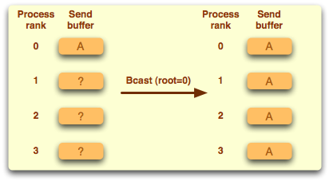
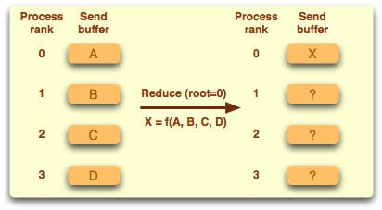
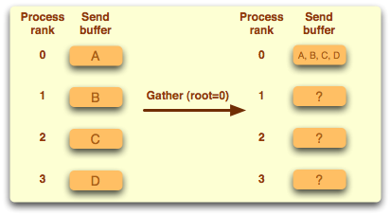
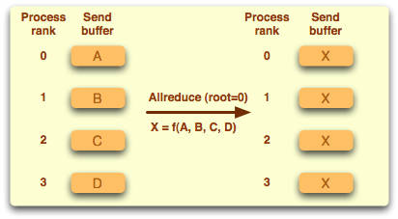
Examples of collective operations

Slide 74
Synchronization
MPI_Barrier ( comm )
Execution blocks until all processes in comm call it
Mostly used in highly asynchronous programs
Notes:
Good point to switch to exercises

Slide 75
Timing using MPI
MPI_Wtime returns number of seconds since an arbitrary point in the past
double mpi_t0,mpi_t1;
if(rank == 0)
{
mpi_t0 = MPI_Wtime();
}
sleep(1);
MPI_Barrier( MPI_COMM_WORLD );
if(rank == 0)
{
mpi_t1 = MPI_Wtime();
printf("# MPI_time = %f\n", mpi_t1-mpi_t0);
}

Slide 76
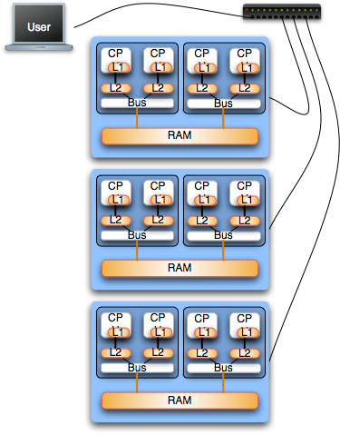
Mixing MPI and OpenMP
Hybrid architectures
  Clusters on SMPs
  HPC Platforms
    IBM BlueGene (i.e. Jugene)
    IBM P6 (i.e. Huygens)
Good starting point
  Mapping of MPI on nodes (interconnection layer)
  Multithreading with OpenMP inside SMPs
Notes:
There do exist situations that are most efficiently solved using a hybrid application of both shared memory and message passing. Often times these situations consist of tightly coupled computations on multiple SMP machines, which communicate (as little as possible) with one another. This is an advanced aspect of parallel programming that will be covered in a more in depth tutorial

Slide 77
Addition of two vectors (OMP)
int main(int argv, char **argv)
{
int n, i;
double *x, *y, *buff;
n = atoi(argv[1]);
x = (double *)malloc(n*sizeof(double));
y = (double *)malloc(n*sizeof(double));
.
.
.
#pragma omp parallel for private(i) shared (x,y)
for (i=0; i<n; i++){
x[i] = x[i] + y[i];
}
}

Slide 78
Addition of two vectors (MPI)
#include “mpi.h”
int main(int argc, char **argv){
int rnk, sz, n, i;
double *x, *y, *buff;
n = atoi(argv[1])
MPI_Init(&argc, &argv);
MPI_Comm_rank(MPI_COMM_WORLD, &rnk);
MPI_Comm_size(MPI_COMM_WORLD, &sz);
chunk = n / sz;
.
.
MPI_Scatter(&buff[rnk*chunk],chunk,MPI_DOUBLE,x,chunk,MPI_DOUBLE,0,MPI_COMM_WORLD);
MPI_Scatter(&buff[rnk*chunk],chunk,MPI_DOUBLE,y,chunk,MPI_DOUBLE,0,MPI_COMM_WORLD);
for (i=0; i<chunk; i++) x[i] = x[i] + y[i];
MPI_Gather(x,chunk,MPI_DOUBLE,buff,chunk,MPI_DOUBLE,0,MPI_COMM_WORLD);
MPI_Finalize();
}

Slide 79
Addition of two vectors (HYBRID)
#include “mpi.h”
int main(int argc, char **argv){
int rnk, sz, n, I, info;
double *x, *y, *buff;
n = atoi(argv[1]);
MPI_Init_thread(&argc, &argv, MPI_THREAD_FUNNELED, &info);
MPI_Comm_size(MPI_COMM_WORLD, &sz);
chunk = n / sz;
MPI_Scatter(&buff[rnk*chunk],chunk,MPI_DOUBLE,x,chunk,MPI_DOUBLE,0,MPI_COMM_WORLD);
MPI_Scatter(&buff[rnk*chunk],chunk,MPI_DOUBLE,y,chunk,MPI_DOUBLE,0,MPI_COMM_WORLD);
#pragma omp parallel for
for (i=0; i<chunk; i++) x[i] = x[i] + y[i];
MPI_Gather(x,chunk,MPI_DOUBLE,buff,chunk,MPI_DOUBLE,0,MPI_COMM_WORLD);
MPI_Finalize(); }

Slide 80
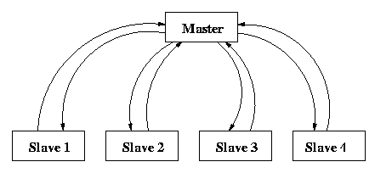
Compile and submit a “mm” job
Master process decomposes matrix a and provides slave processes with input. Each slave process caries ns=nm/sz rows of a and the complete b matrix to carry out computations. Results are sent back to master who prints out timing.

Slide 81


