Slide 1

Simple Storage Service
Sonja Filiposka
Faculty of Computer Science and Engineering
Ss. Cyril and Methodius University
Skopje

Slide 2
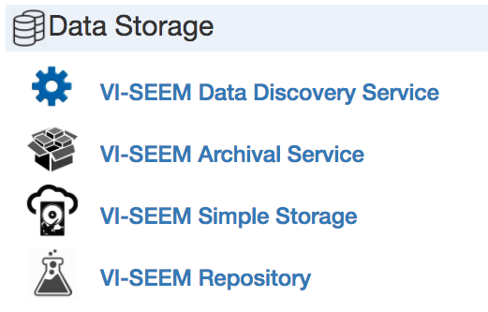
VSS – Simple Storage Service

Slide 3
VSS
keep and sync research data on various devices
share data in a collaborative environment
  with other registered VI-SEEM users
  with anyone using public links
    protected with passwords if needed
Each user is provided with 50 GB of storage for up to 2 years
  Vi-SEEM open call projects

Slide 4
VSS basic info
based on ownCloud platform
  V 9.0.4
Access via
  web browsers
  desktop and mobile clients
  Android, iOS, Windows, Mac and Linux clients
simplestorage.vi‐seem.eu
  VI-SEEM Simple Storage Service instance at ETFBL: https://ipbbox.ipb.ac.rs/
  using VI-SEEM AAI
Service version 1.0.0

Slide 5
VSS features
Server instance (ex. IPB)
Apps
  Calendar
  Contacts
  Over 250 apps in ownCloud App store
Federated clouds
  Federated cloud ID
  Ex. sonja@ipbbox.ipb.ac.rs
fully supports the WebDAV protocol
Linked with external storage
  Must be admin enabled

Slide 6
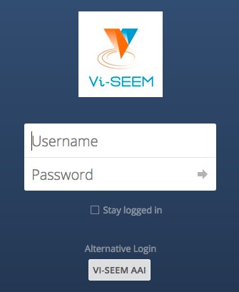
Login

Slide 7
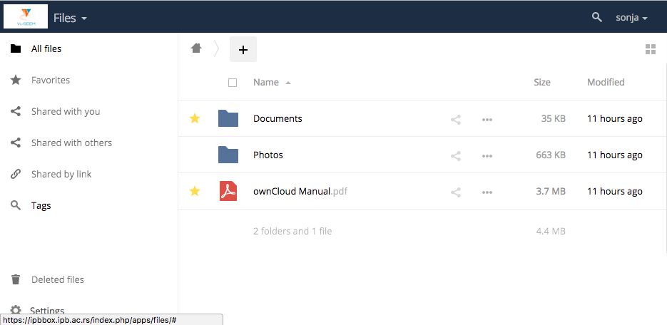
Web GUI

Slide 8
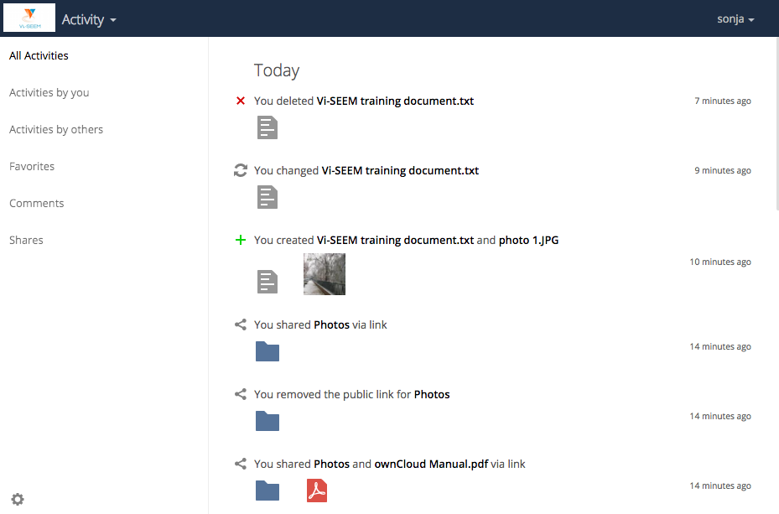
Activity

Slide 9
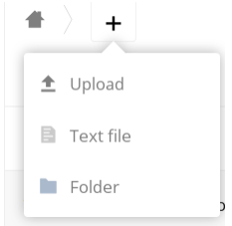
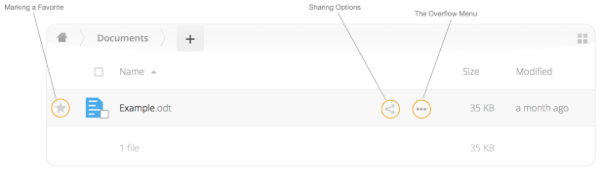
Web interface
create, preview, edit, delete, share, and re-share files
Upload files, create folders
File controls
  Marking Favorites
  Sharing Files
  Overflow Menu
    Display File Details
      Details
      Activity
      Sharing
      Version
    Rename files
    Download files
    Delete files

Slide 10
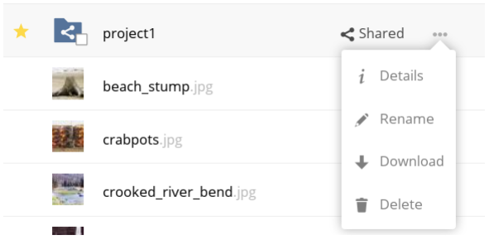
Overflow

Slide 11
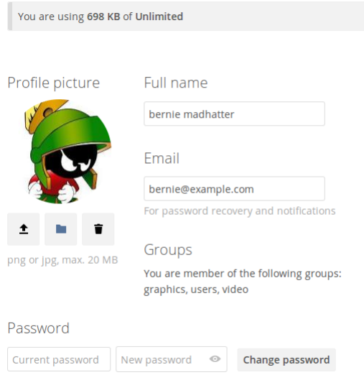
Profile

Slide 12
Settings
Storage quota
  Metadata is not counted against user quotas
  Shared files count against the original share owner’s quota
    all uploaded and edited files count against the owner’s quota
    re-share still counts against the quota of the original share owner
  Deleted files that are still in the trash bin do not count against quotas
    trash bin = 50% of quota
    Deleted file aging = 30 days
      when deleted files exceed 50% of quota then the oldest files are removed until the total is below 50%
  older file versions are not counted against quotas
Sharing groups
  Created by admin
  Custom groups: user created groups for sharing (federation not supported)

Slide 13
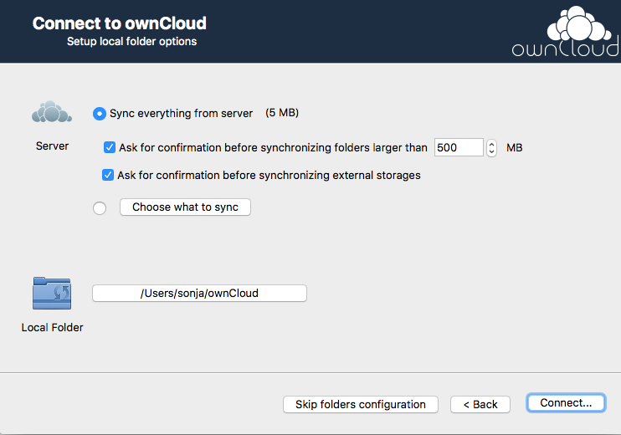
Desktop client
Drag & drop
Seamless sync
Running in background
  System tray

Slide 14
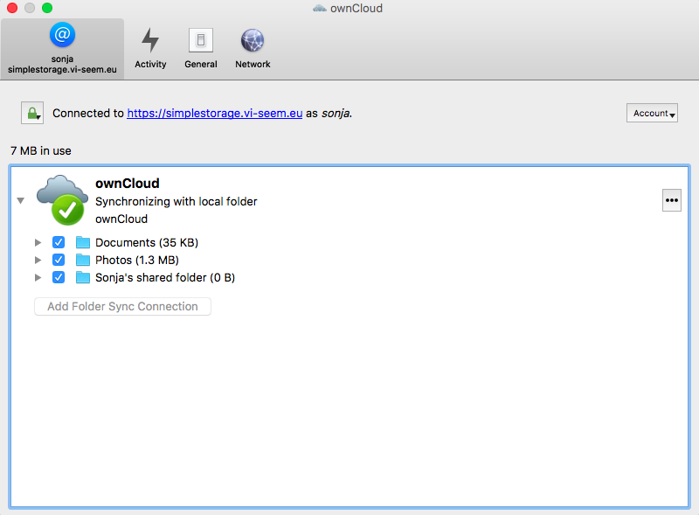
Desktop client settings

Slide 15
File sharing
Sharing files and folders with users or groups
Listing recipients of existing shares
Deleting existing shares
Comments can be applied to any file or folder
  Easier to collaborate in a shared environment
Federated cloud sharing
  Share with users on different servers
  Seamlessly share files across instances
Public sharing with hyperlinks
  with or without upload rights,
  password protection and
  automatic expiration

Slide 16
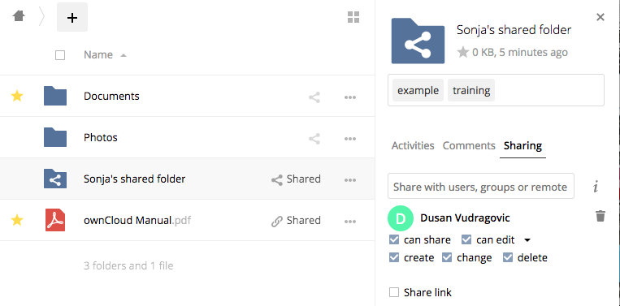
Sharing options
Permissions
  Can share
  Can edit
  Create
  Change
  Delete

Slide 17
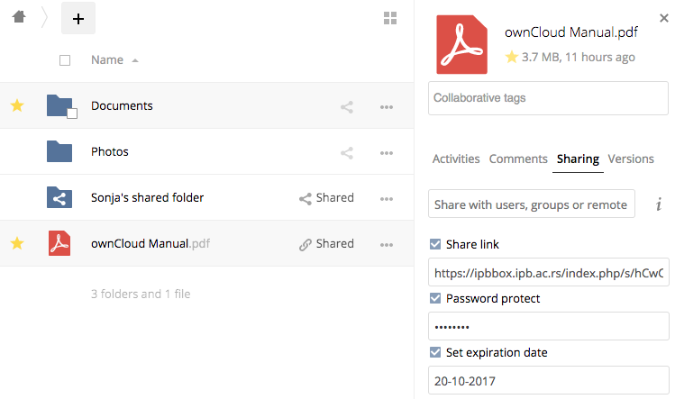
Public links

Slide 18
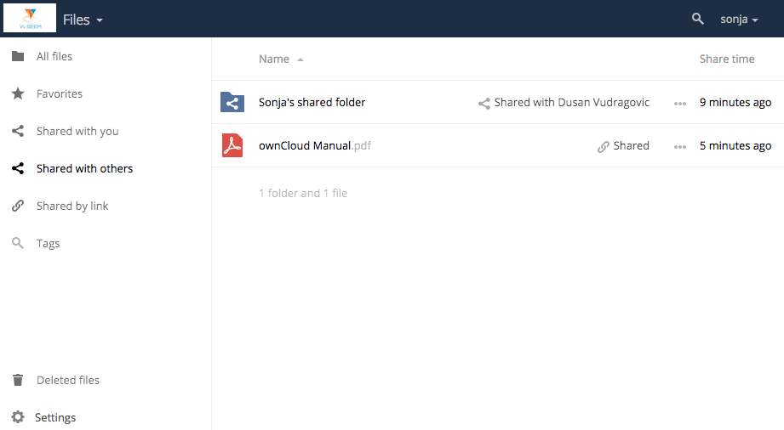
Shared with others

Slide 19
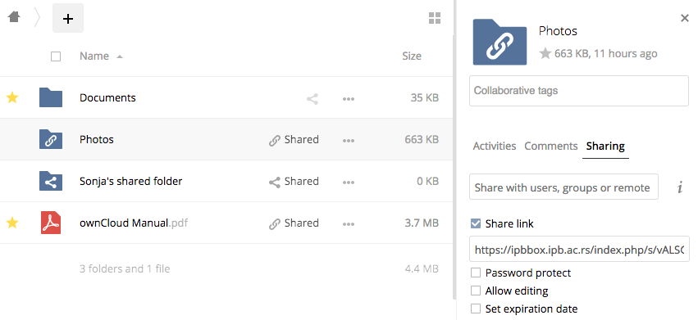
Public links for folders

Slide 20
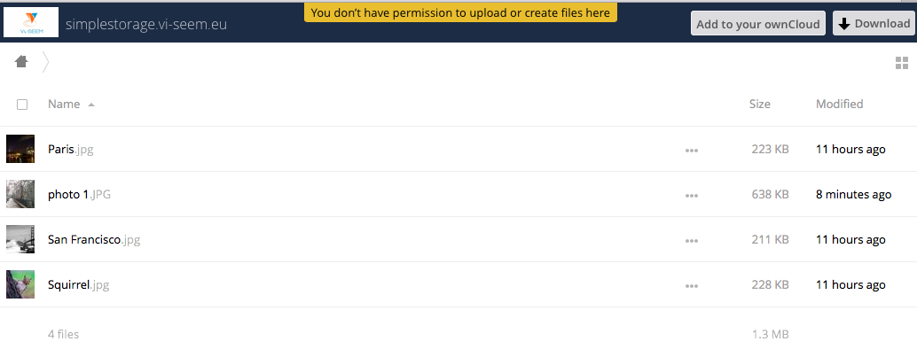
Read only share

Slide 21
Delete file shares
Deleting files gets a little complicated when they are shared files
  User1 shares a folder “test” with User2 and User3
  User2 (the recipient) deletes a file/folder “sub” inside of “test”
  The folder “sub” will be moved to the trash bin of both User1 (owner) and User2 (recipient)
  But User3 will not have a copy of “sub” in her trash bin
When User1 deletes “sub” then it is moved to User1’s trash bin. It is deleted from User2 and User3, but not placed in their trash bins.
When you share files, other users may copy, rename, move, and share them with other people

Slide 22
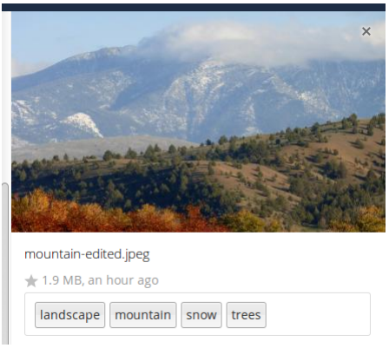
File taging
Find faster what you are looking for
Global tags
  Viewable by everyone
Tag the entire VSS instance
Search based on tags
  Visible, restricted, invisible tags

Slide 23
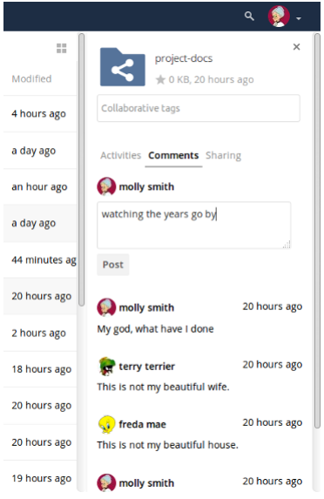
Comments

Slide 24
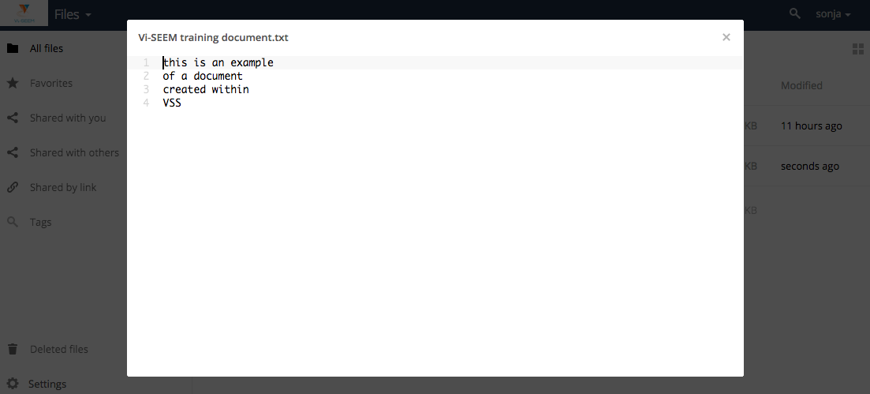
Text documents

Slide 25
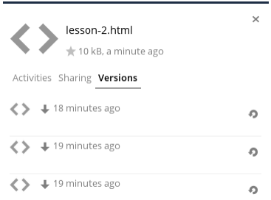
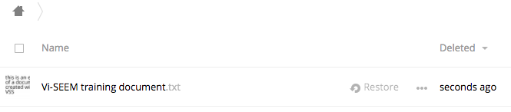
Collaboration
Versioning
  Previous versions of files are
  retained and can be brought back
Undelete
  Deleted files can be found in the trash

Slide 26
Encryption
Encryption app
all of your VSS data files are automatically encrypted
encrypt files on remote storage services that are connected to your VSS server
Only users who have private encryption keys have access to shared encrypted files and folders.
filenames or folder structures are not encrypted
Files never encrypted:
  Old files in the trash bin
  Image thumbnails from the Gallery app
  Previews from the Files app
  The search index from the full text search app
  Third-party app data

Slide 27

Thank you!
VI-SEEM Project Management Office
e-mail: vi-seem-pmo@vi-seem.eu
W: https://vi-seem.eu
T: @vi_seem
L: https://www.linkedin.com/groups/VISEEM-7018941/about

