Slide 1

Parallel programming with GPGPU coprocessors
Petar Jovanović
Institute of Physics Belgrade
The VI-SEEM project initiative is co-funded by the European Commission under the H2020 Research Infrastructures contract no. 675121

Slide 2
Agenda
Introduction
The von Neumann architecture
CPU vs GPU architecture
Heterogeneous execution model
Code for GPUs
CUDA kernel example
GPU memory organization
Matrix multiplication example
VI-SEEM REG CL, 11-13 Oct 2017 2

Slide 3
Introduction
With the introduction of CUDA, graphical processing units (GPUs) became usable for general purpose computation.
For some types of work GPU can bring significant speedup over traditional CPU.
VI-SEEM REG CL, 11-13 Oct 2017 2

Slide 4
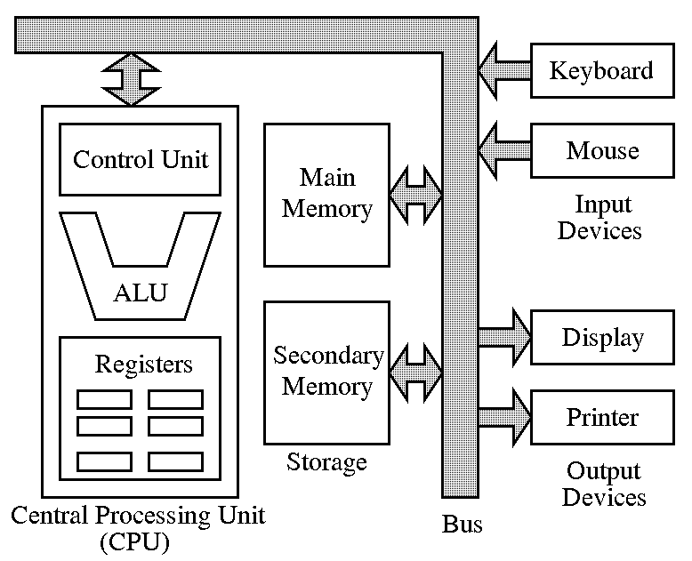
The von Neumann architecture
VI-SEEM REG CL, 11-13 Oct 2017 2

Slide 5
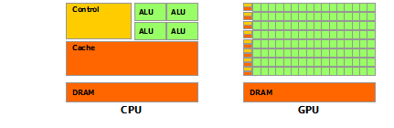

CPU vs GPU architecture
CPU (latency oriented design):
Large caches
Sophisticated control
Powerful ALU
GPU (throughput oriented design):
Small caches
Simple control
Energy efficient ALUs
Latencies compensated by large number of threads
VI-SEEM REG CL, 11-13 Oct 2017 2

Slide 6
Heterogeneous execution model
Host — a CPU which executes the main program in serial.
Device — a GPU which executes parallel portions of the code.
Memory spaces are separate*
  Allocation and data movement is the responsibility of the programmer.
Serial code
CUDA threads
Kernel invocation
More serial code
VI-SEEM REG CL, 11-13 Oct 2017 2

Slide 7
Code for GPUs
CUDA C program is written as follows:
  Serial parts in host C code
  Parallel parts in device SIMD kernel C code
Source code is compiled separately
  Standard C/C++ code for the CPU
  Device code in PTX – compiled just-in-time for the exact device
Use the nvcc for compilation
  PTX is an assembly format
  Specific binary code for the GPU devices
VI-SEEM REG CL, 11-13 Oct 2017 2

Slide 8
CUDA kernel example
// Kernel definition
__global__ void VecAdd(float* A, float* B, float* C)
{
int i = threadIdx.x;
C[i] = A[i] + B[i];
}
int main()
{
...
// Kernel invocation with N threads
VecAdd<<<1, N>>>(A, B, C);
...
}
VI-SEEM REG CL, 11-13 Oct 2017 2

Slide 9
GPU memory organization (1)
Registers (local memory) are per-thread
  very low latency, very high throughput
  limited resource, used for automatic variables
Shared memory (and L1 cache) is per-block
  low latency, high throughput
  can yield significant performance boost, depends on algorithm
  programmer is responsible for its usage
  shared/cache split can be controlled using the API
Global memory is visible to all threads
  high latency, moderate throughput
  memory allocated with cudaMalloc is global
  has the highest capacity
VI-SEEM REG CL, 11-13 Oct 2017 2

Slide 10
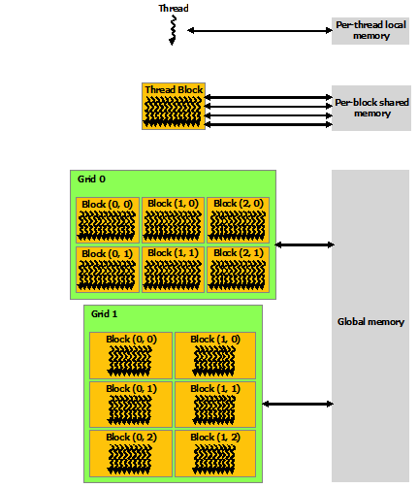
GPU memory organization (2)
VI-SEEM REG CL, 11-13 Oct 2017 2

Slide 11
Matrix multiplication example
Simple version:
__global__
void matrixMulKernel(float* A, float* B, float* C, int width) {
int i;
int row = blockIdx.y*blockDim.y+threadIdx.y;
int col = blockIdx.x*blockDim.x+threadIdx.x;
if ((row<width) && (col<width)) {
float tmp = 0;
for (i = 0; i < width; ++i)
tmp += A[row*width+i]*B[i*width+col];
C[row*width+col] = tmp;
}
}
VI-SEEM REG CL, 11-13 Oct 2017 2

Slide 12
Matrix multiplication w/ shared memory
#define TILE_WIDTH 32
__global__
void matrixMulKernel(float* A, float* B, float* C, int width) {
__shared__ float sA[TILE_WIDTH][TILE_WIDTH];
__shared__ float sB[TILE_WIDTH][TILE_WIDTH];
int bx=blockIdx.x, by=blockIdx.y;
int tx=threadIdx.x, ty=threadIdx.y;
int row = by*TILE_WIDTH+ty;
int col = bx*TILE_WIDTH+tx;
float tmp = 0;
for (int i = 0; i < width/TILE_WIDTH; ++i) {
sA[ty][tx] = A[row*width+i*TILE_WIDTH+tx];
sB[ty][tx] = B[(i*TILE_WIDTH+ty)*width+col];
__syncthreads();
for (int j = 0; j < TILE_WIDTH; ++j) {
tmp += sA[ty][j]*sB[j][tx];
}
__syncthreads();
}
C[row*width+col] = tmp;
}
VI-SEEM REG CL, 11-13 Oct 2017 2

Slide 13
Questions
Thank you for your attention.
VI-SEEM REG CL, 11-13 Oct 2017 2

