Slide 1


VI-SEEM Virtual Research Environment
Antun Balaz
Scientific Computing Laboratory
Center for the Study of Complex System
Institute of Physics Belgrade

Slide 2
Overview
Administrative Details and Historical Context
Project Objectives
eInfrastructure services
Data management services
Domain-specific services
Access to VI-SEEM VRE

Slide 3

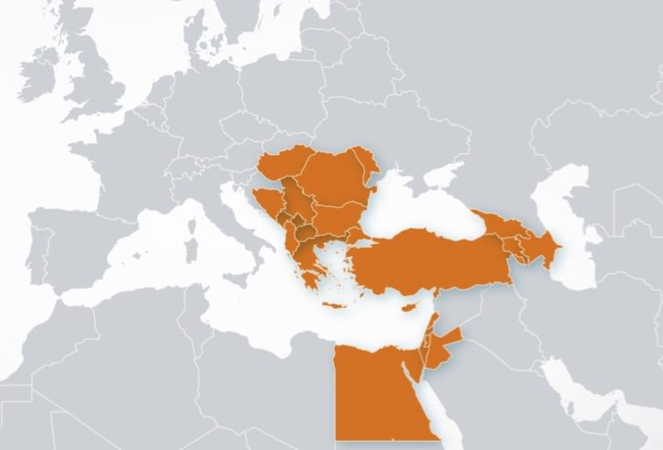
Administrative Details and Historical Context
Administrative details: 1 Oct 2015, 36 months, 715 PMs, 3.3 MEUR
Merging of South East Europe and Eastern Mediterranean regions
South East Europe initiatives
Built up the regional (and national) NRENs, NGI and HPC models
Network: SEEREN1/2
Grid: SEE-GRID-1/2/SCI
HPC: HP-SEE
Eastern Mediterranean initiatives
Linked the EM HPC facilities
HPC: LinkSCEEM1/2

Slide 4
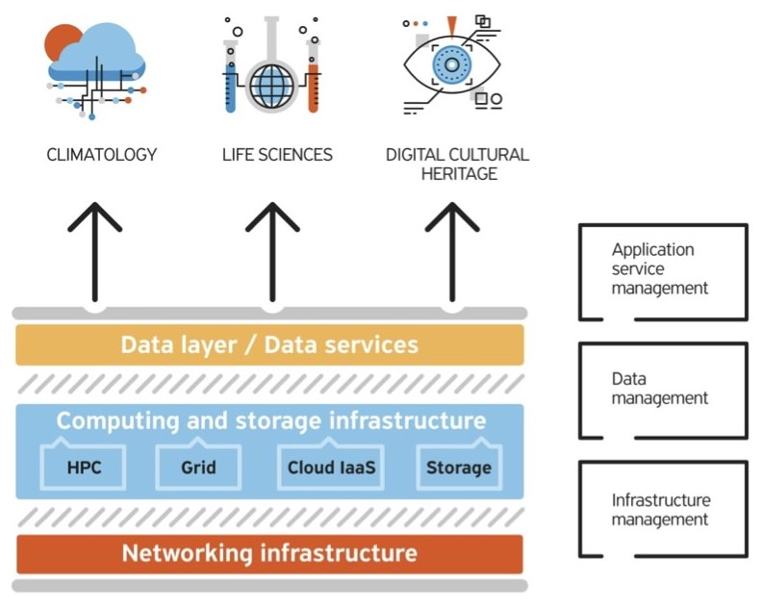
VI-SEEM Project
VI-SEEM unifies SEE and EM for the benefit of 3 large regional communities
Overall objective: Provide user-friendly integrated e-Infrastructure platform for Scientific Communities:
Climatology
Life Sciences
Cultural Heritage
for the SEEM region; by linking compute, data, and visualization resources, as well as services, software and tools
Services are provided through a service catalogue https://services.vi-seem.eu/

Slide 5
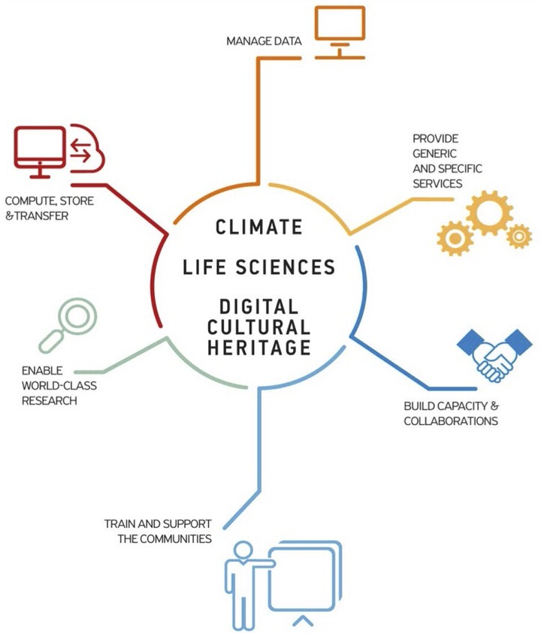
VI-SEEM Objectives
Provide functions to facilitate data management
Provide scientists with access to state of the art e-Infrastructure
Integrate the underlying e-Infrastructure layers with generic as well as domain-specific services
Enable research activities of international standing in the selected fields
Promote capacity building in the region and foster interdisciplinary approaches
Provide adequate user support and training programmes

Slide 6


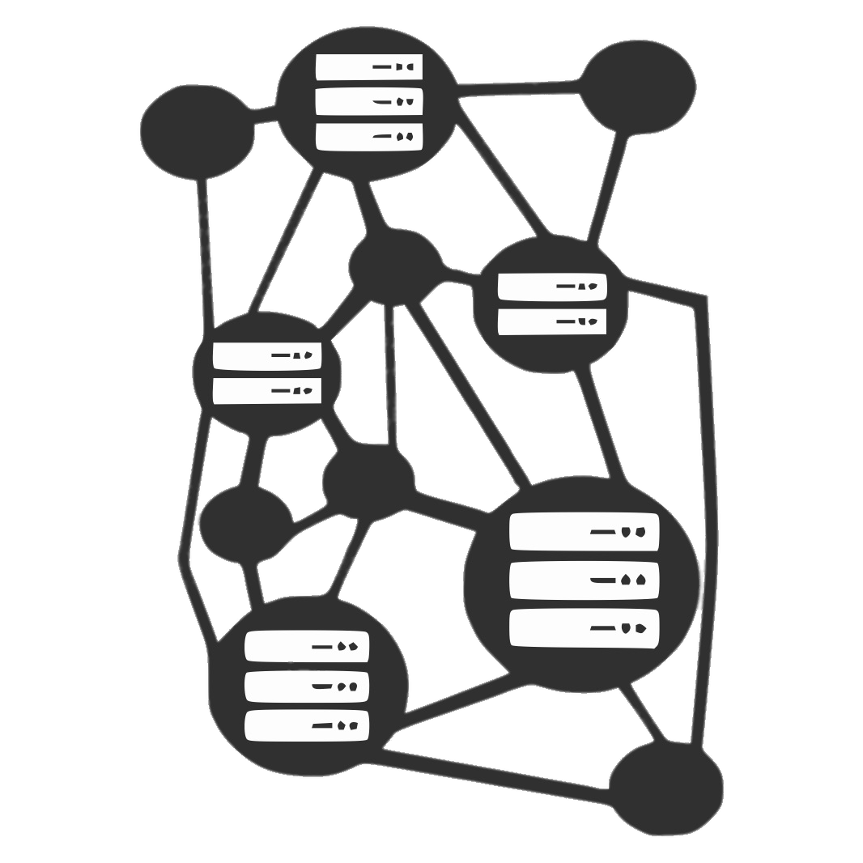
e-Infrastructure Services [1/2]
10,500 VM cores
HPC RESOURCES
ARIS
Cy-Tera
Avitohol
PARADOX
NIIFI SC
Leo
InfraGRID
ICAM BlueGene/P
UPT-HPC
MK-03-FINKI
Armcluster
BA-HPC
Gamma
Zaina
IMAN1-Booster/King
Okeanos
CyI Cloud Facility
Avitohol
InfraGRID Cloud
UPT-Cloud
ETFBL-CC01
MK-04-FINKI_CLOUD
MD-Cloud
IIAP Cloud
IUCC InfinityCloud
CLOUD RESOURCES
21,500 CPU cores 325,000 GP-GPU cores 18,500 Intel Xeon Phi cores
CLIMATE LIFE SCIENCES
DIGITAL CULTURAL HERITAGE
UVT HPC GPFS
ETFBL-CS01
MK-04-FINK
RENAMstor
IIAP
BA-IA
IUCC-InfinityCloud
ARIS
ONYX, Cy-Tera
Avitohol
PARADOX
NIIFI HSM Service
NIIFI iSCSI Service
GRID
RESOURCES
Hellas Grid
BG01-IPP
AEGIS01-IPB-SCL
MK-03-FINKI
MREN01CIS
MD-GRID
ArmCluster
GE-01-GRENA
11 PB
STORAGE RESOURCES
2,900 CPU cores

Slide 7
e-Infrastructure Services [2/2]
Service catalog/portfolio https://services.vi-seem.eu/
Set of operational tools
Monitoring, https://mon.vi-seem.eu/
GOCDB, https://gocdb.vi-seem.eu/portal/
Accounting
Source code repository, https://code.vi-seem.eu/
Helpdesk, https://support.vi-seem.eu/
Technical wiki, https://wiki.vi-seem.eu/
Authentication and Authorization Infrastructure
Service for uniform managing of access to the resources (regardless of their type or location)
Users are able to use their federated identities in order to access resources

Slide 8
Data Management Services
Archival Service
Data that are important for future reference and reproducibility of scientific simulations
Important for regulatory and audit purposes
Used on a less frequent fashion
Simple Storage Service
Keep and sync research data on various devices
Useful tool in collaborative environment
Access is enabled via web browsers, desktop and mobile clients
Repository Service
Hosting the regional community datasets
Publications and their associated data as well as software or references to software and workflows, used to generate such data and publications
Data analysis
Hadoop, IPython notebook, etc.

Slide 9
Domain-Specific Services
Regional Community Datasets
Provides access and information regarding datasets of regional importance for the scientific communities of interest
Scientific Application Environment
Provides access and information to modules (optimized applications and libraries, VM images and list of codes) relevant for the work of the regional scientific communities
Live Access Server
Provide flexible access to geo-referenced scientific data
ChemBioServer
Web-application for effectively mining and filtering chemical compounds used in drug discovery
Workflow repository
Domain-specific workflows
VI-SEEM Clowder
System for metadata extraction

Slide 10
Capacity Building
Access to VI-SEEM VRE through 3 distinct open calls
1st Oct 2016 (announced in Aug 2016)
2nd Mar 2017 (announced in Jan/Feb 2017)
3rd Jan 2018 (to be announced in Nov/Dec 2017)
https://vi-seem.eu/

