Slide 1
DREAMCLIMATE application usage
Luka Ilić
Institute of Physics Belgrade

Slide 2
Dust Regional Atmospheric Model - DREAM
DREAM model is developed as add-on component of an atmospheric model and is designed to simulate and/or predict the atmospheric cycle of mineral dust aerosol.
It solves the Euler-type partial differential nonlinear equation for dust mass continuity.

Slide 3
The DREAM model
Dust concentration is one of the governing prognostic equations in an atmospheric numerical prediction model.
Parameterization of all major atmospheric dust processes
Emission
Turbulent mixing
Long-range transport
Wet/dry deposition

Slide 4
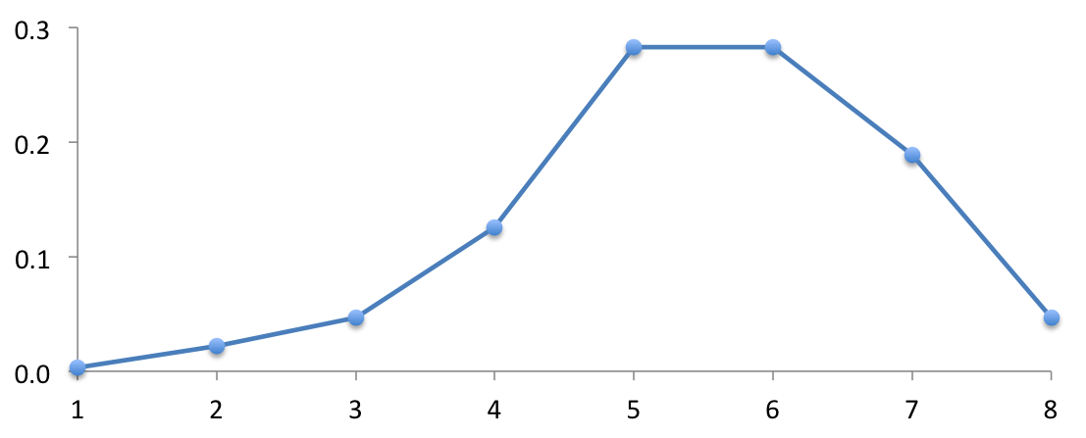
The DREAM model
In the dust emission scheme, aerosol injection into the atmosphere is controlled by type of soil, type of vegetation cover, soil moisture content, and surface atmospheric turbulence.
USGS global 1-km land cover data is used to distinct the dust productive soils from the others.
USDA global 1-km soil texture is used to describe particle size distribution.
For each soil population (clay, silt, and sand) 8 particle size bins are calculated with effective radii of 0.15, 0.25 0.45, 0.78, 1.3, 2.2, 3.8 and 7.1 μm, respectively.
In order to include effects of dust aerosol to weather and climate, online interactive dust – radiation scheme has been developed.
7.1μm
3.8
2.2
0.78
1.3
0.25
0.45
0.15
k=1
k=2
k=3
k=4
k=5
k=6
k=7
k=8

Slide 5
Motivation to study dust
Atmospheric aerosols can be emitted by a great variety of natural and anthropogenic sources resulting in a large variability of their chemical characteristics. With the possible exception of sea-salt aerosol, the dust loading in the atmosphere is the most abundant of all aerosol species (IPCC, 2001).
Dust impacts Human Health (asthma, infections, meningitis in Africa, valley fever in the America’s), Agriculture, Marine productivity, Aviation (air disasters), Ground Transportation, Industry (Semi-conductor, Tourism, etc)
Both the magnitude and the sign of the dust direct and indirect forcing remain unresolved.
Dust models are essential to complement dust-related observations, understand the dust processes and predict the impact of dust on surface level PM concentrations.
Regional-scale models are well suited for simulation of dust storm events or for comparisons with in-situ observations.

Slide 6
DREAM at IPB
Professor Slobodan Ničković and Luka Ilić, from the Environmental Physics Laboratory, Institute of Physics Belgrade (IPB), in collaboration with the Republic Hydrometeorological Service of Serbia under the activities of the South East European Climate Change Center use the DREAM model in research and operational forecasting.
Operational model domain covers wide North Africa, Southern Europe and Middle East regions in 30 km horizontal resolution with 28 vertical levels.
It is used in more than 20 countries.
Operational products (RHMSS) contributing to WMO Sand and Dust Storm Warning Assessment and Advisory System (SDS-WAS) Project.
Recent development in Ice Nucleation due to dust and Dust impacts on health.

Slide 7
Ice Nucleation due to dust
Mineral dust particles act as efficient heterogeneous ice nuclei in the tropospheric mixed-phase clouds; Dust particles lifted to the cold cloud layer effectively glaciate supercooled cloud water.
2/3 of ice clouds formed due to pure dust and dust metallic oxides (observed residues in ice crystals); Relatively small dust concentration needed; Mode of freezing: heterogeneous (freezing in presence of aerosol).
In majority of today’s atmospheric numerical models is predefined value #IN=const=100m⁻³
Dust model calculates the number of ice nuclei n_{IN} originating from mineral dust.
Parameterization schemes:
For the range of temperatures -35°C to -20°C: Immersion nucleation, DeMott et al. (2015)
(number of dust particles with diameter larger than 0.5μm, obtained from prognostic variable dust concentration)
For the range of temperatures -60°C to -35°C: Deposition nucleation, Steinke et al. (2015)
(ice nucleation active surface linked to prognostic dust concentration)

Slide 8
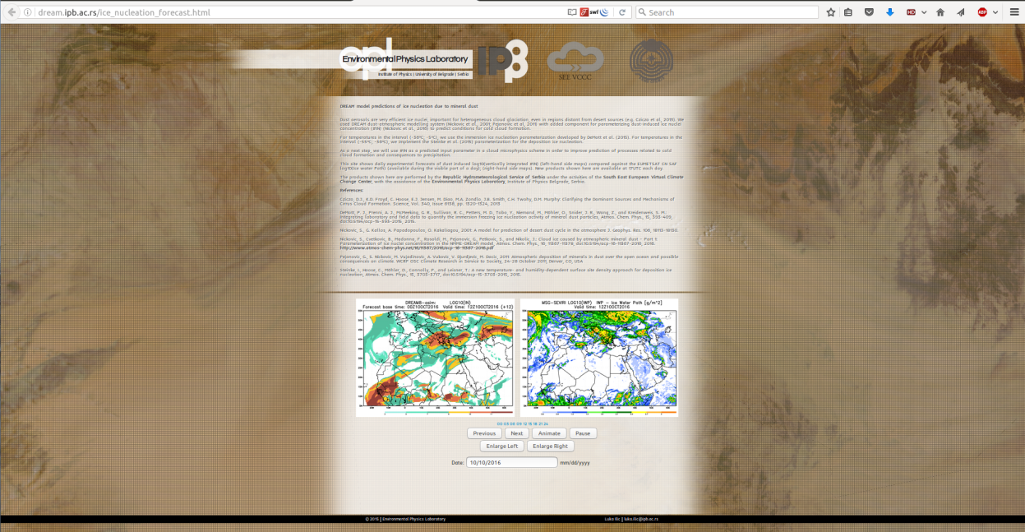
Operational #IN forecasts
Operational capabilities of the methodology
Experimental NMME-DREAM #IN predictions compared against SEVIRI IWP observations
Posted daily at http://dream.ipb.ac.rs/ice_nucleation_forecast.html
Also used in PRE-TECT campaign organized in the frame of GEO-CRADLE Horizon2020 project

Slide 9
DREAMCLIMATE and health
Epidemiological studies have related increased levels of atmospheric particulate matter to premature human mortality caused by cardiopulmonary disease and lung cancer.
Plan is to downscale the atmospheric-dust DREAM model to fine horizontal resolution of 5-10 km, covering wide North Africa, Southern Europe and Middle East regions.
DREAMCLIMATE will provide a 10 year climatology of dust concentration and we will use it to calculate human health impact function to estimate annual premature mortality due to airborne desert dust based on methodology used by Giannadaki et al. 2014.

Slide 10
Preliminary results from dust effects on health study

Slide 11
The DREAM code
DREAM is originally implemented as Fortran code
Due to the implementation language constraints, various configuration parameters and data were hardcoded directly into the application.
Each change in the configuration of the physical system implied recompilation and production of new binaries, which were time and disk-space consuming tasks.
Recompilation also required deep technical knowledge of the implementation itself, which reduced usability and dissemination of the model.

Slide 12
DREAMCLIMATE service
In collaboration with Petar Jovanović and Dušan Vudragović from IPB’s Center for the Study of Complex Systems and its Scientific Computing Laboratory:
the DREAM model was successfully refactored and tuned for usage on high-performance computing infrastructures – the DREAMECLIMATE service was developed and deployed.
Configuration of the physical system of interest is separated from the source code of the application, and grouped into a single configuration file.

Slide 13
DREAMCLIMATE service
New configuration approach enables more user-friendly way to configure various model setups, without diving into the code and technical details of the implementation.
This also enables multiple users to run their model instances independently from each other.
Disk-space consumption of the application is significantly reduced, and its usage standardized using an environment-module approach.

Slide 14
The DREAM model copyright
The DREAM model is a copyright-protected software, but it can be obtained for research purposes with the permission of the principal investigator (professor Slobodan Ničković).
Therefore, the DREAMECLIMATE service source code is only internally available at the VI-SEEM code repository (https://code.vi-seem.eu/petarj/dreamclimate).
Transfer of the software to third parties or its use for commercial purposes is not permitted, unless a written permission from the author is received.

Slide 15
DREAMCLIMATE dataset
Using the DREAMCLIMATE service at PARADOX cluster, IPB team successfully produced a dataset with aerosol optical thickness and surface dust concentration for the period of one year.
The dataset is registered within the VI-SEEM data repository and made publicly available in December 2016 at:
https://repo.vi-seem.eu/handle/21.15102/VISEEM-86

Slide 16
DREAMCLIMATE system structure
Each folder contains the Makefile for its compilation and 2 (or more) subdirectories:
/src/ which contains the corresponded FORTRAN subroutines
/exe/ which contains the executable files produced by the compilation
Pre-Processing System: Its functions include two parts,
The Set-up: Definition of simulation domains and model configuration and the interpolation of terrestrial data (such as terrain, land use, and soil types) to the simulation domain. This part is only executed when the model is installed (compiled) and the model domain configured.
Pre-processing: Interpolation of the meteorological input data from the global meteorological model to this simulation domain, as well as, the initial and boundary conditions for the dust model.
Model Operational System: This is the key component of the modeling system, which is composed of numerical integration program.
Post-Processing & Visualization tools: This includes the GrADS a with the conversion from E-Arakawa grid to georeferenced grid and plots.

Slide 17
Configuration of the model - Configuration file
[DEFAULT]
def_workdir = /home/petarj/workspace/dctest
def_outdir = /home/petarj/workspace/dctest/run/output
def_rundir = /home/petarj/workspace/dctest/run
[DECODING_NL]
fn_grib = ""
fn_ncarsst = %(def_workdir)s/input_data/SSTNH
fn_llspl = %(def_outdir)s/decoding_mf_
fn_llsst = %(def_outdir)s/decoding.llsst
fn_llsurft = %(def_outdir)s/decoding.llsurft
fn_llsurfw = %(def_outdir)s/decoding.llsurfw
fn_lsm = %(def_outdir)s/lsm.eco
fn_lllsm = %(def_outdir)s/decoding.lllsm
[SOIL_NL]
fn_srz = %(def_workdir)s/input_data/srztext.dat
fn_fao = %(def_workdir)s/input_data/faosoil.dat
fn_t4einc = ../src/textparm.inc
fn_smask = %(def_outdir)s/smask.dat
fn_text4eta = %(def_outdir)s/soil.text4eta
fn_texteta = %(def_outdir)s/soil.texteta
fn_soil = %(def_outdir)s/soil.soil
fn_owe = %(def_workdir)s/input_data/owe14.img
fn_veg = %(def_outdir)s/soil.veg
fn_ntext = %(def_workdir)s/input_data
fn_gt30 = %(def_workdir)s/input_data/
fn_mount13 = %(def_outdir)s/mnts.bilin
fn_sourcedat = %(def_outdir)s/source.dat
fn_claysilt = %(def_outdir)s/claysiltnickotex.dat
fn_srcsltcly = %(def_outdir)s/sourcesltcly.dat
fn_a2sltcly = %(def_outdir)s/ALPHA2.sltcly
fn_a2samum = %(def_outdir)s/ALPHA2.SAMUM
input_dir = %(def_workdir)s/input_data
tmp_dir = tmp
[PREPROC_NL]
fn_anec = %(def_outdir)s/preproc.anec.
fn_sst = %(def_outdir)s/sst.16c
fn_surft = %(def_outdir)s/preproc.anec.surft
fn_surfw = %(def_outdir)s/preproc.anec.surfw
fn_nfcste = %(def_outdir)s/preproc.pteta.nfcste
fn_nbce = %(def_outdir)s/preproc.pteta.nbce.
fn_nfcst = %(def_outdir)s/preproc.const.nfcst
fn_nfcst2d = %(def_outdir)s/preproc.const.nfcst2d
fn_nbc = %(def_outdir)s/preproc.boco.nbc.
fn_nhibu = %(def_outdir)s/preproc.const.nhibu
fn_nhibu2d = %(def_outdir)s/preproc.const.nhibu2d
fn_masks = %(def_outdir)s/preproc.const.masks
fn_outdir = %(def_outdir)s
fn_sousam = %(def_outdir)s/sourcesam.dat
fn_mnt13 = %(def_outdir)s/mnts.bilin
fn_s8bin = %(def_outdir)s/s8.bin
fn_albedo = %(def_outdir)s/albedo.16
fn_greenf = %(def_outdir)s/greenf.16
fn_nprep0 = %(def_outdir)s/nprep.000
fn_decoding = %(def_outdir)s/decoding.llsst000
fn_ppsmask = ../../preproc/tmp/smask.dat
fn_tvegeta = ../tmp/vegeta.dat
fn_contam = %(def_outdir)s/contam.dat
fn_soilsand = %(def_outdir)s/soilsand
fn_ppthnfst = %(def_outdir)s/preproc.pteta.nfcsts
fn_deta = %(def_outdir)s/deta
fn_nprep = %(def_outdir)s/nprep.

Slide 18
Configuration of the model - Configuration file
[HLP5_NL]
fcstdata_fn = ../src/fcstdata.parm.as
out_nbc = %(def_outdir)s/nbc
out_nfcst2d = %(def_outdir)s/preproc.const.nfcst2d
out_perf = %(def_outdir)s/PREF.DAT
out_alpha2 = %(def_outdir)s/ALPHA2.sltcly
out_s8bin = %(def_outdir)s/s8.bin
out_co2 = %(def_outdir)s/co2
eta_ulookup = ../src/eta_micro_lookup.dat
etampnewdata = ../src/ETAMPNEW_DATA
out_nhibu2d = %(def_outdir)s/preproc.const.nhibu2d
[MOUNT_NL]
fn_usnavy = ""
fn_e1 = ""
fn_e2 = ""
fn_a1 = ""
fn_a2 = ""
[MODEL2D_NL]
fn_vout = %(def_outdir)s/v_out.
fn_pout = %(def_outdir)s/p_out.
fn_sout = %(def_outdir)s/s_out.
;----------------------------------------------------------------------
[ALLINC]
tlm0d = 18.0
tph0d = 32.0
wbd = 44.0
sbd = -25.0
dlmd = 0.05
dphd = 0.2
dtb = 72.0
lm = 28
[PARMETA]
parmeta_im = 221
parmeta_jm = 251
parmeta_lm = 28
parmeta_lsm = 12
parmeta_kps = 8
parmeta_inpes = 1
parmeta_jnpes = 8
parmeta_igstl = -5
parmeta_igstr = 5
parmeta_jgstl = -5
parmeta_jgstr = 5

Slide 19
The Setup and the static files
The static dataset location is already specified to deafult location
In order to generate and interpolate vegetation and soil texture for the forecast domain, the following steps are performed:
mount/
cd mount/exe
./gt30mounth
soil/
cd soil/exe
./gt30source
./gt30vegetadirect
./text4eta
cd ..
make linux
cd exe
./texteta
The previous programs generate the following 6 files in $DREAMCLIMATE_DIR/output/
mount.13
soil.soil
soil.text4eta
soil.veg
source.dat
smask.dat

Slide 20
Downloading and decoding of meteorological global forecast data
The meteorological fields used as initial and boundary conditions most commonly come from a global model.
ECMWF and GFS have been successfully used.
These are usually provided in GRIB code.
In order to introduce this data in the forecast system a decoding process of these meteorological files is required.
H, U, V and Q meteorological fields from larger area (larger scale) model are extracted.

Slide 21
Pre-processing
Pre-processing is a set of routines whose collective role is to prepare input data to the model Eta grid. Each of the routines performs one stage of the preparation.
climsst.f: horizontal grid (IMT, JMT) Eta Indexing from the climatologically SST as a function of the month.
anecw.f: horizontal grid (IMT, JMT) Eta Indexing from global initial data of H, U, V and Q.
pusiWRF.f: set up of the vertical variables, and vertical interpolation of the pressure to sigma surfaces.
const.f: convert initial fields in Eta coordinate from 2-D horizontal id (IMT, JMT) Eta Indexing into 1-D (IMJM), define dummy initial and boundary soil moisture and temperature values, and calculates constants needed for the 1-D version of the soil model.
dboco.f: create the boundary condition files
gfdlco2.f: interpolate transmission functions grid for which the transmission functions have been pre-calculated, to the grid structure.

Slide 22
Pre-processing binary outputs
The pre-processing produces the binary files interpolated to the model grid (i.e. E-Arakawa grid) in $DREAMCLIMATE_DIR/output/:
decoding.llspl.hhh
preproc.anec.sst
preproc.anec.hhh
preproc.pteta.nfcste
preproc.pteta.nbce.hhh
soilsand
preproc.const.nhibu2d
preproc.const.nfcst2d
preproc.const.masks
preproc.boco.nbc.hhh (hhh indicates the forecast time).

Slide 23
Governing dust equations
All the routines of the model itself describing the atmospheric processes including the dust cycle are in $DREAMCLIMATE_DIR/model/hlp5/.
Executable file nmme12pref
Number of CPU cores used is specified in the configuration file in [PARMETA] section before each compilation
Output variables and output grid currently cannot be modified

Slide 24
Postprocessing and graphical outputs
The main GrADS output DLEV.ctl file needs to be modified according to conversion from E-Arakawa grid to GrADS grid.
xdef (whole distance between western and eastern boundary)=|WBD|*1/DLDM*2
ydef (whole distance between southern and northern boundary=|SBD|*1/DPHD*2
linear (xdef) 1st part (new western boundary of the domain)=WBD+TLMOD
linear (ydef) 1st part (new southern boundary of the domain)=SBD+TPHOD
linear (xdef) 2nd part (vertical model grid resolution)=DLDM
linear (ydef) 2nd part (horizontal model grid resolution)=DPHD
The grid conversion is now almost completed and the whole E-grid should fit the GrADS domain interesting when creating all visual output files.

Slide 25
Using GrADS Data Files
GrADS supports two basic data types:
gridded data data on a grid
station data station or point observations.
The data and meta data (or information about the data) are kept in separate files. the data file is purely data with no space or time identifiers. The file which you open in GrADS is the data descriptor file (the meta data) or *.ctl file.
The *.ctl is constructed to describe various data types and structures (e.g., binary and GRIB).

Slide 26
DLEV.ctl
dset DLEV.gdat
*indset /home/luka/luka/nmme5K/grads/input_g
undef 9.999e+20
title avn model
xdef 401 linear -20.0 0.2
ydef 201 linear 10.0 0.2
tdef 9 linear 06Z31jan2005 03hr
zdef 28 levels 1 2 3 4 5 6 7 8 9 10 11 12 13 14 15 16 17 18 19 20
21 22 23 24 25 26 27 28
vars 58
dmsk 0 200,1,0 ! dust mask
hgt 0 7,1,0 ! hgt orography
psl 0 2,102,0 !pres.sea levels
sst 0 11, 1,0 ! sea/skinctemp
acp 0 61, 1,0 ! precipitation
t2m 0 11,105,2 ! 2m temerature
rh2m 0 52,105,2 ! 2m rel.humidity
u10 0 33,105,10 ! 10m u-wind
v10 0 34,105,10 ! 10m v-wind
sc1 0 211,1,0 ! sfc.conc ! particle No 1
sc2 0 212,1,0 ! sfc.conc
sc3 0 213,1,0 ! sfc.conc
sc4 0 214,1,0 ! sfc.conc
sc5 0 215,1,0 ! sfc.conc
sc6 0 216,1,0 ! sfc.conc
sc7 0 217,1,0 ! sfc.conc
sc8 0 218,1,0 ! sfc.conc
dl1 0 221,1,0 ! dust.loading ! particle No 1
dl2 0 222,1,0 ! dust.loading sflx
dl3 0 223,1,0 ! dust.loading
dl4 0 224,1,0 ! dust.loading
dl5 0 225,1,0 ! dust.loading
dl6 0 226,1,0 ! dust.loading
dl7 0 227,1,0 ! dust.loading
dl8 0 228,1,0 ! dust.loading
dd1 0 231,1,0 ! dry.dust.deposition particle No 1
dd2 0 232,1,0 ! dry.dust.deposition
dd3 0 233,1,0 ! dry.dust.deposition
dd4 0 234,1,0 ! dry.dust.deposition
dd5 0 235,1,0 ! dry.dust.deposition
dd6 0 236,1,0 ! dry.dust.deposition
dd7 0 237,1,0 ! dry.dust.deposition
dd8 0 238,1,0 ! dry.dust.deposition
dw1 0 241,1,0 ! wet.dust.deposition particle No 1
dw2 0 242,1,0 ! wet.dust.deposition
dw3 0 243,1,0 ! wet.dust.deposition
dw4 0 244,1,0 ! wet.dust.deposition
dw5 0 245,1,0 ! wet.dust.deposition
dw6 0 246,1,0 ! wet.dust.deposition
dw7 0 247,1,0 ! wet.dust.deposition
dw8 0 248,1,0 ! wet.dust.deposition
z5 0 07,100,500 ! wet.dust.deposition
z7 0 07,100,700 ! wet.dust.deposition
ice 28 58,109,500 ! model ice
zz 28 07,109,500 ! zetzet
u 28 33,109,500 x u-wind
v 28 34,109,500 x w-wind
t 28 11,109,500 x w-wind
q 28 51,109,500 x w-wind
pin 28 1,109,500 x w-wind
s1 28 201,109,500 x dust.concentration No1
s2 28 202,109,500 x dust.concentration
s3 28 203,109,500 x dust.concentration
s4 28 204,109,500 x dust.concentration
s5 28 205,109,500 x dust.concentration
s6 28 206,109,500 x dust.concentration
s7 28 207,109,500 x dust.concentration
s8 28 208,109,500 x dust.concentration No8
endvars

Slide 27
Configuration of the model – [ALLINC]
The domain parameters:
TLM0D: Longitude of the center point of the domain
TPH0D: Latitude of the center point of the domain
WBD: Western boundary of the domain with respect to the center point (always <0)
SBD: Southern boundary of the domain with respect to the center point (always <0)
DLMD: longitudinal model grid resolution
DPHD: latitudinal model grid resolution
DTB: time step of the model, this variable depends on DLMD and DPHD values by means of the Courant-Friedrichs-Lewy (CFL) criteria.
LM: number of vertical levels

Slide 28
Configuration of the model – [PARMETA]
IM: Number of mass grid points along the first row, essentially half the total number of grid points in the west-east direction due to the horizontal staggering of mass and wind points
JM: Number of rows in the north-south direction

Slide 29
Thank you ☺

