Slide 1

Efficient exact computations of anharmonic X-Y stretching frequencies for molecular species relevant to atmospheric chemistry, climate science and drug delivery
Ljupčo Pejov ljupcop@pmf.ukim.mk
Institute of Chemistry, Faculty of Natural Sciences and Mathematics, Skopje, Macedonia

Slide 2


Slide 3
CLIMATE SCIENCE AND ATMOSPHERIC CHEMISTRY – FROM FRUSTRATION TO SCIENCE
BACK IN 1996
MAKE A STATE-OF-THE-ART (NONSTANDARD) QUANTUM MECHANICAL COMPUTATION ON A FUNDAMENTAL CHEMICAL SYSTEM
WRITE A SCIENTIFIC PAPER
RELEVANCE?
MAKE THE SAME TYPE OF CALCULATION ON A SIMPLE RADICAL, RELEVANT TO ATMOSPHERIC CHEMISTRY
PUBLISHED IN NO TIME

Slide 4

Chemistry-Climate Model Initiative (CCMI)
An evident trend in climate science and meteorology in the last few years is the development of global models in which the chemistry and dynamics of the stratosphere and troposphere are being studied and modelled as a single entity.
Such approach seems unavoidable if one wants to model the phenomena relevant to climate science at the molecular level, and therefore its development has been expected.

Slide 5
Any serious attempt to understand the fundamental physical basis of processes responsible for climate changes must rely on an in-depth understanding of the physics and chemistry of molecular species which constitute Earth’s atmosphere.
New milestones in climate science should aim at the molecular-level understanding of the aforementioned phenomena.
Climate science has to undergo a substantial paradigmatic shift, from mesoscale-level models to molecular models.

Slide 6
Atmospheric chemistry and climate science at molecular level;
Biomedical sciences (PAC in nanocarriers, enzyme-substrate interactions, even olfactory mechanisms???);
Fundamental issues (understanding the very mechanism of formation of larger aggregates of the building blocks of matter at the heart of formation of condensed phases).
Materials science (understanding the “molecular probe experiments”);
Nanoscience and nanotechnology (e.g. understanding the behavior and reactivity of system in confining media);

Slide 7
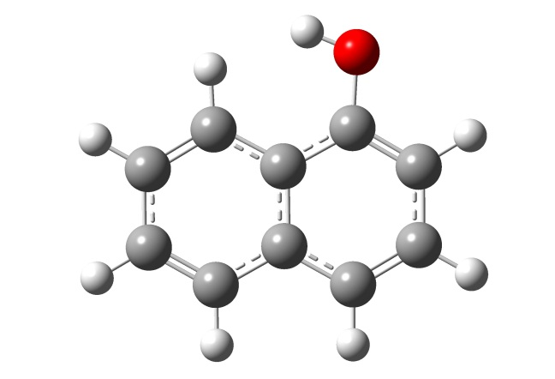
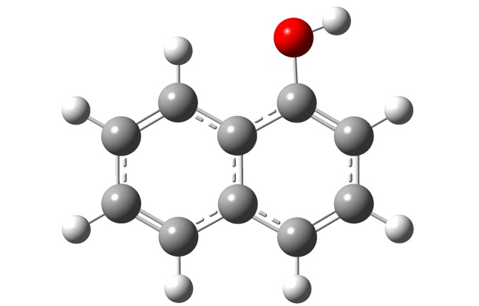
Vibrational chromophore sensitive to the environment: easy to follow with vibrational spectroscopic methods.
The O-H and N-H vibrational chromophores are of particular significance.
Can we thoroughly understand what we observe in the IR experiments by the theory?

Slide 8
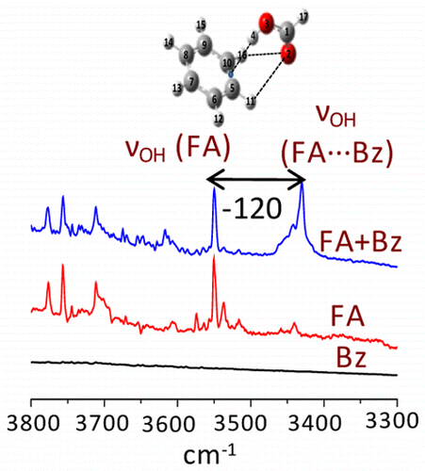
But still…
Very good experiment
Routine computations: PES-based, DFT level with widely used combination of functionals, harmonic approximation → excellent agreement with the experiment

Slide 9
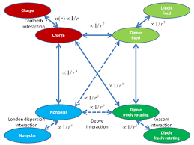
INTERACTIONS!!!
Understand what do the experimentalists observe!
Provide certain new physical insights into the problem/phenomenon;
Make certain predictions of the system’s behavior;
(Attempt to) understand certain complexity issues;

Slide 10
Need for HPC?
THE UNDERLYING PHYSICAL LAWS NECESSARY FOR THE
MATHEMATICAL THEORY OF A LARGE PART OF PHYSICS AND THE
WHOLE OF CHEMISTRY ARE THUS COMPLETELY KNOWN, AND THE
DIFFICULTY IS ONLY THAT THE EXACT APPLICATION OF THESE
LAWS LEADS TO EQUATIONS MUCH TOO COMPLICATED
TO BE SOLUBLE.
THE METHODS OF THEORETICAL PHYSICS SHOULD BE APPLICABLE TO ALL THOSE BRANCHES OF THOUGHT IN WHICH THE ESSENTIAL FEATURES ARE EXPRESSIBLE WITH NUMBERS.
AS LONG AS QUANTUM MECHANICS IS CORRECT, ALL ISSUES IN PHYSICS AND CHEMISTRY ARE ACTUALLY PROBLEMS IN APPLIED MATHEMATICS.
THE LEVEL OF EXACTNESS OF A GIVEN SCIENCE IS DIRECTLY PROPORTIONAL TO THE LEVEL AT WHICH THE PROBLEMS IN THAT SCIENCE CAN BE SUBJECTED TO COMPUTATION.
GOD USED BEAUTIFUL MATHEMATICS IN CREATING THE WORLD.
-- P. A. M. DIRAC

Slide 11
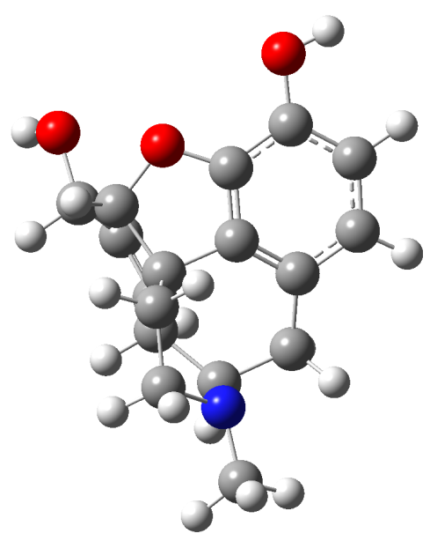
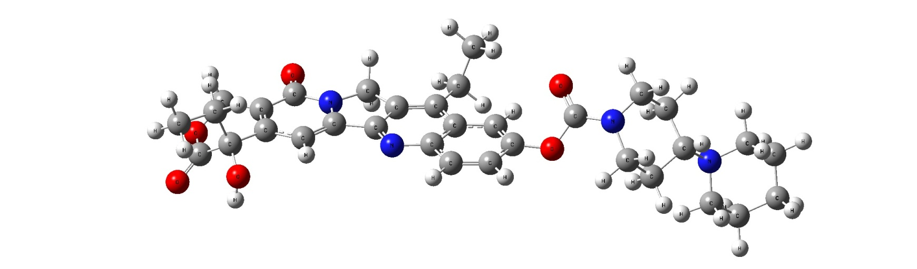
Analytic derivatives techniques (implemented in numerous QC codes);
VSCF and its variants;
Perturbative techniques (as e.g. implemented by Barone in Gaussian series of codes);
But…

Slide 12
m₂
m₁
x₁
x₂
x

Slide 16
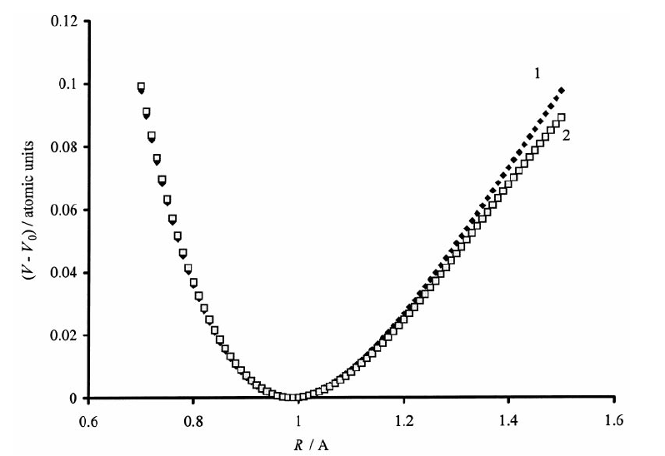
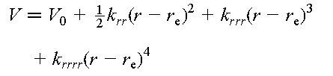

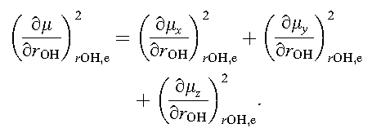

Slide 17
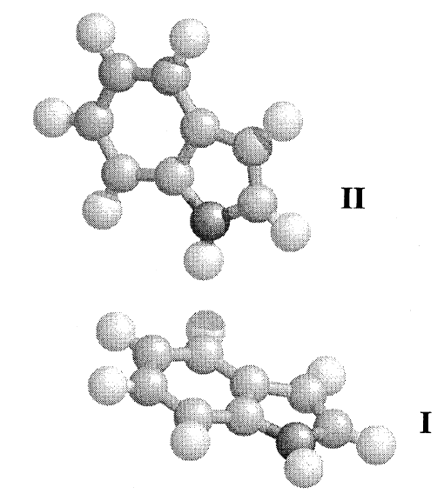
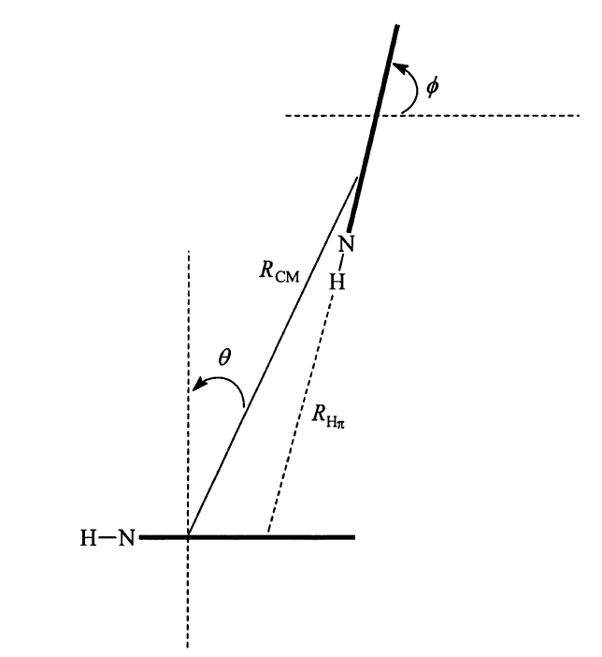
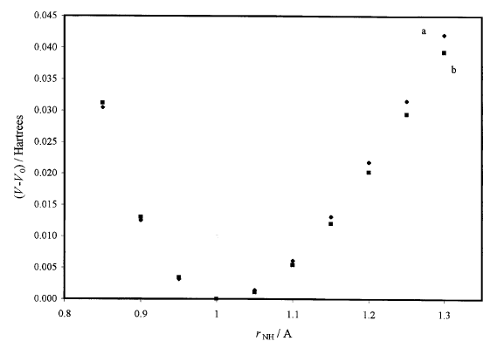

Slide 18







Slide 19


IR Intensities

Slide 20
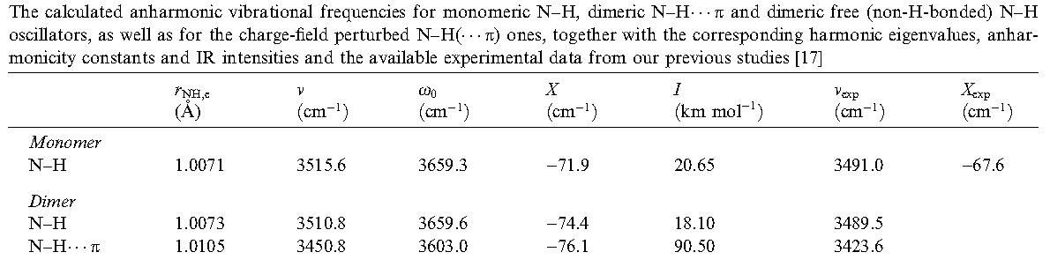
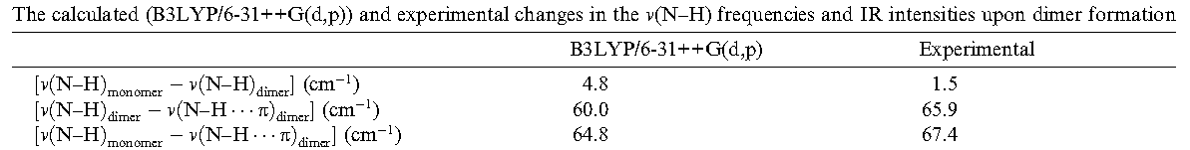

Slide 21
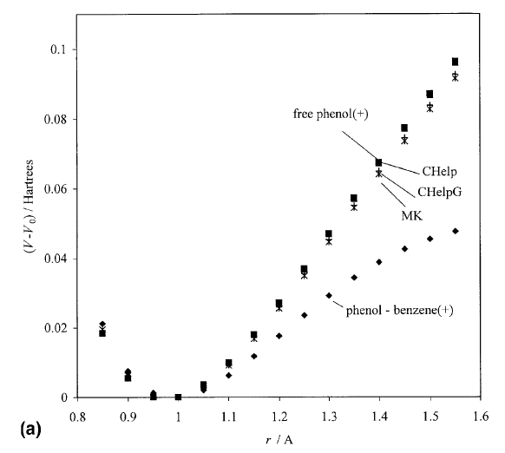
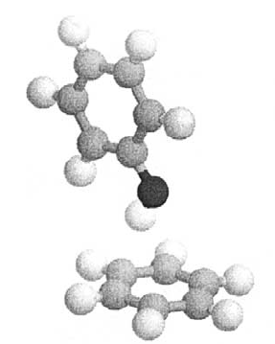

Slide 22
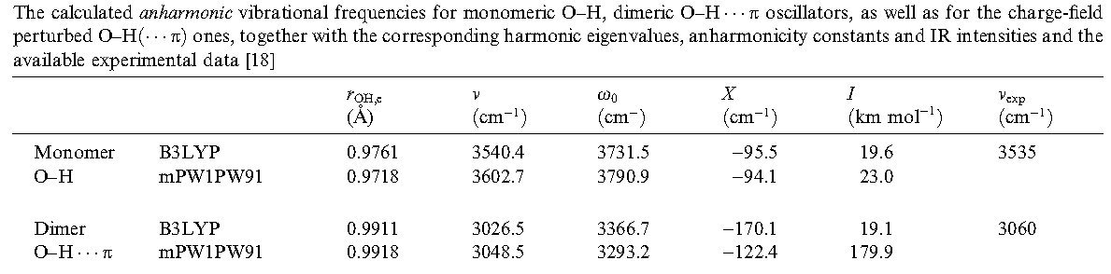
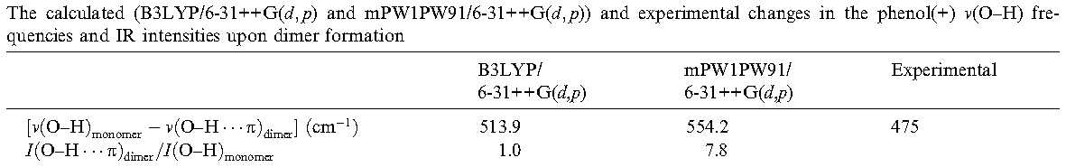

Slide 23
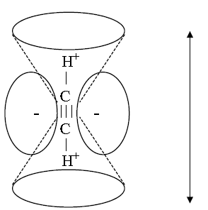
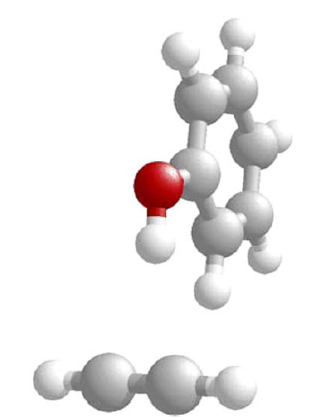
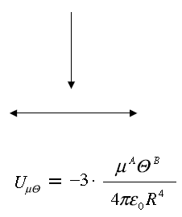
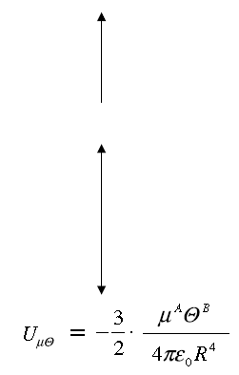
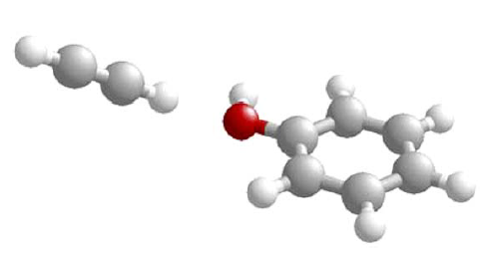

Slide 24
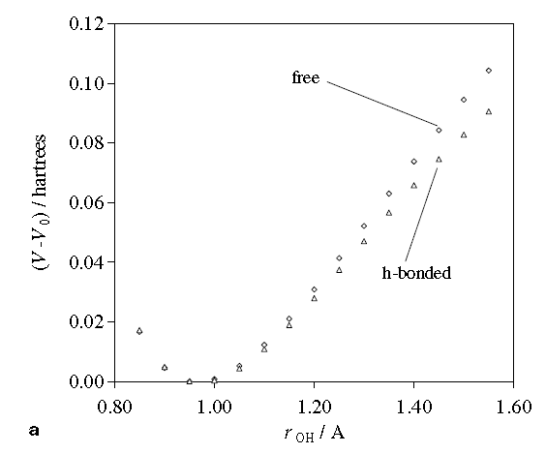

Slide 25
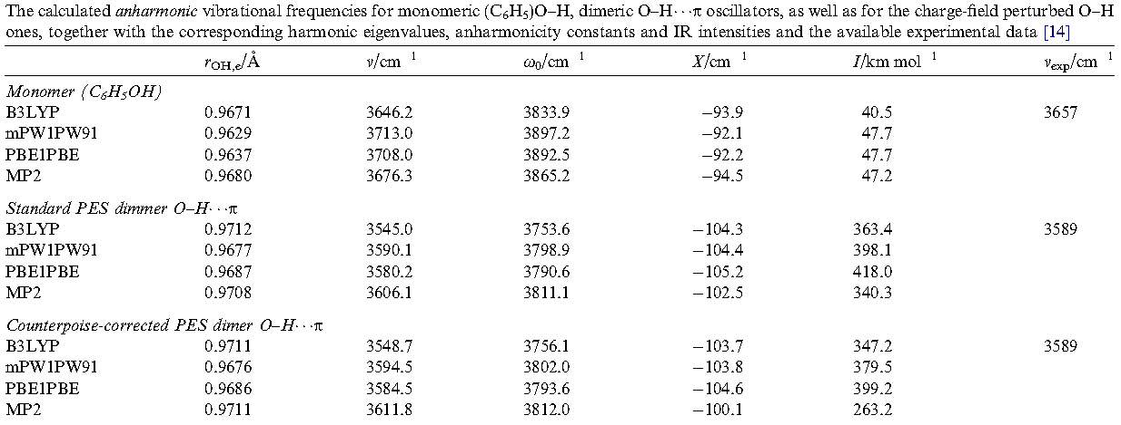
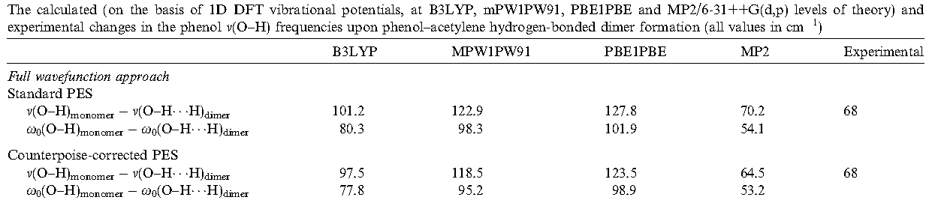

Slide 26
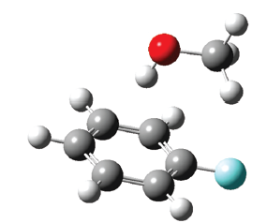
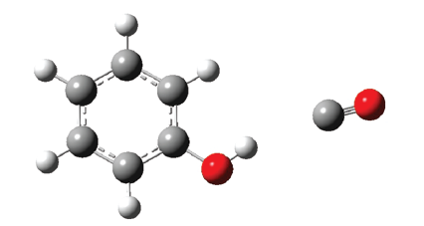
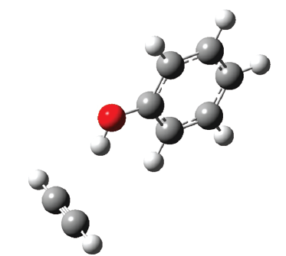
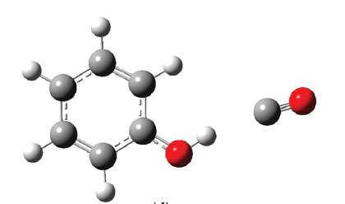
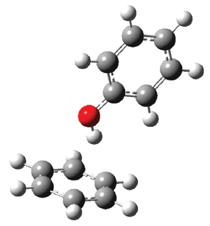

Slide 27
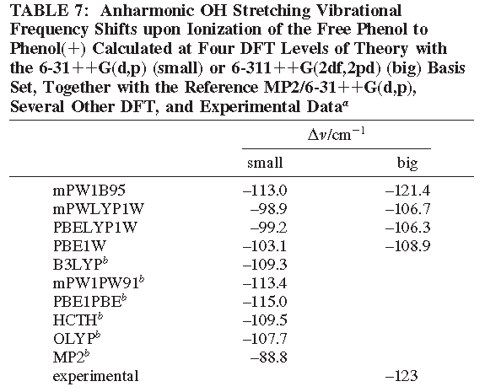

Slide 28
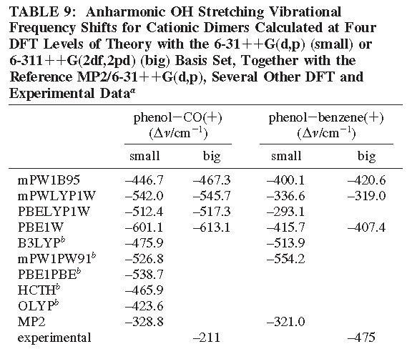

Slide 29
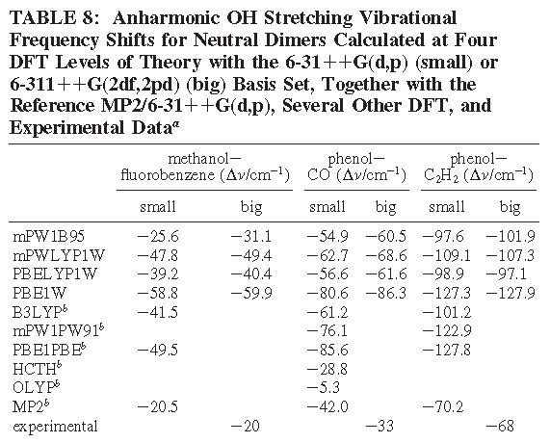

Slide 30
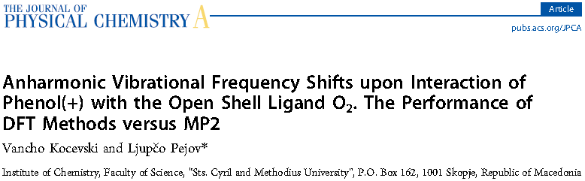
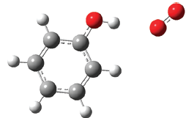

Slide 31
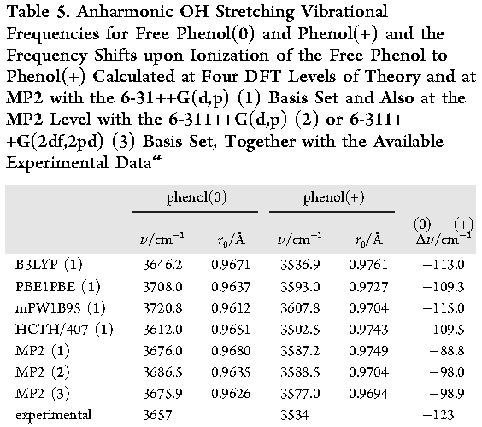

Slide 32
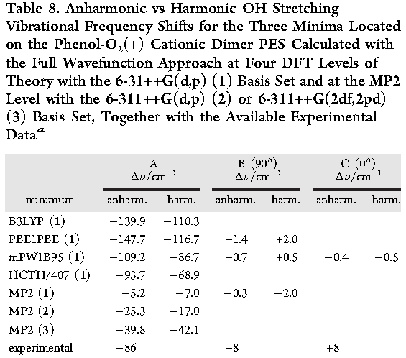

Slide 33
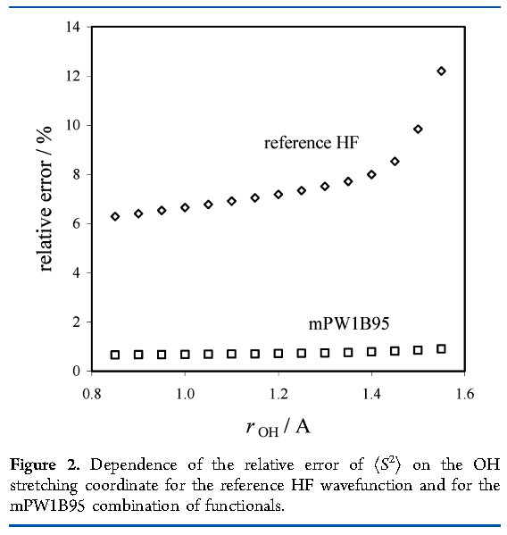

Slide 34
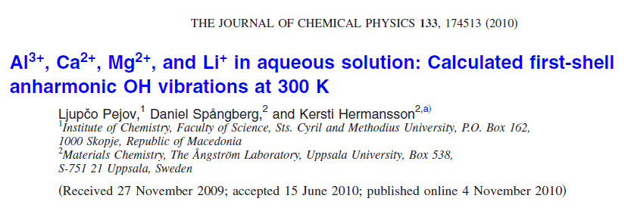

Slide 35
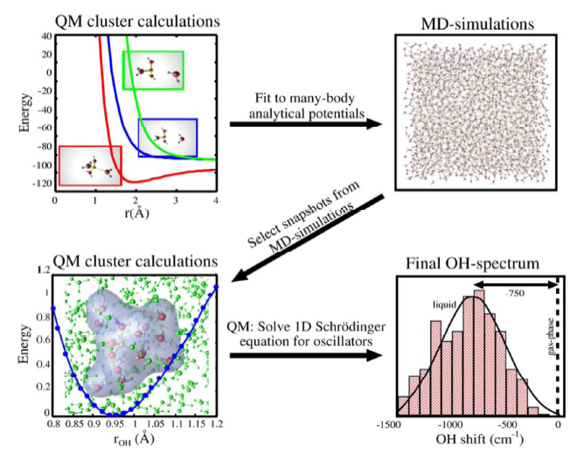


Slide 36
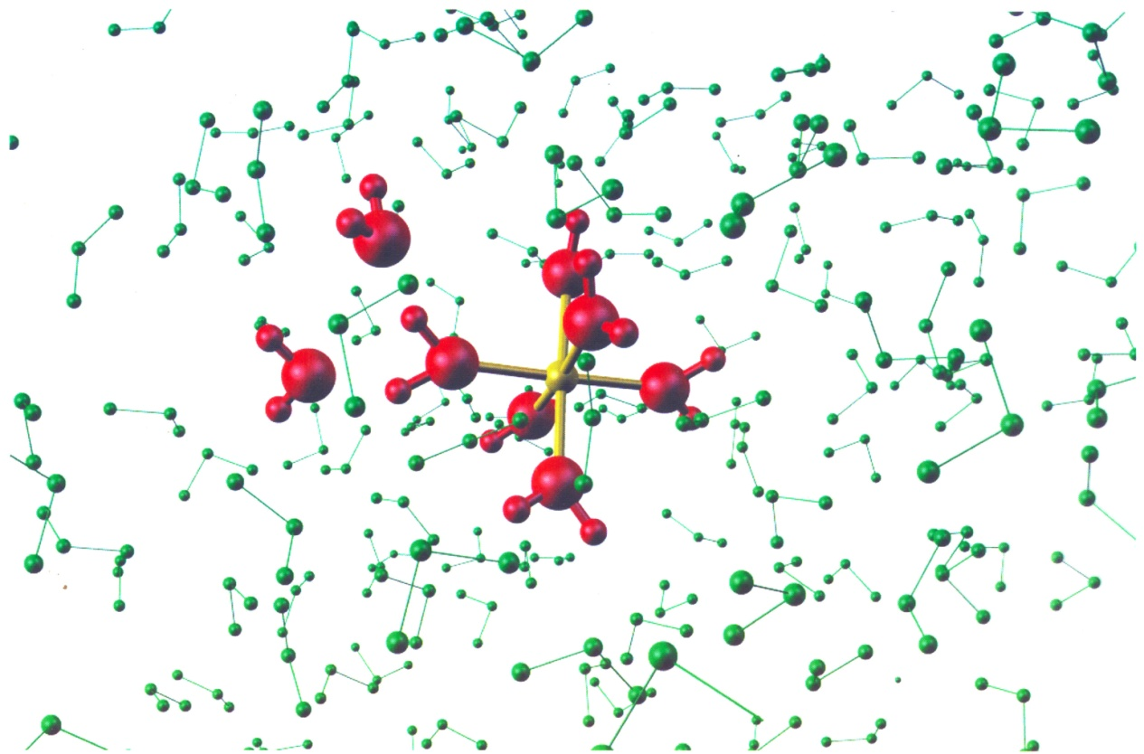
This is repeated for all 1st shell OH bonds and many MD-configurations!

Slide 37
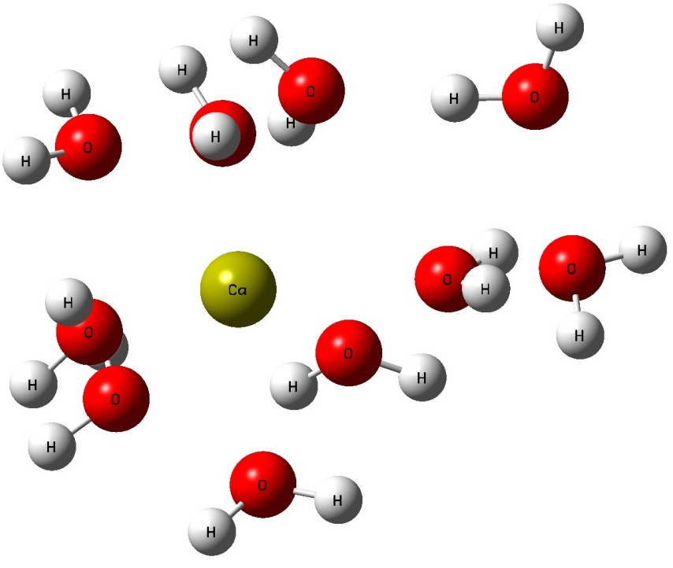
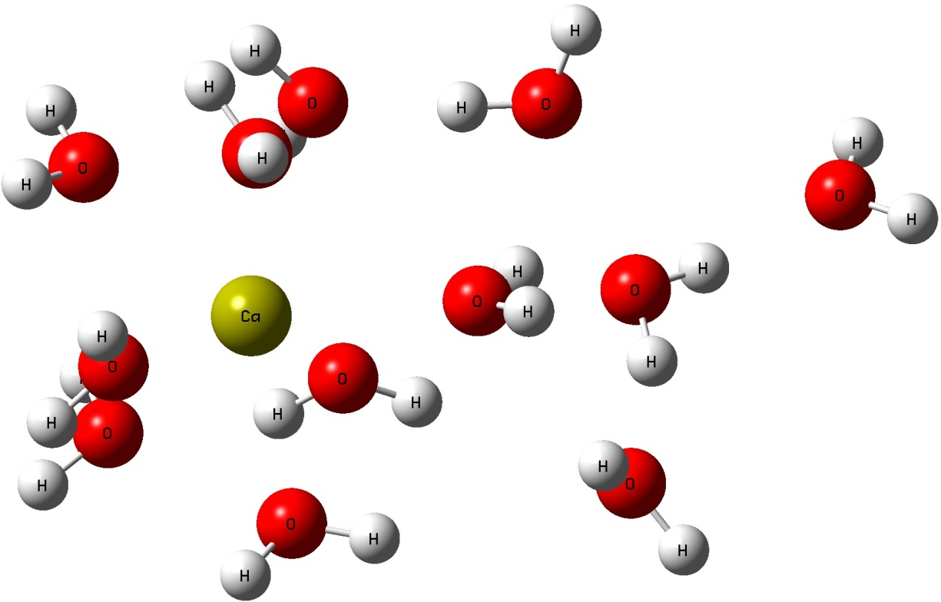

Slide 38
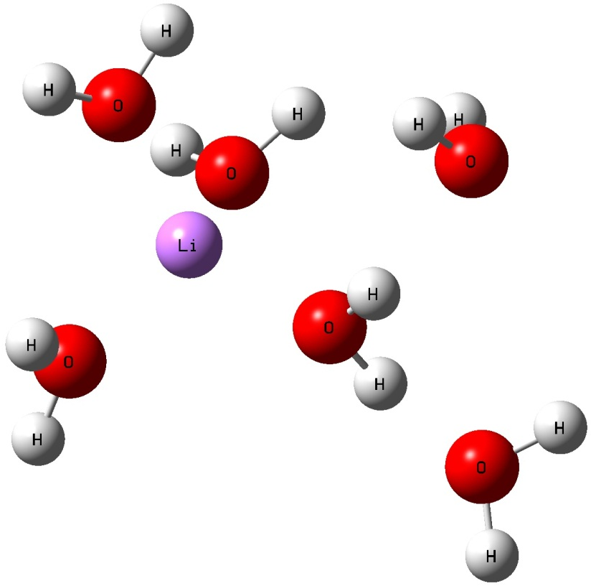
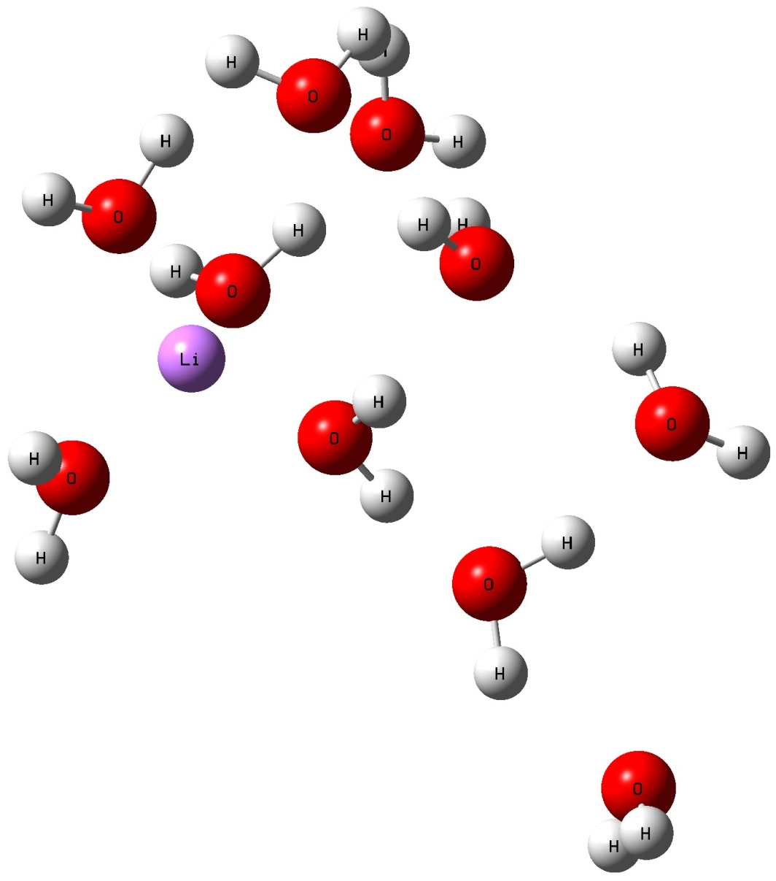

Slide 39
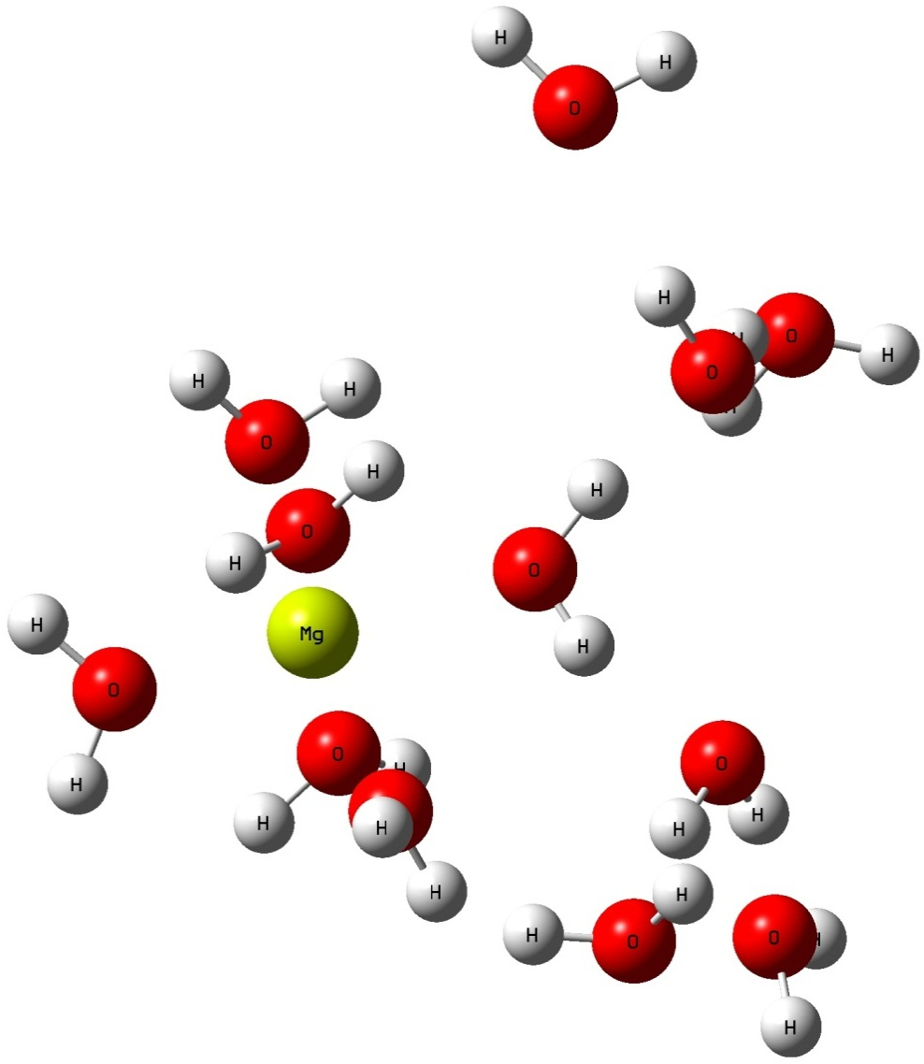

Slide 40
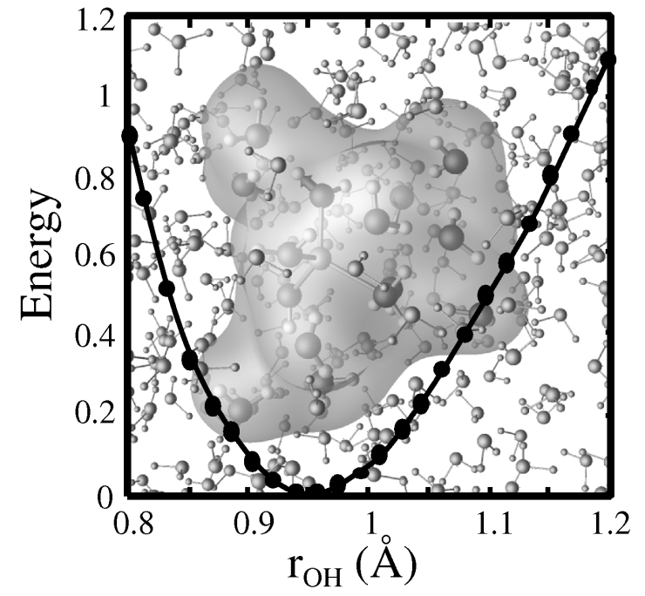



Slide 41


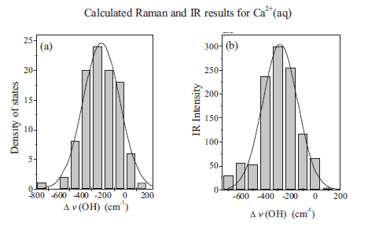

Slide 42
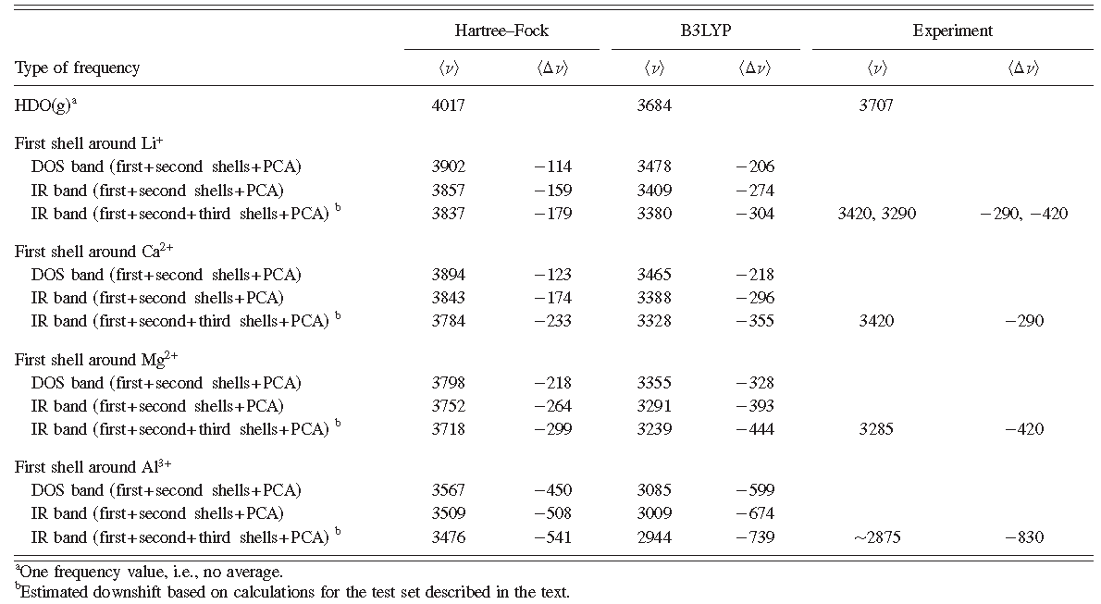

Slide 43


Slide 44



Slide 45


Slide 46



Slide 47


Slide 48



Slide 49


Slide 50



Slide 51


Slide 52



Slide 53


Slide 54
All parts of this application require vast computational efforts, in particular the ab initio molecular dynamics simulations. Though computations required for certain sequences of the complex hybrid algorithms can be carried out on standard PC clusters, the more complex and demanding ones require low-latency parallel environment.

Slide 55
Application of sequential MD-QM_{el}-QM_{nuc} methodology to compute the vibrational spectra of the first-shell water molecules in ionic water solutions.
- Lj. Pejov, D. Spångberg, Kersti Hermansson, Al³⁺, Ca²⁺, Mg²⁺, AND Li⁺ IN AQUEOUS SOLUTION: CALCULATED FIRST-SHELL ANHARMONIC OH VIBRATIONS AT 300K, J. Chem. Phys. 133, 174513 (2010).
- Lj. Pejov, D. Spångberg, K. Hermansson, USING MD SNAPSHOTS IN AB INITIO AND DFT CALCULATIONS: OH VIBRATIONS IN THE FIRST HYDRATION SHELL AROUND Li⁺(aq), J. Phys. Chem. A 109, 5144-5152 (2005).
- Ljupco Pejov, Kersti Hermansson, MD+QM CALCULATIONS OF THE OH VIBRATIONAL STRETCHING BAND IN AN AQUEOUS ALUMINIUM(III) CHLORIDE SOLUTION, J. Mol. Liq. 98-99,369-382 (2002).

Slide 56

Implementation of a hybrid CPMD-QM_{el}-QM_{nuc} methodology to compute the vibrational spectrum of aqueous hydroxide anion.
- K. Hermansson, P. A. Bopp, D. Spångberg, Lj. Pejov, I. Bakó, P. D. Mitev, THE VIBRATING HYDROXIDE ION IN WATER, Chem. Phys. Lett. (FRONTIER ARTICLE), 514, 1-15 (2011), included on the top cover of the Journal.
Application of molecular dynamics simulations to confirm the experimental evidence for the existence of dangling OH bonds in hydrophobic hydration shells.
- J. Tomlinson-Phillips, J. Davis, D. Ben-Amotz, D. Spångberg, Lj. Pejov, K. Hermansson, STRUCTURE AND DYNAMICS OF WATER DANGLING OH BONDS IN HYDROPHOBIC HYDRATION SHELLS. COMPARISON OF SIMULATION AND EXPERIMENT, J. Phys. Chem. A, 115, 6177-6183 (2011).

Slide 57
FORMIC ACID
The simplest representative of the class of organic acids.
The most abundant and ubiquitous organic acid in the atmosphere.
Besides in aerosols and in gas phase, formic acid has also been identified in atmospheric precipitates (acid rain).
In a much wider context, formic acid is also important in the human metabolitic processes.
Formic acid is the simplest organic acid that has been first identified in the interstellar medium

Slide 58


THE SYSTEM – FORMIC ACID

Slide 59

General Theoretical Methodology:
Möller-Plesset perturbation theory (second order) – MP2/6-311++G(3df,3pd).
Density functional tight binding approach – DFTB, analytic computation of matrix elements (instead of using tabulated ones) – DFTB(A).
Exploration of the corresponding PESs with Schlegel’s gradient optimization algorithm.
Subsequent harmonic vibrational analyses for the located stationary points on the PESs.

Slide 60
Calculation of Anharmonic O-H Stretching Vibrational Frequencies
V(Δr) = V₀ + k₂Δr² + k₃Δr³ + k₄Δr⁴ + k₅Δr⁵
Δr = Δr_{OH} = r_{OH} – r_{OH,e}
ρ = (r_{OH} – r_{OH,e}) / r_{OH}
fundamental |0> → |1> vibrational transitions
1D vibrational Schrödinger equation solved with the variational method, using harmonic oscillator eigenfunctions as a basis set.
Second-order perturbative approach developed by Barone.

Slide 61
Diagonalization of the Torsional Hamiltonian
m_{l} = 0, ±1, ±2, …
flexible basis set with m_{l} raging up to ±100 (i.e. using 201 basis functions).

Slide 62
Structural Parameters of Trans-Formic Acid Conformer Computed at the Employed Theoretical Levels Together With the Experimental Data
Parameter | Exp. | MP2 | DFTB
R_{C-H} / Å | 1.097 | 1.093 | 1.135
R_{C-O} / Å | 1.342 | 1.343 | 1.377
R_{O-H} / Å | 0.972 | 0.968 | 0.982
R_{C=O} / Å | 1.203 | 1.202 | 1.211
θ_{HCO(-H)} / º | 112.0 | 109.7 | 112.6
θ_{COH} / º | 106.3 | 106.5 | 107.9
θ_{HCO} / º | 123.2 | 125.2 | 125.8
θ_{OCO} / º | 124.8 | 125.1 | 121.6

Slide 63
Structural Parameters of Cis-Formic Acid Conformer Computed at the Employed Theoretical Levels Together With the Experimental Data
Parameter | Exp. | MP2 | DFTB
R_{C-H} / Å | 1.105 | 1.099 | 1.153
R_{C-O} / Å | 1.352 | 1.350 | 1.379
R_{O-H} / Å | 0.956 | 0.963 | 0.978
R_{C=O} / Å | 1.195 | 1.195 | 1.202
θ_{HCO(-H)} / º | 114.6 | 113.5 | 112.9
θ_{COH} / º | 109.7 | 108.9 | 110.4
θ_{HCO} / º | 123.2 | 124.1 | 124.6
θ_{OCO} / º | 122.1 | 122.4 | 122.5

Slide 64
Changes of Structural Parameters Upon Trans-Cis Interconversion of Formic Acid Computed at the Employed Theoretical Levels Together With the Experimental Data
Parameter | Exp. | MP2 | DFTB
ΔR_{C-H} / Å | 0.008 | 0.006 | 0.018
ΔR_{C-O} / Å | 0.010 | 0.007 | 0.002
ΔR_{O-H} / Å | -0.016 | -0.005 | -0.004
ΔR_{C=O} / Å | -0.008 | -0.007 | -0.009
Δθ_{HCO(-H)} / º | 2.6 | 3.8 | 0.3
Δθ_{COH} / º | 3.4 | 2.4 | 2.5
Δθ_{HCO} / º | 0.0 | -1.1 | -1.2
Δθ_{OCO} / º | -2.7 | -2.7 | 0.9

Slide 65
O-H Stretching Vibrational Frequencies

Slide 66
O-H Stretching Vibrational Frequencies
Experimentally Measured O-H and O-D Stretching Frequencies in Trans- and Cis-Formic Acid and their Changes Upon Trans-Cis Interconversion Together With the Theoretical Anharmonic Values Computed on the Basis of 1D Anharmonic Vibrational Potentials
Parameter | Exp. | MP2 | DFTB
Cis
v_{O-H} / cm⁻¹ | - (3618.0)^{ftn} | 3712.6 | 3568.0
v_{O-D} / cm⁻¹ | 2685.0 | 2906.4 | 2794.7
trans
v_{O-H} / cm⁻¹ | 3568.0 (3570, 3570.5, 3569.0) (3550.5)^{ftn} | 3642.8 | 3524.4
v_{O-D} / cm⁻¹ | 2632.0 (2631.0) | 2852.6 | 2761.1
Δv_{O-H} / cm⁻¹ | 67.5 | 69.8 | 43.6
Δv_{O-D} / cm⁻¹ | 53.0 | 53.7 | 33.6

Slide 67
Torsional Barrier and Intrawell Torsional Transitions

Slide 68
Torsional Barrier and Intrawell Torsional Transitions
Experimentally Measured Frequencies of The O-H Torsional Modes in Trans- and Cis-Formic Acid and their Changes Upon Trans-Cis Interconversion Together With the Theoretical Anharmonic Values Computed From the Variational Solution of the Torsional Schrödinger equation
Parameter | Exp.ª | MP2 | DFTB
cis
τ_{O-H} / cm⁻¹ | 503.0 | 435.5 | 365.9
trans
τ_{O-H} / cm⁻¹ | 642.0 | 566.0 | 484.1
Δτ_{O-H} / cm⁻¹ | -139.0 | -130.5 | -118.2

Slide 69
The local mode approach based on computation of the 1D O-H stretching vibrational potential at MP2/6-311++G(3df,3pd) level of theory followed by solution of the vibrational Schrödinger equation leads to excellent agreement with the experimental data for the frequency shifts of this mode upon trans → cis interconversion.
Computation of the fully relaxed HCOH torsional potential and solution of the torsional Schrödinger equation leads to HCOH torsional frequencies and frequency shifts which are in excellent agreement with the experimental data.

Slide 70
O-H Stretching Vibrational Frequencies By the Dynamical Approach
Born-Oppenheimer molecular dynamics (BOMD) simulations of both cis- and trans- conformers of formic acid have been performed in gas phase, at temperature of 10 K at MP2/6-311++G(3df,3pd) level of theory.
Dynamical simulations were started from the minima located at MP2/6-311++G(3df,3pd) PES.
Subsequently to the BOMD simulations, the contribution of the O-H stretching local mode to the overall IR spectrum of each of the formic acid conformers was computed, utilizing the method of partial autocorrelation functions (pACF)

Slide 72
a) b)
a) The pACF for the O-H stretching coordinate time derivative computed from BOMD/MP2/6-311++G(3df,3pd) trajectory for cis- conformer of formic acid and b) the corresponding pVDOS computed by sequential Fourier transformation of C(t).

Slide 73
a) b)
a) The pACF for the O-H stretching coordinate time derivative computed from BOMD/MP2/6-311++G(3df,3pd) trajectory for trans- conformer of formic acid and b) the corresponding pVDOS computed by sequential Fourier transformation of C(t).

Slide 74
The theoretically computed values of the O-H stretching frequencies in the case of cis- and trans- conformers of free (gas-phase) formic acid by the “dynamic” approach, together with the corresponding experimental data
 | Exp. | BOMD-MP2
cis
v(O-H) / cm⁻¹ | 3618.0 | 3732
trans
v(O-H) / cm⁻¹ | 3550.5 | 3644
Δv(O-H)_{cis-trans} / cm⁻¹ | 67.5 | 88

Slide 75



THANK YOU FOR YOUR ATTENTION

