Slide 1

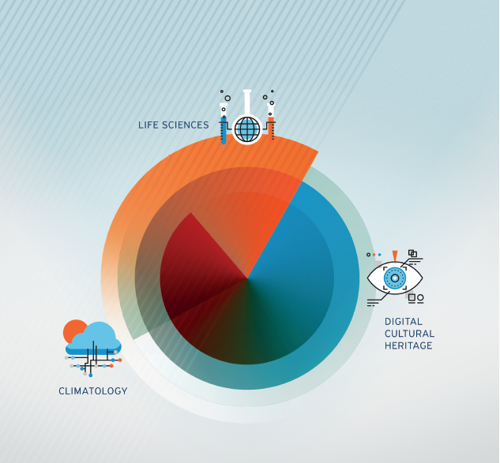
VI-SEE project overview Regional Climate Training, Belgrade, October 2017
Dr. Ognjen Prnjat

Slide 2

Administrative details
VI-SEEM: Virtual Research Environment for regional interdisciplinary communities in Southeast Europe and the Eastern Mediterranean
Start date 01/10/2015
Duration 36 months
Total funded effort: 715 PMs
EC contribution: 3.3m euro
H2020-EINFRA-2015-1: e-Infrastructures for virtual research environments (VRE): EINFRA-9-2015, RIA, contract No 675121
Participant no. | Participant organisation name | Part. short name | Country
1 (Coord) | GREEK RESEARCH AND TECHNOLOGY NETWORK S.A. | GRNET | Greece
2 | THE CYPRUS INSTITUTE | CyI | Cyprus
3 | INSTITUTE OF INFORMATION AND COMMUNICATION TECHNOLOGIES – BULGARIAN ACADEMY OF SCIENCES | IICT-BAS | Bulgaria
4 | INSTITUTE OF PHYSICS BELGRADE | IPB | Serbia
5 | NATIONAL INFORMATION INFRASTRUCTURE DEVELOPMENT INSTITUTE | NIIF | Hungary
6 | WEST UNIVERSITY OF TIMISOARA | UVT | Romania
7 | POLYTECHNIC UNIVERSITY OF TIRANA | UPT | Albania
8 | UNIVERSITY OF BANJA LUKA | UNI BL | Bosnia and Herzegovina
9 | SS CYRIL AND METHODIUS UNIVERSITY OF SKOPJE | UKIM | FYR of Macedonia
10 | UNIVERSITY OF MONTENEGRO | UOM | Montenegro
11 | RESEARCH AND EDUCATIONAL NETWORKING ASSOCIATION OF MOLDOVA | RENAM | Moldova
12 | INSTITUTE FOR INFORMATICS AND AUTOMATION PROBLEMS OF THE NATIONAL ACADEMY OF SCIENCES OF THE REPUBLIC OF ARMENIA | IIAP-NAS-RA | Armenia
13 | GEORGIAN RESEARCH AND EDUCATIONAL NETWORKING ASSOCIATION | GRENA | Georgia
14 | BIBLIOTHECA ALEXANDRINA | BA | Egypt
15 | INTER UNIVERSITY COMPUTATION CENTER | IUCC | Israel
16 | SYNCHROTRON-LIGHT FOR EXPERIMENTAL SCIENCE AND APPLICATIONS IN THE MIDDLE EAST | SESAME | Jordan

Slide 3
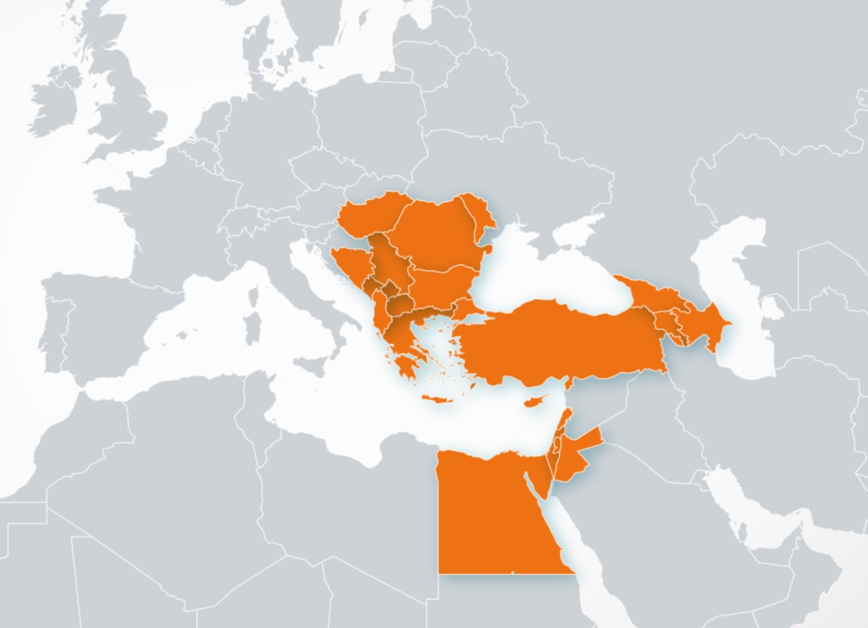
A continuing, integrative effort
e-Infrastructure built over the last decade
Targeting less developed EU countries, countries on path to accession and ENP
Merging of SEE and EM regions
SEE: network SEEREN1-2, Grid SEE-GRID-1/2/SCI, HPC HP-SEE
EM: HPC LinkSCEEM1-2

Slide 4
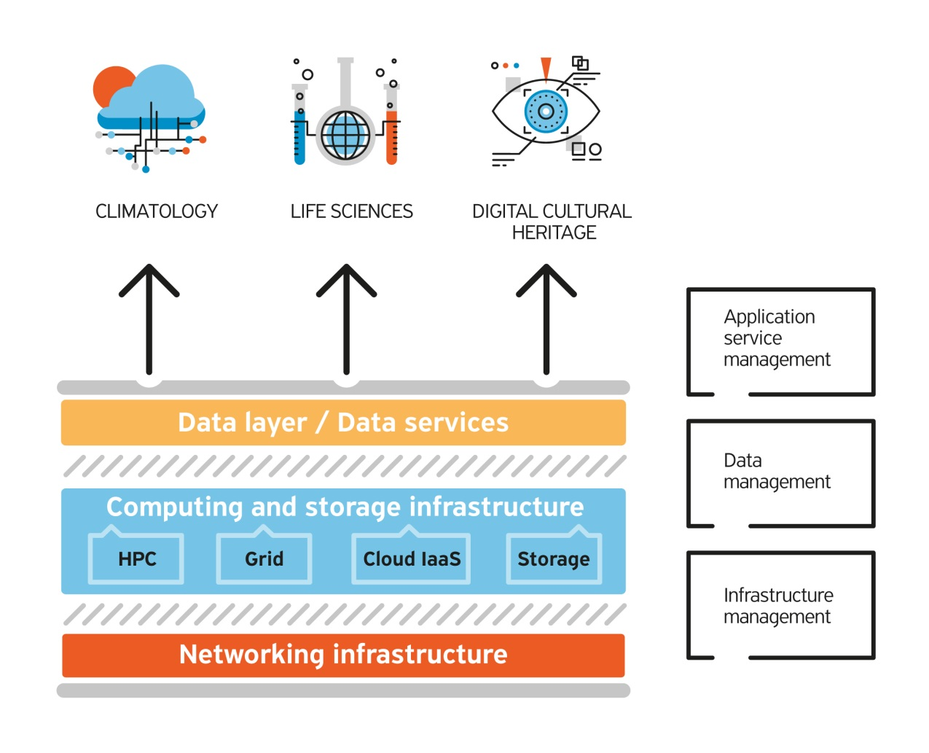
Overall objective
Provide user-friendly integrated e-Infrastructure platform for Scientific Communities in Climatology, Life Sciences, and Digital Cultural Heritage for the SEEM region; by linking compute, data, and visualization resources, as well as services, software and tools.
Diverse computing technologies
Advent of big data / data services
Service orientation

Slide 5
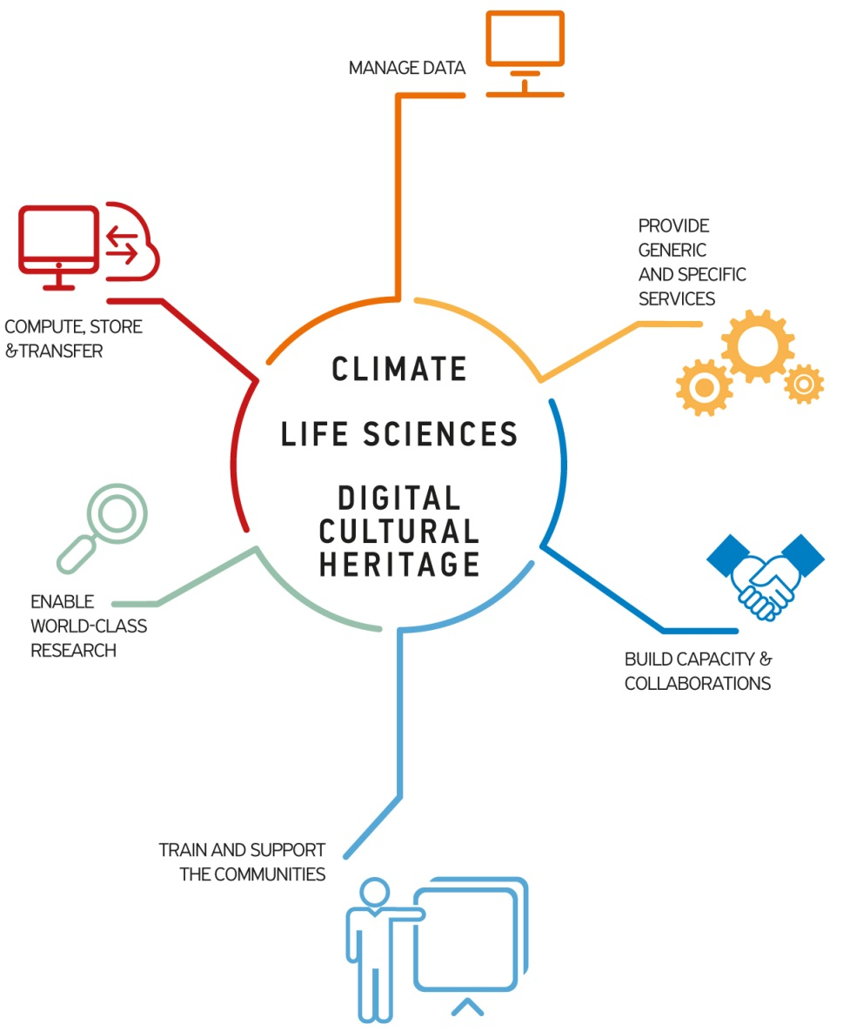
Specific objectives

Slide 6
Work organization – PERT chart

Slide 7
Access to services - the service catalogue (WP3)
Service catalogue provides service discovery and contains all project services
Common services and resources operated by WP3
Storage/data services operated by WP4
Application-level services provided by WP5
Designed to be compatible with the FitSM standards
https://services.vi-seem.eu/
19 services grouped in 5 categories

Slide 8
e-Infrastructure services (WP3)
Project e-Infrastructure
HPC sites – clusters and supercomputers (different hardware architectures)
Grid sites – interconnected via Grid middleware
Cloud sites – virtual machines (VMs) for services and distributed computing
Storage sites – short and long term storage
Modern, state-of-the-art technologies for computing, virtualization and storage are made available to the scientific communities
Overall infrastructure capacity
23,744 CPU-cores, 1,012,736 GPU-cores, 20,496 Xeon Phi-cores
3,112 Grid CPU-cores
14,152 Cloud VM-cores
18 PB of storage space

Slide 9
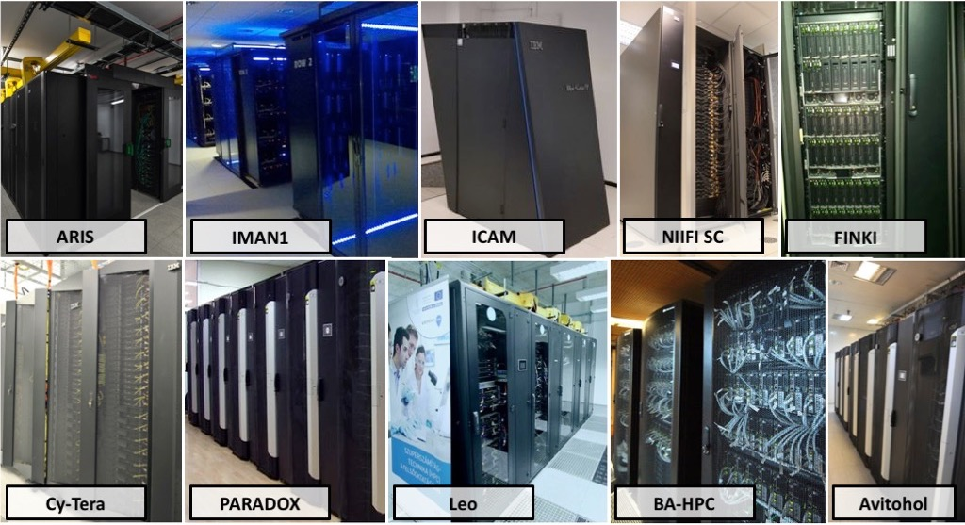
e-Infrastructure example - HPC sites (WP3)

Slide 10
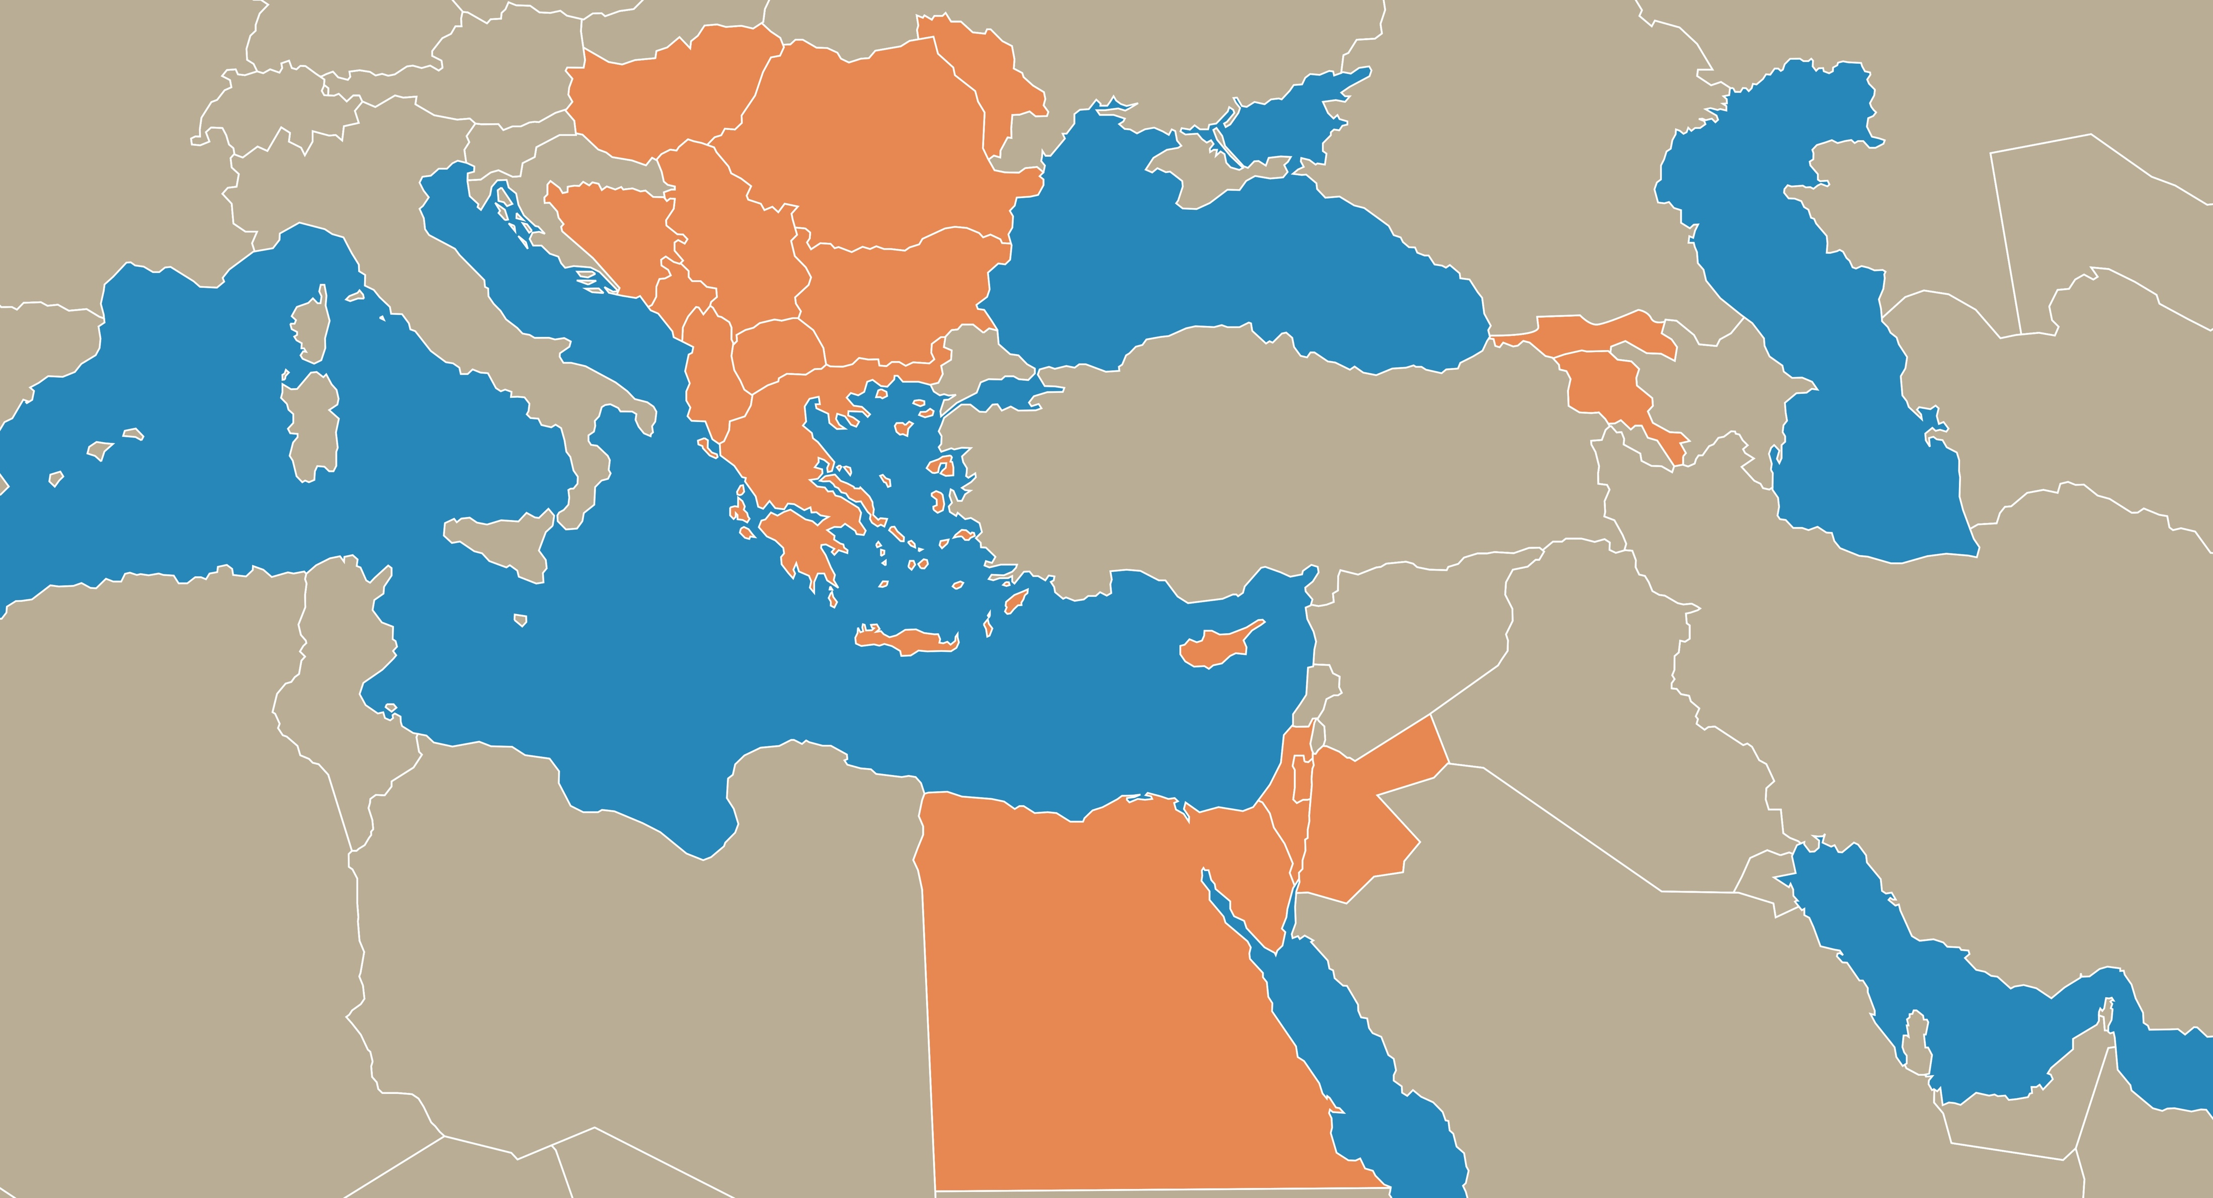
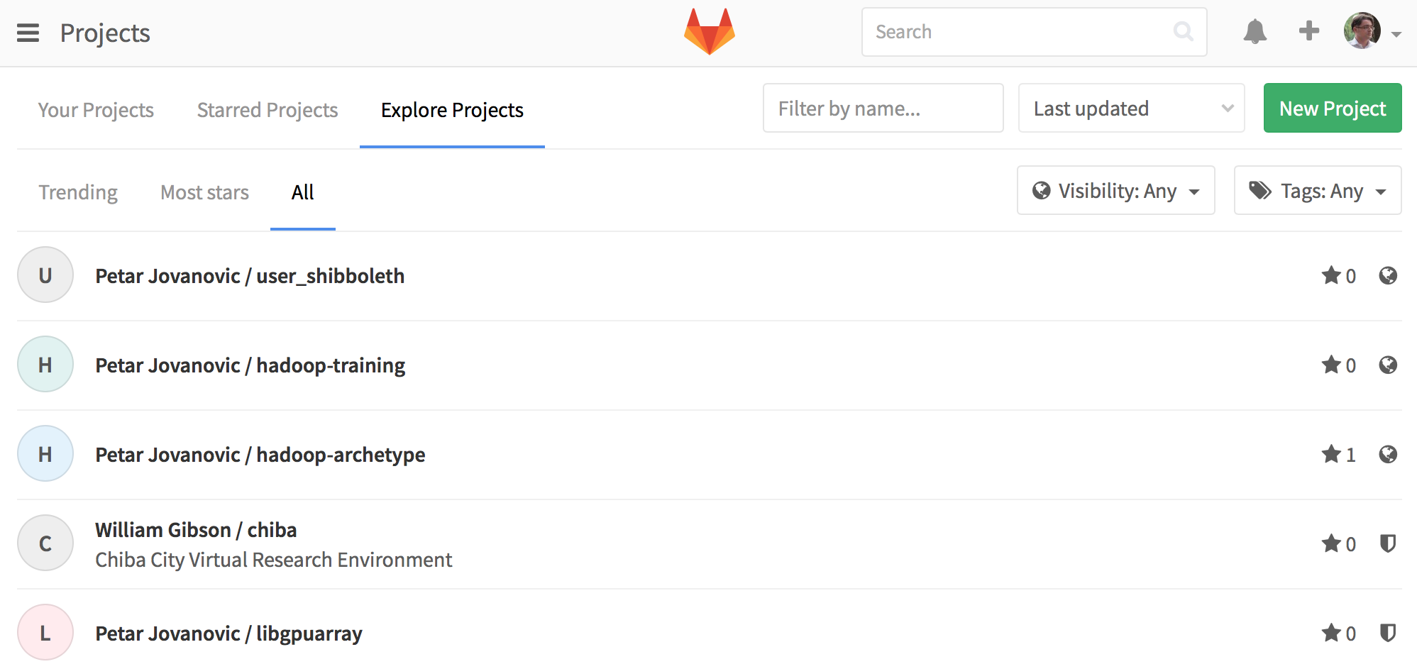
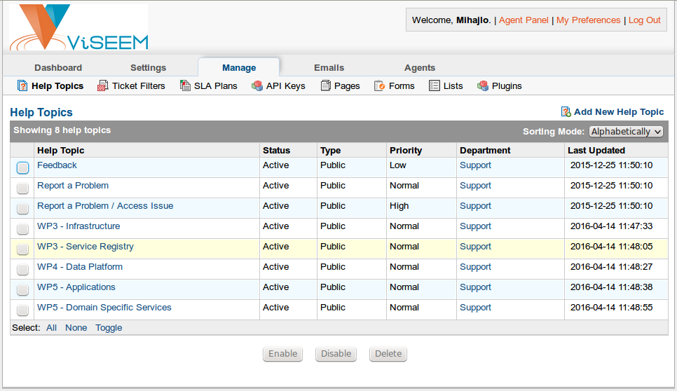
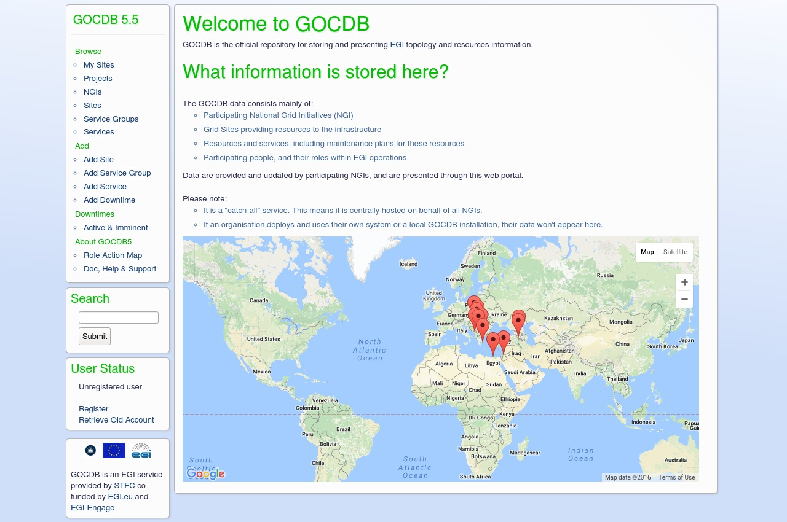
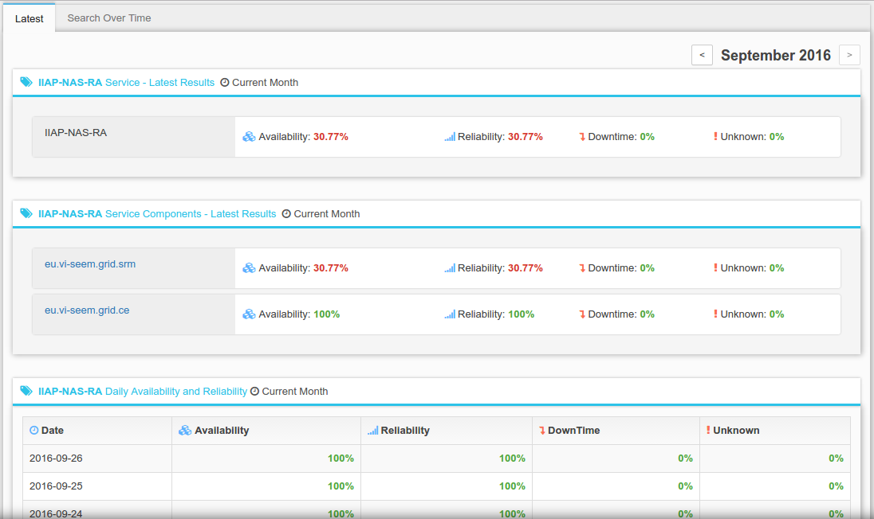
e-Infrastructure operations and resource management (WP3)
Code Repository, UoBL https://code.viseem.eu/
Helpdesk, UoBL https://support.vi-seem.eu/
Accounting, IICT-BAS https://accounting.vi-seem.eu/
GOCDB, UKIM https://gocdb.vi-seem.eu/
Technical Wiki, CYI https://wiki.vi-seem.eu/
Monitoring, GRNET/UoBL https://mon.vi-seem.eu/

Slide 11
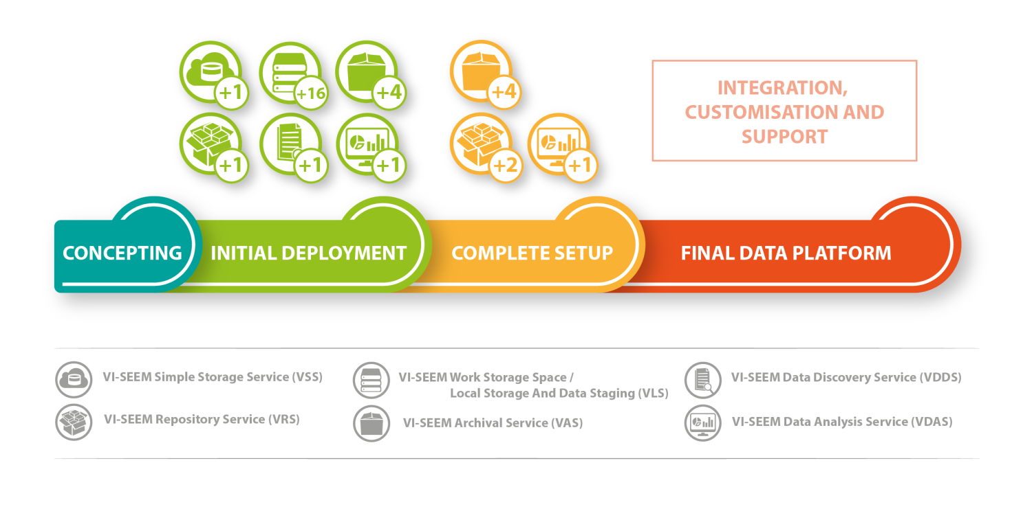
Data management services (WP4)
Functions allowing for data management for selected Scientific Communities, engage the full data management lifecycle
VSS – Simple Storage Service (simplestorage.vi-seem.eu)
VRS – Repository Service (repo.vi-seem.eu); integrated with PID service
VAS – Archival Service (deployed at 6 sites – GRNET, IPB, IICT-BAS, NIIF, IUCC, BA)
VLS – work storage space / local storage and data staging (at 12 sites)
VDDS – Data Discovery Service (search.vi-seem.eu)
VDAS – Data Analysis Service (hadoop.ipb.ac.rs)
PIDs (handle.grnet.gr)

Slide 12
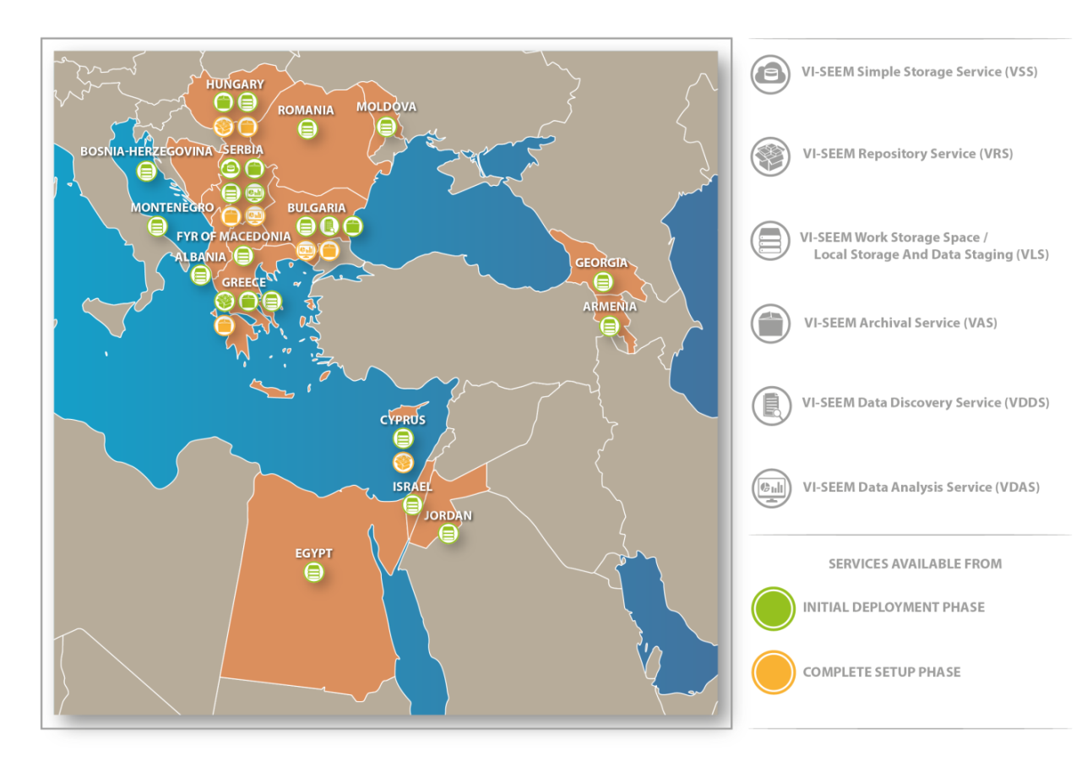
Data management services – spread (WP4)

Slide 13
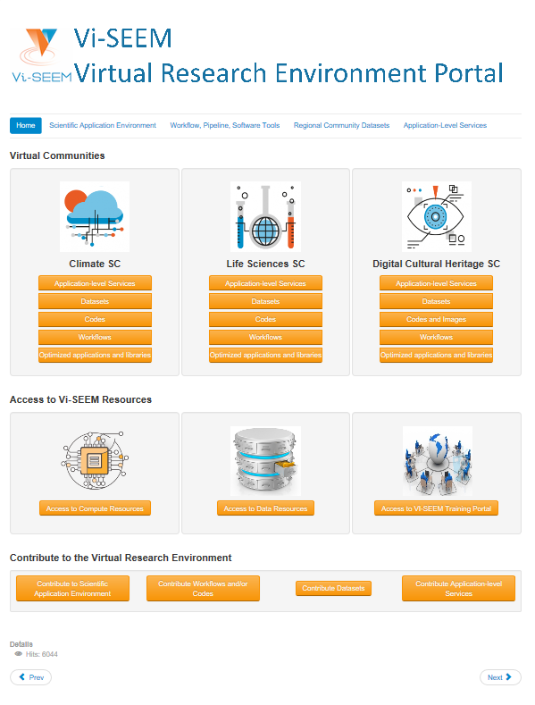



VRE portal (WP5)
All services integrated through the user-facing VRE portal
https://vre.vi-seem.eu/
Organized per Scientific Community
Climate SC
Life Sciences SC
Digital Cultural Heritage SC
Access to VI-SEEM services and resources: Compute, Data, Domain-specific, Training
Guidelines on how to contribute to
Applications
Workflows/codes
Datasets
Domain-specific services
Domain-specific services integrated in the portal in a series of phases carried out by services enablers and user communities

Slide 14
Domain-specific services (WP5)
VRE Scientific Application Environment
Optimized applications and libraries
Virtual Machine (VM) images
Codes from the three scientific communities
Workflow, software tools repository
Regional community datasets
Application level services
Climate
Live Access Server
Digital Cultural Heritage
VI-SEEM Clowder
3DINV
AUTOGR
Life Sciences
ChemBioServer
AFMM
NANO-Crystal
Subtract

Slide 15
Application-level service flagships (WP5)
Climate
Live Access Server
Digital Cultural Heritage
VI-SEEM Clowder
Life Sciences
ChemBioServer

Slide 16
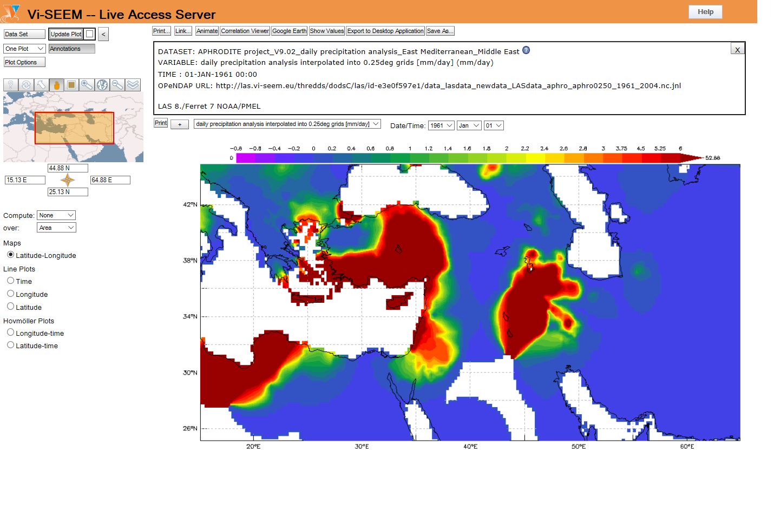
Live Access Server (WP5)
Live Access Server
http://las.vi-seem.eu/las
A web server providing flexible access to geo-referenced scientific data, offering visualization & post-processing capabilities for climate data

Slide 17
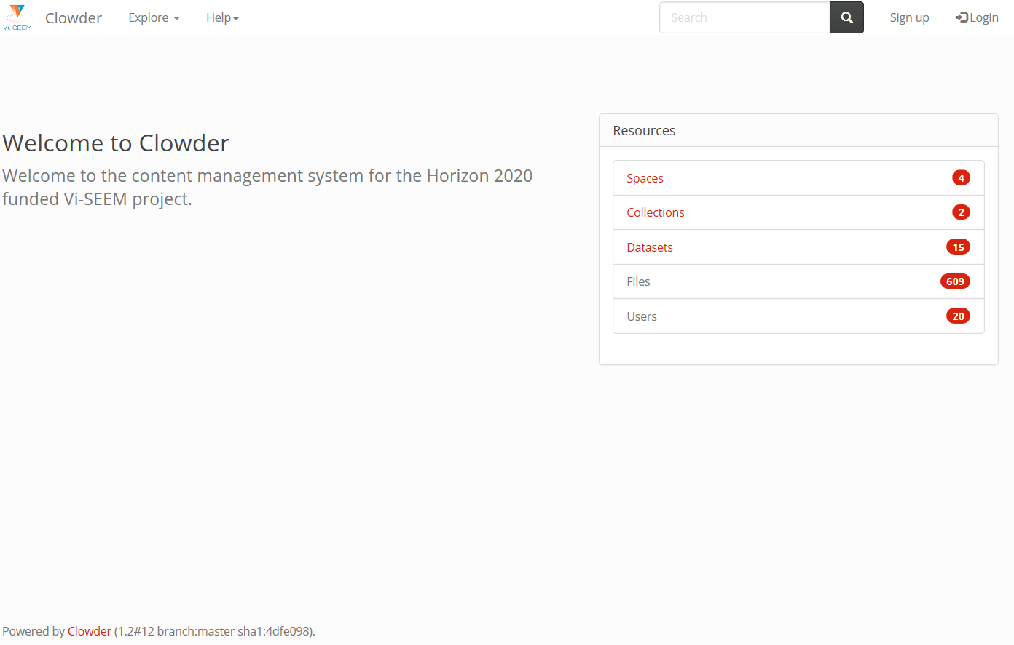
Clowder (WP5)
VI-SEEM Clowder
http://dchrepo.vi-seem.eu/
A Digital Culture Heritage repository which also offers integrated interactive visualization tools

Slide 18
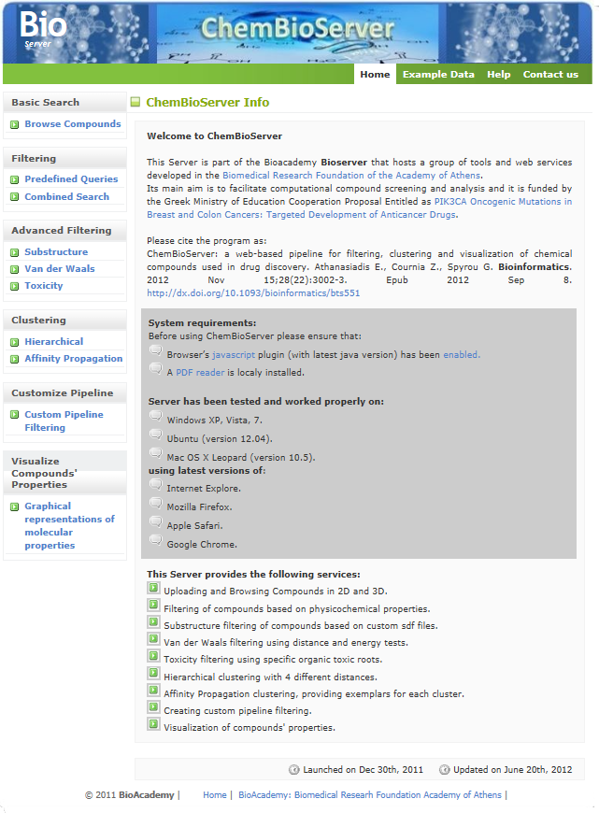
ChemBioServer (WP5)
ChemBioServer
http://bioserver-3.bioacademy.gr
/Bioserver/ChemBioServer/
A web-based pipeline for filtering, clustering and visualization of chemical compounds used in drug discovery

Slide 19
Access to the VRE (WP6)
Defined the framework for accessing VI-SEEM services and resources
Opened up the VRE to the widest possible regional communities
Uses a fair, transparent and trusted mechanism for allocation of VRE resources
Facilitates access and deployment of new applications in the VRE
3 calls envisaged
40+ applications have been allocated resources
Scientific support also via WP5

Slide 20
Access to the VRE - application areas (WP6)
Modeling and Molecular Dynamics (MD) study of important drug targets
Computer-aided drug design
Analysis of Next Generation DNA sequencing data
Synchrotron data analysis
Image processing for biological applications
Regional climate modelling to better understand and predict climate change and impacts, and phenomena such as dust storms.
Air quality modelling, including atmospheric chemistry and air pollution transport.
Weather forecast and extreme weather prediction, model development, application.
Online services and access to repositories in order to enable studies of the immense cultural heritage assets in the region (e.g., searchable digital libraries; with support of meta-data and OCR for Latin characters).
Online visualization tools and data management systems to drive breakthrough contributions to art historical problems (e.g., interactive visualization viewer of RTi files and 3D models with digital libraries integration).
Unsupervised feature learning in photogrammetric techniques, data processing for image classification; semantic referencing; and geo-referencing.

Slide 21
1st Open call (WP6)
23 project applications, 21 accepted
11 in Climatology
5 in Digital Cultural Heritage
5 in Life Sciences
10 different countries of the region
14 of the applications required HPC services
6 required Grid and Cloud services
12 required storage services
8 required application specific services
Per-country distribution: Bosnia and Herzegovina: 1, Bulgaria: 6, Cyprus: 3, FYR of Macedonia: 2, Georgia: 1, Greece: 4, Montenegro: 1, Israel: 1, Romania: 1, Serbia: 1.
14M CPU core hours, 3.4M GPU core hours, 1M Phi core hours provided

Slide 22
2nd Open call (WP6)
Call Opened in May 2017 with deadline June 2017
14 Services made available to users
In total 15 million CPU core hours, 370 million GPU core hours and 15 million Phi core hours are available
Targeted research fields
5 areas in Life Sciences
3 areas in Climate Research
3 areas in Digital Cultural Heritage
18 applications have been received
7 in Life Sciences
5 in Climate Research
6 in Digital Cultural Heritage

Slide 23
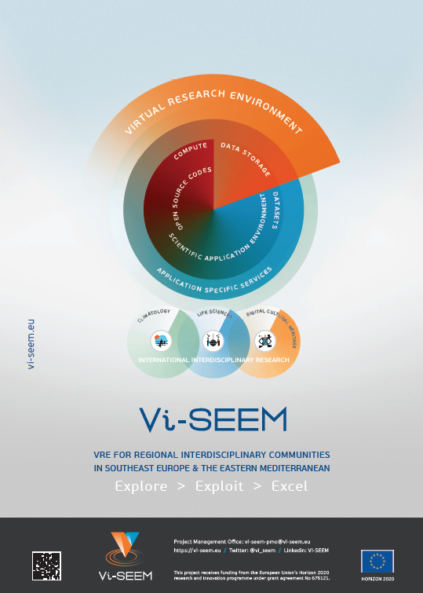
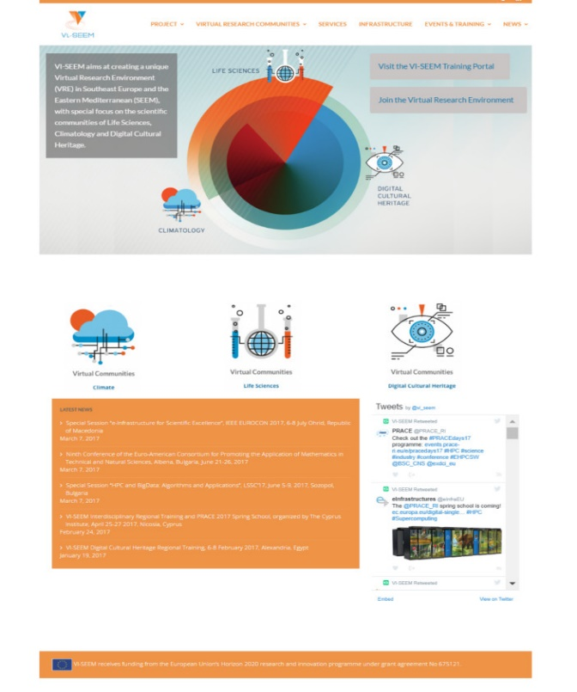
Training, dissemination, marketing, innovation (WP2)
Content-rich platform for communication within the VRE community and beyond
Main web page, VRE portal, training portal, wiki
Agenda system, document repository system
VI-SEEM marketing activities
Newsletters, popular articles, promotional materials, focused meeting and events for various types of audiences (SMEs, museums, universities, institutes, etc.), seminars and tours for students
Events organized
7 national dissemination events
7 national training events
3 regional training events
26 external events where project presented
25 papers
9 innovative developments

Slide 24
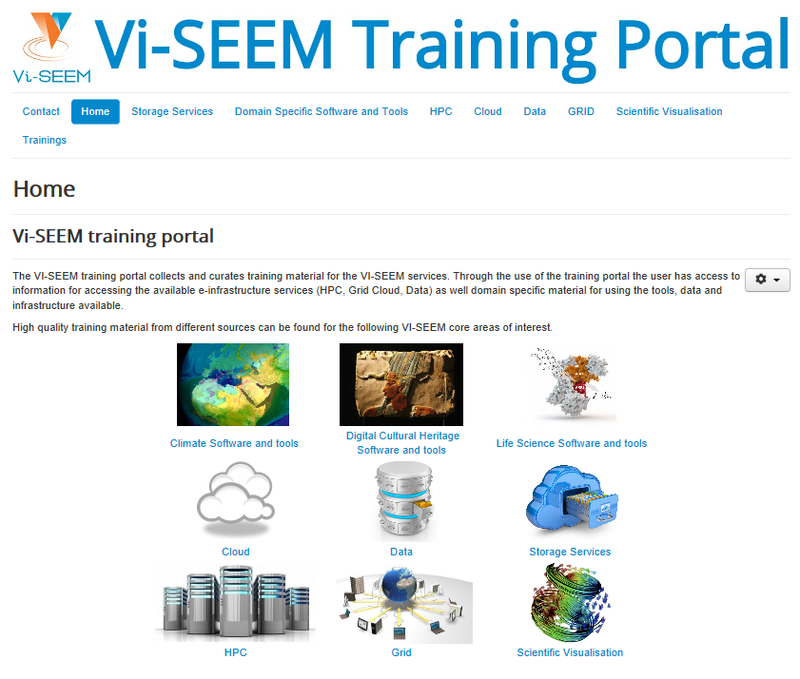






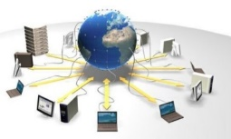

Training portal (WP2, WP5)
VI-SEEM Training Portal
Access via: https://training.vi-seem.eu/
Storage services
Domain-specific software and tools
Climate
Digital Cultural Heritage
Life Sciences
HPC
Cloud
Data
Grid
Scientific visualization

Slide 25
Main achievements
VI-SEEM provides a Virtual Research Environment for the scientific user communities in Climatology, Life Sciences, and Cultural Heritage
VI-SEEM provides an integrated platform bringing together computing, data management and domain-specific services
Services listed in the Service Catalogue and provided through the VRE Portal
Support the full lifecycle of scientific research
User-centric view
Open calls for access, peer review
Wide outreach campaign
Promote and support future usage, access, and underlying services

Slide 26
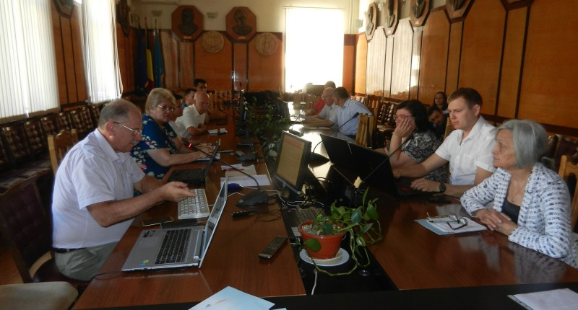
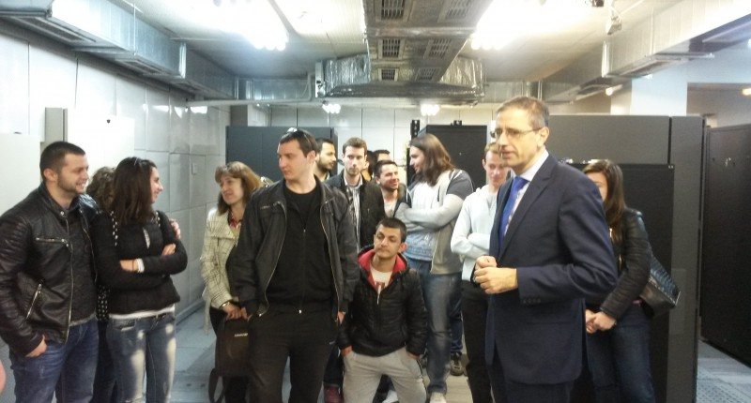
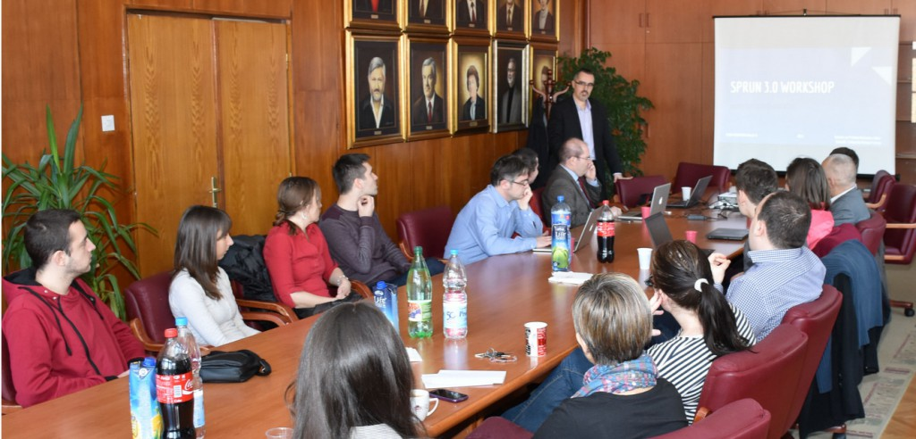
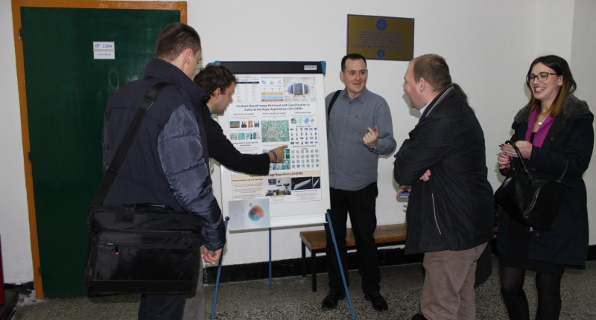
We cherish our community!

Slide 27




Thanks!
https://vi-seem.eu
@vi_seem
VI-SEEM
vi-seem-pmo@vi-seem.eu

