Slide 1


The WRF-Chem model
Implementation on ARIS HPC
Theodore M. Giannaros
Post-doc Researcher
National Observatory of Athens
Institute for Environmental Research and Sustainable Development
Email: thgian@noa.gr
VI-SEEM REG-CL: Training Event, 11 October 2017, Belgrade, Serbia

Slide 2
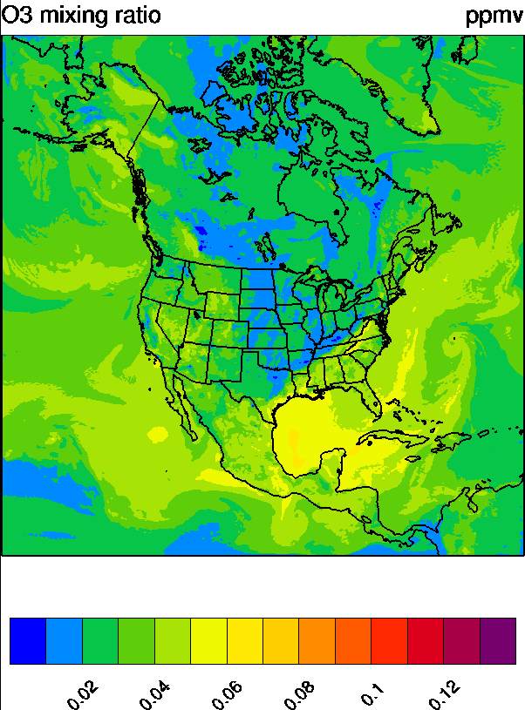
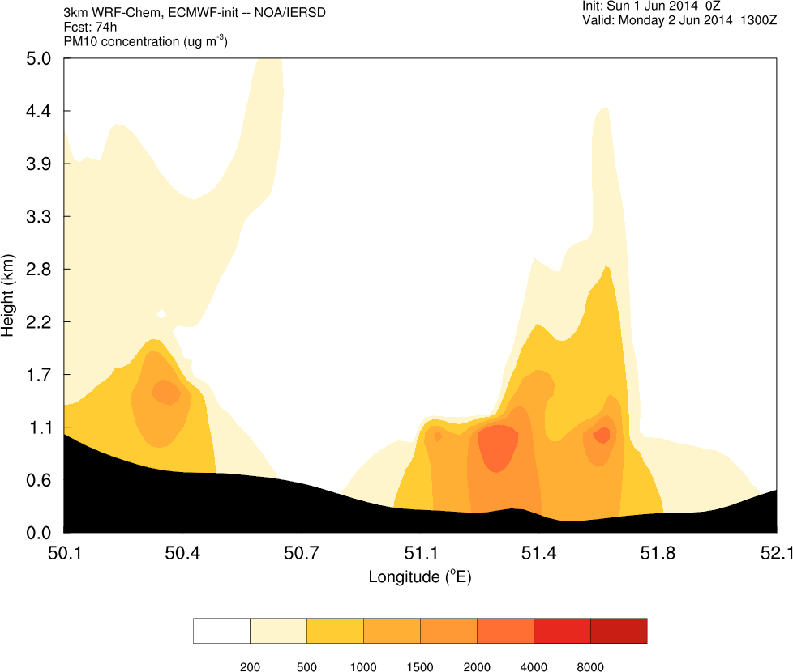
What is it?
A version of the WRF model that can be used for the simulation of trace gases and particulate matter simultaneously with the meteorology (Grell et al., 2005)
Online chemistry, fully embedded within the WRF
Consistency: same grid structure (vertical, horizontal), same physics for sub-grid scale transport, no time interpolations
Perfectly suited for examining meteorology-chemistry feedbacks on local to global scales (climate change)
Suitable for operational air quality forecasting on regional to cloud-resolving scales
VI-SEEM REG-CL: Training Event, 11 October 2017, Belgrade, Serbia

Slide 3
Why ‘online’ is important?
“Eventually though, a migration to an integrated modeling system will provide new opportunities for weather prediction modelers as well. The simulation of chemical species will allow identification of shortcomings in currently used forecast models as well as lead to better use of meteorological data assimilation”
More realistic representation of the atmosphere: the offline approach introduces errors that increase with increasing grid resolution
Numerically more consistent: same grid structure (horizontal, vertical), no time interpolation
Proven improvements in medium-range weather forecasts
Nevertheless:
Computationally very expensive
Less flexibility for conducting ensemble modeling
VI-SEEM REG-CL: Training Event, 11 October 2017, Belgrade, Serbia

Slide 4
How does the ‘coupling’ work?
Advection and diffusion provided by WRF
Sub-grid scale transport carried out by WRF physics parameterizations, PBL schemes and convective parameterization schemes
Chemical processes carried out by WRF-Chem, dependent on meteorological input: emissions (anthropogenic, biogenic, fire, dust, sea salt, volcanic), dry deposition, wet scavenging
Chemical reactions carried out by WRF-Chem: aqueous and gas phase chemistry, aerosols
Chemical radiation processes carried out by WRF-Chem: computation of photolysis rates
Chemistry-meteorology feedback carried out by coupling interface: radiation, microphysics, convection
VI-SEEM REG-CL: Training Event, 11 October 2017, Belgrade, Serbia

Slide 5
Installation
Similar procedure and dependencies as for installing the WRF model
export WRF_CHEM=1
./configure
./compile em_real
50+ compilation options: Serial, DM, SM, Hybrid (DM+SM), numerous compilers and architectures
VI-SEEM REG-CL: Training Event, 11 October 2017, Belgrade, Serbia

Slide 6
Quick how-to
Procedure similar to a meteorological WRF simulation
1. Setup your modeling domain as you do for a typical WRF simulation
./geogrid.exe
2. Decode forcing data
./ungrib.exe
3. Horizontally interpolate forcing data on your modeling domain
./metgrid.exe
Chemistry ‘part’
Select chemistry option
chem_opt = ??
Prepare emissions (users’ ‘job from scratch’) ** will not be covered in this talk
Generate initial and boundary conditions (optionally also lower boundaries) for both meteorology and chemistry
./real.exe
Run your simulation!
./wrf.exe
VI-SEEM REG-CL: Training Event, 11 October 2017, Belgrade, Serbia

Slide 7
Getting started: Read - Think - Design
Define your objectives
What are your scientific and/or practical objectives? Why do you need to run WRF-Chem? How will you know that your simulations are successful?
You and your scientific problem: ‘to know us better’
Review literature! What are the atmospheric and chemical processes involved? Which are the most important (clouds, radiation, convection, aerosols, etc.)? What is known? Is anything missing? Judge the efficacy of your “simulations-to-do”.
Determine available observational datasets
What observations are available? Again, become familiar with the processes that you want to study. How will the observations be used for verifying and/or complementing your simulations? Judge the adequacy of your “simulations-to-do”.
Prepare your strategy
Are you going to focus on a case study? If yes, which one and why? Are there adequate observations for verifying your “simulations-to-do”? Will you set up an operational weather and air quality forecasting service? What are the practical requirements?
VI-SEEM REG-CL: Training Event, 11 October 2017, Belgrade, Serbia

Slide 8
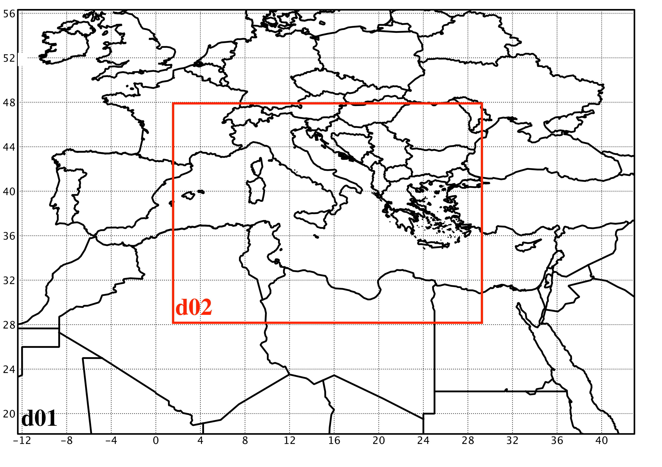
Setting up domains
First things, first
Target horizontal grid spacing
Resolution of initialization data
Most often, you will need to adopt a nesting strategy.
Hints
Place domain boundaries away from each other, and away from steep topography
Odd parent-child ratios are preferred (e.g. 3:1, 5:1)
Higher horizontal resolution will also require higher vertical resolution
Use at least 30-35 vertical levels; larger density closer to the ground and to the model top to avoid numerical instability (aka ‘CFL violation’)
Lambert: mid-latitudes, Mercator: low-latitudes, Lat-Lon: global, Rotated lat-lon: regional
Start inside-out (first the nest, then move up)
Never forget!
Avoid the “grey zone” (4-10 km)
What about computational requirements?
VI-SEEM REG-CL: Training Event, 11 October 2017, Belgrade, Serbia

Slide 9
Forcing data
Garbage in, garbage out (GIGO)
Read - Think - Design
General questions:
Do the static data (topography, land use, etc.) represent my study area adequately?
How ‘good’ are the meteorological forcing data? Does their resolution (temporal, spatial) fit my domain setup?
Do I need lower boundary conditions (e.g. SST)?
WRF-Chem specific questions:
Do I need an emission inventory? Do I have one? Does it represent well my study area? Does it have adequate resolution (temporal and spatial) and fit the purposes of my simulation?
What kind of chemistry do I need? Gas phase only? Do I need to include aerosols?
VI-SEEM REG-CL: Training Event, 11 October 2017, Belgrade, Serbia

Slide 10
Physics
Too many options! Where to start from?
Back to basics: Which processes are important? Review literature. What others did?
Consider first well documented (extensively tested) schemes
Hints
Convective schemes are generally not required at dx<4 km
Sophisticated microphysics schemes (double-moment, detailed species) may not be necessary at dx>>10 km
Try to have consistent physics between the domains or use 1-way nesting
If your simulation spans more than 5 days, you could start thinking to adopt the SST update option
What about the meteorology-chemistry feedback?
Certain physics parameterizations may be required to account for e.g. aerosol-radiation and aerosol-microphysics interactions
VI-SEEM REG-CL: Training Event, 11 October 2017, Belgrade, Serbia

Slide 11
Chemistry (1)
Chemistry option
Timesteps
Input emissions options
Anthro/volcanic emissions
Input emissions options
Photolysis option
Dry deposition
Biogenic, dust, sea salt
VI-SEEM REG-CL: Training Event, 11 October 2017, Belgrade, Serbia

Slide 12
Chemistry (2)
Gas/aerosols ICBC
Gas/aerosols chemistry switches
Wet scavenging
Aerosol effects
Sub-grid scale processes
Biomass burning options
Gas/aerosols ICBC
Aerosol effects
VI-SEEM REG-CL: Training Event, 11 October 2017, Belgrade, Serbia

Slide 13
Dust in WRF-Chem
Why dust?
Large uncertainty in estimating global dust emissions: 514 - 4313 Tg/yr
Emissions depend heavily on surface wind speed and soil properties: high spatial and temporal variability
Incomplete understanding of the processes that lead to dust emission: threshold friction velocity, horizontal saltation flux, vertical flux
Understanding changes in dust emissions is of paramount importance for both interpreting past and predicting future climate change
VI-SEEM REG-CL: Training Event, 11 October 2017, Belgrade, Serbia

Slide 14
Dust emissions options
Available dust emission schemes (version 3.9)
All schemes are founded on the GOCART mechanism:
GOCART (dust_opt = 1)
module_gocart_dust.F
2. AFWA (dust_opt = 3)
module_gocart_dust_afwa.F
3. UoC (dust_opt = 4) with either dust_schme=1 (Shao, 2001) or dust_schme = 2 (Shao, 2004) or dust_schme = 4 (Shao, 2011)
module_uoc_dust.F
module_uoc_dustwd.F
module_qf03.F
Required input
Dust source function: Ginoux erodibility (default, provided via WPS)
Dust emissions are computed online using surface wind speed and soil properties; no need for any emission inventory
Advice: Adopt a sufficiently long spin-up period for building up emissions
Always, examine code!
VI-SEEM REG-CL: Training Event, 11 October 2017, Belgrade, Serbia

Slide 15
(Dust) aerosol models
Available aerosol models (version 3.9)
Modal (MADE/SORGAM, MADE/VBS, MAM)
Size distribution of aerosols represented by several overlapping intervals (modes), assuming a log-normal distribution within each mode
Computationally efficient
Less accurate
2. Sectional (MOSAIC)
Size distribution of aerosols represented by several discrete size bins, specified by the upper and lower dry particle diameters
Computationally expensive
More accurate
3. Bulk (chem_opt = 401)
Provides only dust concentration, assuming 10 ash size bins
Computationally fast
Dust is treated as a passive tracer
When do I need to use an aerosol model for dust?
Necessary to account for aerosol direct and indirect effects
VI-SEEM REG-CL: Training Event, 11 October 2017, Belgrade, Serbia

Slide 16
(Dust) aerosol direct (radiative) effects (1)
Modification of the radiative balance
Direct effect: Solar/IR scattering & absorption
Semi-direct effect: Modification of heating rates, surface fluxes (sensible, latent), static stability
VI-SEEM REG-CL: Training Event, 11 October 2017, Belgrade, Serbia

Slide 17
(Dust) aerosol direct (radiative) effects (2)
Aerosol optical properties (AOD, asymmetry factor, SSA) computed for 4 SW and 16 LW wavelengths: large uncertainty in determining dust refractive indices!
Compatible aerosol models: Bulk, MADE/SORGAM, MAM, MOSAIC
Compatible radiation schemes: Goddard, RRTMG
Setting up your namelist
ra_sw_physics = 2 or 4
ra_lw_physics = 4
aer_ra_feedback = 1
aer_op_opt > 0 (select mixing rule for Mie calculations)
cu_rad_feedback = .true. (account for sub-grid scale cloud effects)
chem_opt = any (except for 401 - ‘dust-only’)
Evaluate direct effects
Compare simulations with aer_ra_feedback = 0 (OFF) and 1 (ON) but consider semi-direct effects (changes in clouds induced by radiative effects)
VI-SEEM REG-CL: Training Event, 11 October 2017, Belgrade, Serbia

Slide 18
(Dust) aerosol indirect effects (1)
When activated, they are effective cloud condensation nuclei (CCN) and ice nuclei (IN), thus modifying the microphysical properties of clouds.
VI-SEEM REG-CL: Training Event, 11 October 2017, Belgrade, Serbia

Slide 19
(Dust) aerosol indirect effects (2)
Prognostic aerosol number concentrations influence cloud albedo and rain mixing ratio
Compatible chemistry options: any with aqueous reactions
Compatible aerosol models: Bulk, MADE/SORGAM, MAM, MOSAIC
Compatible radiation schemes: Goddard, RRTMG
Compatible microphysics schemes: Lin, Morrison
Setting up your namelist
progn = 1 (enable prognostic number concentrations for microphysics species)
mp_physics = 2 or 10
cldchem_onff = 1 (turn on cloud chemistry)
wetscav_onff = 1 (turn on wet scavenging)
chem_opt = any that supports aqueous chemistry (suggested 10-MOSAIC, 11-MADE/SORGAM)
Evaluate indirect effects
1 control simulation (CNTL)
1 radiative experiment (RAD)
1 experiment with radiative and indirect effects (TOT)
indirect effects = TOT - RAD
VI-SEEM REG-CL: Training Event, 11 October 2017, Belgrade, Serbia

Slide 20
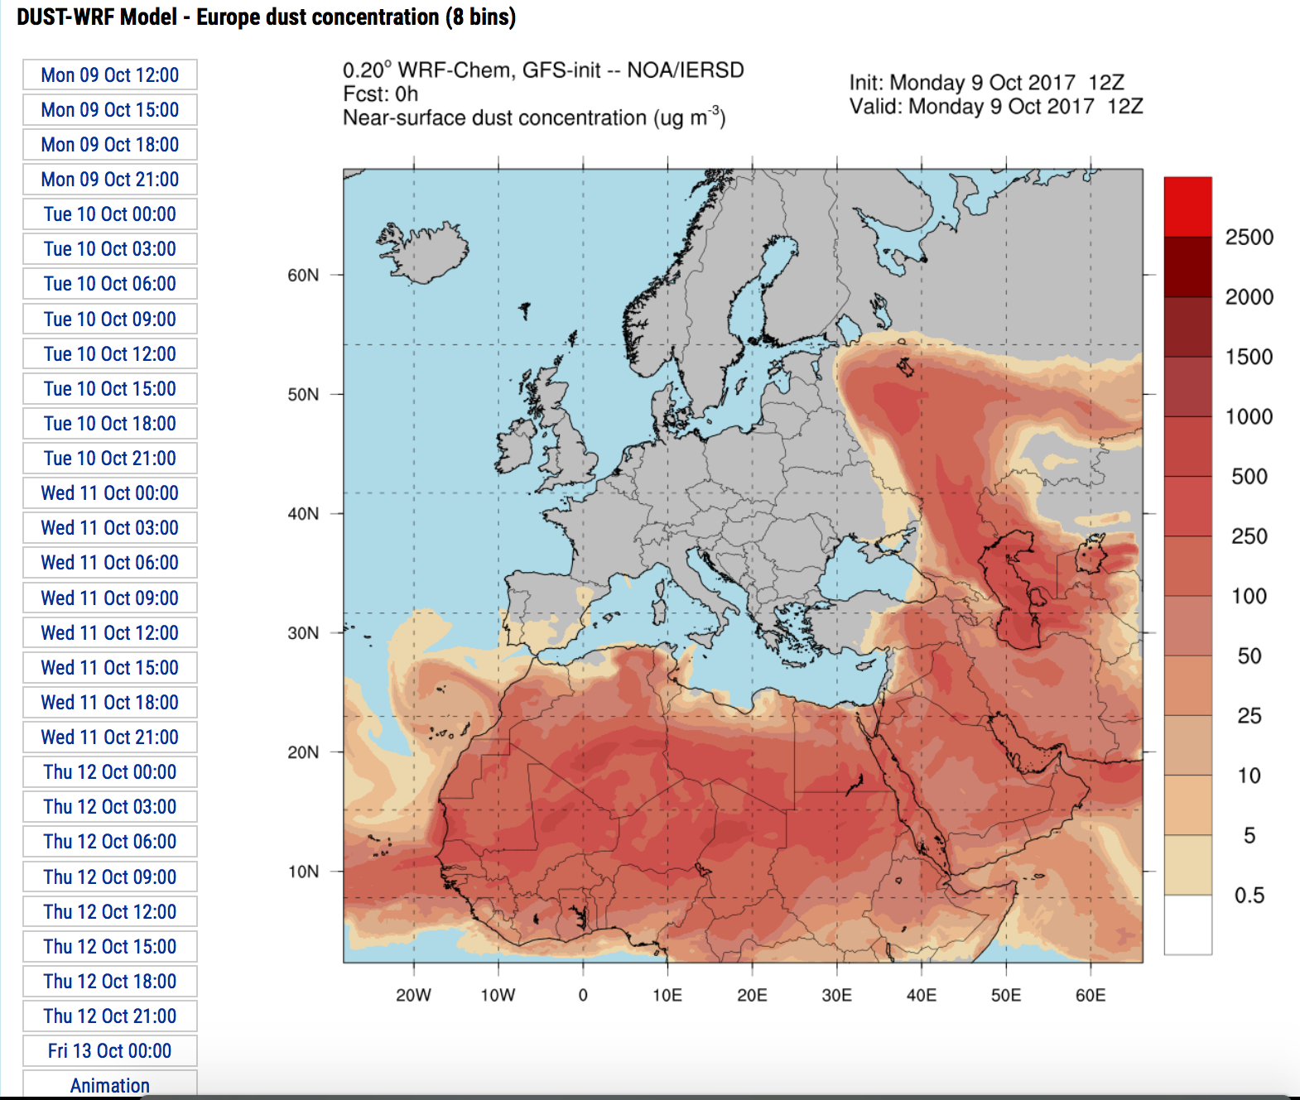
WRF-Chem application examples (1)
Operational dust forecasting system for Europe
WRF-Chem v3.6.1
‘Dust-only’
Modified GOCART scheme (chem_opt=401) to use 8-bin size distribution following DREAM (Flaounas et al., 2017 GMD)
Daily, 84-h forecasts
Part of WMO SDS-WAS for NA-ME-E
http://meteo.gr/meteomaps/wrf_dust.cfm
VI-SEEM REG-CL: Training Event, 11 October 2017, Belgrade, Serbia

Slide 21
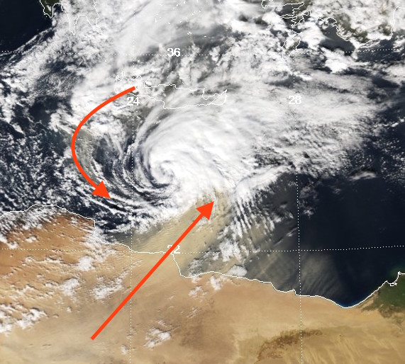
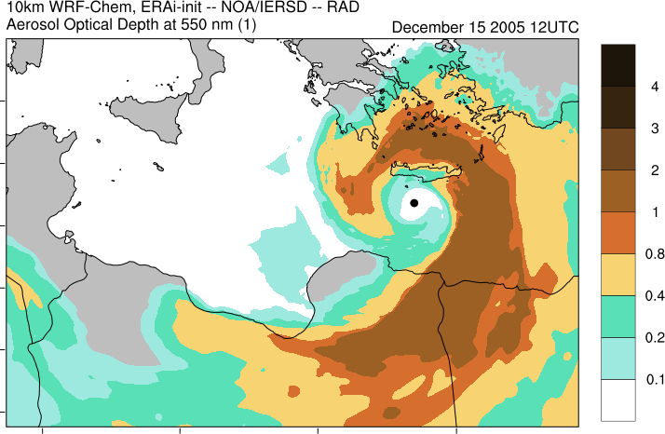
WRF-Chem application examples (2)
Work in progress!
Dust-cyclones interactions
Application on ARIS HPC in the frame of VI-SEEM
WRF-Chem v3.7.1
Study direct/indirect effects of dust on a Medicane
GOCART/MOSAIC (Zhao et al., 2010)
chem_opt=10, dust_opt=2
Nested modeling: 10, 3.333 km
VI-SEEM REG-CL: Training Event, 11 October 2017, Belgrade, Serbia

Slide 22
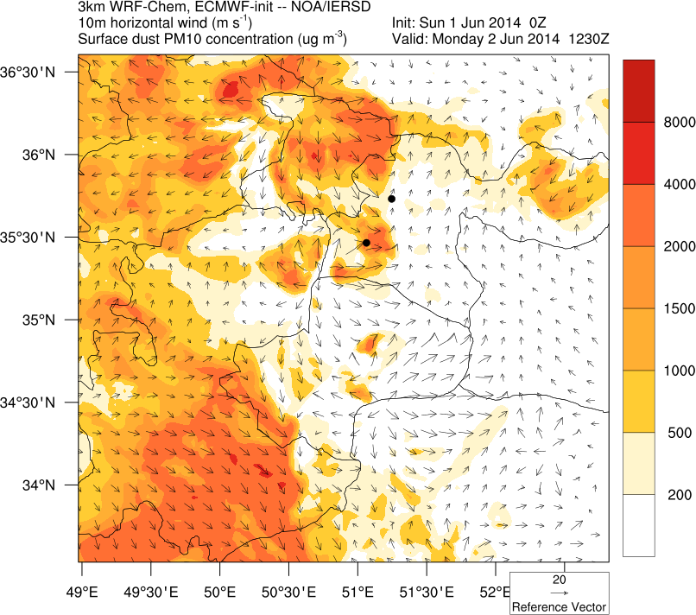
WRF-Chem application examples (3)
Work in progress!
Dust storms - Haboob in Iran
Application on ARIS HPC in the frame of VI-SEEM
WRF-Chem v3.7.1
Numerical simulation of an intense, short-lived dust storm (haboob) in Iran
GOCART/MOSAIC (Zhao et al., 2010)
chem_opt=10, dust_opt=2
Nested modeling: 9, 3 km
VI-SEEM REG-CL: Training Event, 11 October 2017, Belgrade, Serbia

Slide 23
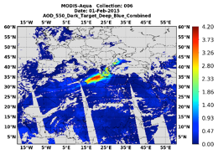
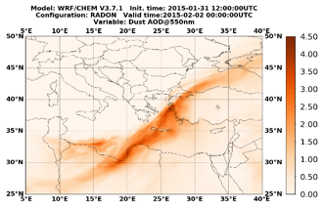
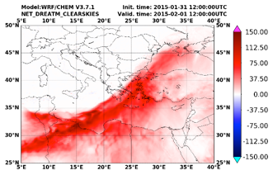
WRF-Chem application examples (4)
Work in progress!
Dust outbreak in the Mediterranean
Application on ARIS HPC in the frame of VI-SEEM
WRF-Chem v3.7.1
Numerical simulation of an intense dust outbreak in SE Med
GOCART/MOSAIC (Zhao et al., 2010)
chem_opt=10, dust_opt=2
1 domain: 10 km
VI-SEEM REG-CL: Training Event, 11 October 2017, Belgrade, Serbia

Slide 24
Summary
WRF-Chem is a powerful integrated modeling system that can support a wide range of applications including:
air quality forecasting services
case study modeling of chemistry-meteorology feedbacks (e.g. aerosols)
climate change assessment studies focusing on chemistry (e.g. aerosols)
Take-aways & Hints
Read - think - design
Get your hands dirty - dig into the code!
There are some ‘hidden’ schemes and options, and bugs as well
WRF-Chem is a really heavy model
Consider carefully the scope of your application, its adequacy and its efficiency
Resources (not the wealth you may be used to for WRF)
https://ruc.noaa.gov/wrf/wrf-chem/ (main WRF-Chem page)
Tutorials, user manuals, references for chemistry options, papers using the model for various purposes
VI-SEEM REG-CL: Training Event, 11 October 2017, Belgrade, Serbia

Slide 25
Thank you!
Questions? Comments?
Contact: Theodore M. Giannaros, thgian@noa.gr
VI-SEEM REG-CL: Training Event, 11 October 2017, Belgrade, Serbia

