Slide 1

VI-SEEM data analysis service
Petar Jovanovic
Institute of Physics Belgrade

Slide 2
Agenda
Apache Hadoop
Hadoop basic component
HDFS
MapReduce
Word count example with mvn archetype from VI-SEEM code repo
Hadoop streaming
More examples

Slide 3
Apache Hadoop
Open-source programming framework that supports processing and storing large data sets in a distributed computing environment.
Based on Google’s MapReduce and Google File System papers
https://research.google.com/archive/mapreduce.html
https://research.google.com/archive/gfs.html
Evolved from an effort to build an open source search engine (Nutch)
Hadoop ecosystem

Slide 4
Hadoop: basic components
HDFS
A distributed file system
Cuts files into chunks
Stores chunks across multiple machines with multiple copies
helps with fault tolerance and access speeds
MapReduce
A basic approach to programming data analysis workflows in Hadoop.
A batch system of execution
Two types of nodes:
Name node
Data node

Slide 5
HDFS
HDFS file system commands (https://hadoop.apache.org/docs/r2.4.1/hadoop-project-dist/hadoop-common/FileSystemShell.html)
list files in the current directory: hdfs dfs -ls
put a file into HDFS: hdfs dfs -put data_file.dat
get a file from HDFS: hdfs dfs -get data_file.dat

Slide 6
MapReduce
Works on data as key-value pairs
2 step approach:
Map is a function applied to every record in a dataset, which translates it into a key-value pair
Reduce is a function that combines key-value pairs in some meaningful way and calculates results on them (e.g. word frequencies in a language corpus)
Between map and reduce step, key-value pairs are sorted by key.
MapReduce in Unix commands: $ cat input.dat | mapper | sort | reducer > output.dat

Slide 7
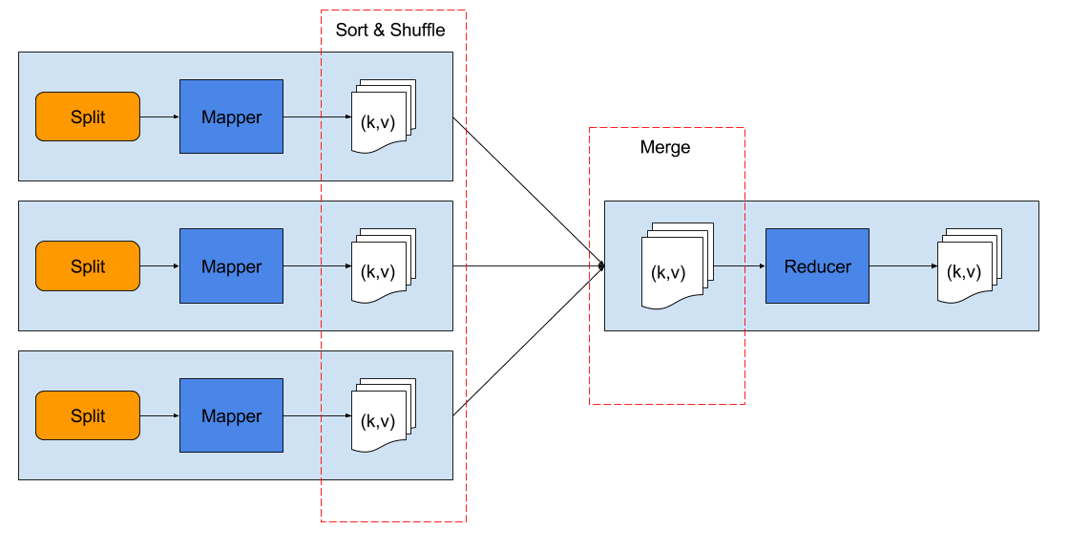
MapReduce - basic

Slide 8
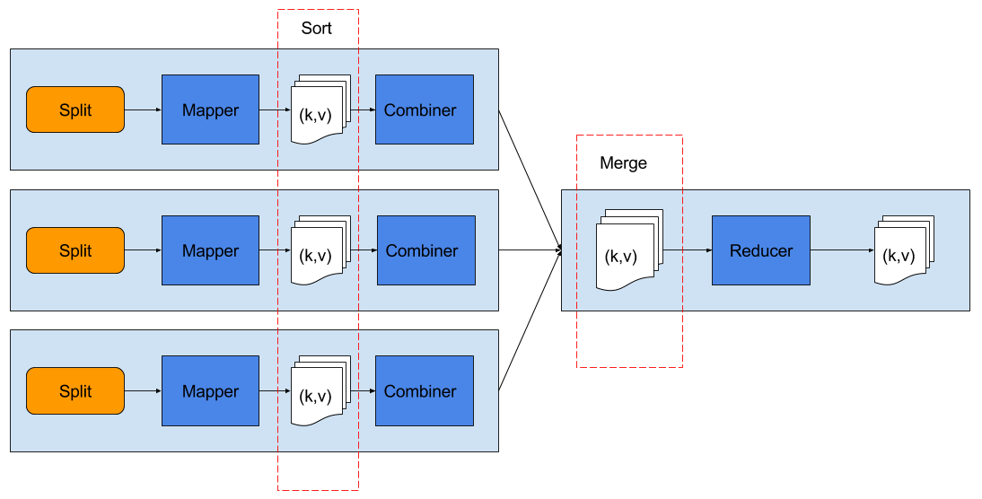
MapReduce - with combiner

Slide 9
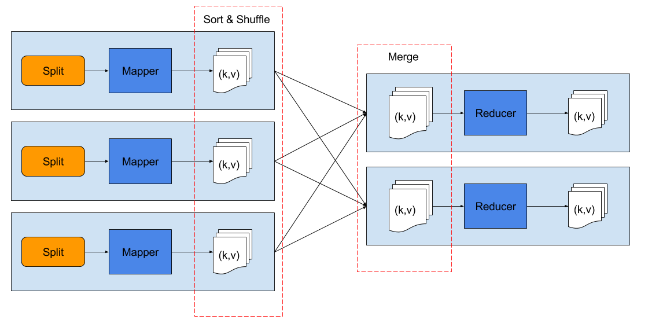
MapReduce - multiple reducers

Slide 10
Word count example
Mapper
split input lines into words
add 1 as initial count of each word
Reducer
for each word (key), sum its counts (value)
Combiner
same as reducer, but runs locally on mapper outputs
commutative and associative operation
useful when it can reduce the mapper output
Maven project archetype in VI-SEEM code repository: https://code.vi-seem.eu/petarj/hadoop-archetype

Slide 11
Hadoop streaming (1)
MapReduce in Unix commands: $ cat input.dat | mapper | sort | reducer > output.dat
Hadoop streaming pipes input through standard input to the mapper, whose output is sorted and then piped to reducer.
Inputs are processed line by line, and each line is a string
the mapper and the reducer are responsible for parsing the input lines
slight difference to the Java api where reducer gets a list of values associated with a key

Slide 12
Hadoop streaming (2)
Command to execute: $ hadoop jar $HADOOP_HOME/share/hadoop/tools/lib/hadoop-streaming-2.7.2.jar \ -files mapper_executable,reducer_executable[,combiner_executable] \ -mapper mapper_executable \ [-combiner combiner_executable] \ -reducer reducer_executable \ -input input_data \ -output output_data
Combiner is optional
To specify more than one reducer add parameter: -D mapreduce.job.reduces=42

Slide 13
Word count with straming
Getting the code
$ git clone https://code.vi-seem.eu/petarj/hadoop-training.git
Executing $ cd hadoop-training/wordcount $ hadoop jar $HADOOP_HOME/share/hadoop/tools/lib/hadoop-streaming-2.7.2.jar \ -files=mapper.py,reducer.py \ -mapper mapper.py \ -combiner reducer.py \ -reducer reducer.py \ -input /user/petarj/train_v2.txt -output wcout
Notes:
git -c http.sslVerify=false clone

Slide 14

Twitter user ranking (1)
Goal: find influential Twitter users
Simple PageRank algorithm:
PR(u) - page rank of u
L(v) - number of out edges of v
Bu - set of nodes adjacent to u
u & v - any two distinct nodes
In our case: L(v) is the number of people v is following, Bu are all the people u is following.

Slide 15
Twitter user ranking (2)
Input data:
Text file: /user/petarj/twitter_rv.net (26 GB)
Each line contains 2 numbers separated by tabs
First column is id of a user, second column is an id of his follower
Two map-reduce steps needed to perform the analysis:
Convert data from edge list to adjacency list and set initial PageRank
Compute the PageRank approximation
Running multiple reducers

Slide 16
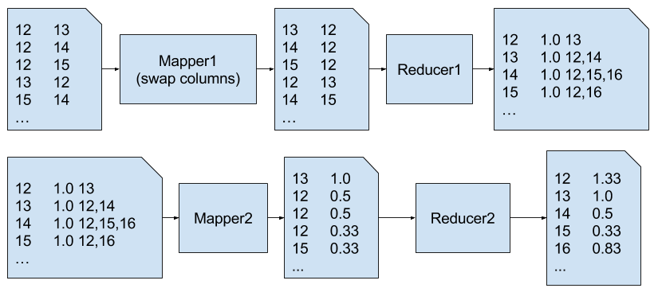
Twitter user ranking (3)
STEP 1
STEP 2

Slide 17
Twitter demo
Getting the code
$ git clone https://code.vi-seem.eu/petarj/hadoop-training.git
Executing $ cd hadoop-training/twitterrank $ hadoop jar $HADOOP_HOME/share/hadoop/tools/lib/hadoop-streaming-2.7.2.jar \ -D mapreduce.job.reduces=20 -files=mapper1.py,reducer1.py \ -mapper mapper1.py \ -reducer reducer1.py \ -input /user/petarj/twitter_rv.net -output twrank_step1 $ hadoop jar $HADOOP_HOME/share/hadoop/tools/lib/hadoop-streaming-2.7.2.jar \ -D mapreduce.job.reduces=6 -files=mapper2.py,reducer2.py \ -mapper mapper2.py \ -reducer reducer2.py \ -input twrank_step1 -output twrank_step2

Slide 18
Questions
Thank you for your attention.

