Slide 1

VI-SEEM biobank implementation
Dusan Vudragovic
Institute of Physics Belgrade

Slide 2
Overview
Brief overview of the REDCap
REDCap project development
REDCap built-in tools
REDCap instances

Slide 3
Brief overview of the REDCap
REDCap is a tool for building online surveys and databases
Projects are webpages (data collection instruments), used for data entry
Designed to be neutral, can capture almost any type of data, for any purpose
Entering data while logged, using REDCap as a database
Entering data without logging in, using REDCap as a survey
Data entry process is intuitive, instructional text and prompts provide guidance at every step
Most frequently used for clinical and research purposes, but it is designed to support any type of work
REDCap mobile phone version

Slide 4
REDCap project development
Customizing the questions is part of project development
Development process can involve advanced features to improve your data collection strategy: data validation, branching logic, calculated fields, matrix ranking, slider scales
Instruments can be built online in real-time through the Online Designer or built offline through a spreadsheet
Project can use only one data collection instrument or multiple instruments (control access)
These instruments are where project data can be added, modified or deleted

Slide 5
REDCap built-in tools
Many data management tools, here few the most important
User rights – users of the project
  Access level for data collection instruments and applications can be set
Report builder – the search engine of a REDCap project
  View multiple records worth of data without exporting it
Data export tool – snapshot of current dataset
  Saved as a file that can be download and used externally
  Several common statistical packages formats are supported
Data import tool – import data for multiple fields over multiple records
  Existing data in a spreadsheet or other database can be transferred into REDCap
  Can be used to modify existing data or add entirely new data

Slide 6
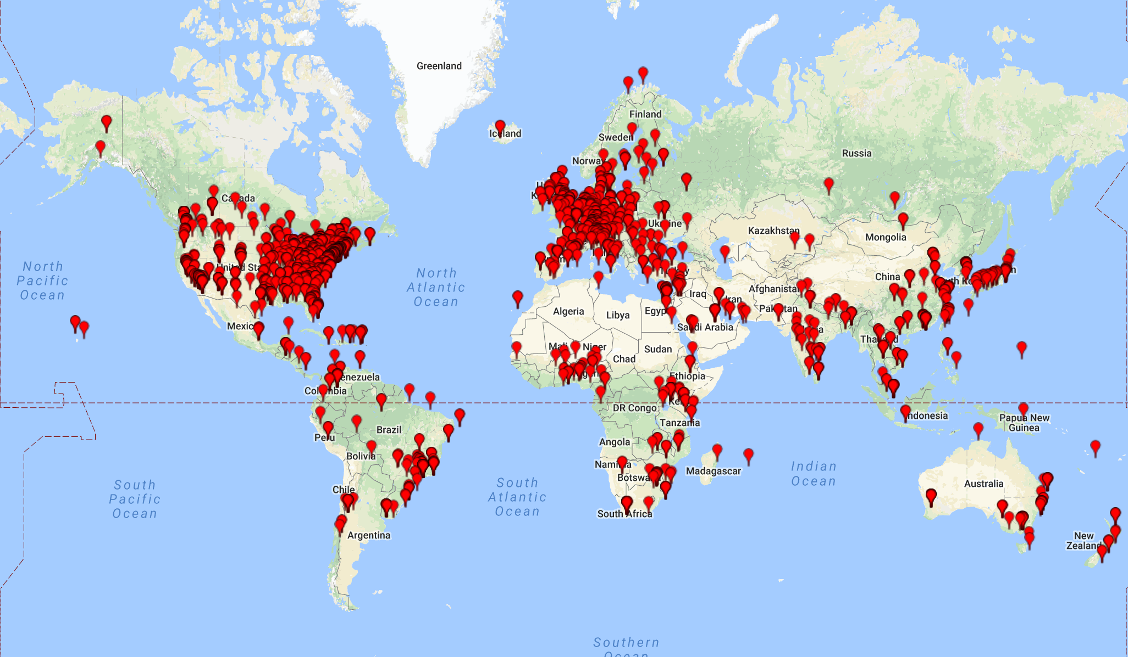
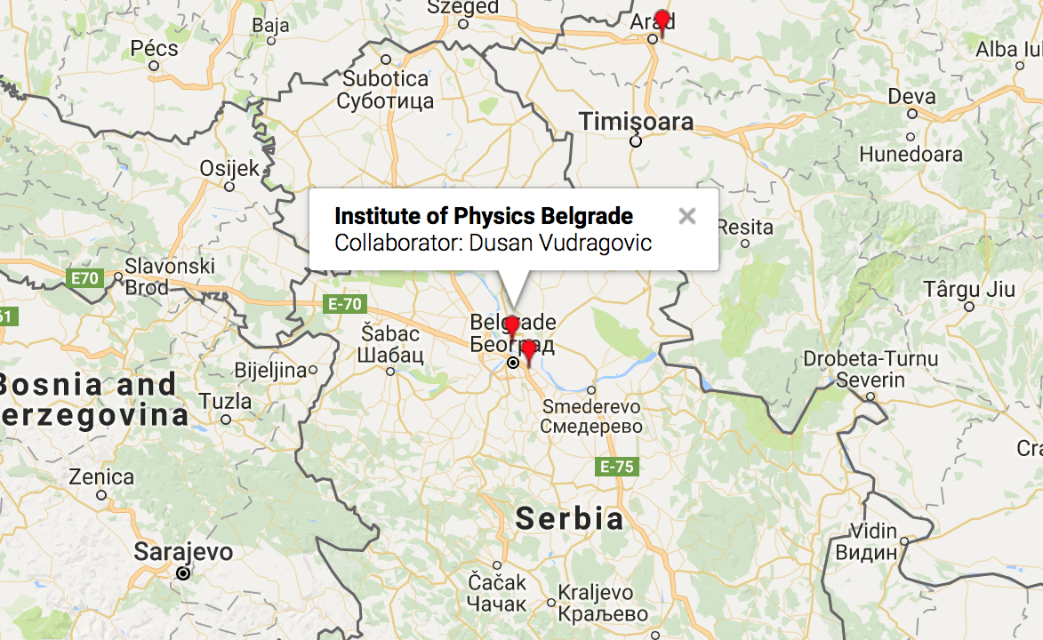
REDCap instances

Slide 7
DEMO

