Slide 1
Main drivers for long-range climate prediction
Nato Kutaladze
VI-SEEM national training event

Slide 2
Outline
1. climate change scenarios;
2. GCMs’ (General Circulation Models) development way and current status.
3. IPCC’s activities and reports.
4. Regional climate models and other ways to predict regional climate characters.
5. RegCM4 model code, installation, structure, main steps to run model Description of tools and software for models output manipulation, visualization and interpretation
(CDO, Grads), some examples of operating on output files with GIS.
1. RegCM4 model output files, format and structure;
2. CDO and GRADS, main examples of RegCM4 model output files processing;
3. GIS and RegCM4 output files.

Slide 3
Scenarios of potential future anthropogenic climate change, underlying driving forces, and response options have always been an important component of the work of the Intergovernmental Panel on Climate Change (IPCC).
In the past, the IPCC coordinated the process of developing scenarios for its assessments. During its 25th session (Mauritius, 26–28 April 2006), the IPCC decided that rather than directly coordinating and approving new scenarios itself, the process of scenario development should now be coordinated by the research community.
In the IPCC (I-IV) reports Scenarios are presented as SRES social economic development scenarios and in the fifth report - “Representative Concentration Pathways—RCPs”

Slide 4
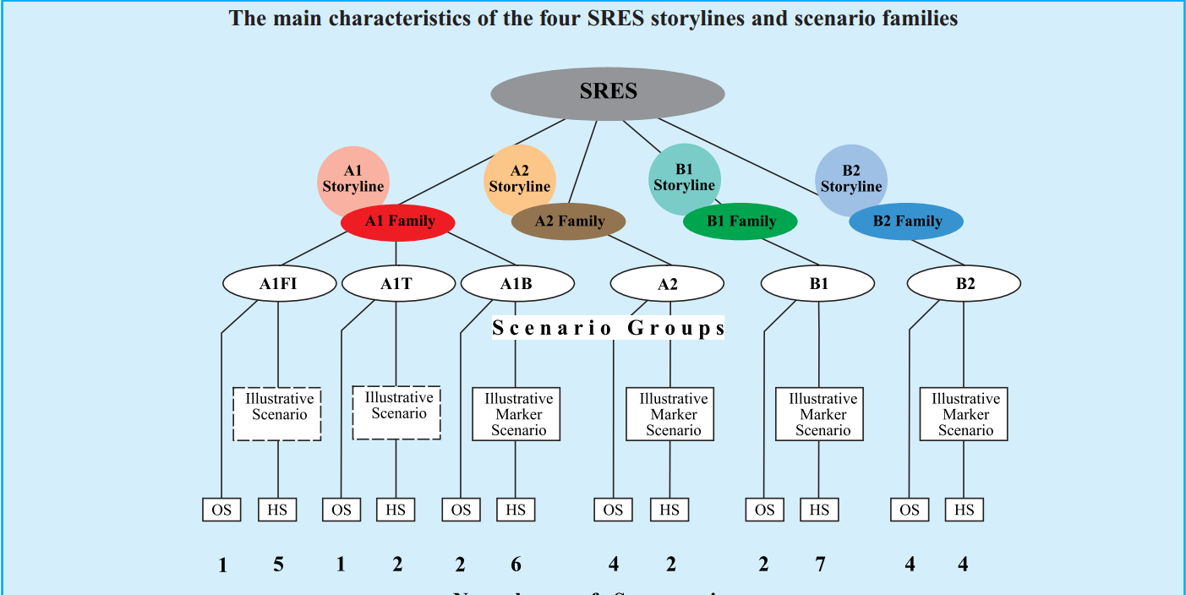

Slide 5
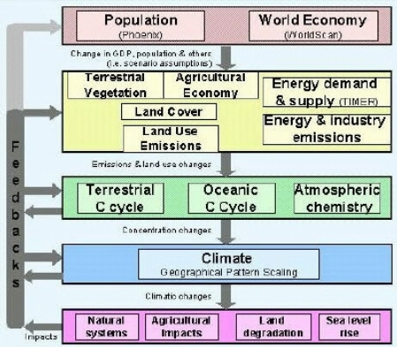
major closely interlinked driving forces:
1.Population development
2. World Economy
3. The energy system
4.Land use (change)

Slide 6
World Economy: growth, distribution, technology
Economic development is expressed in GNP (Gross National Product). The SRES scenarios span a wide range of future levels of economic activity. The highest overall prediction is for the A1 scenario; an estimated GNP of US$529 trillion (1990 US dollars) in 2100. The lowest overall prediction is for the B2 scenario; an estimated GNP of US$235 trillion in 2100. This means that globalization combined with an emphasis on wealth would generate the highest economic growth. This is mainly because population growth is lower in a global scenario, causing a narrower division of the GNP. The emphasis on wealth rather than on sustainability also increases the GNP.

Slide 7
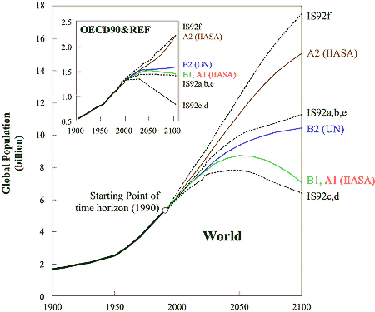
Population development

Slide 8
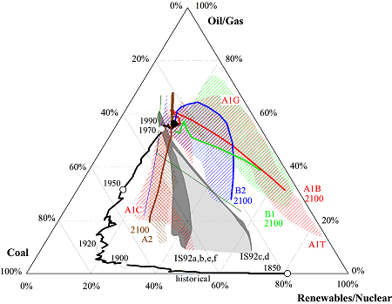
Energy system
The impact of future energy use will largely depend on the fuel type. Both global scenarios depict a transition towards more non-fossil fuel sources. In the regional sustainable scenario the transition towards non-fossil fuel sources is much more gradual. The regional wealth scenario marks a stark transition back to fossil fuels. In all scenarios the share of oil and gas declines and more coal will be used for energy generation in the future.

Slide 9
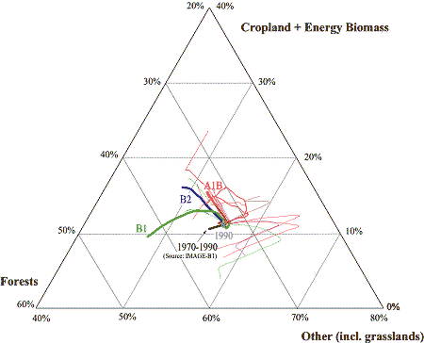
Land use change
Currently there is a lot of deforestation. In most SRES scenarios, the current trend of deforestation is eventually reversed because of slower population growth and increased agricultural productivity. Reversals of deforestation trends are strongest in the globalized scenarios. In the globalized sustainable scenario pasture lands decrease significantly because of increased productivity in livestock management and dietary shifts away from meat.

Slide 10
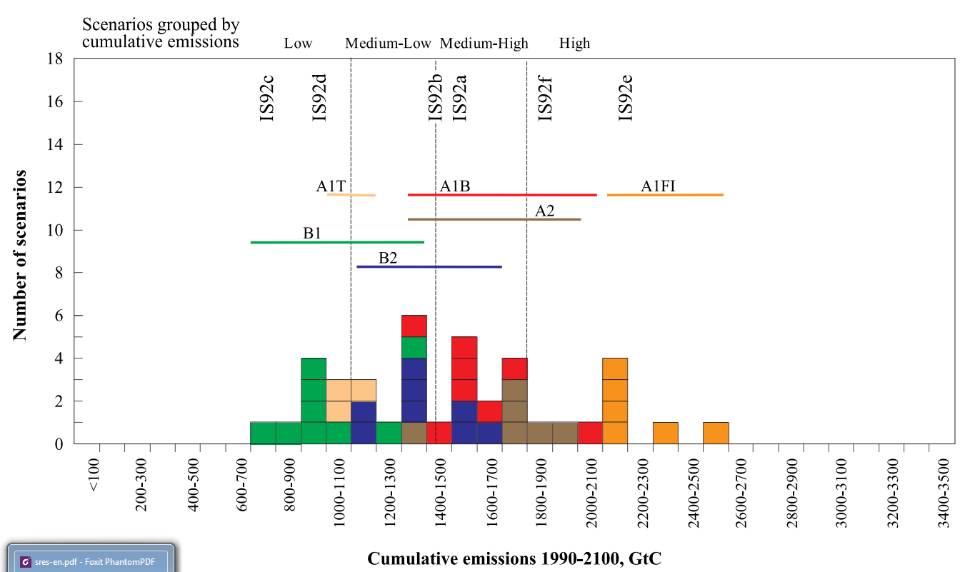

Slide 11
SRES scenarios
•The A2 storyline and scenario family describes a very heterogeneous world. The underlying theme is self-reliance and preservation of local identities. Fertility patterns across regions converge very slowly, which results in continuously increasing global population. Economic development is primarily regionally oriented and per capita economic growth and technological change are more fragmented and slower than in other storylines.
• The B1 storyline and scenario family describes a convergent world with the same global population that peaks in midcentury and declines thereafter, as in the A1 storyline, but with rapid changes in economic structures toward a service and information economy, with reductions in material intensity, and the introduction of clean and resource-efficient technologies. The emphasis is on global solutions to economic, social, and environmental sustainability, including improved equity, but without additional climate initiatives.
• The B2 storyline and scenario family describes a world in which the emphasis is on local solutions to economic, social,and environmental sustainability. It is a world with continuously increasing global population at a rate lower than A2, intermediate levels of economic development, and less rapid and more diverse technological change than in the B1 and A1 storylines. While the scenario is also oriented toward environmental protection and social equity, it focuses on local and regional levels.

Slide 12
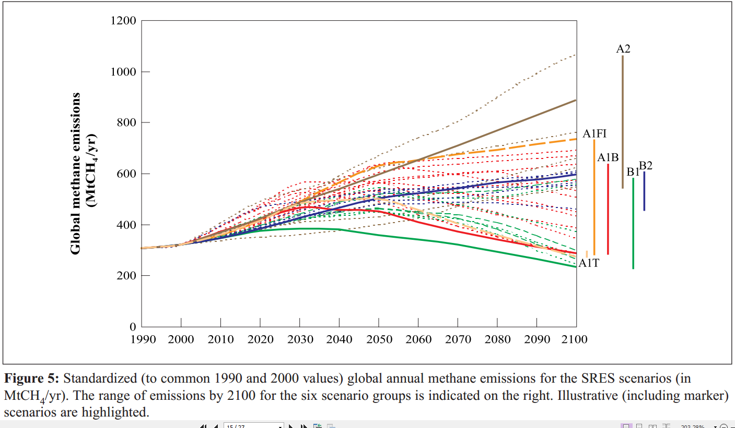

Slide 13
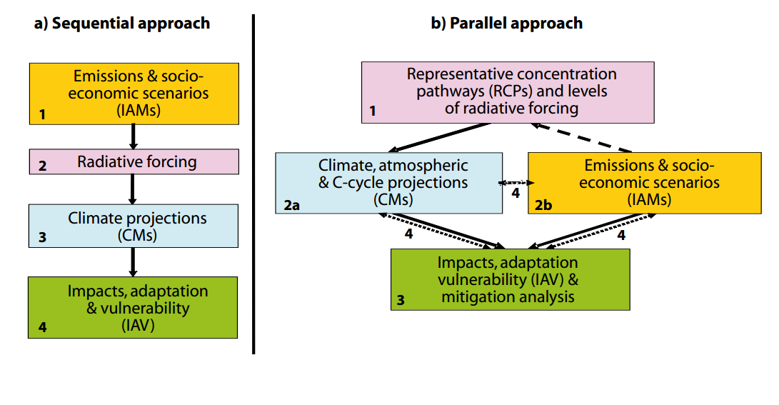
Approaches to the development of global scenarios: (a) previous sequential approach; (b) proposed parallel approach. Numbers indicate analytical steps (2a and 2b proceed concurrently). Arrows indicate transfers of information (solid), selection of RCPs (dashed), and integration of information and feedbacks (dotted).

Slide 14
Representative Concentration Pathways
The early identifiation of a set of “Representative Concentration Pathways” (RCPs) will facilitate coordination of new integrated socioeconomic, emissions, and climate scenarios. The main rationale for beginning with RCPs is to expedite the development of a broad literature of new and integrated scenarios by allowing the modeling of climate system responses to human activities to proceed in parallel to emissions scenario development

Slide 15
The CO2 pathways associated with scenarios providing comprehensive radiative forcing pathways effectively represent more than the 10th to 90th percentile range of CO2 emissions pathways across the post-SRES literature.

Slide 16
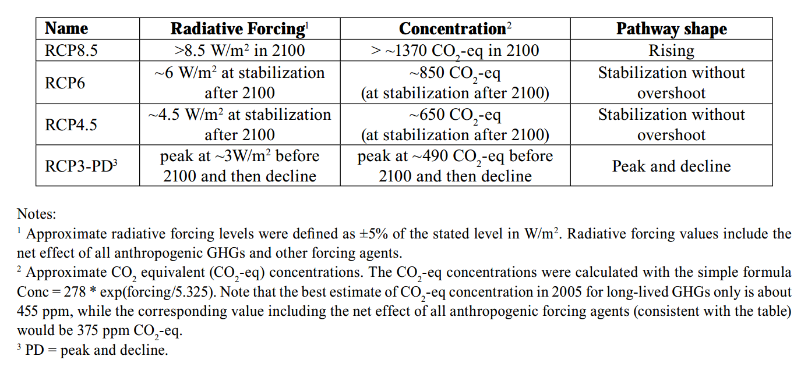
Types of representative concentration pathways

Slide 17
Modelling Climate Change
Global Climate Models also known as General Circulation Models (GCMs) are the most complex of climate models, since they attempt to represent the main components of the climate system in three dimensions. GCMs are the tools used to perform climate change experiments from which climate change scenarios (possible representations of how the climate will evolve) can be constructed. The design and structure of an individual GCM determines the climate change experiments that can be performed. These characteristics are limited by our scientific understanding of the climate system and by the available computing resources.

Slide 18
GCMs can be split into three main types:
1. Atmospheric GCMs coupled with a simple slab ocean (a single fixed layer representation of the ocean) and simple land-surface parameterization schemes (e.g. UKLO and UKHI).
2. Atmospheric GCMs coupled to a three-dimensional representation of the the ocean system (one in which ocean currents and heat transport are represented) and with simple land-surface parameterization schemes (e.g. UKTR).
3. Atmospheric GCMs coupled to a three-dimensional representation of the ocean and a three dimensional terrestrial biosphere model (e.g. HadCM2 and HadCM3).

Slide 19
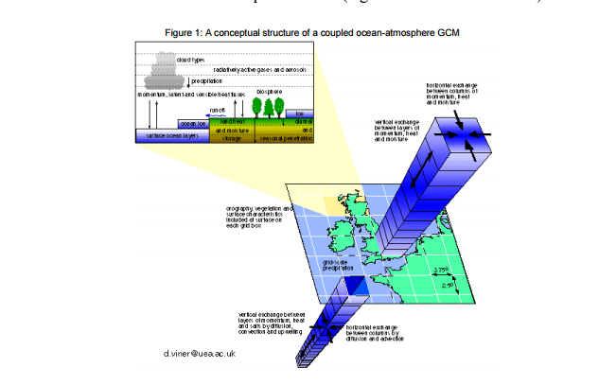
A conceptual structure of a coupled ocean-atmosphere GCM

Slide 20
Climate Change Experiments
Climate change experiments performed with GCMs can be split into two generic types:
1.Equilibrium Climate change experiments The first generation of climate change experiments were performed with atmosphere only GCMs. These were used to simulate the equilibrium response of the climate system to a n instantaneous increase (usually a doubling) of the atmospheric carbon dioxide concentration. Because of the absence of an ocean component, and because only slow computers were available, these experiments could only be performed to simulate short periods (e.g. 10 years) and their results could not be fixed to calendar years.

Slide 21
2. Transient Climate change With the advent of more powerful computers, climate change experiments could be performed with coupled ocean-atmosphere and, more recently, coupled ocean- 3 atmosphere-biosphere GCMs. The most recent climate change experiments have consisted of multi-century ensembles of integrations which have been used to investigate the response of the climate system to different scenarios of radiative forcing. One of the major implications of these experiments was that results could be fixed to calender years.

Slide 22
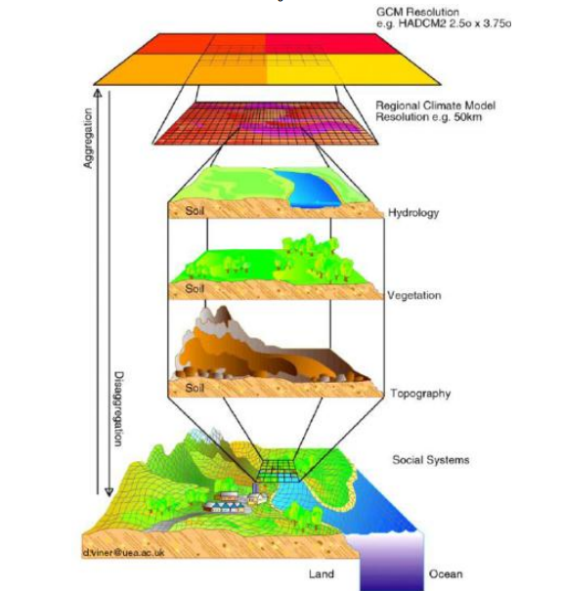
Results and Application of the results from GCM Climate Change Experiments

Slide 23
General Circulation Models and Their Role in the Climate Modeling Hierarchy
We outline the familiar concept of a hierarchy of models for solving problems in climate dynamics. General circulation models (GCMs) occupy a special position at the apex of this hierarchy, and provide the main link between basic concepts—best captured by very simple, “toy” models—and the incomplete and inaccurate observations of climate variability in space and time. We illustrate this role of GCMs in addressing the problems of climate variability on three time scales: intraseasonal, seasonal-to-interannual, and interdecadal. The problems involved require the use of atmospheric, oceanic, and coupled ocean-atmosphere GCMs. We emphasize the role of dynamical systems theory in communicating between the rungs of the modeling hierarchy—toy models, intermediate ones, and GCMs—and between modeling results and observations.

Slide 24
Atmospheric modeling
The first rung is formed by zero-dimensional (0-D) models, where the number of dimensions, from zero to three, refers to the number of independent space variables used to describe the model domain, i.e. to physical-space dimensions. Such 0-D models essentially attempt to follow the evolution of global surface-air temperature T as a result of changes in global radiative balance (Crafoord and Källén, 1978; Ghil and Childress, 1987)

Slide 25
Atmospheric modeling
There are two kinds of one-dimensional (1-D) atmospheric models, for which the single spatial variable is latitude or height, respectively. The former are so-called energy-balance models (EBMs: Budyko, 1969; Sellers, 1969),
Two-dimensional (2-D) atmospheric models are also of two kinds, according to the third space coordinate which is not explicitly included. Models that resolve explicitly two horizontal coordinates, on the sphere or on a plane tangent to it, tend to emphasize the study of the dynamics of large-scale atmospheric motions (see Sec. II below), whether they have a single layer (Charney and DeVore, 1979; Legras and Ghil, 1985) or two (Lorenz, 1963b; Reinhold and Pierrehumbert, 1982).

Slide 26
Ocean and coupled modeling
The simplest 0-D ocean models are so-called box models, used to study the stability of the oceans' thermohaline circulation (Stommel, 1961; see Sec. IV below) or biogeochemical cycles (Sarmiento and Toggweiler, 1984; Keir, 1988; Paillard et al., 1993). There are 1-D models that consider the vertical structure of the upper ocean, whether the oceanic mixed layer only (Kraus and Turner, 1967; Karaça and Müller, 1989) or the entire thermocline structure.
For the oceans, 2-D models also fall into the two broad categories of "horizontal" and "vertical."

Slide 27
Dynamical systems theory
Dynamical systems theory studies the common features of nonlinear systems of differential equations, ordinary (Smale, 1967) and partial (Constantin et al., 1989);
Dynamical systems theory studies the common features of nonlinear systems of differential equations, ordinary (Smale, 1967) and partial (Constantin et al., 1989)

Slide 28
Bifurcation theory permits one to follow—through successive bifurcations, computed analytically or numerically—climatic behavior from the simplest kind of model solutions to the most complex, from single equilibria through multiple ones and on to periodic, chaotic and fully turbulent solutions. Bifurcations can be computed analytically only for steady states (fixed points in the language of the theory) and periodic solutions (limit cycles in the same language), and for relatively simple models (Charney and DeVore, 1979; North et al., 1981; Jin and Ghil, 1990). Transitions to more complicated behavior, quasi-periodic, chaotic, or fully turbulent, need to be investigated numerically. Furthermore, even transitions to multiple equilibria or to periodic solutions need to be computed numerically in more detailed, realistic models (Ghil, 1976; Legras and Ghil, 1985; Strong et al., 1995).

Slide 29
The ergodic theory of dynamical systems provides statistical models for deterministically chaotic, as well as stochastically perturbed, climate evolution in space and time. This kind of nonlinear statistics permits one to evaluate systematically to which extent the behavior of fairly complex climate-model solutions matches that obtained with simpler, more easily understandable models, on the one hand, and that reflected by the existing observations, on the other (see, again, Ghil et al., 1991a; Ghil, 1995; and further references therein). A number of scalar quantities are obtained by applying the theory to univariate time series, such as the leading Lyapunov exponents or the various dimensions associated with the dynamical system that presumably produced the time series in question (Guckenheimer and Holmes, 1983; Drazin and King, 1992). The leading Lyapunov exponent provides a nonlinear generalization of the linear stability of a steady state; its being positive indicates that the system it characterizes is chaotic. Of the various phase-space dimensions (Eckmann and Ruelle, 1985) used to quantify a dynamical system’s number of independent degrees of freedom, the correlation dimension (Grassberger and Procaccia, 1983) became best known for its ease of computation.

Slide 30
Intraseasonal oscillations, their theory and simulation
Extratropical oscillations: observations and theory;
El Niño-Southern Oscillation, from the Devil’s Staircase to prediction;
ENSO's regularity and irregularity;
The Devil's Staircase across the modeling hierarchy;
Regularity and prediction

Slide 31
Scenarios, Ensembles and Uncertainties
Changes in Atmospheric Circulation
Changes in the Water Cycle
Changes in the Cryosphere
Changes in the Ocean
Carbon Cycle
Long-Term Climate Change, Commitment and Irreversibility
A large fraction of climate change is largely irreversible on human time scales, unless net anthropogenic carbon dioxide emissions were strongly negative over a sustained period.

Slide 32
Scenarios, Ensembles and Uncertainties
Equilibrium Climate Sensitivity and Transient Climate Response
Equilibrium Climate Sensitivity and Transient Climate Response
Some aspects of climate will continue to change even if temperatures are stabilised
Abrupt Change;
Methods to Quantify Model Agreement in Maps;
Joint Projections of Multiple Variables

Slide 33
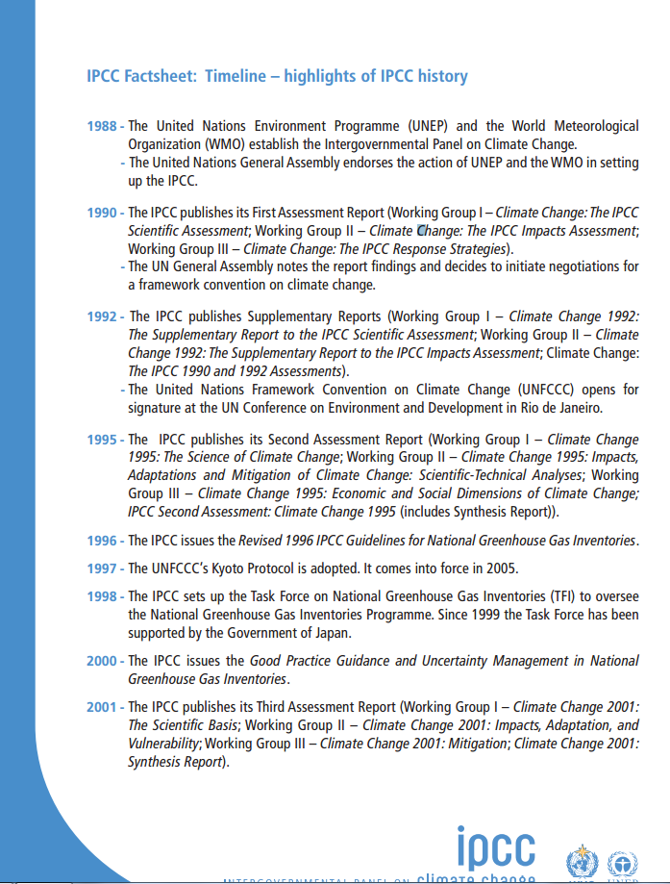
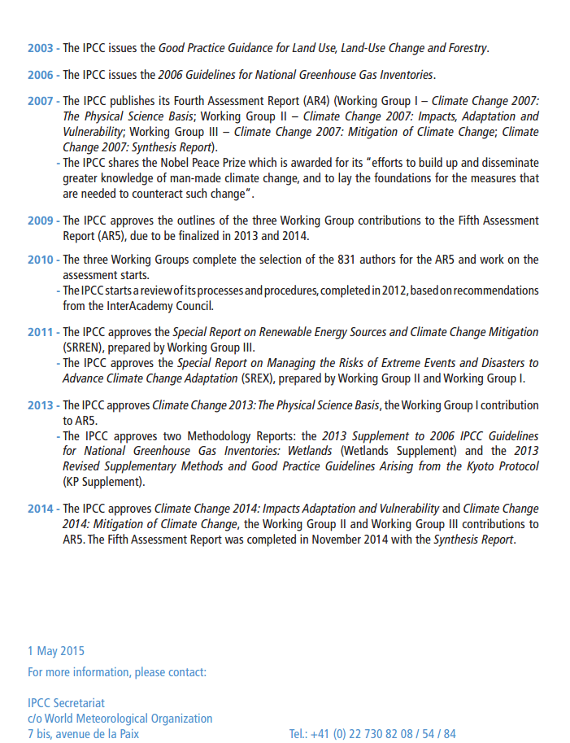

Slide 34
CMIP - Coupled Model Intercomparison Project
Under the World Climate Research Programme (WCRP) the Working Group on Coupled Modelling (WGCM) established the Coupled Model Intercomparison Project (CMIP) as a standard experimental protocol for studying the output of coupled atmosphere-ocean general circulation models (AOGCMs). CMIP provides a community-based infrastructure in support of climate model diagnosis, validation, intercomparison, documentation and data access. This framework enables a diverse community of scientists to analyze GCMs in a systematic fashion, a process which serves to facilitate model improvement. Virtually the entire international climate modeling community has participated in this project since its inception in 1995. The Program for Climate Model Diagnosis and Intercomparison (PCMDI) archives much of the CMIP data and provides other support for CMIP. PCMDI's CMIP effort is funded by the Regional and Global Climate Modeling (RGCM) Program of the Climate and Environmental Sciences Division of the U.S. Department of Energy's Office of Science, Biological and Environmental Research (BER) program.
Coupled atmosphere-ocean general circulation models allow the simulated climate to adjust to changes in climate forcing, such as increasing atmospheric carbon dioxide. CMIP began in 1995 by collecting output from model "control runs" in which climate forcing is held constant. Later versions of CMIP have collected output from an idealized scenario of global warming, with atmospheric CO2 increasing at the rate of 1% per year until it doubles at about Year 70. CMIP output is available for study by approved diagnostic sub-projects.

Slide 35
CMIP5 - Coupled Model Intercomparison Project Phase 5
At a September 2008 meeting involving 20 climate modeling groups from around the world, the WCRP's Working Group on Coupled Modelling (WGCM), with input from the IGBP AIMES project, agreed to promote a new set of coordinated climate model experiments. These experiments comprise the fifth phase of the Coupled Model Intercomparison Project (CMIP5). CMIP5 will notably provide a multi-model context for 1) assessing the mechanisms responsible for model differences in poorly understood feedbacks associated with the carbon cycle and with clouds, 2) examining climate “predictability” and exploring the ability of models to predict climate on decadal time scales, and, more generally, 3) determining why similarly forced models produce a range of responses.

Slide 36
Regional and local scenarios: downscaling
IPCC scenario downscaling - ApproachDownscaling of IPCC scenarios refers to a process of taking global information on climate response to changing atmospheric composition, and translating it to a finer spatial scale that is more meaningful in the context of local and regional impacts. Two general approaches are used in downscaling:
Dynamical, where a high resolution regional climate model with a better representation of local terrain simulates climate processes over the region of interest.
Statistical downscaling, where large scale climate features are statistically related to fine scale climate for the region.
The advantage of using dynamical downscaling is that a regional model can simulate local fine-scale feedback processes not anticipated with statistical methods. The disadvantage, however, is that the regional models are far more computationally requiring and that the end performance is highly dependent on the quality of the input data.

Slide 37
CORDEX: COordinated Regional climate Downscaling Experiment
CORDEX is a WCRP-sponsored program to organize an international coordinated framework to produce an improved generation of regional climate change projections world-wide for input into impact and adaptation studies within the AR5 timeline and beyond (visit the web of the kick-off workshop on evaluating and improving regional climate projections held in Toulouse).
CORDEX will produce an ensemble of multiple dynamical and statistical downscaling models considering multiple forcing GCMs from the CMIP5 archive. Initially a 50 km grid spacing has been selected, favoring engagement of wider community. Multiple common domains covering all (or most) land areas in the World have been selected (with initial focus on AFRICA).

Slide 38
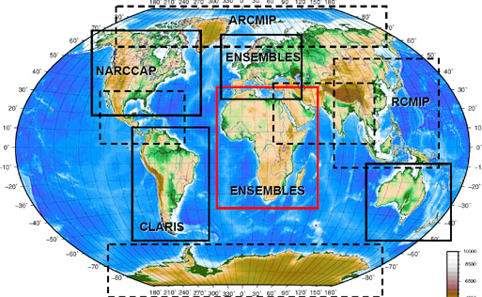
CORDEX Domains

