Slide 1
RegCM model
Nato Kutaladze
VI-SEEM national training event

Slide 2
OUTLINE
RegCM4 model code, installation, structure, main steps to run model Description of tools and software for models output manipulation, visualization and interpretation
(CDO, Grads), some examples of operating on output files with GIS.
1. RegCM4 model output files, format and structure;
2. CDO and GRADS, main examples of RegCM4 model output files processing;
3. GIS and RegCM4 output files.

Slide 3
RegCM Model
RegCM3 is comprised of a dynamical core (Grell and others, 1995), physics representing radiative transfer (Kiehl and others, 1996), large-scale or dynamic precipitation (Pal and others, 2000), convective precipitation (Grell, 1993), a planetary boundary layer component (Holtslag and others, 1990; Holtslag and Boville, 1993), a biosphere component BATS (Dickinson and others, 1993), representation of open ocean (Dickinson and others,1993; Zeng and others, 1998) and closed water bodies (lakes) (Hostetler and Bartlein, 1990; Hostetler and others, 1993; Small and others, 1999) and atmospheric chemistry and aerosols (Qian and others, 2001). These components are coupled and interactive.

Slide 4
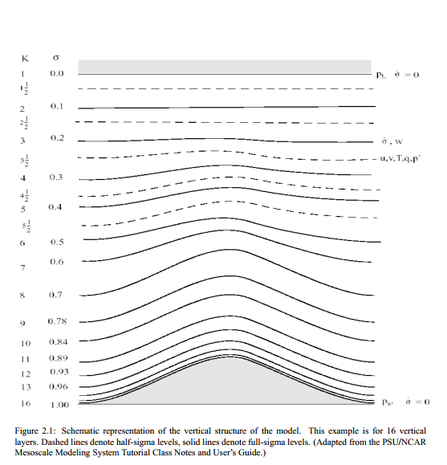
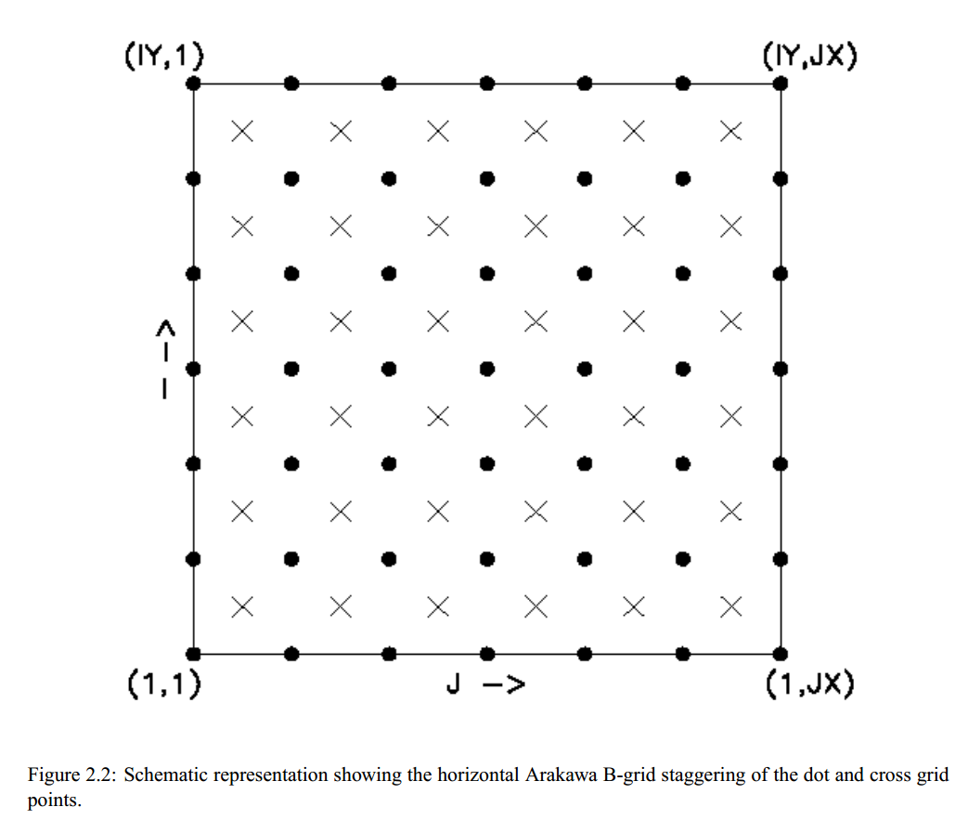
The RegCM Model Horizontal and Vertical Grid

Slide 5
RegCM3 requires time-dependent lateral (that is, vertical profiles of wind, temperature, and humidity) and surface [surface pressure and sea surface temperature (SST)] boundary conditions that are continuously updated every 6 hours of simulation. The lateral boundary conditions derived from GCM output are assimilated into the RegCM3 with exponential decay in space over 12 grid cells around the perimeter of the model domain. Boundary conditions for RCMs are derived by preprocessing saved GCM fields into a standard format that can be read into the model. Virtually all GCM history files differ both in their format and composition so it is necessary to develop specialized preprocessing codes to accommodate GCM-specific output.

Slide 6
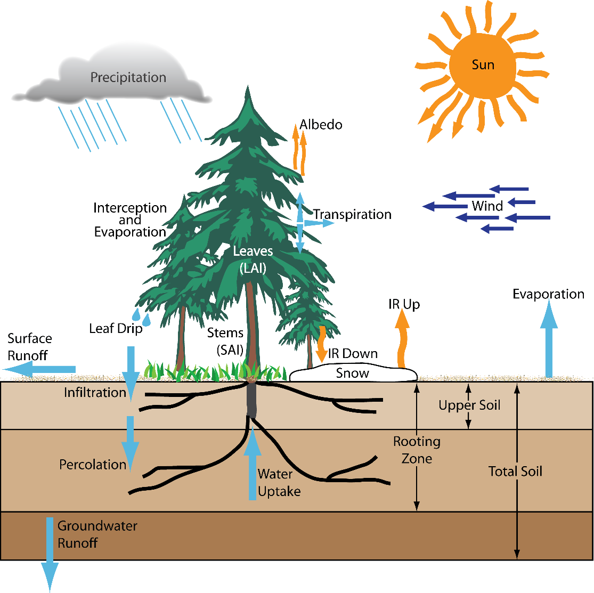
BATS
Energy, water, and momentum are exchanged between the surface and atmosphere through the atmospheric boundary layer. The surface is represented by the BATS (Dickinson and others, 1993, figure below) that simulates surface processes related to vegetation (for example, evapotranspiration, leaf temperature, and phenology) and hydrology (for example, soil moisture, runoff, and snow) that vary in response to atmospheric conditions.

Slide 7
Model components
The RegCM modeling system has four components: Terrain, ICBC, RegCM, and Postprocessor. Terrain and ICBC are the two components of RegCM preprocessor. Terrestrial variables (including elevation, landuse and sea surface temperature) and three-dimensional isobaric meteorological data are horizontally interpolated from a latitude longitude mesh to a high-resolution domain on either a Rotated (and Normal) Mercator, Lambert Conformal, or Polar Stereographic projection. Vertical interpolation from pressure levels to the σ coordinate system of RegCM is also performed. σ surfaces near the ground closely follow the terrain, and the higher-level σ surfaces tend to approximate isobaric surfaces.

Slide 8
Scientific description of RegCM4.0
RegCM4.0 is
The latest version of RegCM
Designed by International Center for Theoretical Physics (ICTP), Trieste, Italy
A non-hydrostatic, σ-coorindate, primitive equation model
Developed by fortran-95 language
Having four components such as Terrain, ICBC, RegCM, and Postprocessor
    Terrain and ICBC are the two components of RegCM preprocessor
8

Slide 9
Technical details before Grid
Operating System (OS)
Any suitable version of LINUX/UNIX
Compilers
The model can be run with the following compilers:
    gfortran/sunf90
      These are general fortran-95 compiler on different Linux distribution
      gfortran compiler version should be > 4.2
      These compilers are not sufficient to compile all the module of the model (Serial Part only)
Compilers Contd…
9

Slide 10
Technical details before Grid
2. pgi compiler(pgf90/pgcc)
    Portland Group Fortran compiler
    It is not freely available
    The version should be >= 10
3. Intel Fortran Compiler (ifort/icc)
    This is a very popular fortran compiler
    It is freely available
    For our case this is the most efficient one
Python
  This is required for some utility tools of the model
  The version should be >= 2.5
10

Slide 11
Technical details before Grid
Libraries
1. NetCDF libraries with HDF5 and zlib or szlib
    Input/Output of RegCM4.0 stored in NetCDF format
    Includes data compression through HDF file format & compression library (zlib or szlib)
2. Message Passing Interface (MPI)
  RegCM4.0 supports Parallel execution through MPI interface
  Offers libraries, compiler wrappers and program that execute parallel code
  Generally, openmpi-1.4.3 is used
Kolkata, EPIKH Workshop, 18.02.2011

Slide 12
Run Environment
Run Environment We setup a run environment and start the setup
cd /scratch/$USER
mkdir -p run/{input,output}
cd run
ln -sf /scratch/$USER/RegCM-4.3-rc1/Bin .
cp /scratch/$USER/RegCM-4.3-rc1/Testing/test_001.in .
gedit test_001.in

Slide 13
Running the model
./Bin/terrain test_001.in
./Bin/sst test_001.in
./Bin/icbc test_001.in
mpirun -np 2 ./Bin/regcmMPI test_001.in
We can now go to step 2, analize the output.

Slide 14
Fortran Namelist file
&nl_name
key1 = 0,
key2 = 0.0,
key3 = ’a string’,
key4 = 1.0,2.0,
/
program test
implicit none
integer :: key1
real :: key2
character(len=16) :: key3
real , dimension(8) :: key4
namelist /nl_name/ key1,key2,key3,key4
open(unit=200,file=’test.namelist’, &
status=’old’,action=’read’)
read(unit=200,nml=nl_name)
end program test

Slide 15
Coreparam namelist
Choice of the dynamical core
!
&coreparam
idynamic = 1, ! Choice of dynamical core
! 1 = MM4 hydrostatical core
! 2 = MM5 NON hydrostatical core
/

Slide 16
Dimparam namelist
&dimparam
iy = 34, ! This is number of points in the N/S direction
jx = 48, ! This is number of points in the E/W direction
kz = 18, ! Number of vertical levels
dsmin = 0.01, ! Minimum sigma spacing (only used if kz is not 14, 18, or 23)
dsmax = 0.05, ! Maximum sigma spacing (only used if kz is not 14, 18, or 23)
nsg = 1, ! For subgridding, number of points to decompose. If nsg=1,
! no subgridding is performed. CLM does NOT work as of now with
! subgridding enabled.
njxcpus = -1, ! Number of CPUS to be used in the jx (lon) dimension.
! If <=0 , the executable will try to figure out a suitable
! decomposition.
niycpus = -1, ! Number of CPUS to be used in the iy (lat) dimension.
! If <=0 , the executable will try to figure out a suitable
! decomposition.
/

Slide 17
Geomparam namelist
&geoparam
iproj = ’LAMCON’, ! Domain cartographic projection. Supported values are:
! ’LAMCON’, Lambert conformal.
! ’POLSTR’, Polar stereographic.
! ’NORMER’, Normal Mercator.
! ’ROTMER’, Rotated Mercator.
ds = 60.0, ! Grid point horizontal resolution in km
ptop = 5.0, ! Pressure of model top in cbar
clat = 45.39, ! Central latitude of model domain in degrees
! North hemisphere is positive
clon = 13.48, ! Central longitude of model domain in degrees
! West is negative.
plat = 45.39, ! Pole latitude (only for rotated Mercator Proj)
plon = 13.48, ! Pole longitude (only for rotated Mercator Proj)
truelatl = 30.0, ! Lambert true latitude (low latitude side)
truelath = 60, ! Lambert true latitude (high latitude side)
i_band = 0, ! Use this to enable a tropical band. In this case the ds,
! iproj, clat, clon parameters are not considered.
/

Slide 18
Terrainparam namelist
&terrainparam
domname = ’AQWA’, ! Name of the domain/experiment.
! Controls naming of input files
smthbdy = .false., ! Smoothing Control flag
! true -> Perform extra smoothing in boundaries
lakedpth = .false., ! If using lakemod (see below), produce from
! terrain program the domain bathymetry
ltexture = .false., ! If using DUST tracers (see below), produce
! the domain soil texture dataset
lsmoist = .false., ! Use Satellite Soil Moisture Dataset for
! initialization of soil moisture.
fudge_lnd = .false., ! Fudging Control flag, for landuse of grid
fudge_lnd_s = .false., ! Fudging Control flag, for landuse of subgrid
fudge_tex = .false., ! Fudging Control flag, for texture of grid
fudge_tex_s = .false., ! Fudging Control flag, for texture of subgrid
fudge_lak = .false., ! Fudging Control flag, for lake of grid
fudge_lak_s = .false., ! Fudging Control flag, for lake of subgrid
h2opct = 50., ! Surface min H2O percent to be considered water
h2ohgt = .false., ! Allow water points to have hgt greater than 0
ismthlev = 1, ! How many times apply the 121 smoothing
dirter = ’input/’, ! Output directory for terrain files
inpter = ’globdata/’, ! Input directory for SURFACE dataset
moist_filename = ’moist.nc’, ! Read initial moisture and snow from this file
/

Slide 19
Glob datparam namelist
&globdatparam
ibdyfrq = 6, ! boundary condition interval (hours)
ssttyp = ’OI_WK’, ! Type of Sea Surface Temperature used
! One in: GISST, OISST, OI2ST, OI_WK, OI2WK,
! FV_A2, FV_B2, EH5A2, EH5B1, EHA1B,
! EIN75, EIN15, ERSST, ERSKT, CCSST,
! CA_XX, HA_XX, EC_XX, IP_XX, GF_XX,
! CN_XX, MP_XX
dattyp = ’EIN15’, ! Type of global analysis datasets used
! One in: ECMWF, ERA40, EIN75, EIN15, EIN25,
! ERAHI, NNRP1, NNRP2, NRP2W, GFS11,
! FVGCM, FNEST, EH5A2, EH5B1, EHA1B,
! CCSMN, ECEXY, CA_XX, HA_XX, EC_XX,
! IP_XX, GF_XX, CN_XX, MP_XX
! with XX for CMIP5 datasets in 26, 45, 85
chemtyp = ’MZ6HR’, ! Type of Global Chemistry boundary conditions
! One in : MZ6HR, 6 hours MOZART output
! : MZCLM, MOZART climatology 1999-2009
gdate1 = 1990060100, ! Start date for ICBC data generation
gdate2 = 1990070100, ! End data for ICBC data generation
calendar = ’gregorian’, ! Calendar type : gregorian, noleap, 360_day
dirglob = ’input/’, ! Path for ICBC produced input files
inpglob = ’globdata/’, ! Path for ICBC global input datasets.
ensemble_run = .false., ! If this is a member of a perturbed ensemble
! run. Activate random noise added to input
! ICBC controlled by the perturbparam stanza
! Look http://users.ictp.it/~pubregcm/RegCM4/globedat.htm
! on how to download them./

Slide 20
Timeparam namelists
&timeparam
dt = 150., ! time step in seconds
dtrad = 0., ! time interval solar radiation calculated (minutes)
dtabem = 0., ! time interval absorption-emission calculated (hours)
dtsrf = 0., ! time interval at which land model is called (seconds)
dtcum = 0., ! time interval at which cumuls is called (seconds)
dtche = 900., ! time interval at which chem model is called (seconds)
/

Slide 21
Boundaryparam namelist
&boundaryparam
nspgx = 12, ! nspgx-1 represent the number of cross point slices on
! the boundary sponge or relaxation boundary conditions.
nspgd = 12, ! nspgd-1 represent the number of dot point slices on
! the boundary sponge or relaxation boundary conditions.
high_nudge = 3.0D0, ! Nudge value high range
medium_nudge = 2.0D0, ! Nudge value medium range
low_nudge = 1.0D0 ! Nudge value low range
/

Slide 22
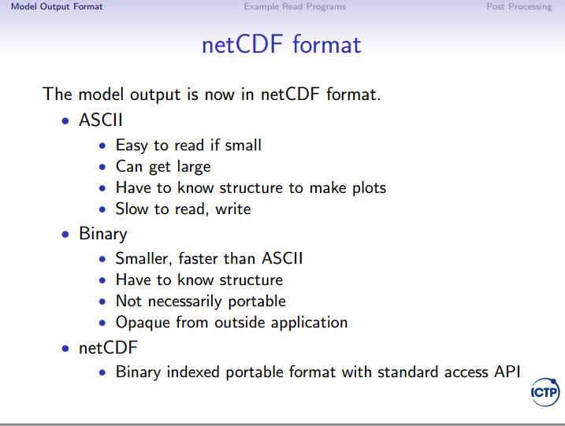

Slide 23
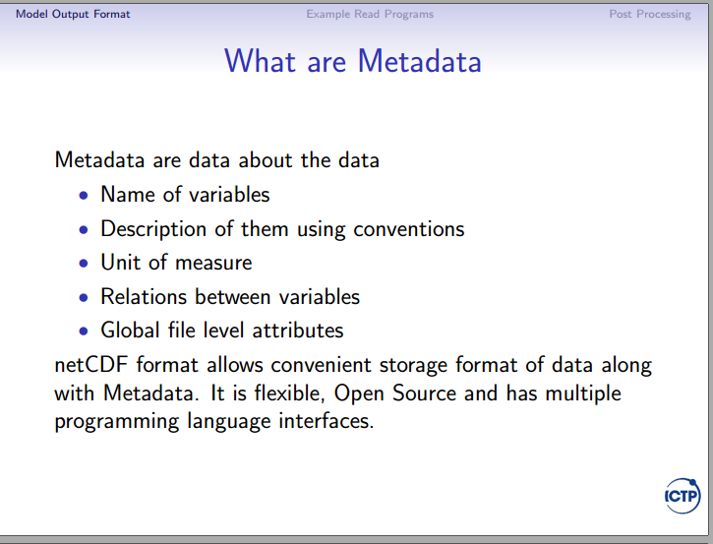

Slide 24
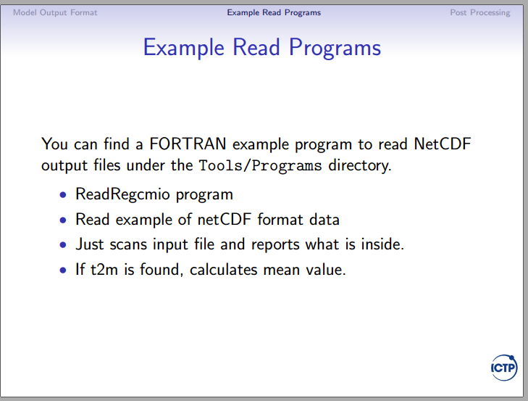

Slide 25
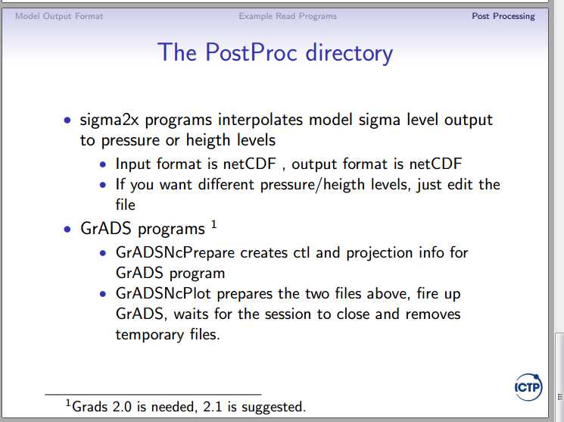

Slide 26
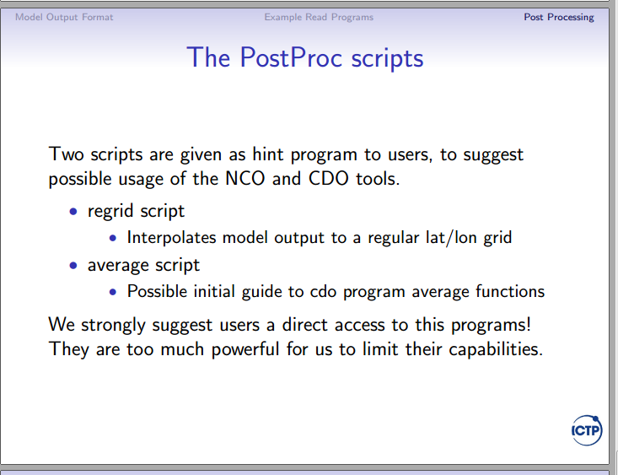

Slide 27
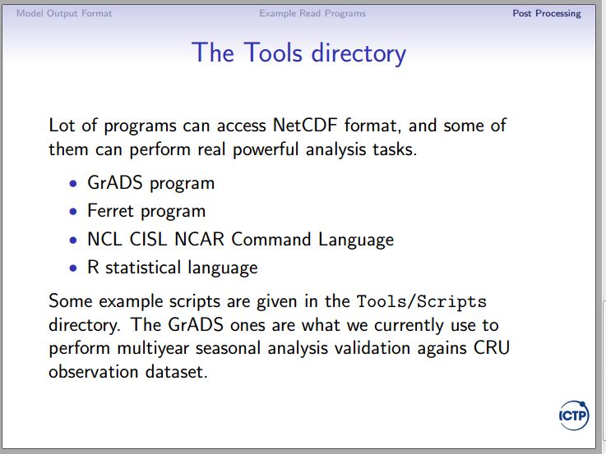

Slide 28
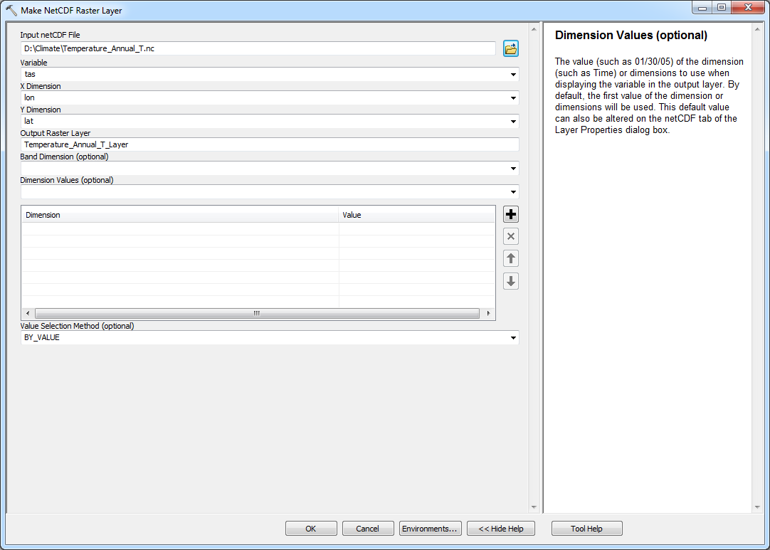
RegCM output in GIS
Make NetCDF Raster Layer (Multidimension)

Slide 29
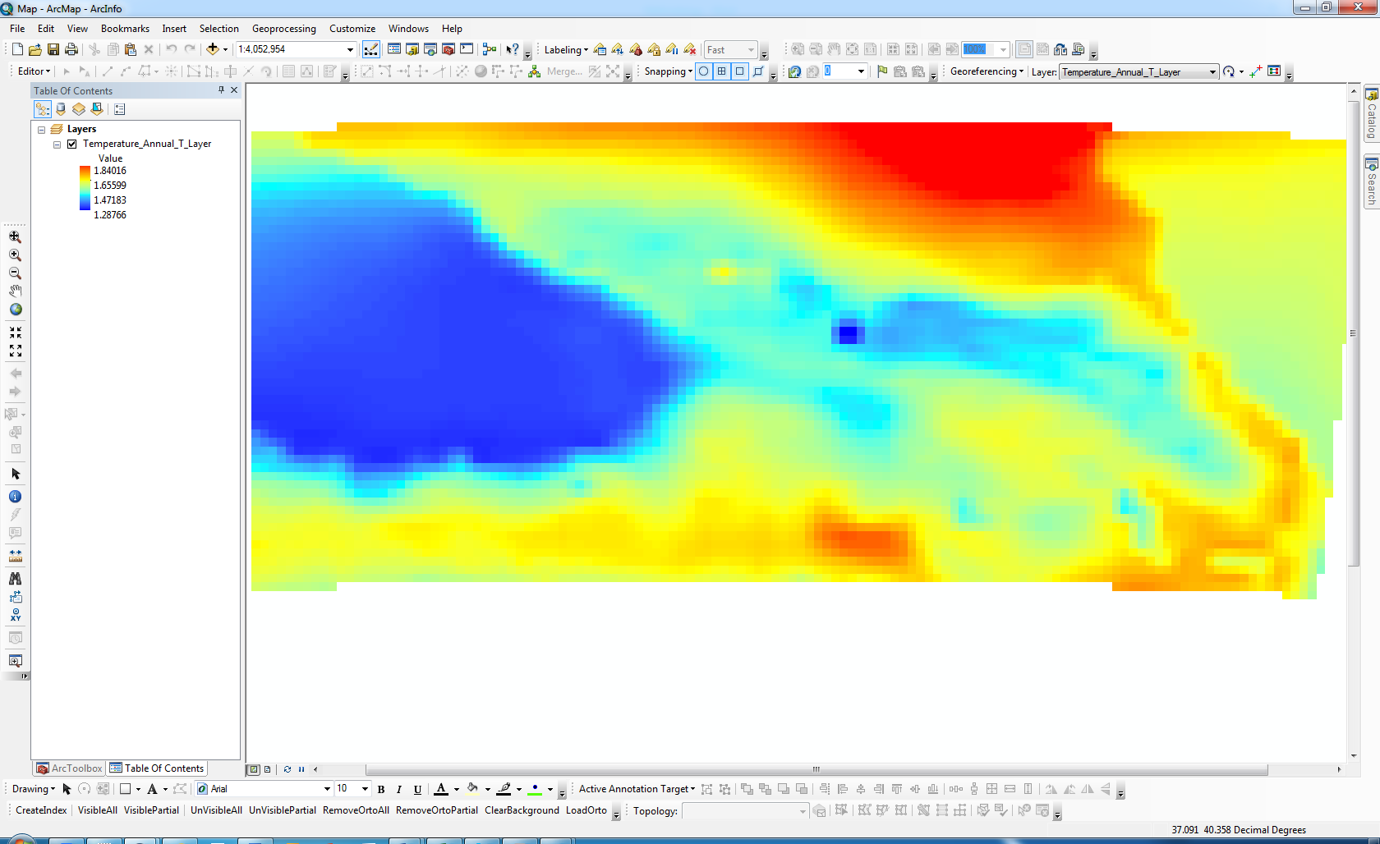
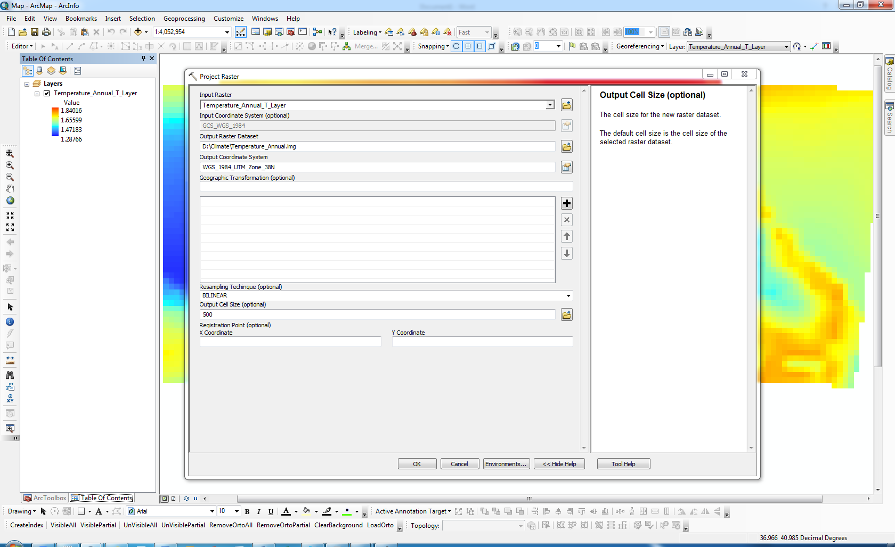
Project Raster -(Data Management)

Slide 30
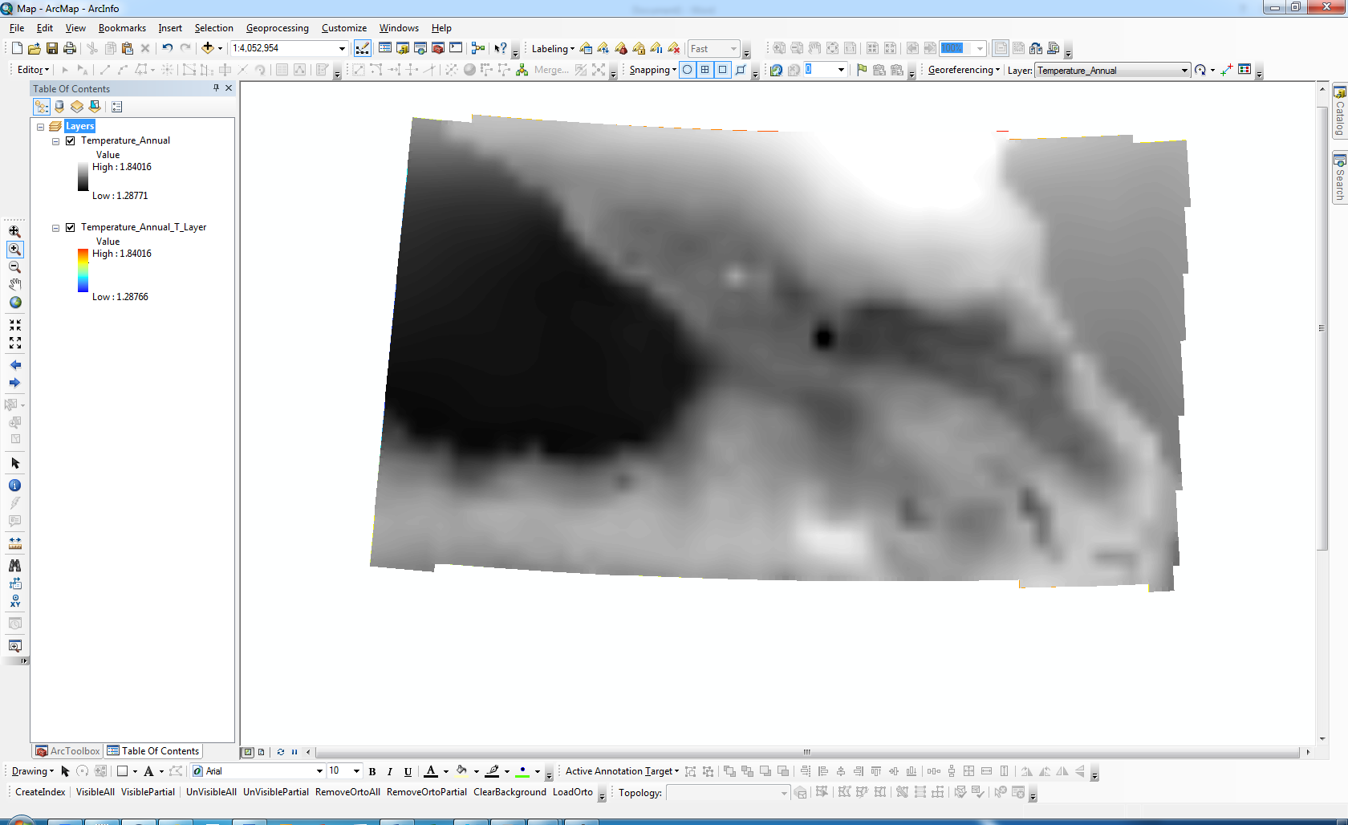
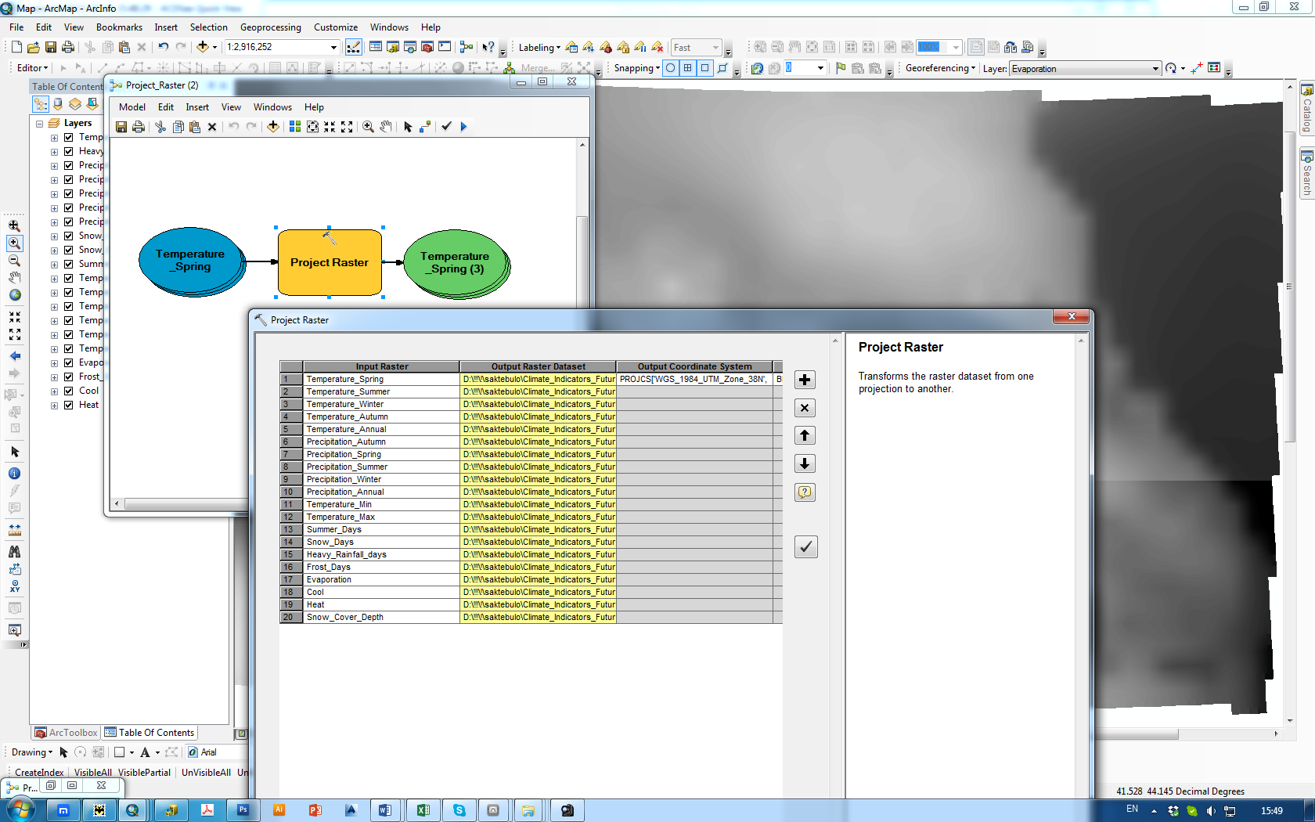
From layer to Raster

