Slide 1

National Scientific Library at Tbilisi State University
Setup and run WRF-Chem model
over the south Caucasus domain
George Mikuchadze

Slide 2
WRF-Chem
WRF-Chem is the Weather Research and Forecasting (WRF) model coupled with Chemistry. The model simulates the emission, transport, mixing, and chemical transformation of trace gases and aerosols simultaneously with the meteorology. The model is used for investigation of regional-scale air quality, field program analysis, and cloud-scale interactions between clouds and chemistry. It is a state-of-the-art system for simulation and prediction of weather, climate, air quality and dispersion of pollutants.
Current version of WRF-Chem (3.8) contains multiple parameterizations to simulate greenhouse gases, dust, fires, volcanoes, gas and aerosol chemistry (ranging from simple to more complex schemes), meteorology-chemistry interactions and so on.

Slide 3
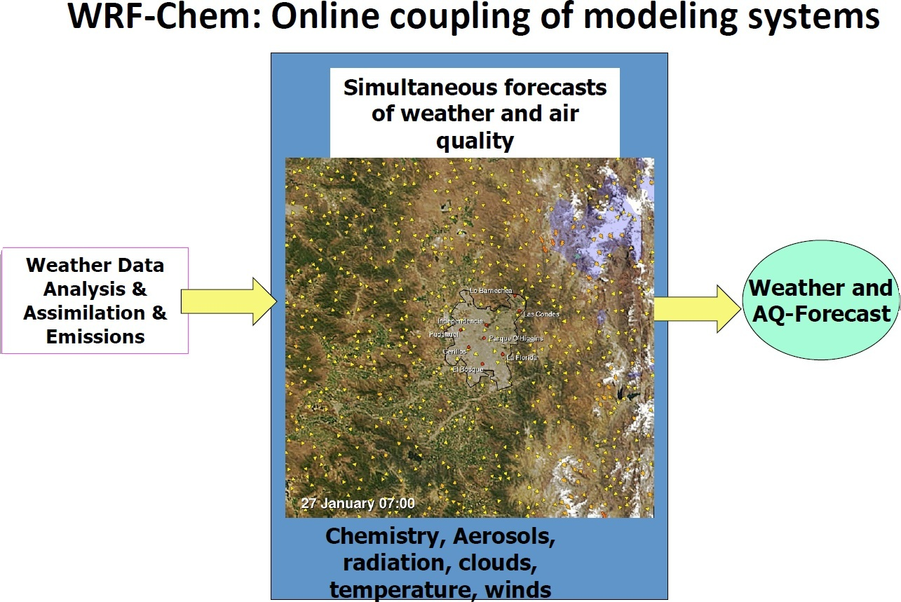

Slide 4
WRF-Chem
We use WRF model both ARW and NMM cores since 2008 and have more than 1000 runs of it. NMM core (v3.6) is our numerical weather prediction model in National Environmental Agency of Georgia since June 2014.
Since Nov 2015 we use WRF-Chem model (v3.7) for the modeling of dust erosions over the south Caucasus domain. From June 2016 we upgraded the model to the version 3.8.

Slide 5
WRF-Chem: Download code
For the setup of WRF-Chem one needs to download both WRF and chemistry codes from WRF web page: http://www2.mmm.ucar.edu/wrf/users/download/get_sources.html. Also the following libraries: NetCDF/HDF5, Jasper and PNG have to be installed.
One has to download WRF-ARW tar file (WRFV3.8.TAR.gz) WRF-Chemistry code tar file, the same version (WRFV3-Chem-3.8.TAR.gz) and WRF Preprocessing System (WPS) tar file, also the same version (WPSV3.8.TAR.gz).
Unzip tar files: WRFV3.8.TAR.gz -> WRFV3, WRF-Chemistry code tar file in WRFV3 directory WRFV3-Chem-3.8.TAR.gz -> WRFV3/Chem and WPSV3.8.TAR.gz -> WPS (in the directory, where WRFV3 is located).

Slide 6
WRF-Chem: Compile code
Set environmental variables:
Define which model core to build (use ARW only) - setenv EM_CORE 1 / export EM_CORE=1
Include Chemistry code in WRF model - setenv WRF_CHEM 1 / export WRF_CHEM=1
Use/(not use) Kinetic Pre-Processor (KPP) - setenv WRF_KPP 1(use) or setenv WRF_KPP 0 (no KPP)
setenv FLEX_LIB_DIR /usr/lib Or export FLEX_LIB_DIR=/usr/lib
setenv YACC ‘/usr/bin/yacc –d’ Or export YACC= ‘/usr/bin/yacc –d’
Go to the WRV3 directory; configure and issue “compile em_real” command.
Check if “real.exe and wrf.exe” files are created in WRFV3/main directory.
Go to the WPS directory; configure and compile Preprocessing files: mainly “geogrid.exe, ungrib.exe and metgrid.exe”. For our purpose these 3 files are quite enough.

Slide 7
WRF-Chem: Run
WRF-Chem modeling system follows the same structure as the WRF model by consisting of these major programs:
― The WRF Pre-Processing System (WPS)
― WRF-Var data assimilation system
― WRF solver (ARW core only) including chemistry
― Post-processing and visualization tools

Slide 8
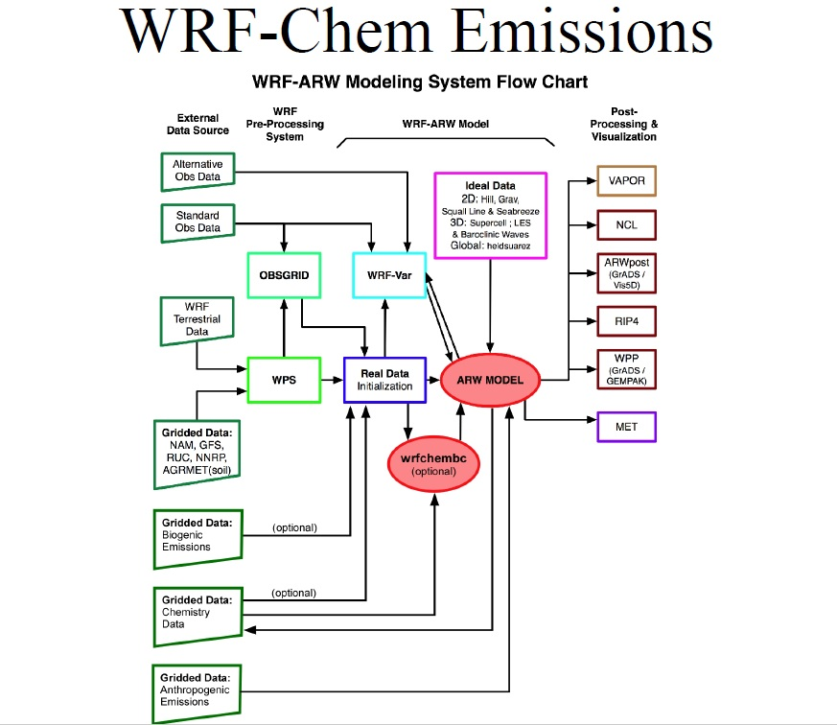

Slide 9
WRF-Chem: Run
To run the WRF-Chem one needs special files located in the specified directory: above mentioned files “geogrid.exe, ungrib.exe and metgrid.exe” with GEOGRID.TBL.ARW_CHEM (renamed to GEOGRID.TBL), METGRID.TBL.ARW (renamed to METGRID.TBL) and Vtable.GFS (renamed to Vtable) files in wpsprd directory for the preprocessing, and “real.exe and wrf.exe” files with appropriate configuration files in the wrfprd directory for the model run.
Except these software files, description of preconfigured domain (may be with nested one) is required, which is presented in “namelist.wps and namelis.input” files.
For the dust only simulation we use the following chemistry options:
chem_opt = 401,
chemdt = 5,
dust_opt = 1

Slide 10
WRF-Chem: Run
For this case there is no difference between run schemes for normal WRF (ARW core) and WRF-Chem, because additional data dealing with chemistry are provided by WPS (GEOGRID.TBL has dust emission fields) as well as GFS grib files contain distributed data of mineral dust.
For the post processing and visualization of results we use NCL (NCAR Command Language) and VAPOR (Visualization and Analysis Platform for Ocean, Atmosphere, and Solar Researchers).

Slide 11
