Slide 1

VI-SEEM Data Repository
Vladimir Slavnić
Research Assistant
Institute of Physics Belgrade

Slide 2
Agenda
VI-SEEM Repository
Underlying Technology
Benefits of VI-SEEM Repo
Features
Types of data
Information Model
The DSPACE (VI-SEEM Repo) Architecture
Repository Organization
Live Demo

Slide 3
VI-SEEM Repository
The VI-SEEM Repository provides long term data preservation, suitable for data set sharing
https://repo.vi-seem.eu/
Use cases
To store curated data sets for long term preservation
To share those datasets with selected collaborators or open them up to whole communities, via web interface
To make such data sets searchable by means of associating meta data and then harvesting them
Enables scientific communities to capture and describe digital works using a custom submission workflow module

Slide 4
Underlying Technology
Based on DSpace
DSpace is a platform that allows you to capture items in any format – in text, video, audio, and data. It distributes it over the web. It indexes your work, so users can search and retrieve your items. It preserves your digital work over the long term.
Developed by the MIT Libraries with support from the HP-MIT Alliance
A platform to build an Institutional Repository

Slide 5
Benefits of VI-SEEM Repo
Some example benefits:
Getting your research results out quickly, to a worldwide audience
Reaching a worldwide audience through exposure to search engines such as Google
Storing reusable teaching materials that you can use with course management systems
Archiving and distributing material you would currently put on your personal website
Storing examples of students’ projects (with the students’ permission)
Showcasing students’ theses (again with permission)
Keeping track of your own publications/bibliography
Having a persistent network identifier for your work, that never changes or breaks
No more page charges for images. You can point to your images’ persistent identifiers in your published articles.

Slide 6
Features
User Interface
Web based, for submission, end-user and System Administrators
Search and retrieval of items by browsing or searching the metadata
Workflow
Enables differing submission workflows for communities
Models "e-people" who have "roles" in the workflow of a particular Community in the context of a given collection
Open Archives Initiative (OAI)
OAI-PMH 2.0 Compatible and uses used the OCLC OAICat -> For integration with VI-SEEM Data Search platform (to be available soon)
Persistent Identifiers (Handles)
Implements CNRI handles as the persistent identifier associated with each item
Soon to be integrated with the VI-SEEM PID service
Access Control
Allows contributors to limit access to items in the repository, at both the collection and the individual item level
Integrated with the VI-SEEM Login Service
Metadata Schema
Utilises Qualified Dublin Core

Slide 7
Types of data in the VI-SEEM Repository
Articles
Preprints, e-prints
Technical Reports
Working Papers
Conference Papers
E-theses
Audio/Video
Lecture notes, Visualizations, simulations
Datasets in various formats
Experimental
Simulation
Input
Output
Images
Visual, scientific
Teaching material
Digitized library collections

Slide 8
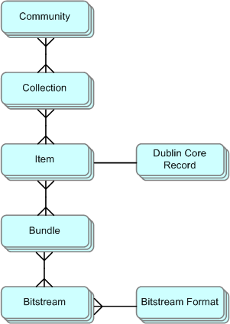
Information Model
Communities
Departments, Labs, Research Centers, Schools…
Collections (in communities)
Distinct groupings of like items
Items (in collections)
Logical content objects
Receive persistent identifier
Bitstreams (in items)
Individual files
Receive preservation treatment
Versioning- Item “versions” can be
All instances of a work in different formats
E.g. the XML, PDF, and PostScript versions
All editions of a work over time
Metadata lists all available versions of items

Slide 9
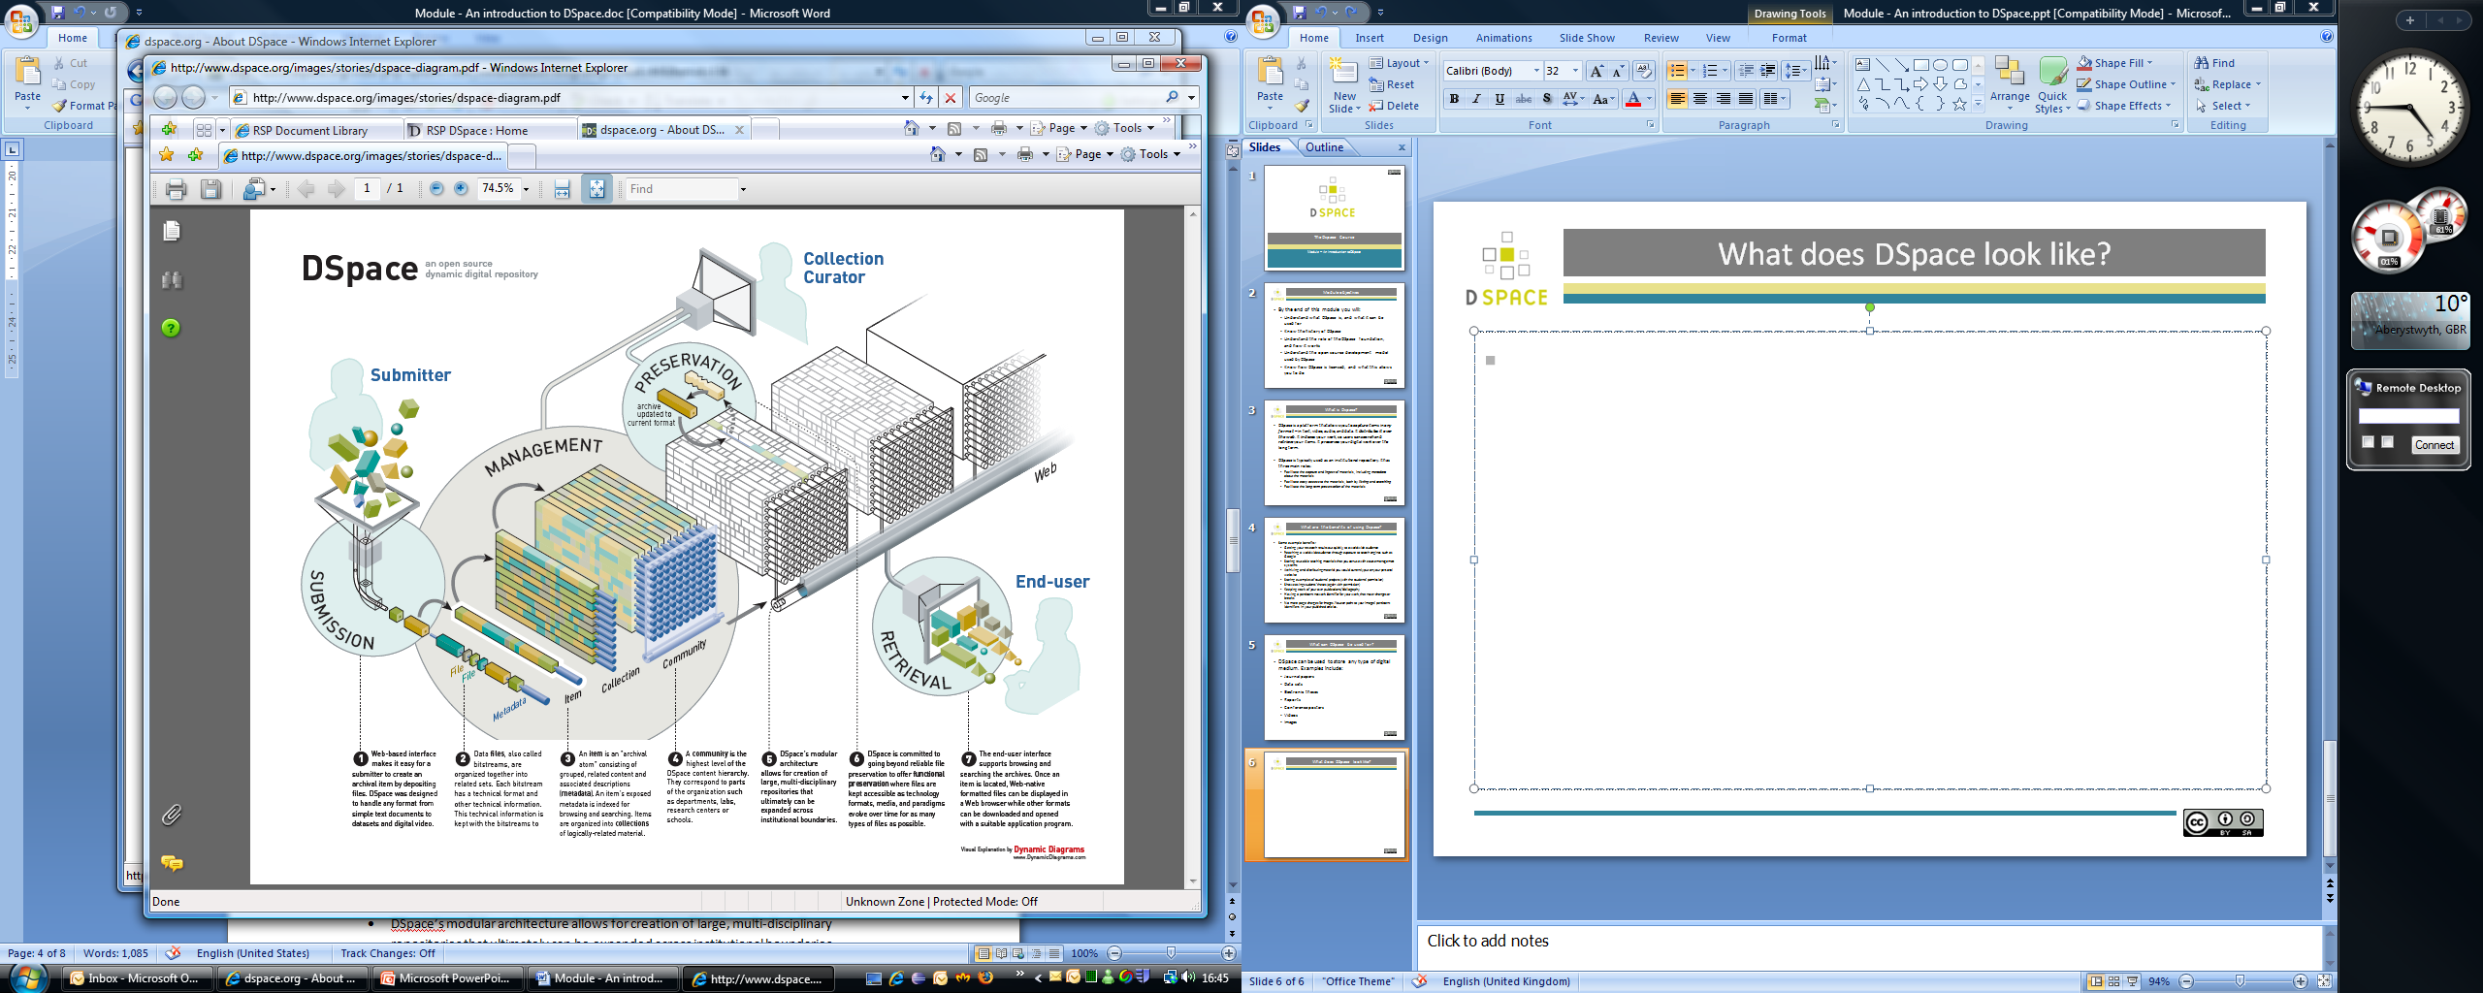
The DSpace (VI-SEEM Repo) Architecture

Slide 10
Repository Organization
Each Dspace service is comprised of Communities – the highest level of the Dspace content hierarchy
Communities may be:
Departments
Labs
Research Centres
Schools
Each community contains descriptive metadata about itself and the collections contained within it

Slide 11
Collections
Each community in turn have collections which contain items or files
Collections can belong to a single community or multiple communities (collaboration between communities may result in a shared collection)
As with communities, each collection contains descriptive metadata about itself and the items contained within it

Slide 12
Example Structures
Structures may be based around organizational units:
Structures are hierarchical:
Community | Collection | Items
Life Sciences | MD Data | Items
Climate | Future Climate Modelling | Items
Digital Cultural Heritage | Social Sciences Library | Items
Community | Sub Community | Collection | Item
Life Sciences | Molecular Dynamics | Cancer Related Data | ....

Slide 13
Live Demo

Slide 14
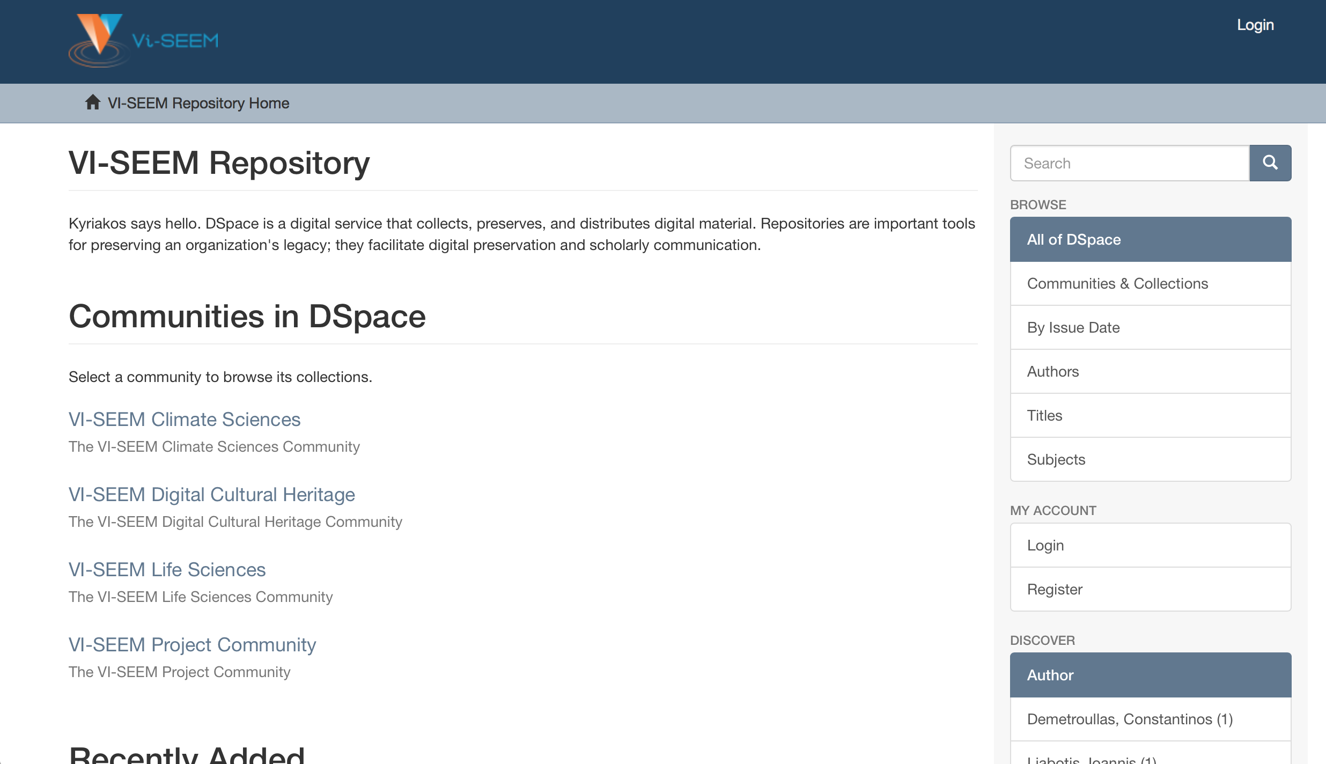

Slide 15
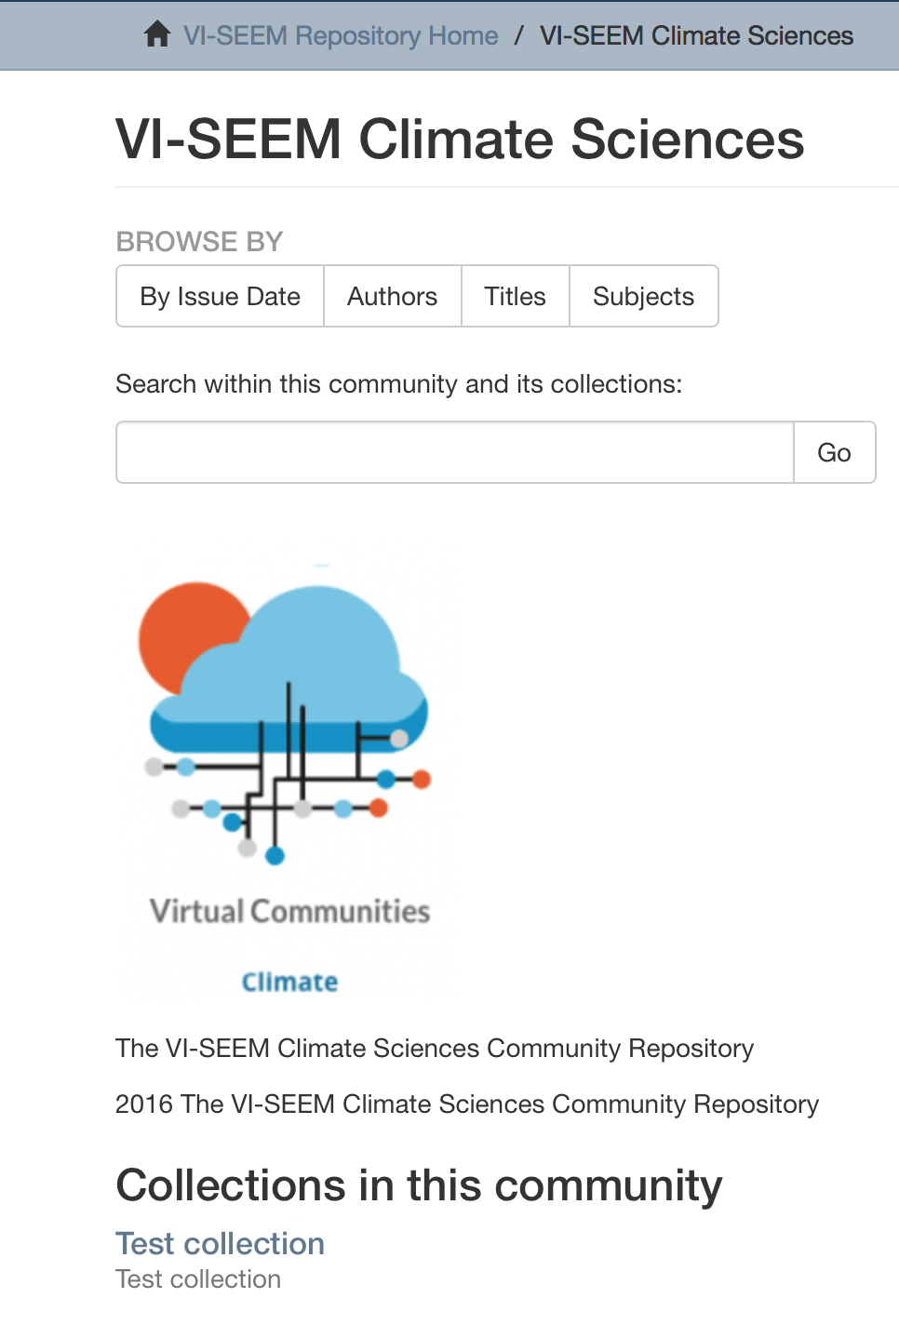
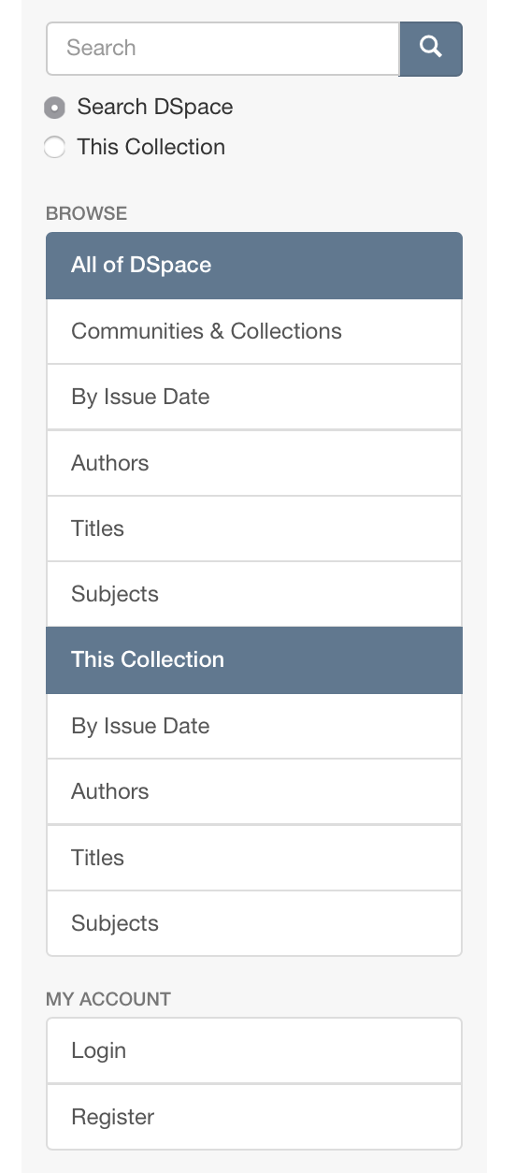

Slide 16
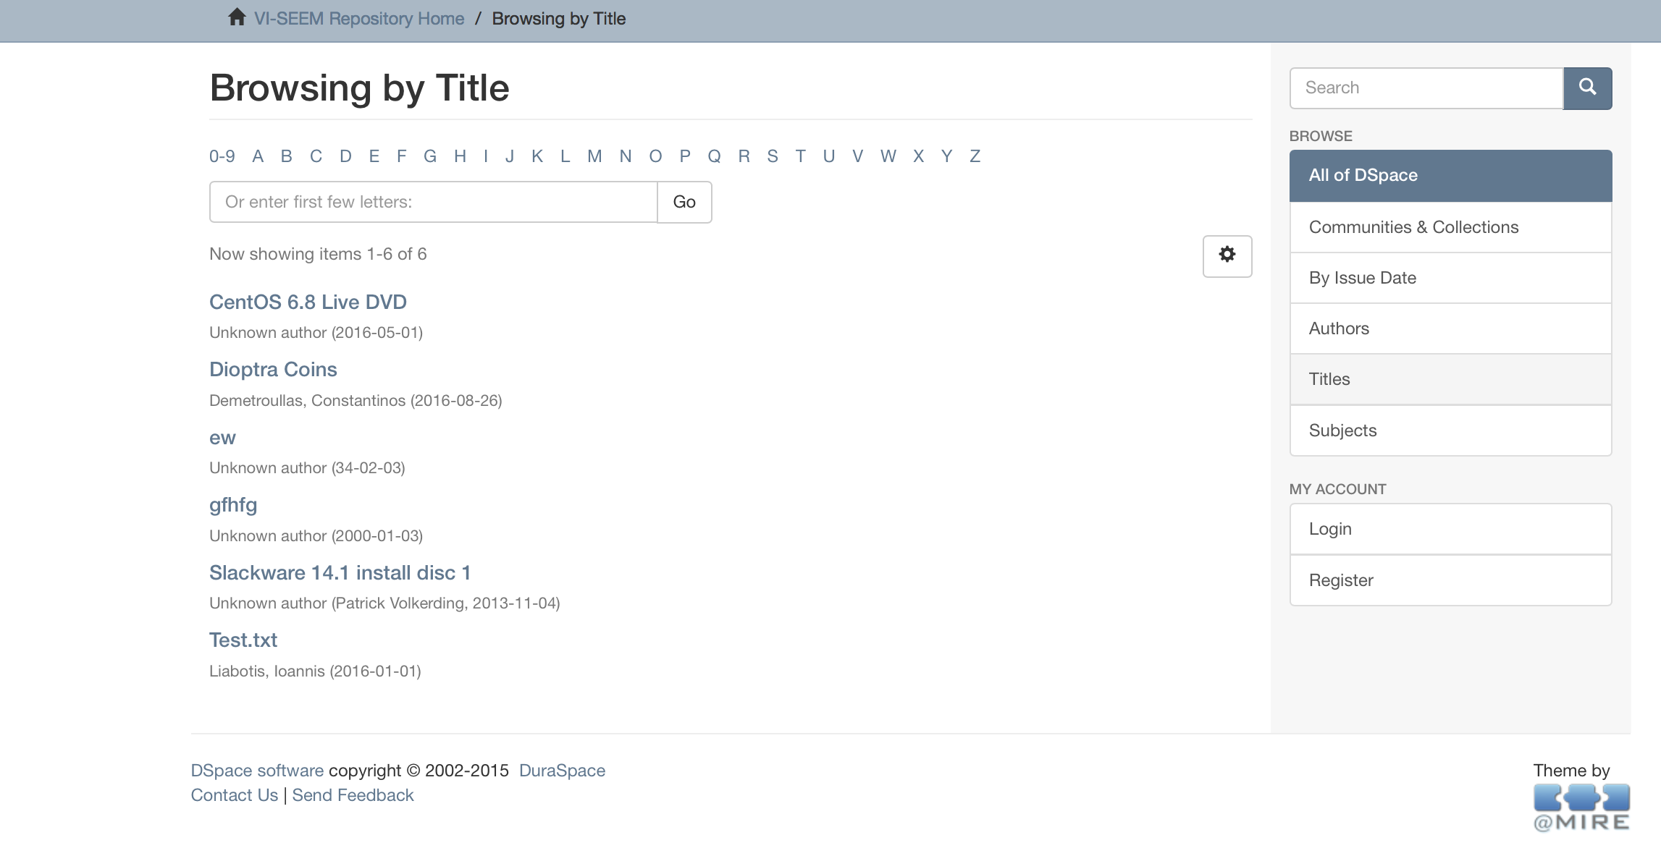

Slide 17
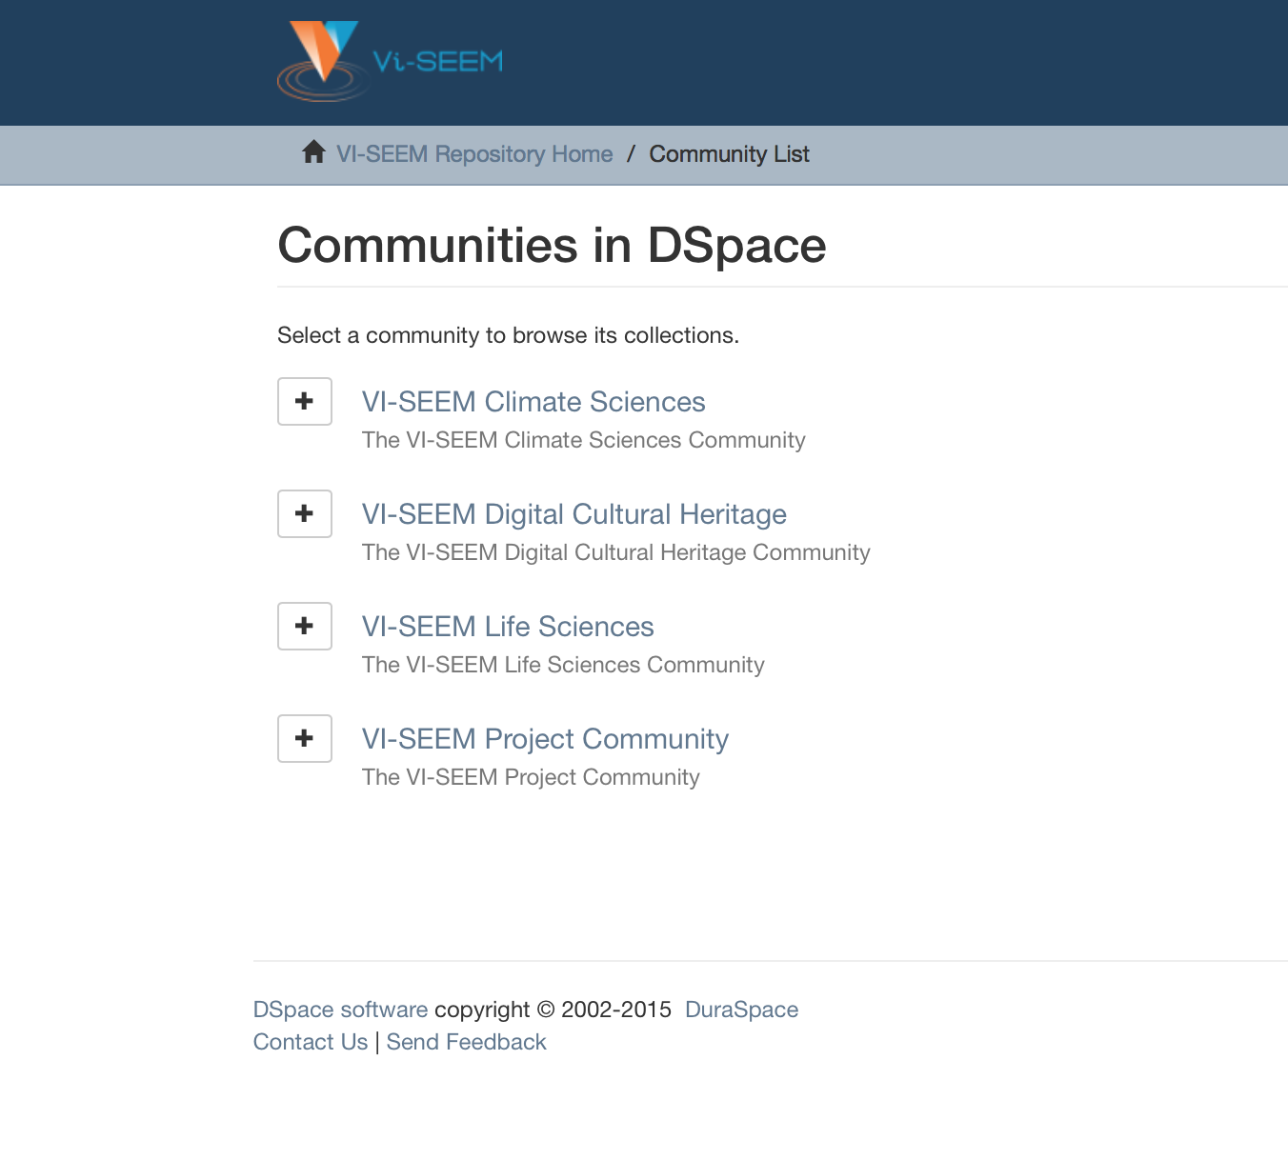

Slide 18
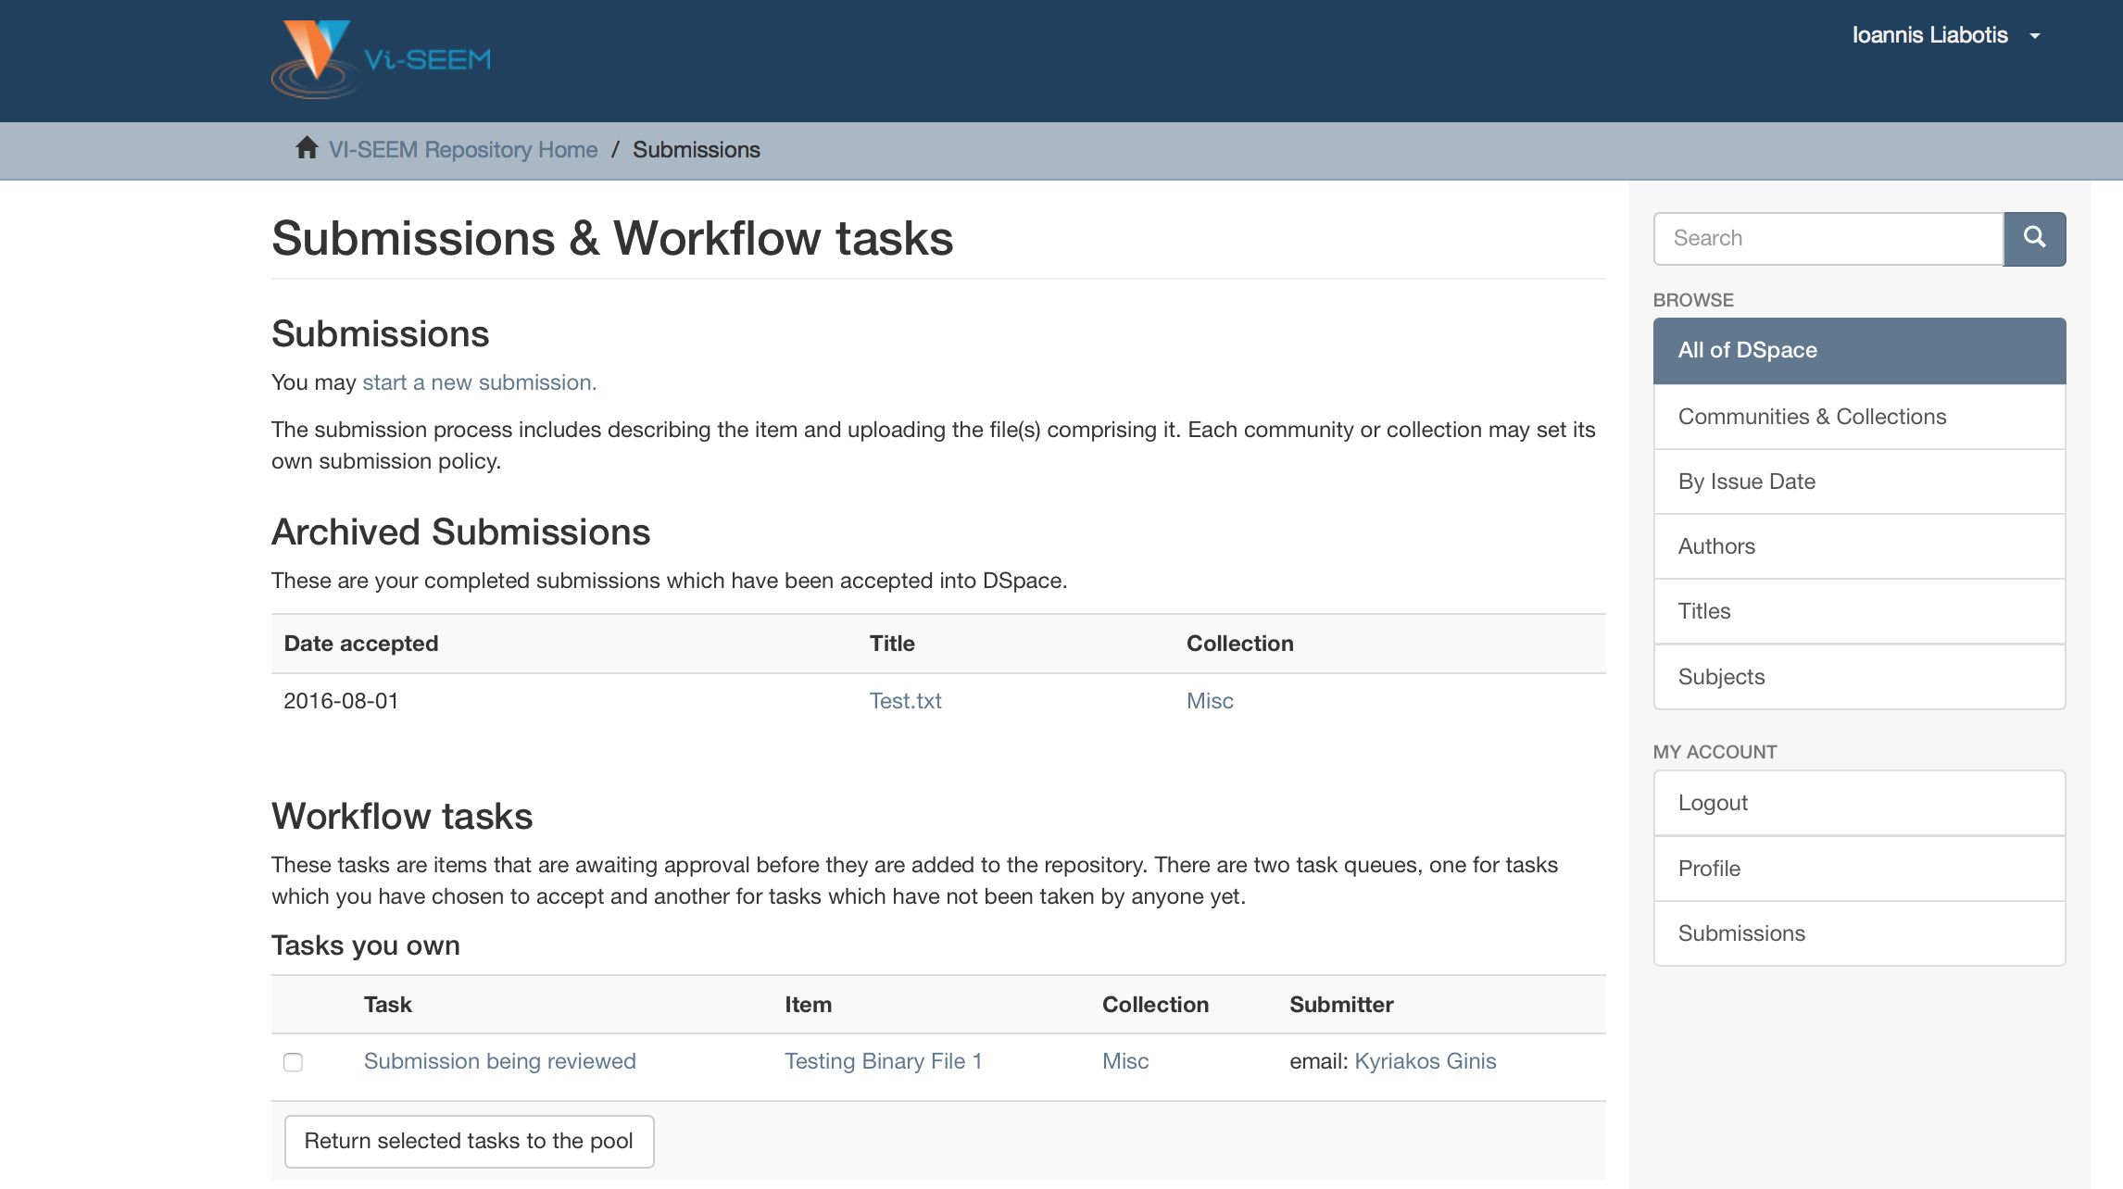

Slide 19
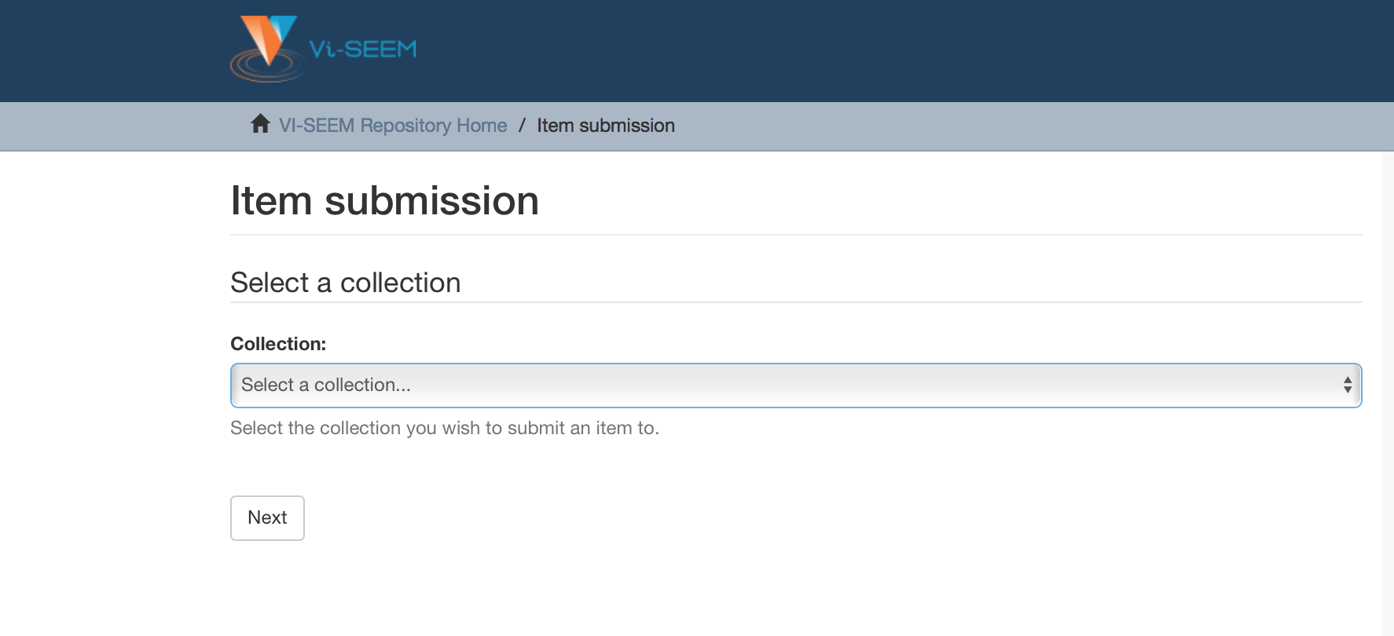

Slide 20
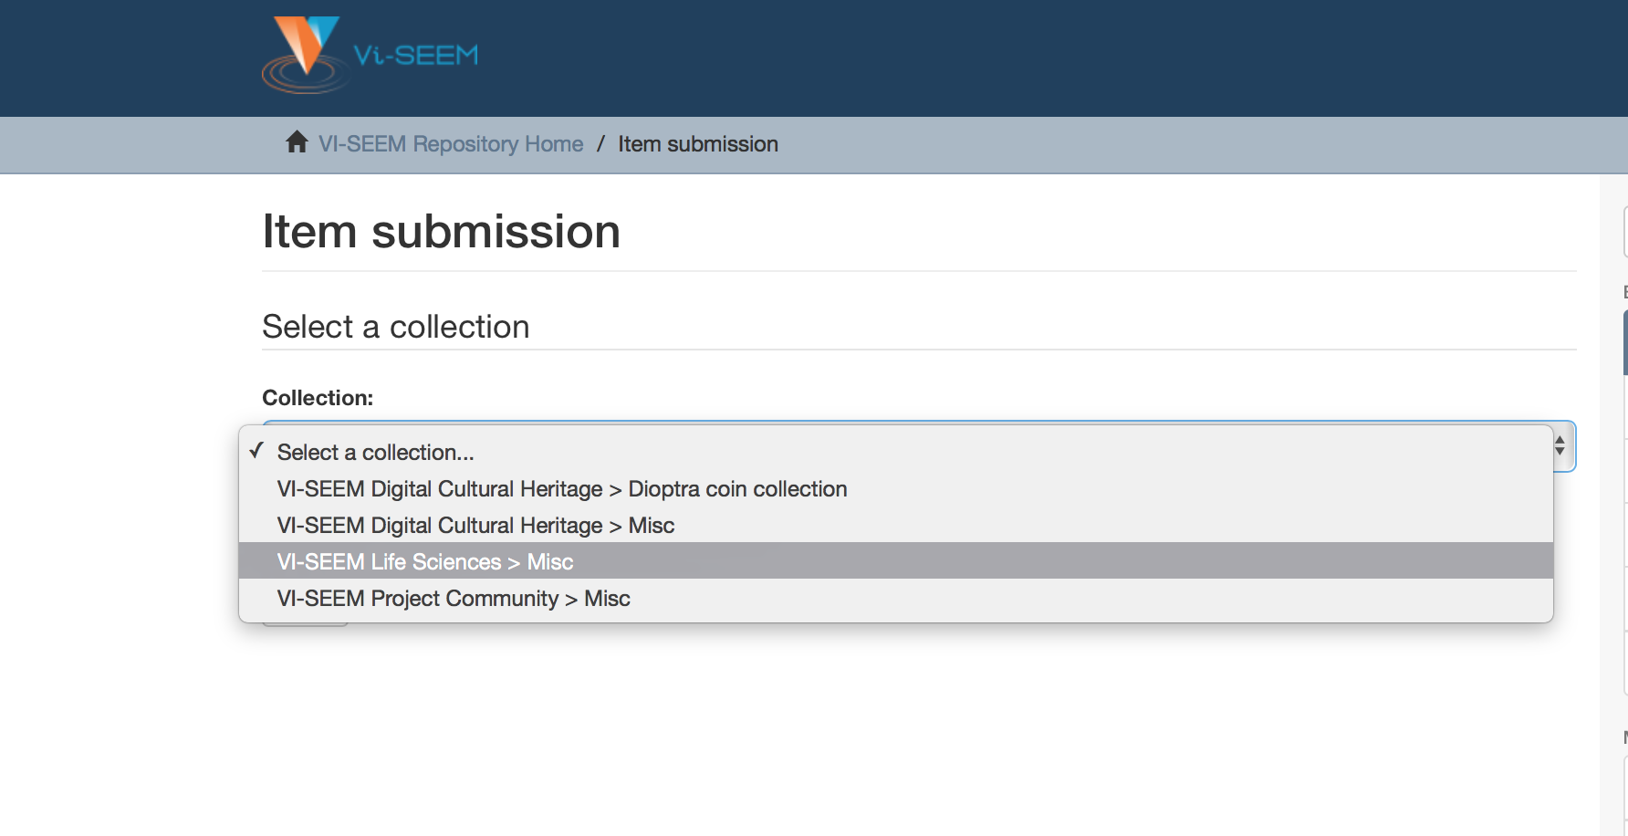

Slide 21
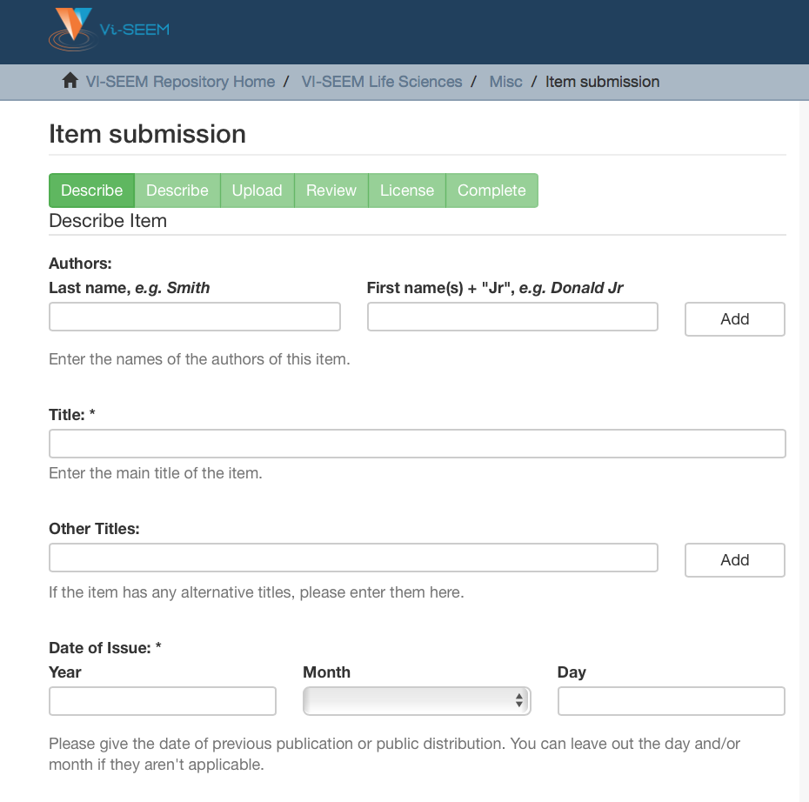

Slide 22
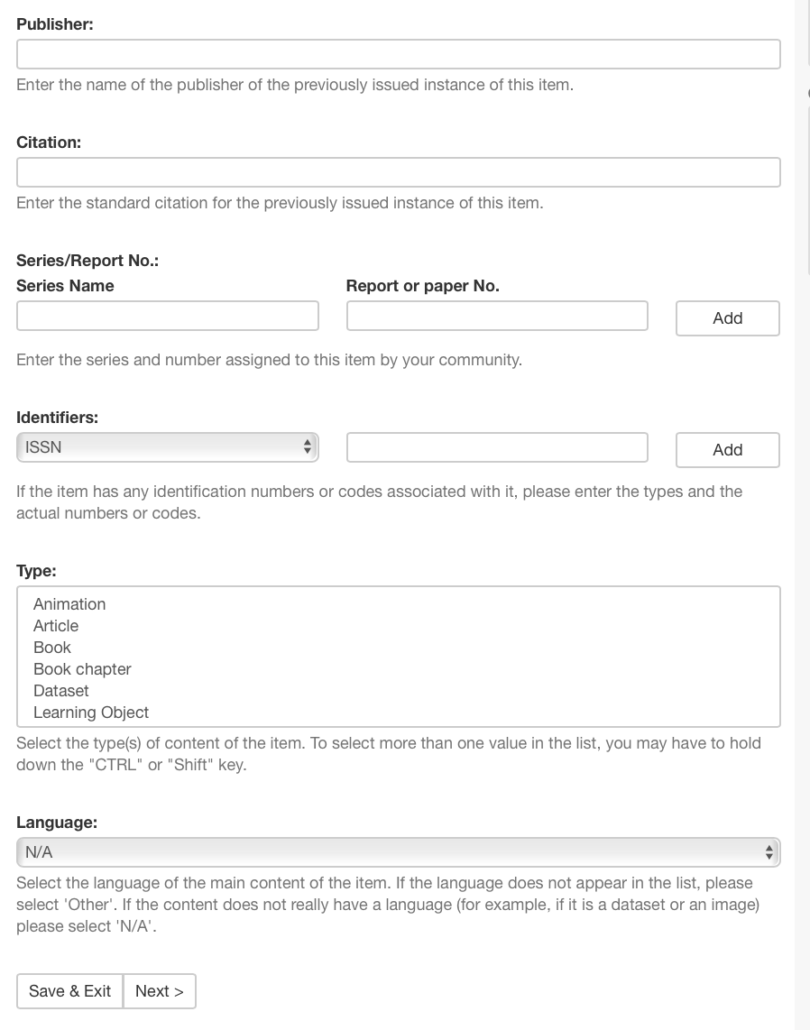

Slide 23
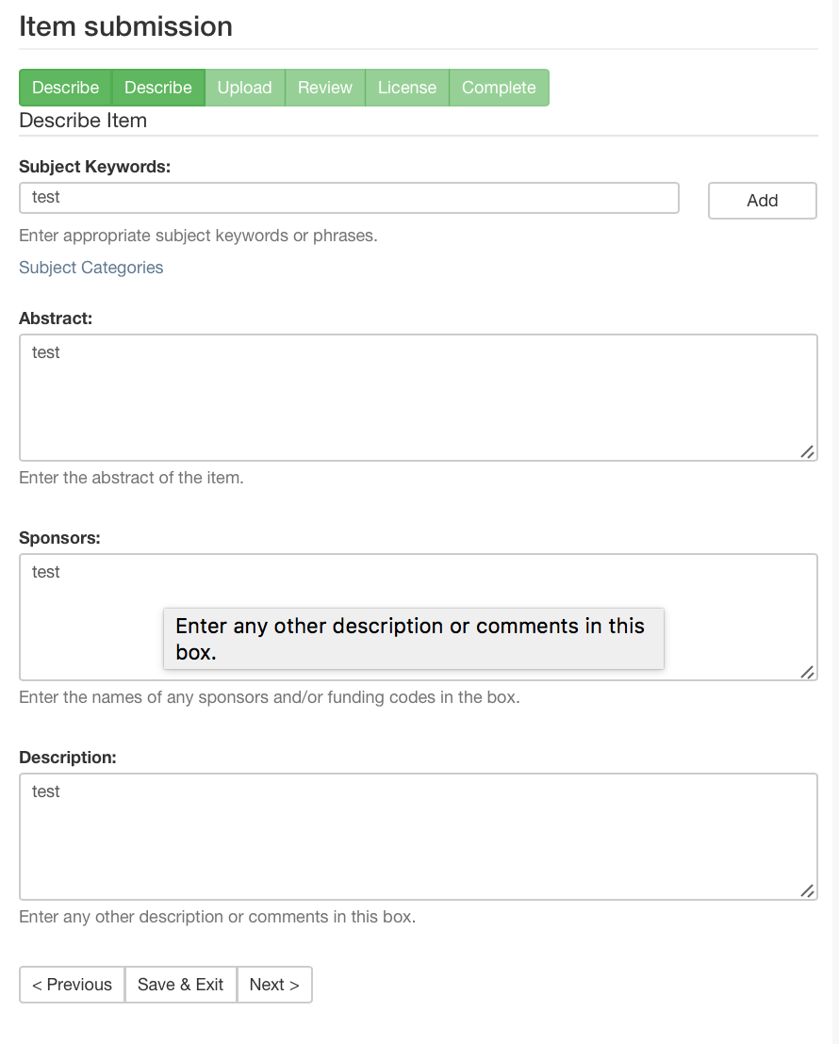

Slide 24
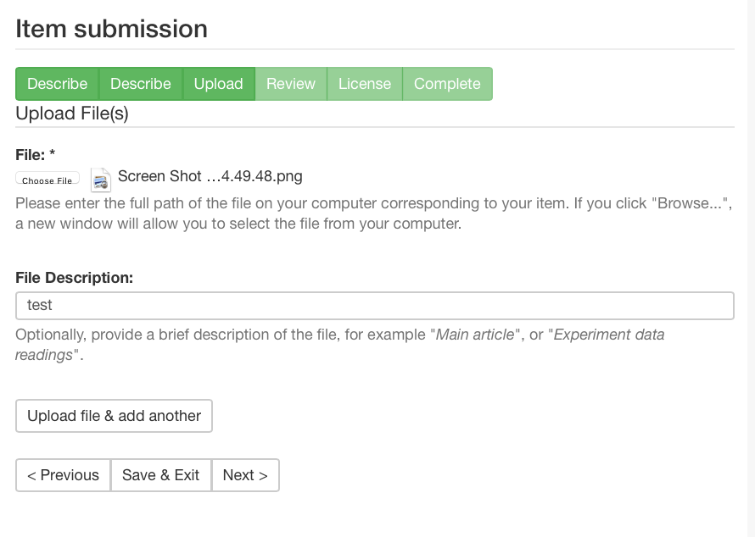

Slide 25
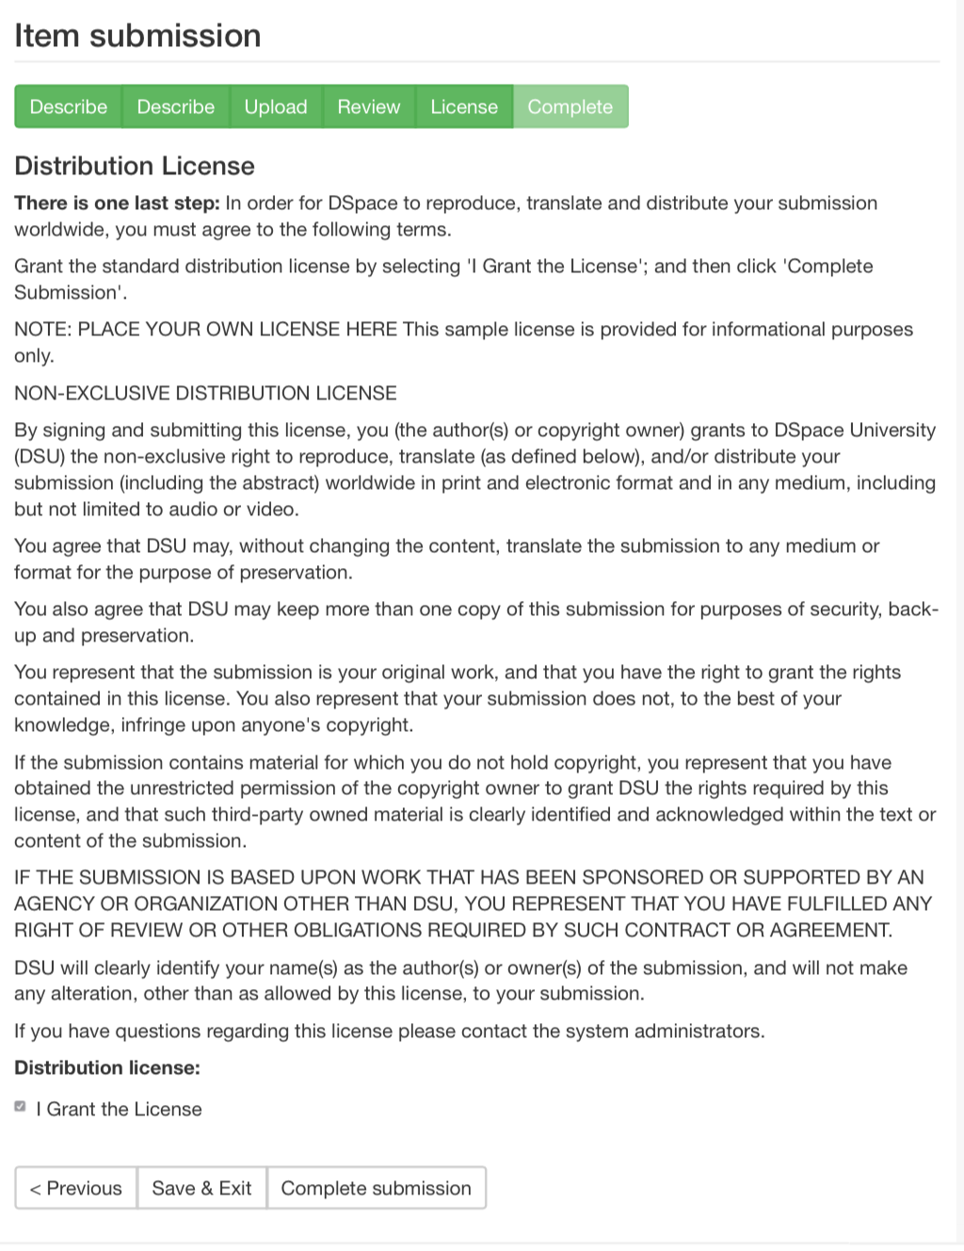

Slide 26
