Slide 1
Life Sciences Community
PSC Meeting, 19 October 2016
Zoe Cournia
Investigator C’
Biomedical Research Foundation
Academy of Athens, Greece
zcournia@bioacademy.gr

Slide 2
Outline
Life Sciences SC Overview - Objectives
Life Sciences SC Open Call Areas
1st Integration Phase Results
2nd Integration Phase Plan
VRE LS SC Services Content
ChemBioServer Overview
Other Activities
  Training Workshop
  Twitter

Slide 3
LS SC Scientific Objectives
Enable the description of the medical needs in SEEM
Identify disease mechanism pathways
Target oncogenes using computer-aided drug design
Provide patients with timely diagnosis, assessment of risk for developing the disease
Predict of mutation effect based on phenotype
Targeted and efficient therapy
Ultimately lead to regional characteristics that would assist the effort for developing personalized medicine in the SEEM region

Slide 4
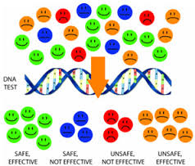
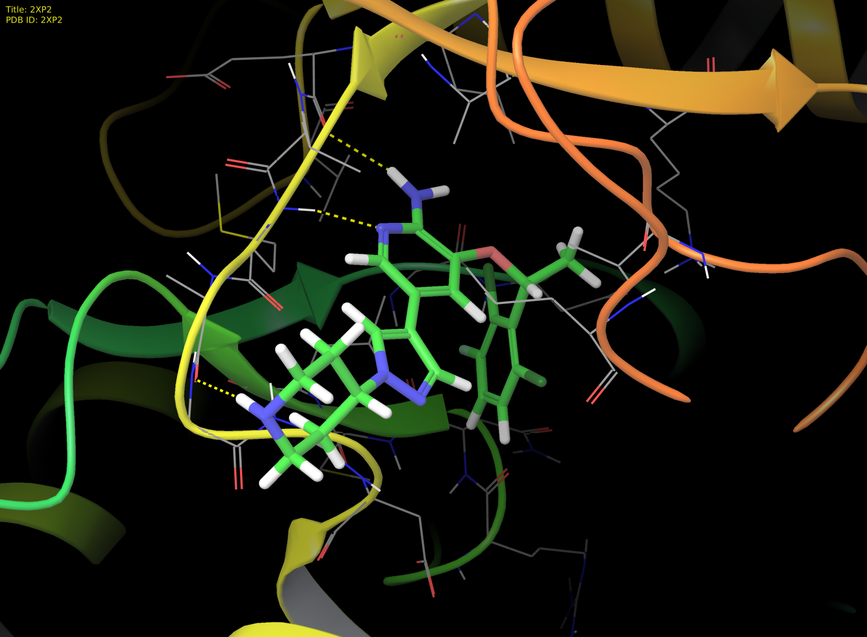
The era of personalized medicine
Lung Cancer
genotyping
4% of patients with
non-small cell lung carcinoma
Rearrangement in ALK protein
carcinogenesis
Drug design for this specific subset of patients
Crizotinib for ALK+ lung cancer patients
Notes:
In the past, one medicine would fit all. For example chemotherapy could be used to treat all cancers and some medicine would be provided at a uniform dosage, although some people need different doses. Personalized medicine is the ability to offer medicines according to the patient’s specific genotype. The detailed account of genetic information from the individual will help prevent adverse events, allow for appropriate dosages, and create maximum efficacy with drug prescriptions.
Having the genetic content of an individual will allow better guided decisions in determining the source of the disease and thus treating it or preventing its progression. This will be extremely useful for diseases like Alzheimer’s or cancers that are thought to be linked to certain mutations in our DNA.
In addition to specific treatment, personalized medicine can greatly aid the advancements of preventive care. For instance, many women are already being genotyped for certain mutations in the BRCA1 and BRCA2 gene if they are predisposed because of a family history of breast cancer or ovarian cancer.[

Slide 5
LS Areas of Applications
Modeling and Molecular Dynamics (MD) study of important drug targets (BRFAA [GR], ISEC-NAS-RA [AR], YSU [AR], FM-BIU)
Computer-aided drug design (BRFAA, IICT-BAS (2 labs) [BG], YSU [AM], UoM/MREN [ME], FP-UKIM [MK])
Analysis of Next Generation DNA sequencing data (IMGGE [RS], CING [CY])
Synchrotron data analysis (SESAME [JO])
Image processing for biological applications (IICT-BAS [BG], IEM [MD])
Computational simulation of DNA and RNA (IICT-BAS [BG], YSU [AM]
Notes:
1) Bioinformatics Group of the International Scientific-Educational Center of the National Academy of Sciences of the Republic of Armenia
Drug Discovery Laboratory, Faculty of Medicine, Bar-Ilan University in Israel.
Molecular physics department of the Yerevan State University and Armenian-Indian Center of Excellence in ICT.

Slide 6
Life Sciences Open Call Areas
Open Calls in the scientific field of Life Sciences:
  LS Area A: Modeling and Molecular Dynamics (MD) study of important drug targets.
  LS Area B: Computer-aided drug design.
  LS Area C: Analysis of Next Generation DNA sequencing data.
  LS Area D: Synchrotron data analysis.
  LS Area E: Image processing for biological applications.

Slide 7
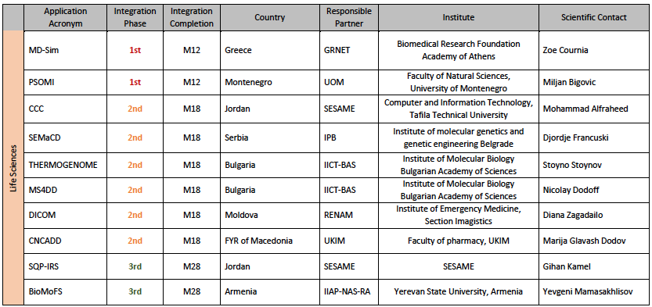
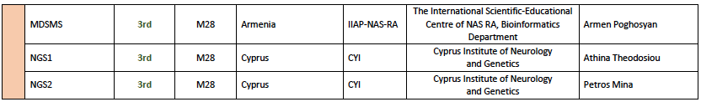
Integration Phase Allocation & Partners for LS SC

Slide 8
1st Integration Phase Results
1st Integration Phase Applications:
  MD-Sim: Biomedical Research Foundation, Academy of Athens
  PSOMI: University of Montenegro
All developers have gained access to the provisioned resources.
Workflows were developed.
No specific issues have been raised.
All planned results already available or by the end of calendar year

Slide 9
2nd Integration Phase Status
2nd Integration Phase Applications:
Resources access already given:
  CCC, SESAME, Jordan
Resource Allocation Underway:
  SEMaCD, IPB, Serbia
  THERMOGENOME, IICT-BAS, Bulgaria
  MS4DD, IICT-BAS, Bulgaria
  DICOM, RENAM, Moldova
  CNCADD, UIKM, FYROM

Slide 10
Life Sciences VRE Services
VI-SEEM scientific application environment: Provides several modules such as optimized applications and libraries, VM images and list of codes, relevant for the work of the regional scientific communities of interest.
Workflow, pipeline and software tools repository: Provides several modules such as documents containing best practice procedures and workflows for the production of scientific results relevant to the application categories identified in the SEEM region.
Regional Community Datasets: Pprovides datasets of regional importance for the scientific communities of interest.
Application-Level Services for the regional communities: Contains Web-based or visualization services providing easy access to underlying workflows, applications, and resources.
Training Material: Contains training documentation for several LS areas

Slide 11
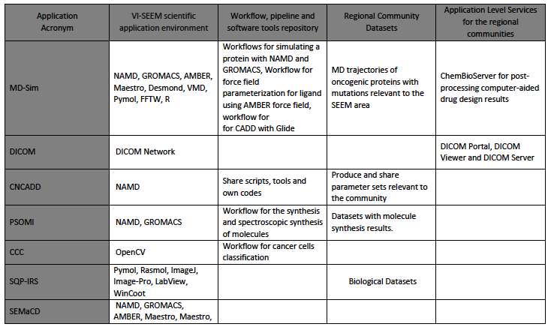
VI-SEEM LS services to be offered: 1. Codes

Slide 12
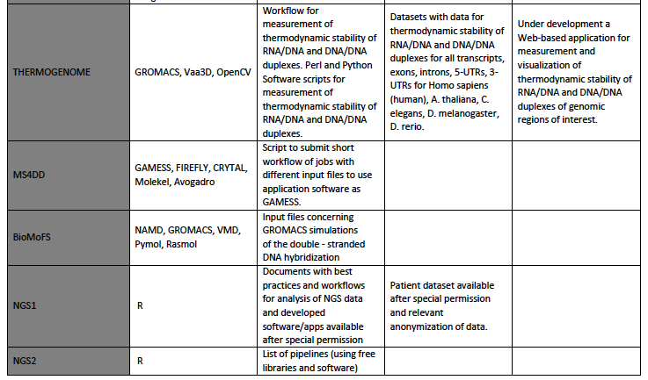

Slide 13
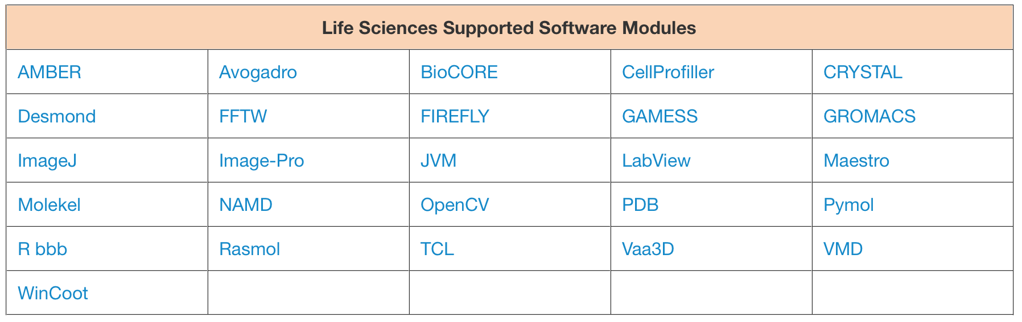
Codes currently installed + available
All requested codes have been installed

Slide 14
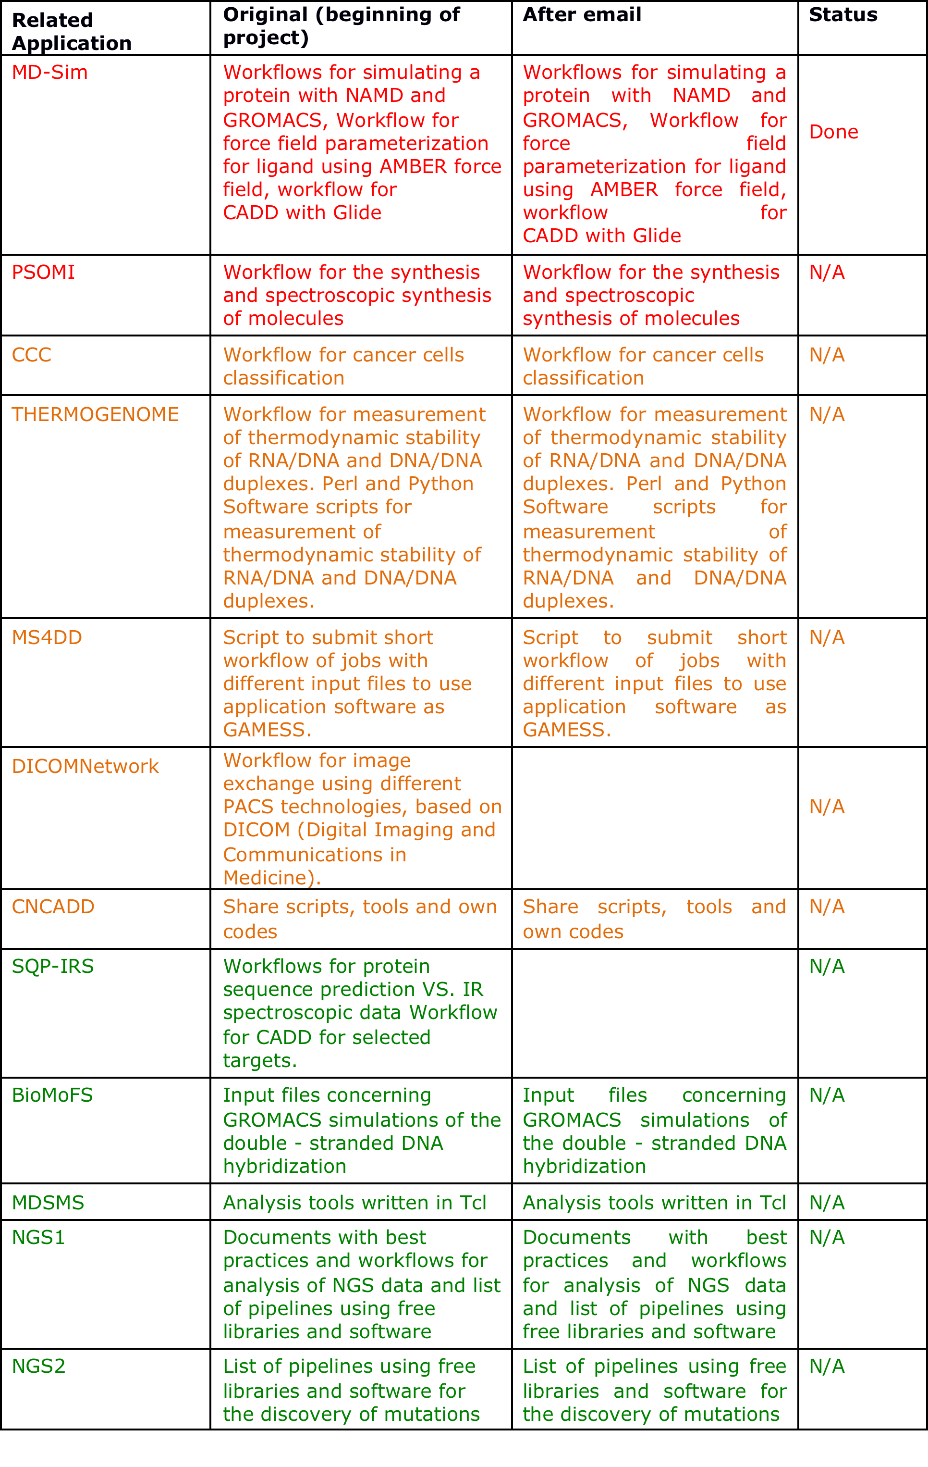
VI-SEEM LS services to be offered: 2. Workflows, pipelines, tools
1st Integration Phase
2nd Integration Phase
3rd Integration Phase

Slide 15
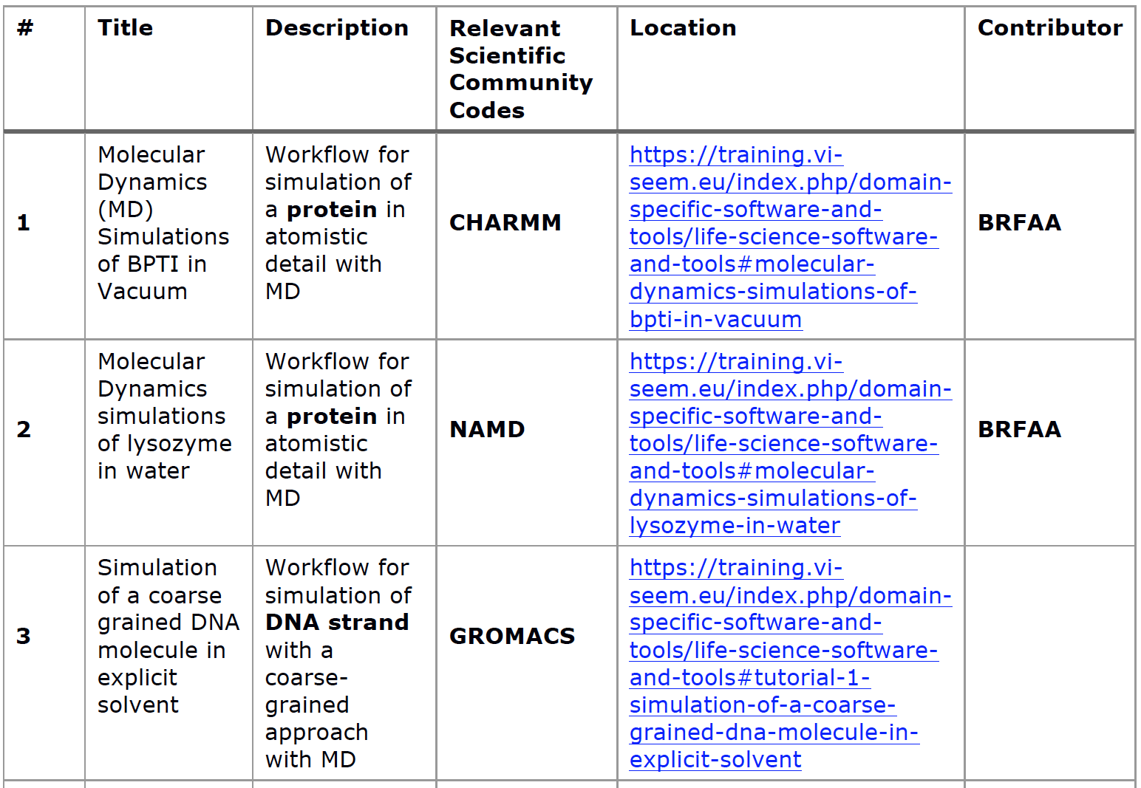
Workflows, pipelines, software tools currently available in VI-SEEM repo

Slide 16
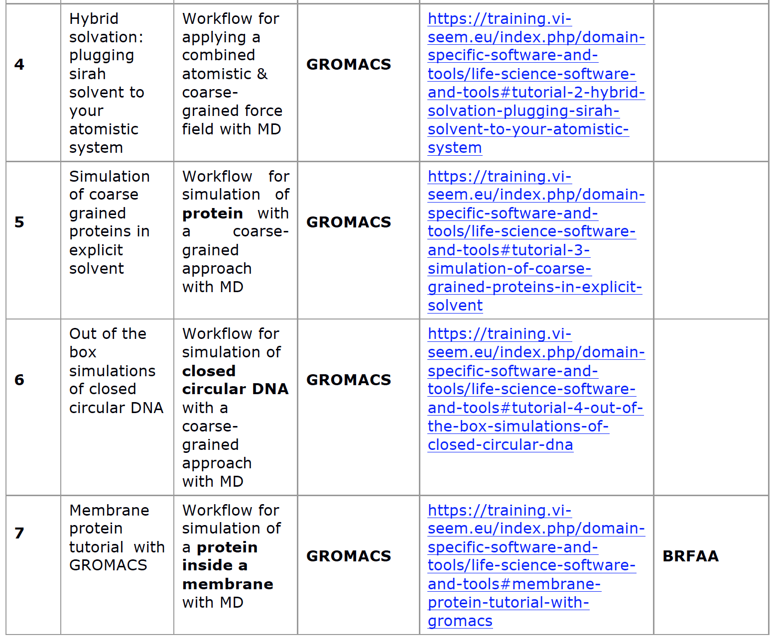
Workflows, pipelines, software tools currently available in VI-SEEM repo
Workflows from participants of the 1st integration phase are also currently being uploaded

Slide 17
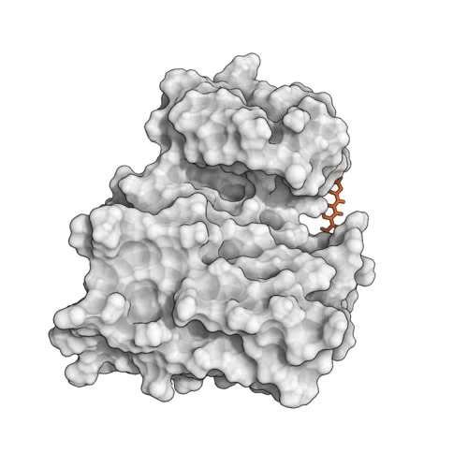
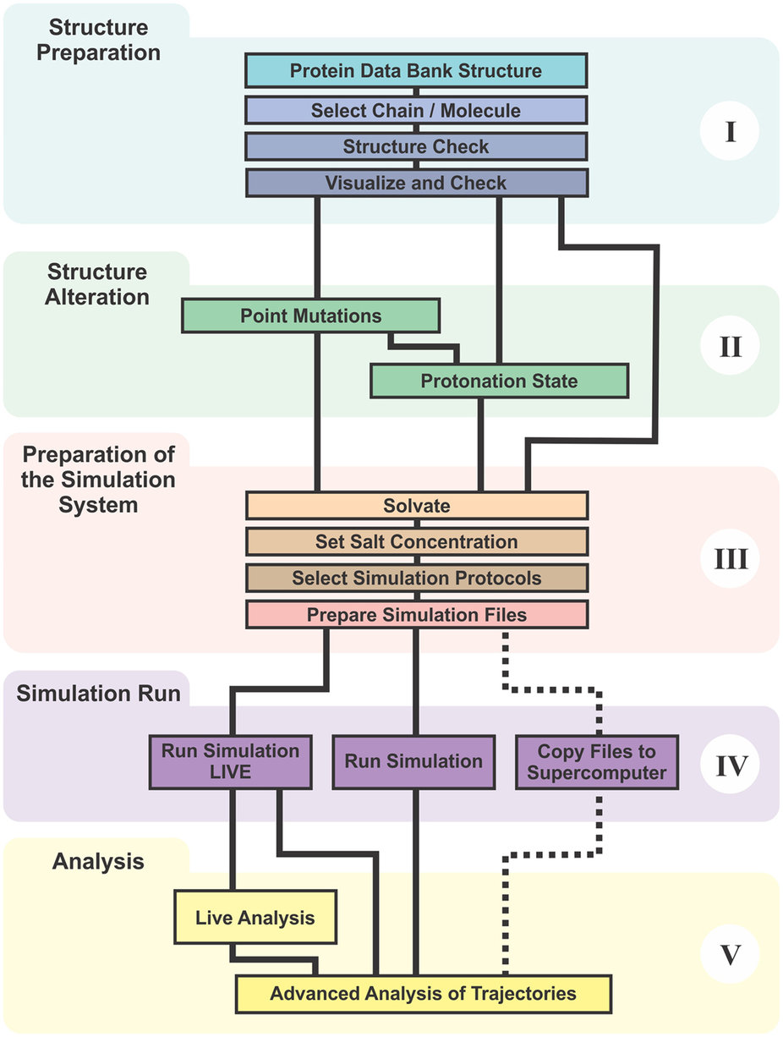
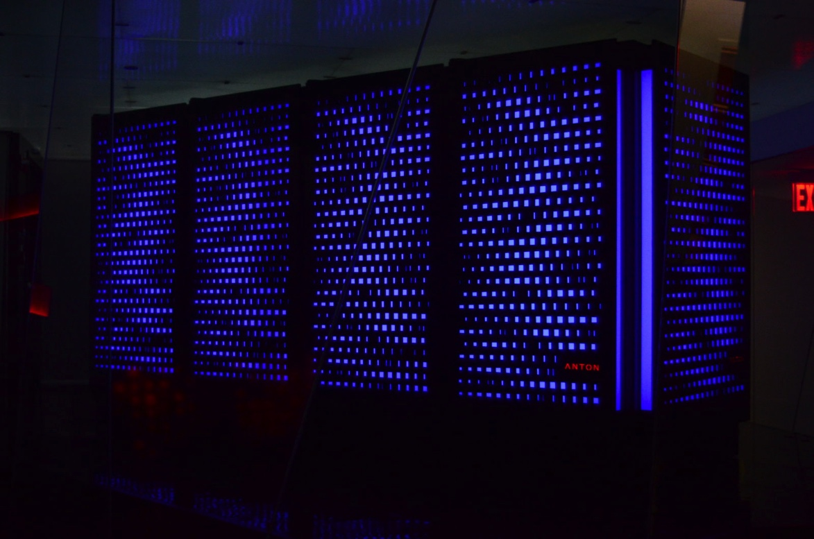
Automating Workflows in VI-SEEM: Molecular Dynamics Simulations
Shan et al (2011)
Cancer drug dasatinib binding on Src kinase

Slide 18
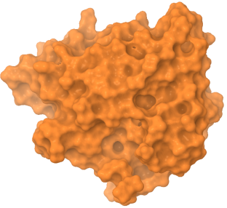


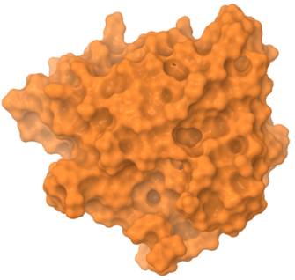
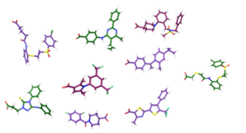

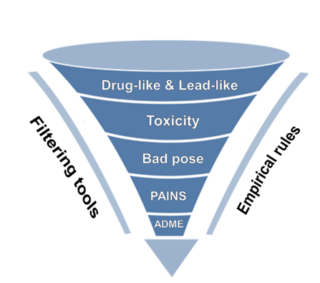
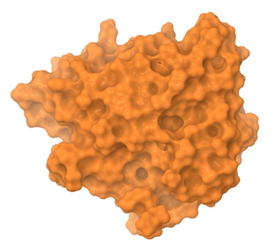

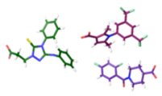
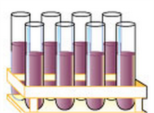

Automating Workflows in VI-SEEM: Virtual Screening for Drug Discovery
Docking & Scoring of compound libraries
Protein conformational Ensemble
Protein Preparation
Virtual Screening algorithm
Binding site
identification algorithm
Binding
sites
Compound selection & in vitro assays
Binding Site implication in large scale motions (PCA)

Slide 19
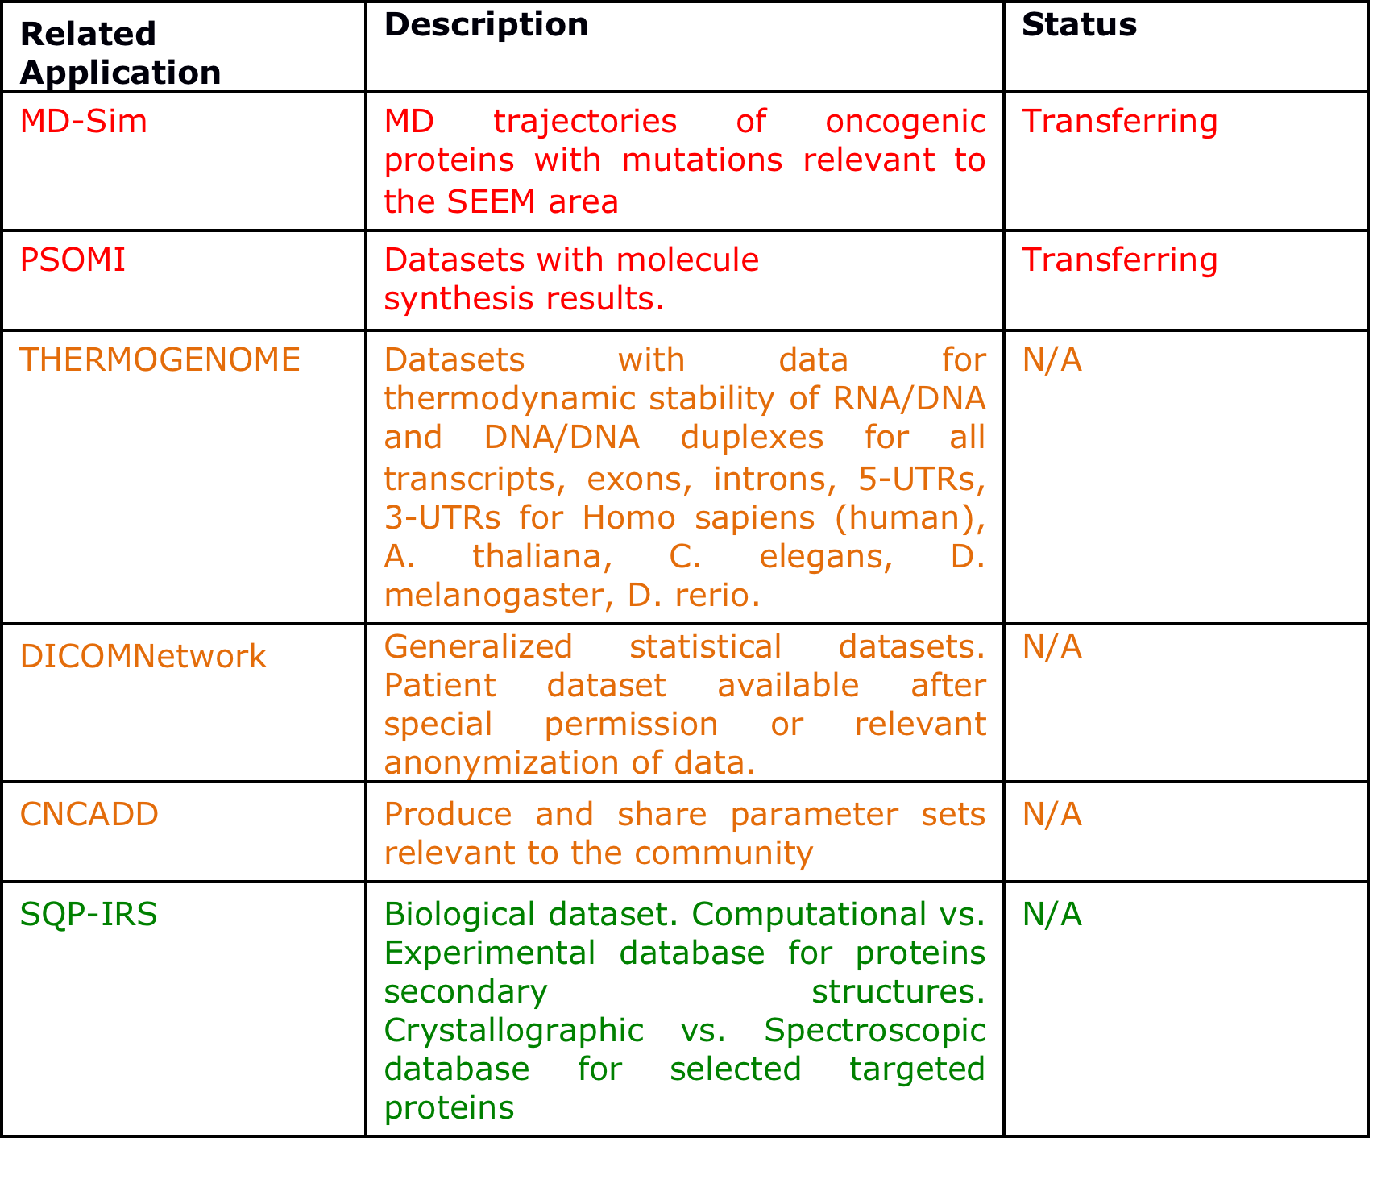
VI-SEEM LS services to be offered: 3. Regional Community Datasets
1st Integration Phase
2nd Integration Phase
3rd Integration Phase

Slide 20
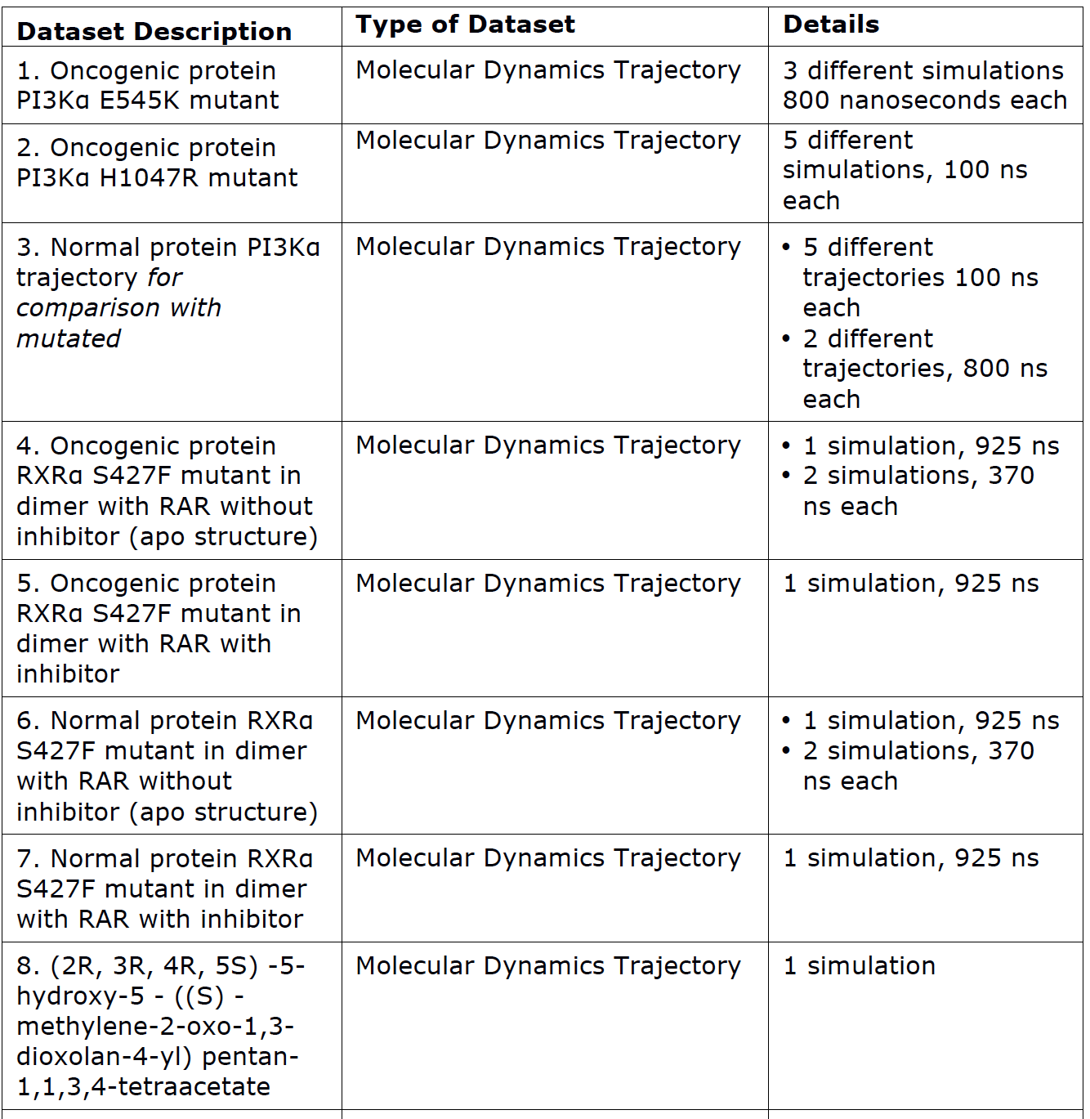
Datasets currently transferring to
VI-SEEM repository

Slide 21
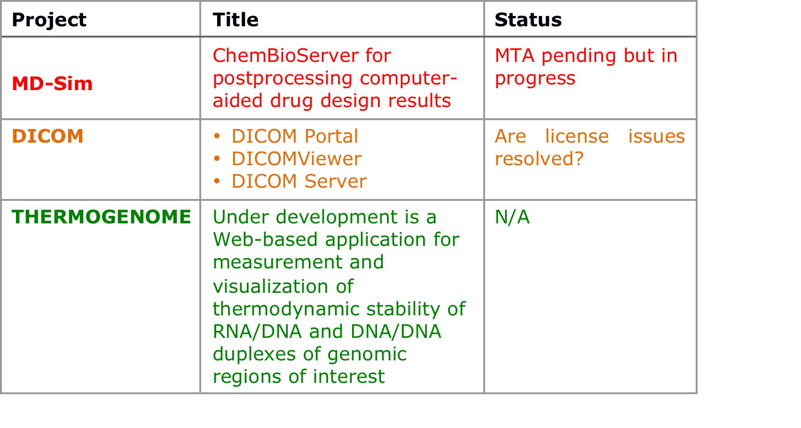
VI-SEEM LS services to be offered: 4. Application Level Services
1st Integration Phase
2nd Integration Phase
3rd Integration Phase

Slide 22
ChemBioServer
ChemBioServer is a web-based pipeline for filtering, clustering and
visualization of chemical compounds used in drug discovery
http://bioserver-3.bioacademy.gr/Bioserver/ChemBioServer/
Performs filtering to discard molecules with steric clashes / bad conformations,
Performs filtering for toxic moieties on the molecule set
Clusters the molecules according to chemical similarity
Draws exemplars from the chemical clusters in order to select chemically diverse molecules for biological assays
Performs substructure searches
Provides graphical representations of molecular properties (logP, MW, PSA, etc)

Slide 23
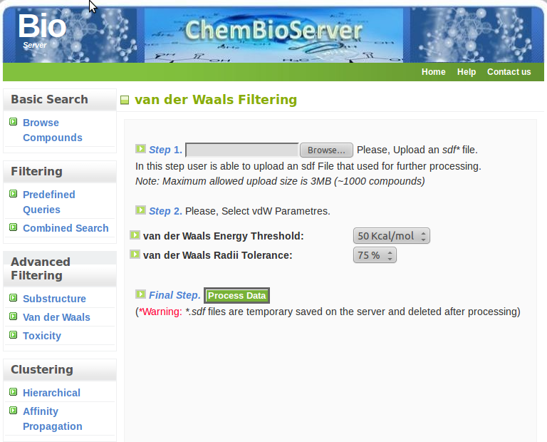
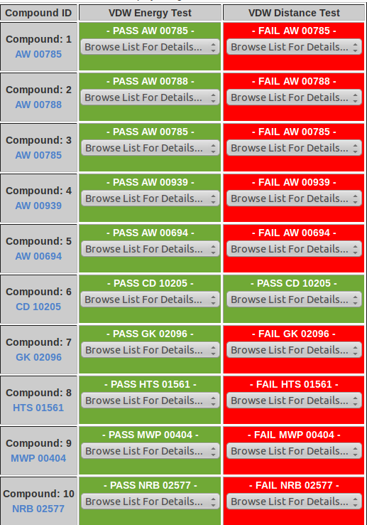
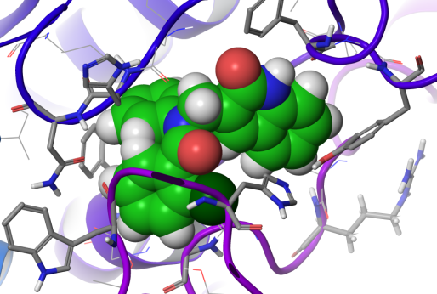
ChemBioServer
ChemBioServer post-processes virtual screening results

Slide 24
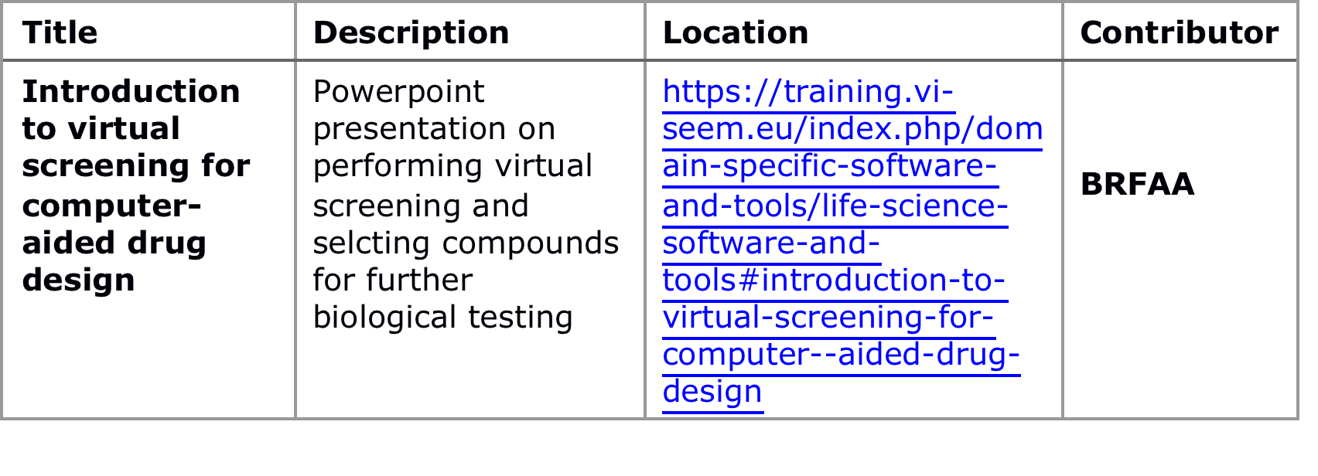
VI-SEEM LS services to be offered: 5. Training Material
One Training event completed in UIMK, 30 August 2016
Topic: Using Maestro for virtual screening and ChemBioServer for post-processing virtual screening data
Presenter: Zoe Cournia
Material will be available soon in VI-SEEM portal
Training Material of this week’s LS SC Training will also be available

Slide 25
Summary of LS SC progress
26 Codes installed
7 Workflows uploaded and available (MD-Sim)
4 Workflows ready and will be uploaded (PSOMI)
8 Datasets are being transferred
1 training material uploaded and more material will be immediately available
Notes:
Person who approached me for gromacs
Target number of workflows?

Slide 26
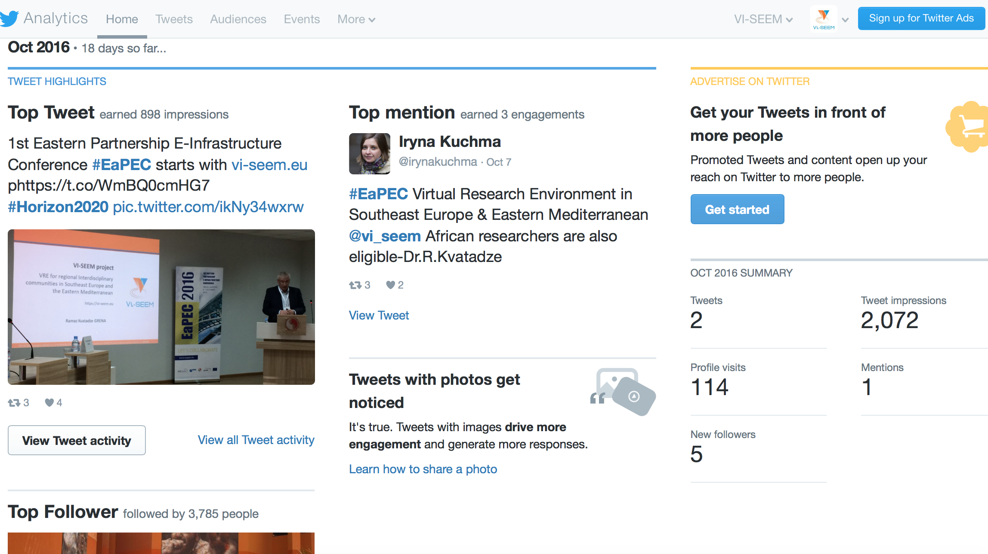
VI-SEEM Twitter Account

Slide 27
Material & People needed to disseminate VI-SEEM in Social Media
Open Calls
Information on VRE Portal
Location and information on Code Availability, Workflows, Datasets, Applications
Advertise Training Material
Dissemination of Training Events in advance to attract participants
Newsletters, other activities
Publications
Participation in Conferences, Short Description of Content
News

