Slide 1
FROM MOLECULAR-LEVEL TO MESOSCALE MODELS IN CLIMATE SCIENCE:
IN SILICO CHEMISTRY-CLIMATE MODEL DEVELOPMENTS ON HIGH PERFORMANCE COMPUTING RESOURCES
Ljupčo Pejov
ljupcop@pmf.ukim.mk
Institute of Chemistry, Faculty of Natural Sciences and Mathematics, Skopje, Macedonia

Slide 2
CLIMATE SCIENCE AND ATMOSPHERIC CHEMISTRY – FROM FRUSTRATION TO SCIENCE
BACK IN 1996
MAKE A STATE-OF-THE-ART (NONSTANDARD) QUANTUM MECHANICAL COMPUTATION ON A FUNDAMENTAL CHEMICAL SYSTEM
WRITE A SCIENTIFIC PAPER
RELEVANCE?
MAKE THE SAME TYPE OF CALCULATION ON A SIMPLE RADICAL, RELEVANT TO ATMOSPHERIC CHEMISTRY
PUBLISHED IN NO TIME

Slide 3
Need for HPC?
THE UNDERLYING PHYSICAL LAWS NECESSARY FOR THE
MATHEMATICAL THEORY OF A LARGE PART OF PHYSICS AND THE
WHOLE OF CHEMISTRY ARE THUS COMPLETELY KNOWN, AND THE
DIFFICULTY IS ONLY THAT THE EXACT APPLICATION OF THESE
LAWS LEADS TO EQUATIONS MUCH TOO COMPLICATED
TO BE SOLUBLE.
THE METHODS OF THEORETICAL PHYSICS SHOULD BE APPLICABLE TO ALL THOSE BRANCHES OF THOUGHT IN WHICH THE ESSENTIAL FEATURES ARE EXPRESSIBLE WITH NUMBERS.
AS LONG AS QUANTUM MECHANICS IS CORRECT, ALL ISSUES IN PHYSICS AND CHEMISTRY ARE ACTUALLY PROBLEMS IN APPLIED MATHEMATICS.
THE LEVEL OF EXACTNESS OF A GIVEN SCIENCE IS DIRECTLY PROPORTIONAL TO THE LEVEL AT WHICH THE PROBLEMS IN THAT SCIENCE CAN BE SUBJECTED TO COMPUTATION.
GOD USED BEAUTIFUL MATHEMATICS IN CREATING THE WORLD.
-- P. A. M. DIRAC

Slide 4

Chemistry-Climate Model Initiative (CCMI)
An evident trend in climate science and meteorology in the last few years is the development of global models in which the chemistry and dynamics of the stratosphere and troposphere are being studied and modelled as a single entity.
Such approach seems unavoidable if one wants to model the phenomena relevant to climate science at the molecular level, and therefore its development has been expected.

Slide 5


Chemistry-Climate Model Initiative (CCMI)
Within the CMIP5 (Coupled Model Intercomparison Project Phase 5), simulations have been performed by several groups using global models with interactive chemistry spanning the surface through the stratosphere and above.

Slide 6
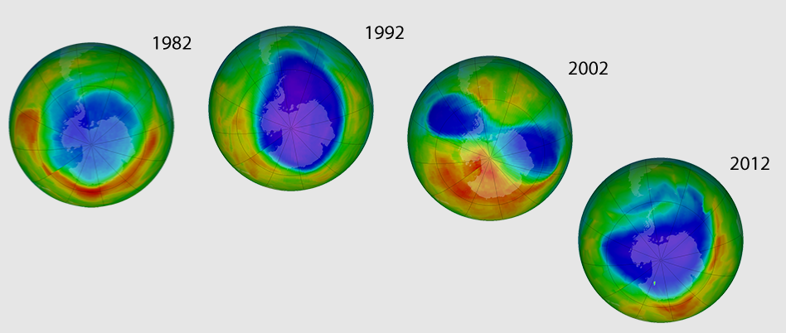
Chemistry-Climate Model Initiative (CCMI)
We have evidenced a grown interest in the issues related to the influence of dynamical changes of stratospheric ozone on the chemistry of troposphere exhibited through actinic fluxes and ozone fluxes (arising e.g. from the expected strengthening of the Brewer-Dobson circulation).

Slide 7
Chemistry-Climate Model Initiative (CCMI)
Numerous recently evidenced shortcomings in our understanding of even basic issues such as e.g.:
  long-term ozone trends
  methane lifetime
  have highlighted the need for a better coordination between the mentioned two domains.

Slide 8


Chemistry-Climate Model Initiative (CCMI)
To address these issues, the joint IGAC/SPARC Chemistry-Climate Model Initiative (CCMI) was established to coordinate future (and to some extent existing) IGAC and SPARC chemistry-climate model evaluation and associated modeling activities.

Slide 9


CCMI-Global issues
Roles of Different Forcing Agents in Global Stratospheric Temperature Changes
Interpreting Space-based Trends in Carbon Monoxide with Multiple Models

Slide 10


CCMI-Global issues
Implications of CO bias in Chemistry-Climate Models
Air-Mass Origin in the Arctic. Part I: Seasonality and Part II: Response to Increases in Greenhouse Gases

Slide 11


CCMI-Global issues
Air-mass origin in the tropical lower stratosphere: The influence of Asian boundary layer air
The Atmospheric Chemistry of Nitrous Oxide and its Changing Lifetime

Slide 12


CCMI-Global issues
Modeling Effects of Geoenginnering on Stratospheric Ozone
Improvements in Modeling Ozone and Application to a New Scenario

Slide 13


CCMI-Global issues
North Pacific Sea Surface Temperatures Affect the Arctic Winter Climate
Atmospheric Response to the 11-year Solar Cycle

Slide 14


CCMI-Global issues
The Effect of Volcanic Eruptions on the Stratosphere
Unusual Dynamical Conditions in the Arctic Stratosphere in March 2011

Slide 15


CCMI-Global issues
Ozone and Reactive Nitrogen in Arctic Free Troposhere Determined Primarily by Stratospheric Influx
The Response of Tropical Tropospheric Ozone to El Nino Southern Oscillation (ENSO)

Slide 16


CCMI-Global issues
Ozone Hole and Southern Hemisphere Circulation Change
Investigations of Aerosol Impacts on Climate

Slide 17


CCMI-Global issues
Investigations of 21st Century Ozone
Long-term Changes in Stratospheric Circulation

Slide 18


CCMI-Global issues
Investigation of Stratospheric Water Vapor
Stratospheric Ozone in the post-CFC Era

Slide 19


CCMI-Global issues
Future Temperature Trends in the Antarctic Stratosphere
Impacts of El Nino Events on the Antarctic Stratosphere

Slide 20
VI-SEEM Climate – our contributions
Essentially all of the processes taking place in the atmosphere involve molecular clusters in which molecular species interact either by noncovalent intermolecular forces, or undergo reactive transformations.
To help complement the global models in climate science, the research activities that we propose will focus on the dynamics of noncovalently bonded molecular clusters, but also clusters in which molecular constituents could undergo certain chemical transformations, under the realistically encountered condition within various parts of the atmosphere.

Slide 21
VI-SEEM Climate – our contributions
A simple “undergraduate level” example

Slide 22
VI-SEEM Climate – our contributions
A simple “undergraduate level” example

Slide 23
VI-SEEM Climate – our contributions
A simple “undergraduate level” example

Slide 24
VI-SEEM Climate – our research
Molecular “fingerprints” – identifying molecular species in the atmosphere.
BUT: How CERTAIN is molecular identification???.

Slide 25
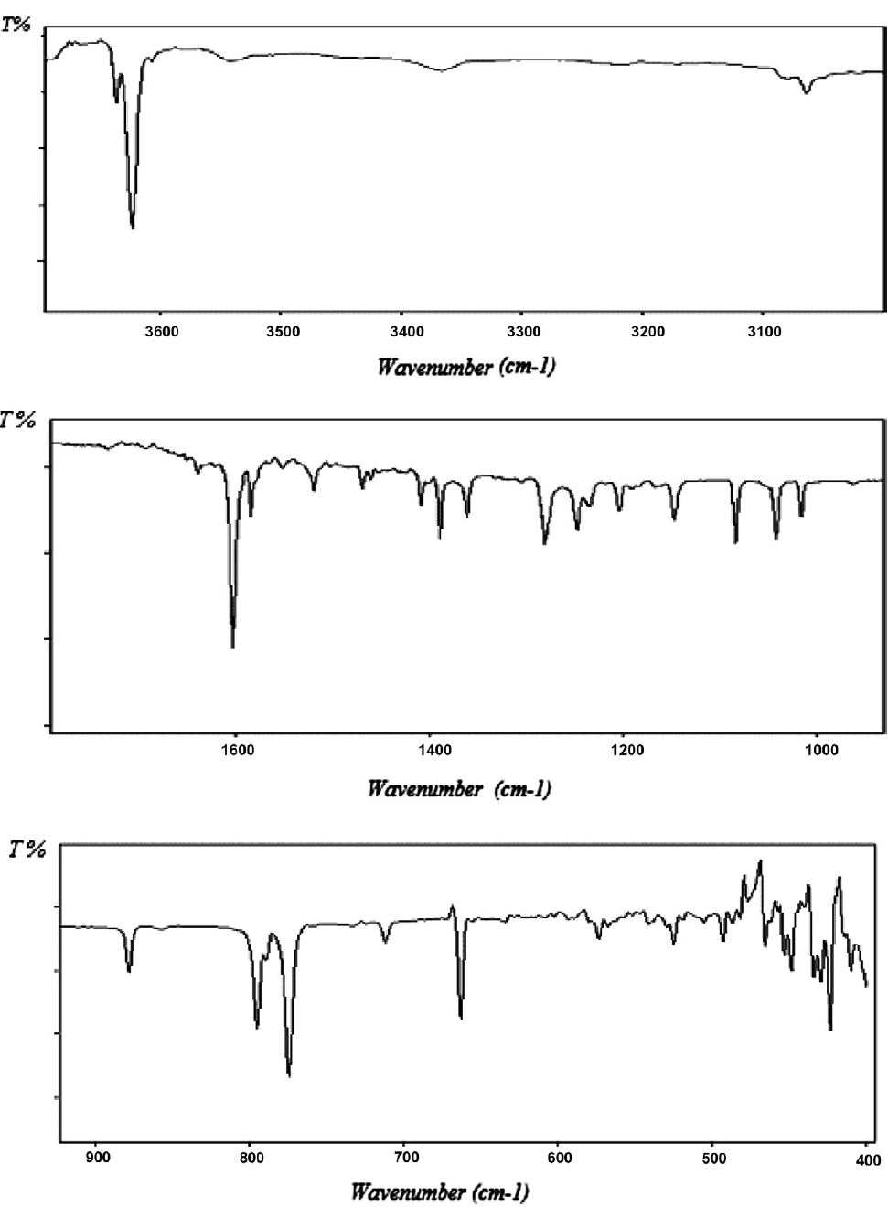
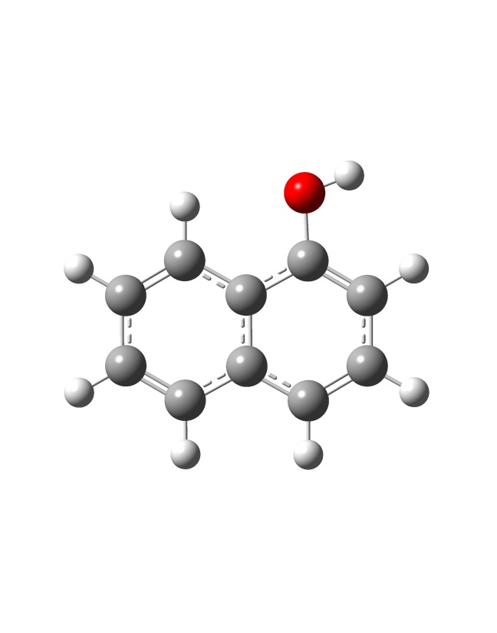

Slide 26

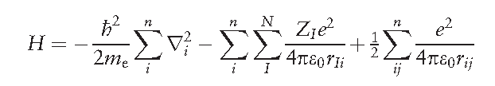

VI-SEEM Climate – our research
In “conventional” quantum chemistry and physics:
1. Set-up the electronic structure problem:

Slide 27


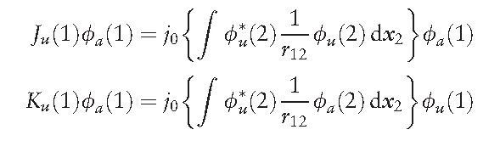
VI-SEEM Climate – our research

Slide 28
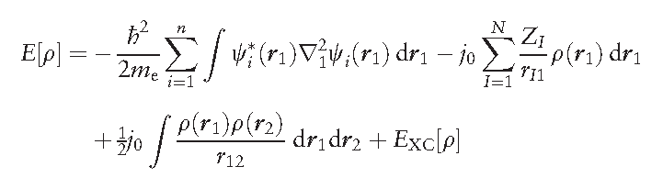
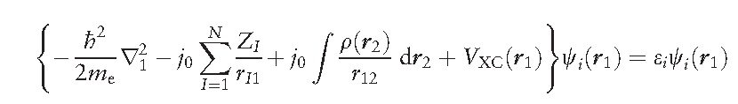
VI-SEEM Climate – our research

Slide 29
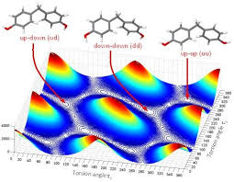
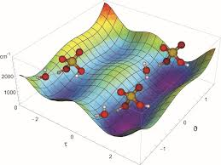
VI-SEEM Climate – our research

Slide 30
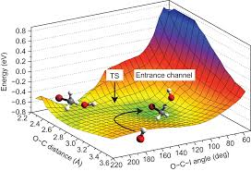
VI-SEEM Climate – our research

Slide 31
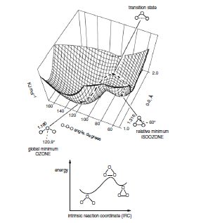
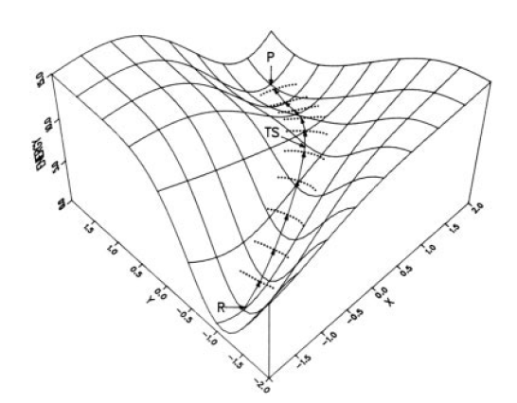
VI-SEEM Climate – our research

Slide 32
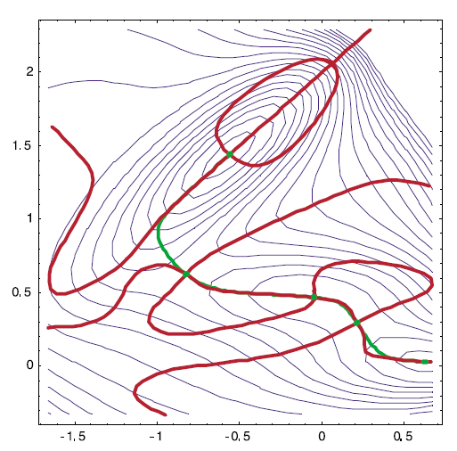
VI-SEEM Climate – our research

Slide 33
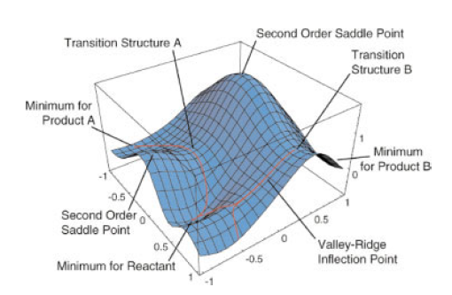
VI-SEEM Climate – our research

Slide 34
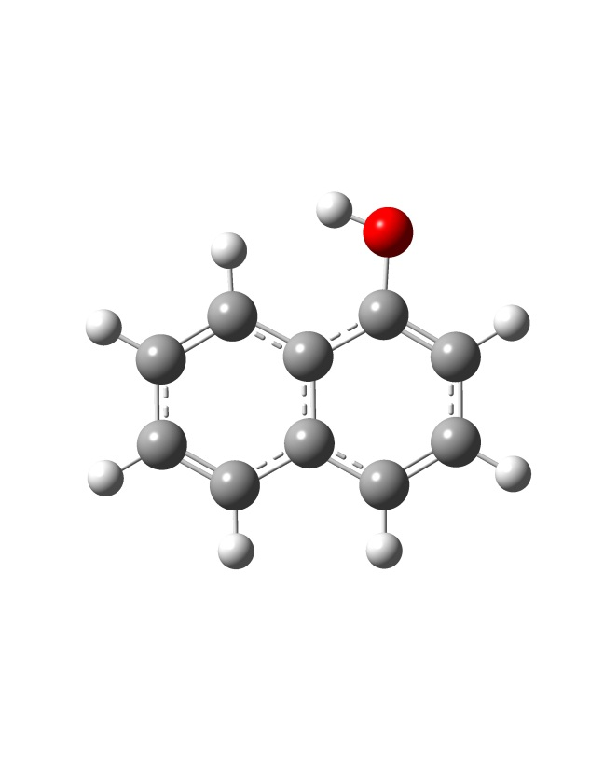
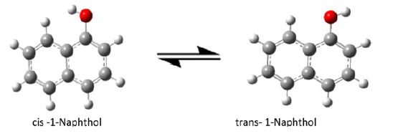
VI-SEEM Climate – our research
Dynamical subtleties:
1-naphtol cis- and trans- conformers

Slide 36
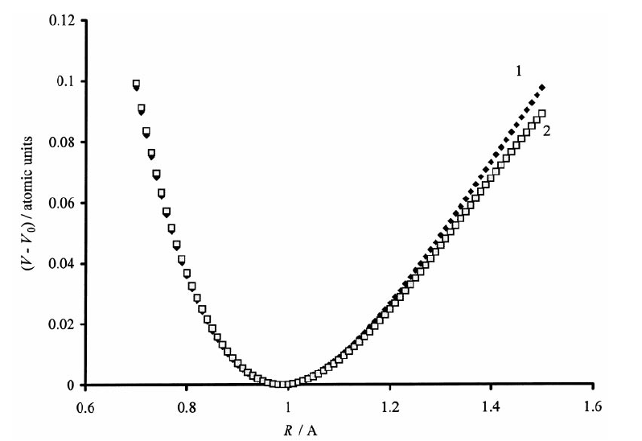
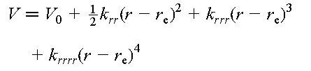

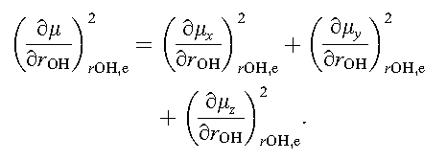

Slide 37




VI-SEEM Climate – our research

Slide 38
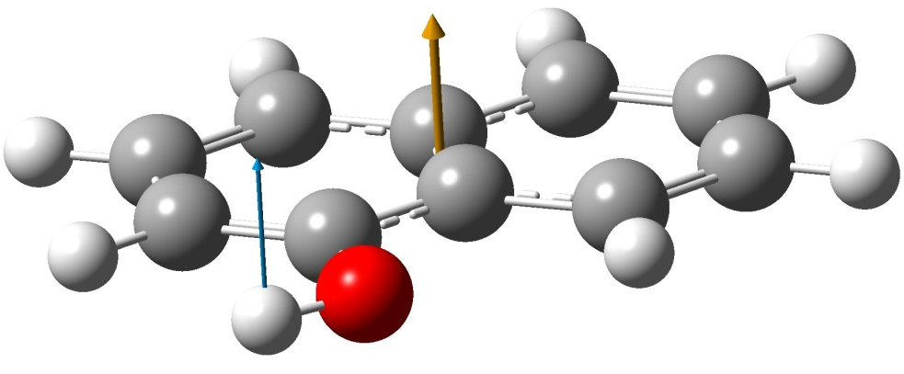
VI-SEEM Climate – our research
Example: the case when intramolecular O‑H chromophore possesses conformational flexibility.

Slide 39
VI-SEEM Climate – our research

Slide 40
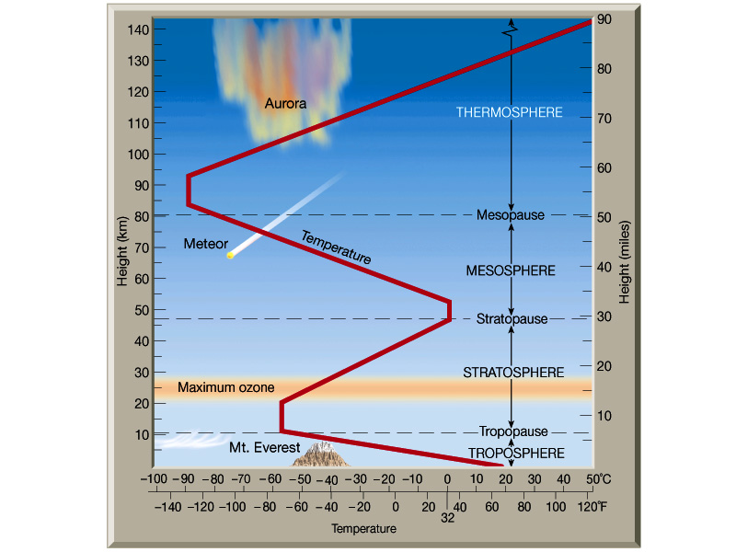
VI-SEEM Climate – our research

Slide 41
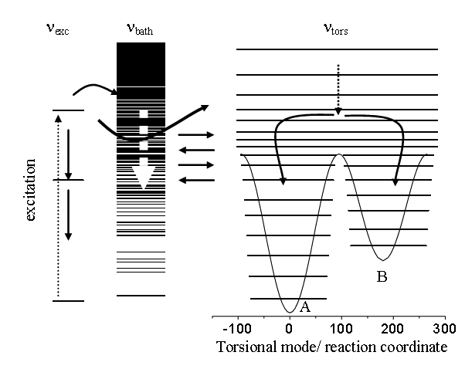
VI-SEEM Climate – our research

Slide 42
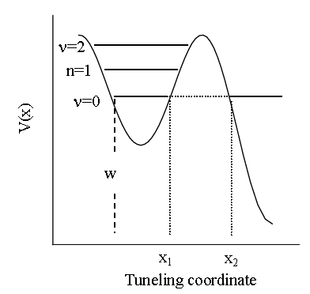
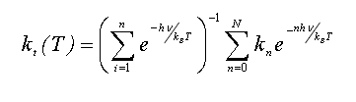
VI-SEEM Climate – our research

Slide 43
VI-SEEM Climate – our research
In such case: solute molecule exists in several forms (detectable experimentally).
All experiments are carried out at finite temperatures (>> 0 K) ⇒ thermal energy could induce interconversion between rotameric forms.

Slide 44
These can occur:
- classically
- by quantum tunneling

Slide 46
VI-SEEM Climate – our research
We are currently working on development of hybrid statistical physics – quantum mechanical methodologies to address the previous issues. Instead of relying on the more convenient theoretical chemistry approaches, based solely on exploration of potential energy hypersurfaces of the studied relevant clusters, in which the dynamical information and the highly fluctuating character of the environment in which these processes take place are practically completely lost, we will derive quite an alternative approach.

Slide 47
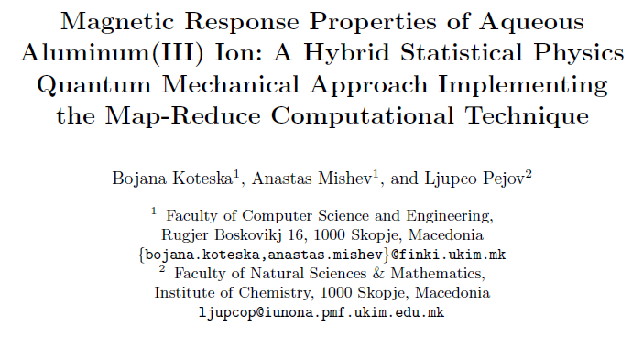

VI-SEEM Climate – our research

Slide 48
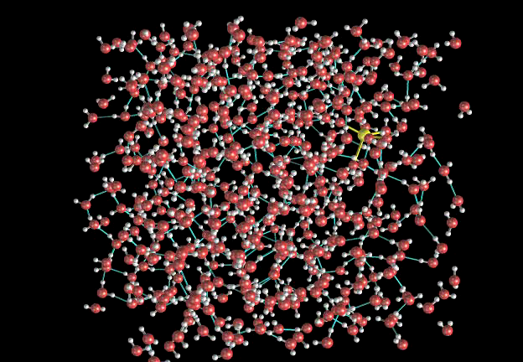

Slide 49
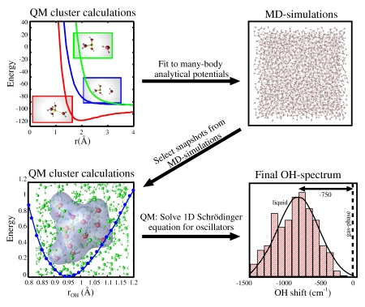

Slide 50
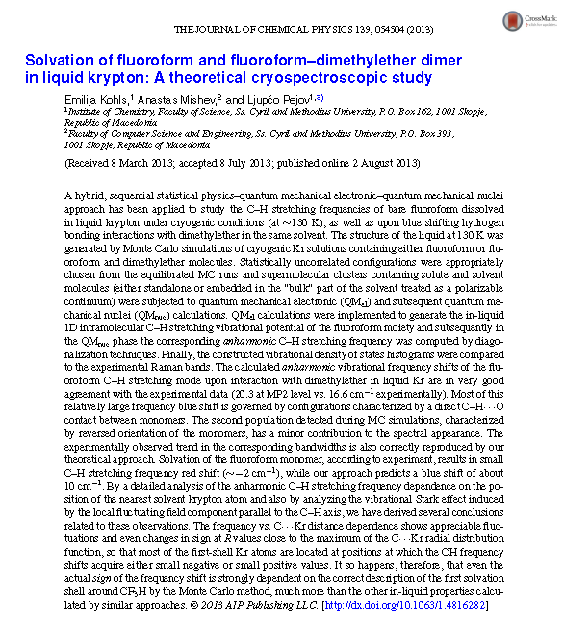

Slide 51
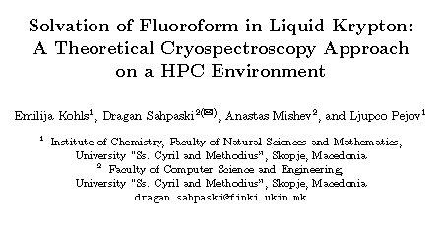


Slide 52
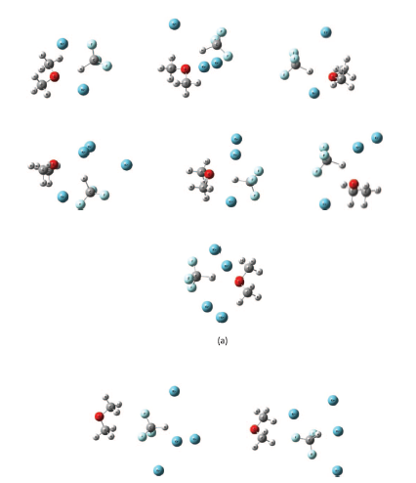

Slide 53
VI-SEEM Climate – our research

Slide 54
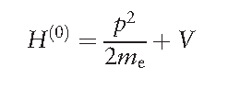

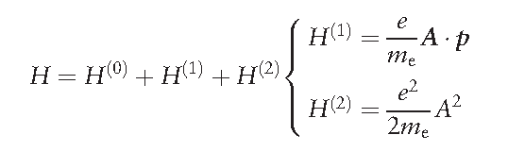
VI-SEEM Climate – our research

Slide 55

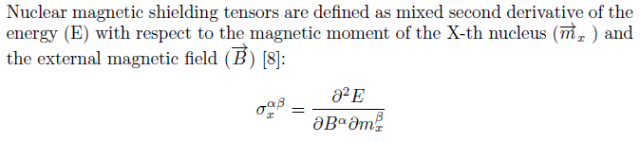

VI-SEEM Climate – our research

Slide 56
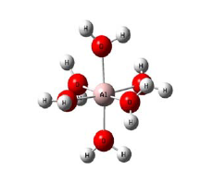
VI-SEEM Climate – our research

Slide 57
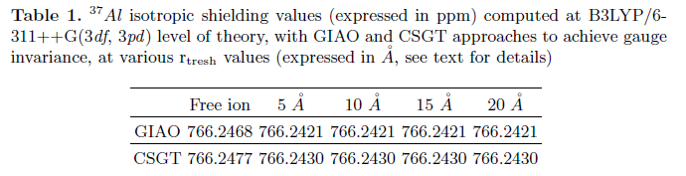
VI-SEEM Climate – our research

Slide 58
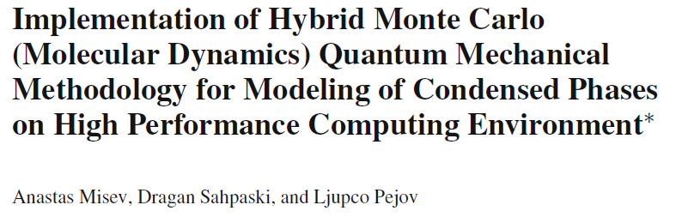


VI-SEEM Climate – our research

Slide 59

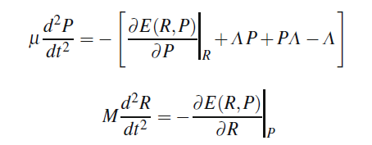


VI-SEEM Climate – our research

Slide 60
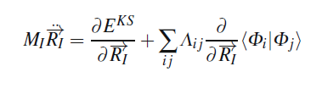

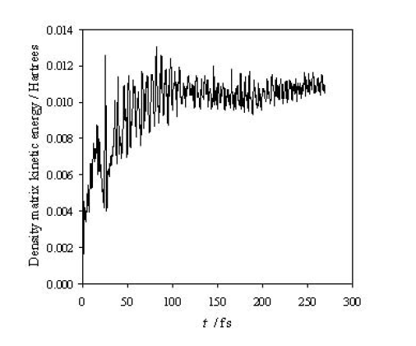

VI-SEEM Climate – our research

Slide 61
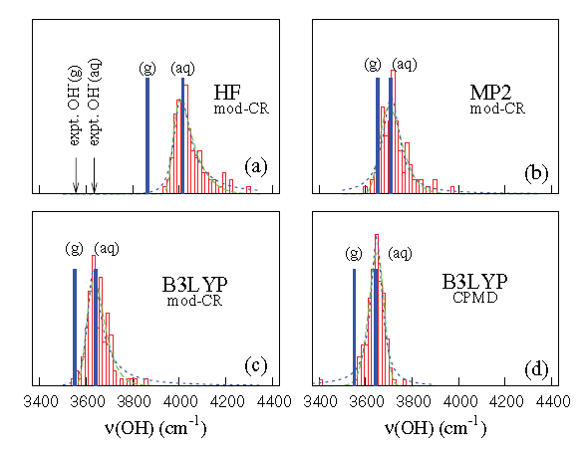
VI-SEEM Climate – our research

Slide 62
VI-SEEM Climate – our research

Slide 63


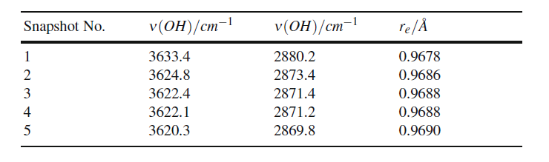
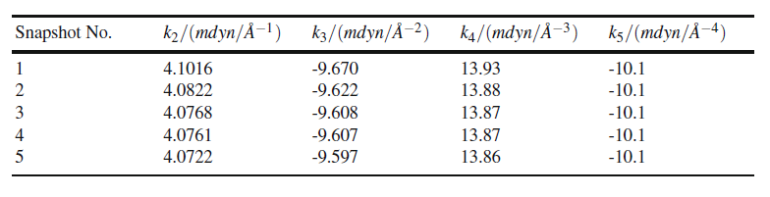
VI-SEEM Climate – our research

Slide 64
THANK YOU FOR YOUR ATTENTION

