Slide 1

Life Science and Climatology national training FCSE, UKIM
Anastas Mishev
FCSE, UKIM
The VI-SEEM project initiative is co-funded by the European Commission under the H2020 Research Infrastructures contract no. 675121

Slide 2

VI-SEEM training portal
The portal will be structured so that the user can have easy access to the training material.
Navigation through the portal will be facilitated through a menu which will be structured in way that reflects the thematic areas defined in the project
The current version of the training portal is already offering training material for High Performance Computing, including development and code improvement.
The main focus during the lifetime of the project is to develop and add high quality training material for the domain specific software and tools, while continuing to add to the library of gathered training material for the general applications and uses.

Slide 3
VI-SEEM training portal thematic categories
High Performance Computing
Grid Computing
Cloud Computing
Scientific visualization
Storage services
Domain specific software and tools
Climate software and tools
Digital Cultural Heritage software and tools
Life Sciences software and tools

Slide 4
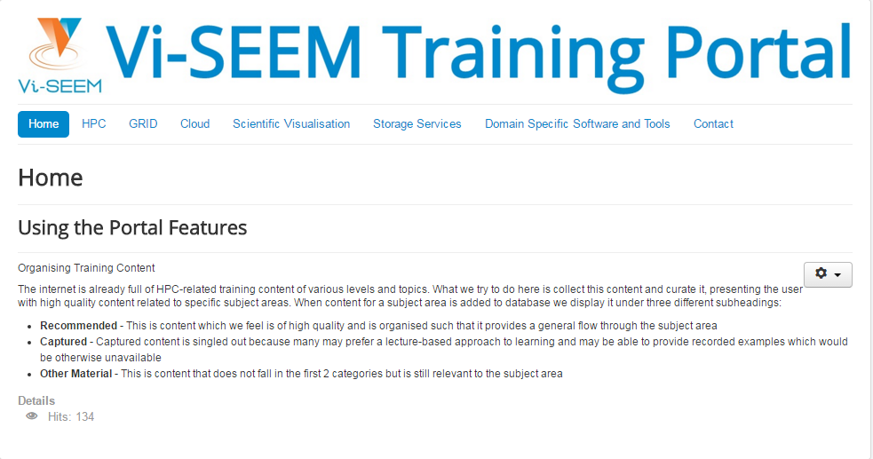
VI-SEEM training portal

Slide 5
Thanks!
Training portal: http://training.vi-seem.eu
W: https://vi-seem.eu
T: @vi_seem
L: https://www.linkedin.com/groups/VISEEM-7018941/about

