Slide 1
Life Sciences Training Event
Zoe Cournia
Investigator C’
Biomedical Research Foundation
Academy of Athens, Greece
zcournia@bioacademy.gr
Principles of Computer-Aided Drug Design
30th August, 2016

Slide 2
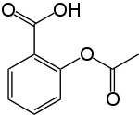
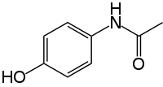
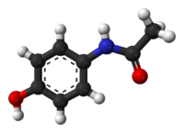
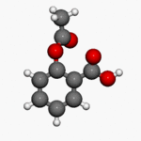
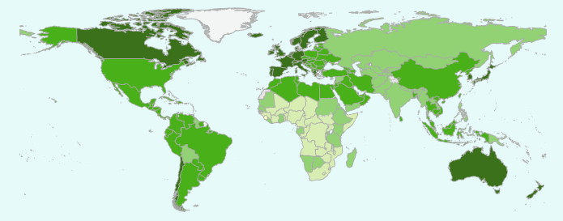

Drugs
Normally they are small organic molecules
Therapy
Relief
Prevention
Quality of life improvement
Life expectancy prolongation
Paracetamol (Depon)
Aspirin
Source: World Health Organization
Life expectancy map
Notes:
Intro on the goal of LS SC which is personalized medicine and why computers are very important in this area. Then I will talk about the challenges in the LS SC and provide and overall presentation…

Slide 3
Traditional Drug Discovery
Random screening of hundreds of thousands of molecules
with High Throughput Screening (HTS) for combating the pathogen
Random discoveries (i.e. penicillin, viagra)
Trying out existing drugs and modifications
Estimated number of small molecules that can act as drugs
10⁶⁶
10⁵⁰
Estimated number of atoms in the
world
Structure-based approaches + Targeted Therapy

Slide 4
Phases of Pharmaceutical Development
Preclinical Trials
Target discovery
Lead discovery
Clinical Trials
(I-III)
Target
Identification
Target
Validation
Lead
Identification
Lead
Optimization
Few selected ligands as potential drugs
FDA
Approval
28 million ligands currently known
Duration: 12 – 15 years, Costs: 1 billion US $

Slide 5
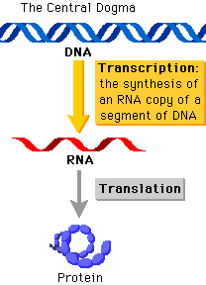
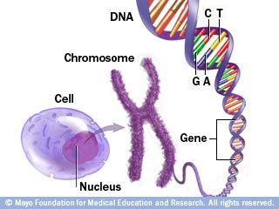
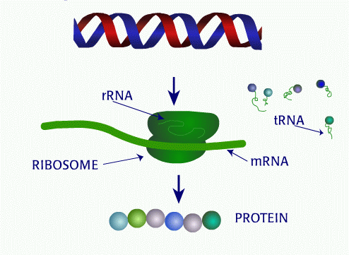
From DNA to genes to proteins
(gene)
X-rays
= Picture
Proteins are the expression of genes into functional bio-molecules
Proteins perform essential cellular functions
20.000 genes in the nucleus of our cells
→ PROTEINS

Slide 6
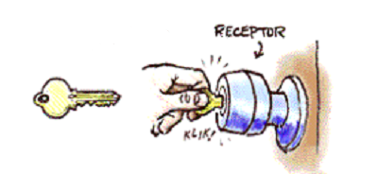
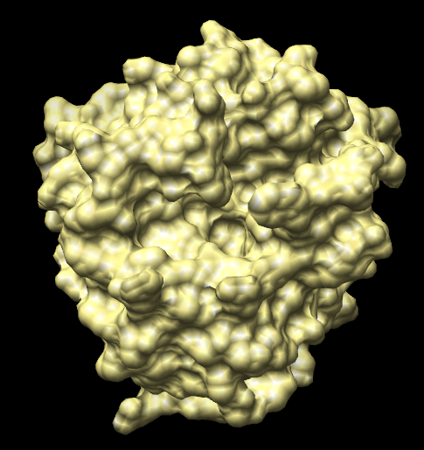
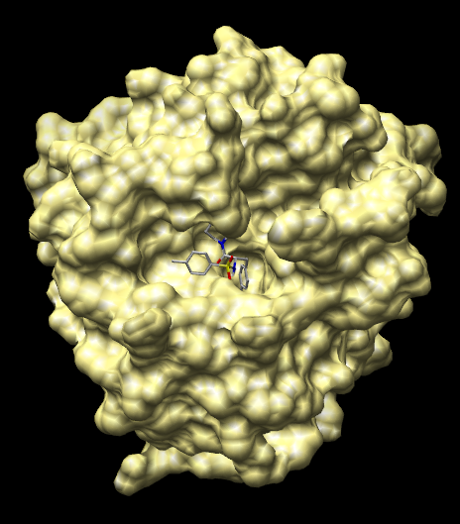
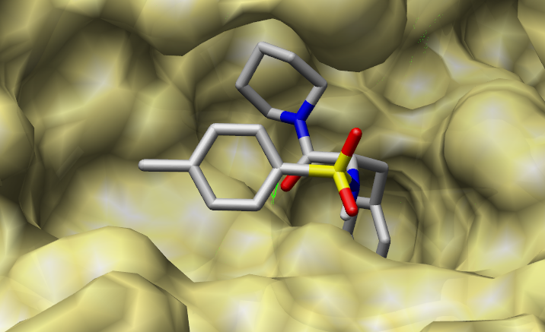
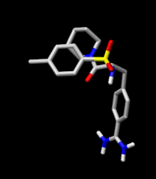
Rational Drug Discovery
Identify important genes for a diseases
Targeting/inactivating genes (proteins) of the pathogen with small molecules = drugs
TARGETED THERAPY!
Curr Opin Drug Discov Devel. 2002 May; 5(3): 355–360

Slide 7
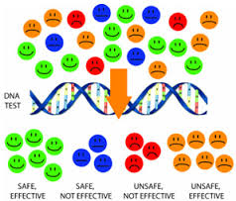
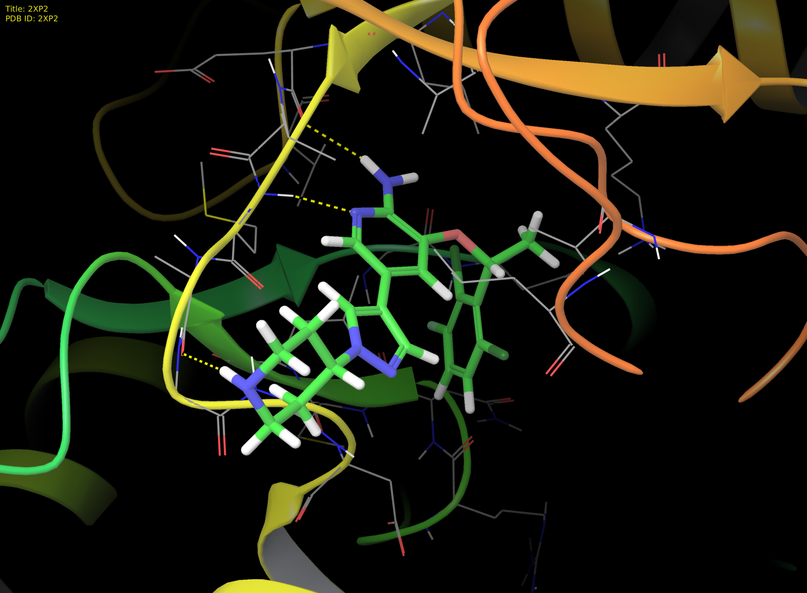
The era of personalized medicine
Lung Cancer
genotyping
4% of patients with
non-small cell lung carcinoma
Rearrangement in ALK protein
carcinogenesis
Drug design for this specific subset of patients
Crizotinib for ALK+ lung cancer patients
Notes:
In the past, one medicine would fit all. For example chemotherapy could be used to treat all cancers and some medicine would be provided at a uniform dosage, although some people need different doses. Personalized medicine is the ability to offer medicines according to the patient’s specific genotype. The detailed account of genetic information from the individual will help prevent adverse events, allow for appropriate dosages, and create maximum efficacy with drug prescriptions.
Having the genetic content of an individual will allow better guided decisions in determining the source of the disease and thus treating it or preventing its progression. This will be extremely useful for diseases like Alzheimer’s or cancers that are thought to be linked to certain mutations in our DNA.
In addition to specific treatment, personalized medicine can greatly aid the advancements of preventive care. For instance, many women are already being genotyped for certain mutations in the BRCA1 and BRCA2 gene if they are predisposed because of a family history of breast cancer or ovarian cancer.[

Slide 8
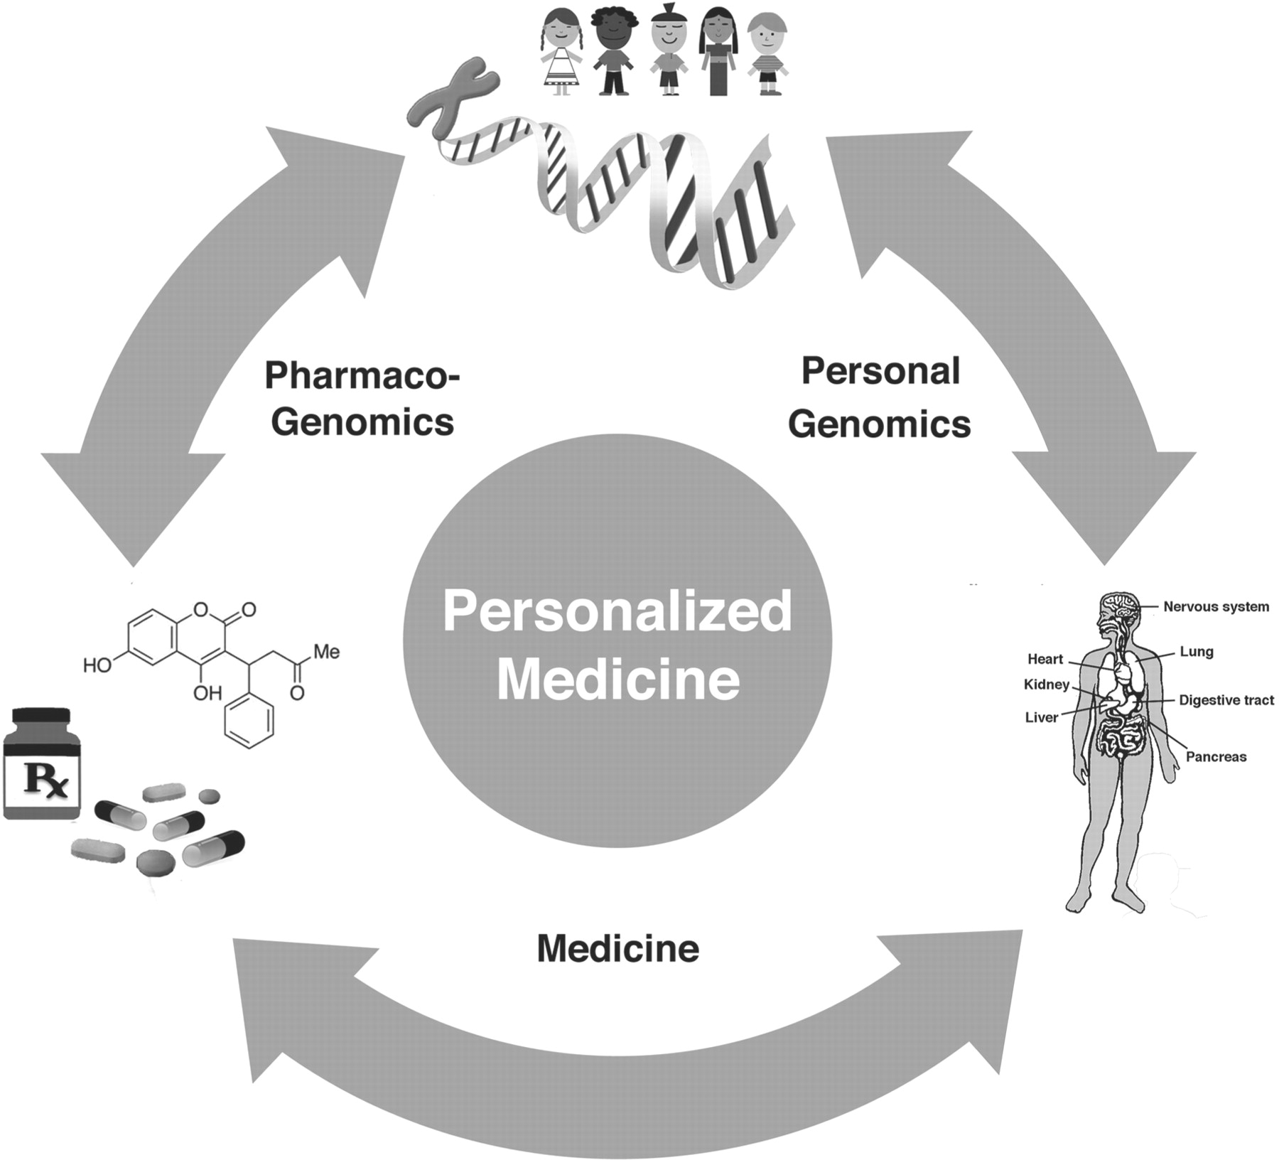
The era of personalized medicine
Provide "the right patient with the right drug at the right dose at the right time."
Tailoring of medical treatment for
Diagnosis
Treatment
Dosage
Prevention
Notes:
Personalized medicine is the ability to offer medicines according to the patient’s specific genotype. The detailed account of genetic information from the individual will help prevent adverse events, allow for appropriate dosages, and create maximum efficacy with drug prescriptions.
Having the genetic content of an individual will allow better guided decisions in determining the source of the disease and thus treating it or preventing its progression. This will be extremely useful for diseases like Alzheimer’s or cancers that are thought to be linked to certain mutations in our DNA.
In addition to specific treatment, personalized medicine can greatly aid the advancements of preventive care. For instance, many women are already being genotyped for certain mutations in the BRCA1 and BRCA2 gene if they are predisposed because of a family history of breast cancer or ovarian cancer.[

Slide 9
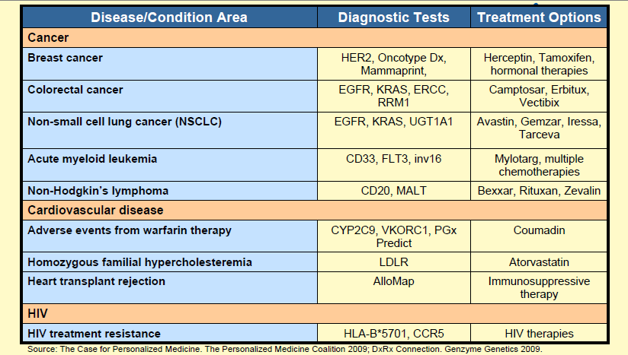
Personalized medicine: The next drug generation

Slide 10
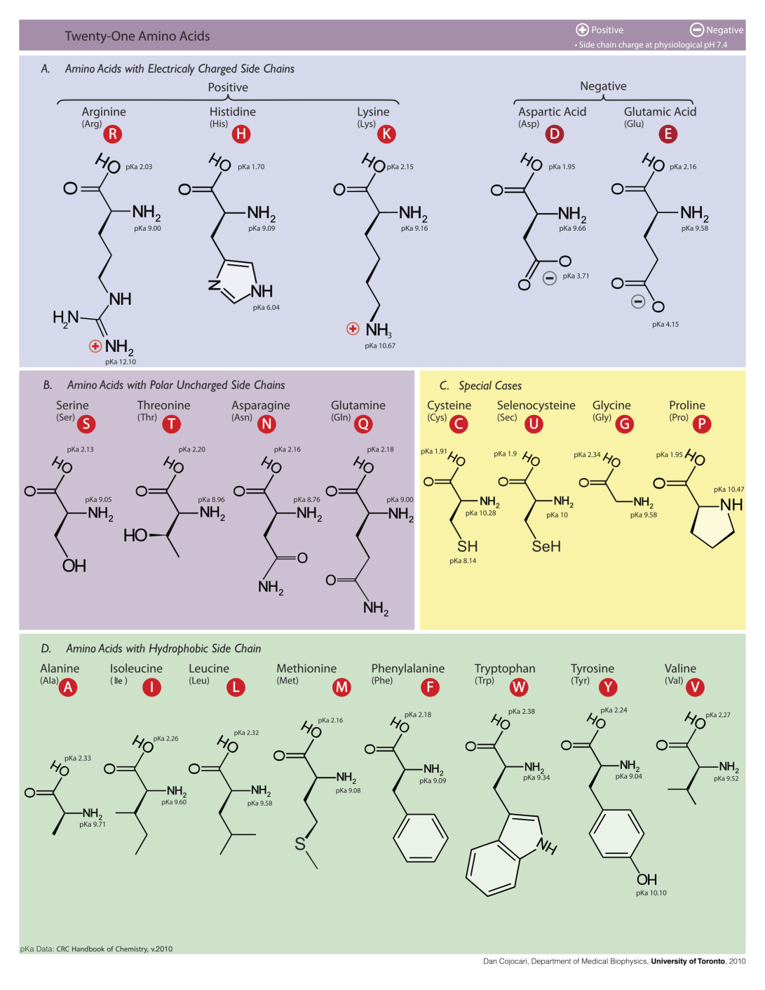
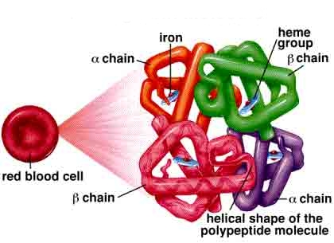
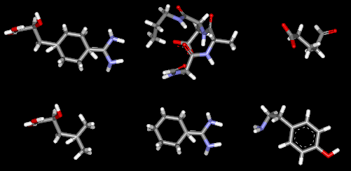
Intermolecular Interactions
Intermolecular Interactions!
Hydrogen Bonds
Electrostatic Interactions
van der Waals Forces
π – π Interactions
Notes:
Personalized medicine is the ability to offer medicines according to the patient’s specific genotype. The detailed account of genetic information from the individual will help prevent adverse events, allow for appropriate dosages, and create maximum efficacy with drug prescriptions.
Having the genetic content of an individual will allow better guided decisions in determining the source of the disease and thus treating it or preventing its progression. This will be extremely useful for diseases like Alzheimer’s or cancers that are thought to be linked to certain mutations in our DNA.
In addition to specific treatment, personalized medicine can greatly aid the advancements of preventive care. For instance, many women are already being genotyped for certain mutations in the BRCA1 and BRCA2 gene if they are predisposed because of a family history of breast cancer or ovarian cancer.[

Slide 11

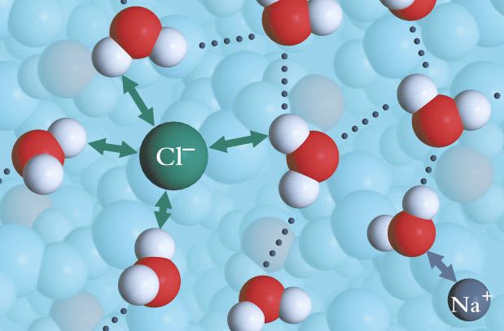
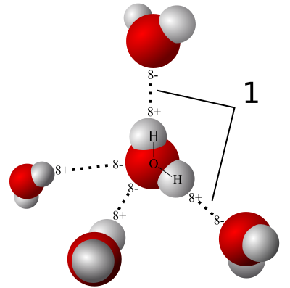

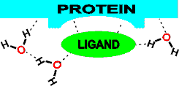

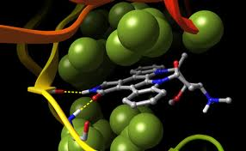


Intermolecular Interactions
Electrostatic Interactions
-
+
Hydrogen Bonds
van der Waals Forces
π – π, cation - π interactions
Notes:
Personalized medicine is the ability to offer medicines according to the patient’s specific genotype. The detailed account of genetic information from the individual will help prevent adverse events, allow for appropriate dosages, and create maximum efficacy with drug prescriptions.
Having the genetic content of an individual will allow better guided decisions in determining the source of the disease and thus treating it or preventing its progression. This will be extremely useful for diseases like Alzheimer’s or cancers that are thought to be linked to certain mutations in our DNA.
In addition to specific treatment, personalized medicine can greatly aid the advancements of preventive care. For instance, many women are already being genotyped for certain mutations in the BRCA1 and BRCA2 gene if they are predisposed because of a family history of breast cancer or ovarian cancer.[

Slide 12
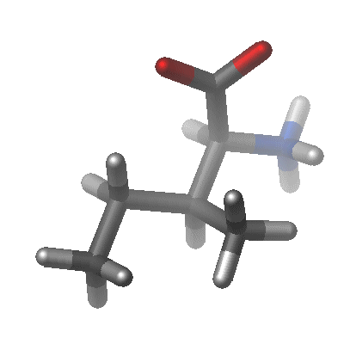

Molecular Simulations?
Nobel Prize in Chemistry 2013
Notes:
Personalized medicine is the ability to offer medicines according to the patient’s specific genotype. The detailed account of genetic information from the individual will help prevent adverse events, allow for appropriate dosages, and create maximum efficacy with drug prescriptions.
Having the genetic content of an individual will allow better guided decisions in determining the source of the disease and thus treating it or preventing its progression. This will be extremely useful for diseases like Alzheimer’s or cancers that are thought to be linked to certain mutations in our DNA.
In addition to specific treatment, personalized medicine can greatly aid the advancements of preventive care. For instance, many women are already being genotyped for certain mutations in the BRCA1 and BRCA2 gene if they are predisposed because of a family history of breast cancer or ovarian cancer.[

Slide 13
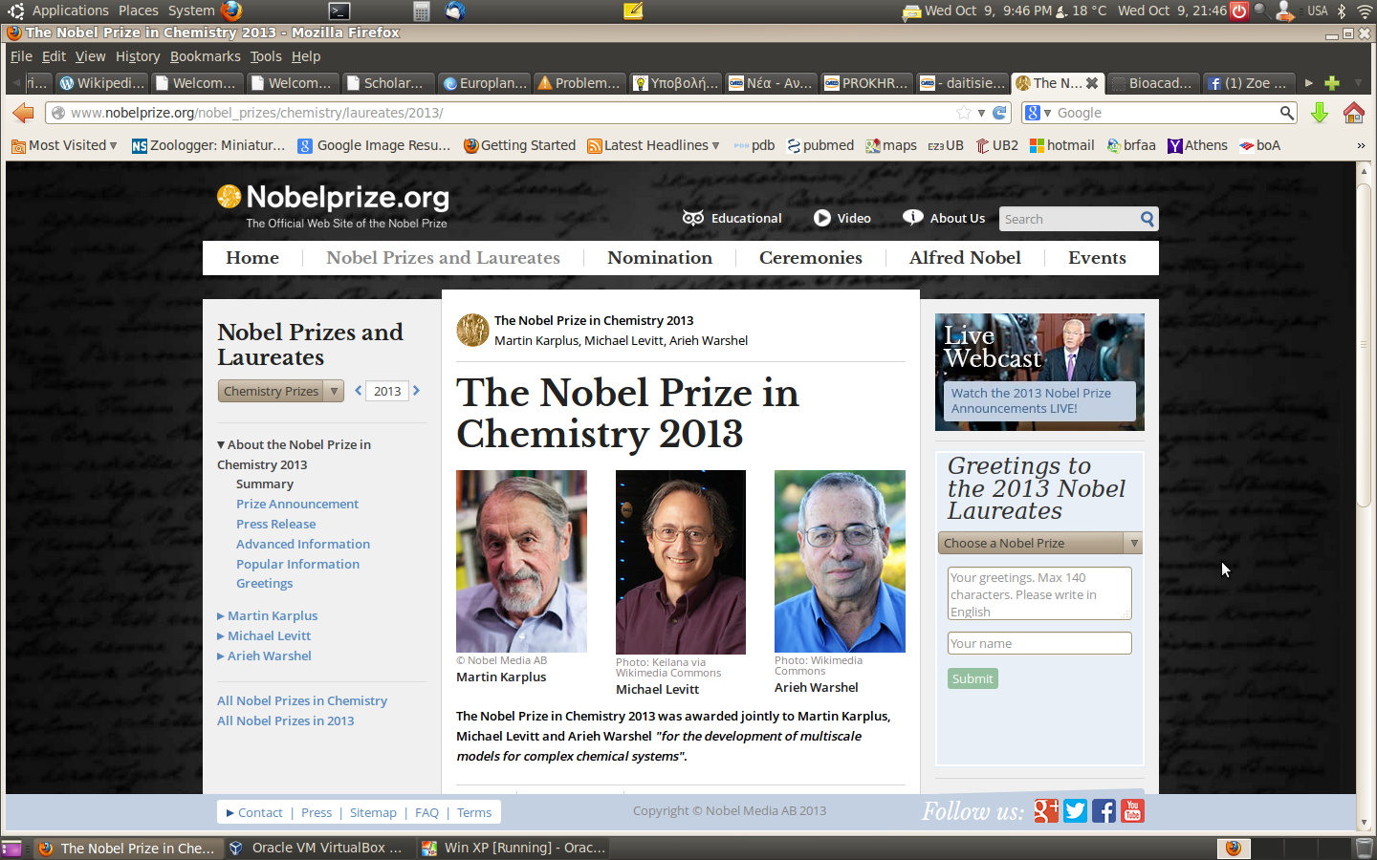
The era of personalized medicine
Notes:
Personalized medicine is the ability to offer medicines according to the patient’s specific genotype. The detailed account of genetic information from the individual will help prevent adverse events, allow for appropriate dosages, and create maximum efficacy with drug prescriptions.
Having the genetic content of an individual will allow better guided decisions in determining the source of the disease and thus treating it or preventing its progression. This will be extremely useful for diseases like Alzheimer’s or cancers that are thought to be linked to certain mutations in our DNA.
In addition to specific treatment, personalized medicine can greatly aid the advancements of preventive care. For instance, many women are already being genotyped for certain mutations in the BRCA1 and BRCA2 gene if they are predisposed because of a family history of breast cancer or ovarian cancer.[

Slide 14

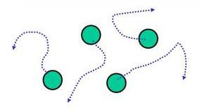
Molecular Dynamics Simulations
Step 1: Use coordinates from experimental structures and assign initial velocities
Step 2: Integrate Newton’s second law and get the new velocities (v) of the system and the new coordinates (r) of the atoms
Step 3: Macroscopic properties can be expressed through v and r via statistical mechanics
Potential energy
Notes:
Personalized medicine is the ability to offer medicines according to the patient’s specific genotype. The detailed account of genetic information from the individual will help prevent adverse events, allow for appropriate dosages, and create maximum efficacy with drug prescriptions.
Having the genetic content of an individual will allow better guided decisions in determining the source of the disease and thus treating it or preventing its progression. This will be extremely useful for diseases like Alzheimer’s or cancers that are thought to be linked to certain mutations in our DNA.
In addition to specific treatment, personalized medicine can greatly aid the advancements of preventive care. For instance, many women are already being genotyped for certain mutations in the BRCA1 and BRCA2 gene if they are predisposed because of a family history of breast cancer or ovarian cancer.[

Slide 15
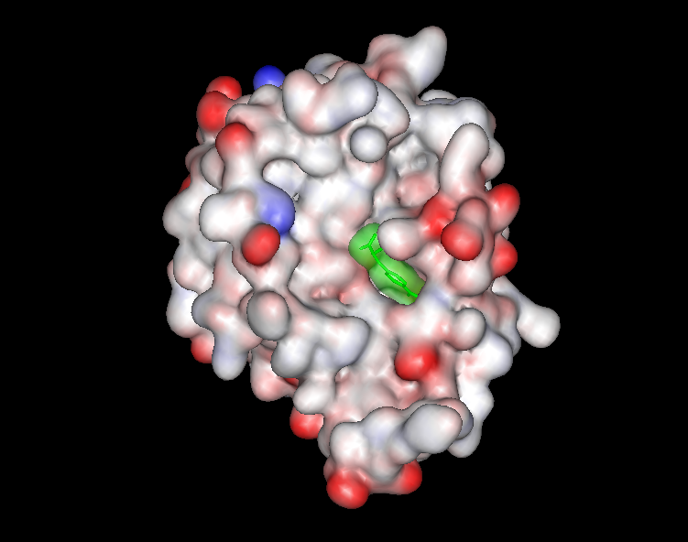
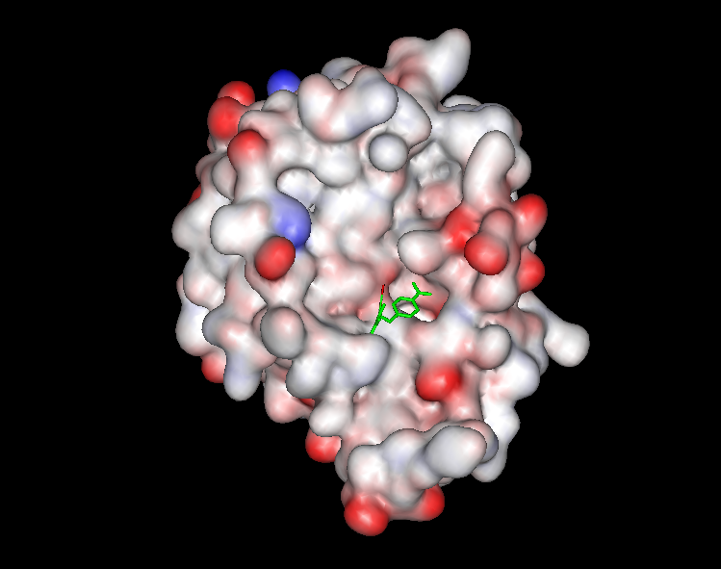
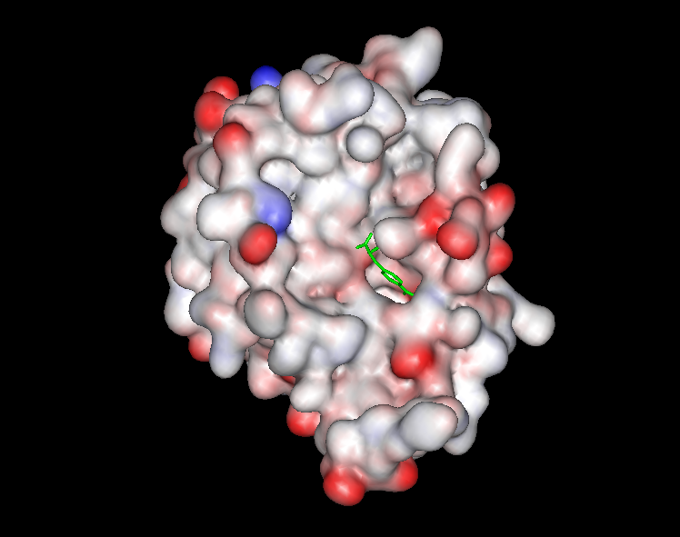
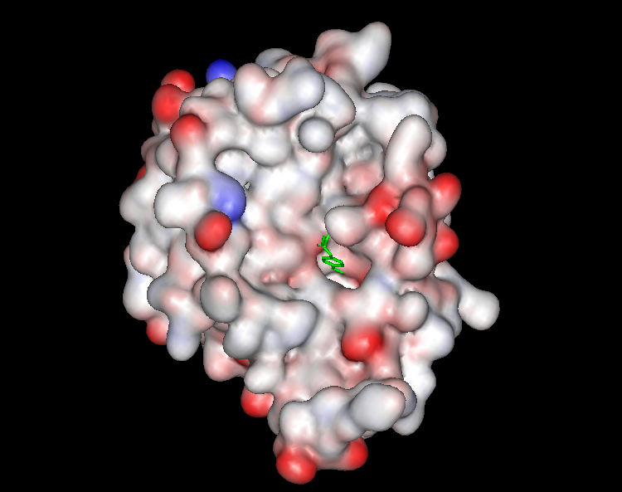

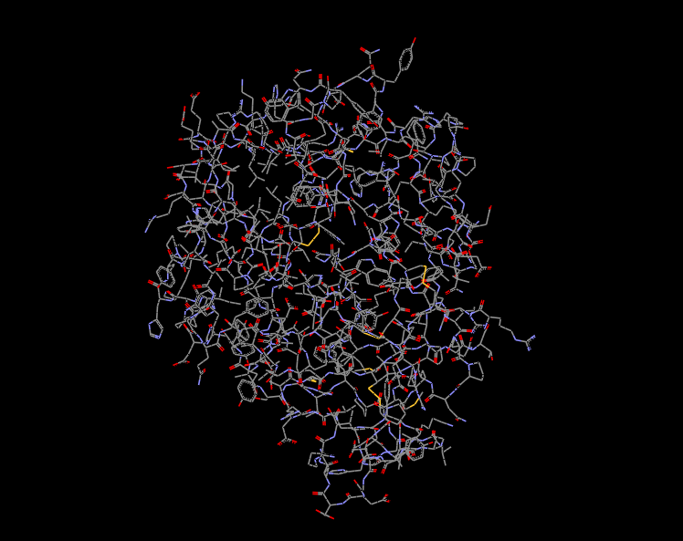
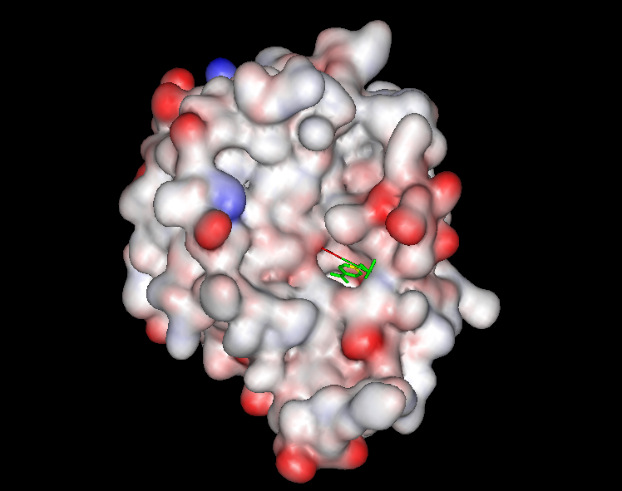
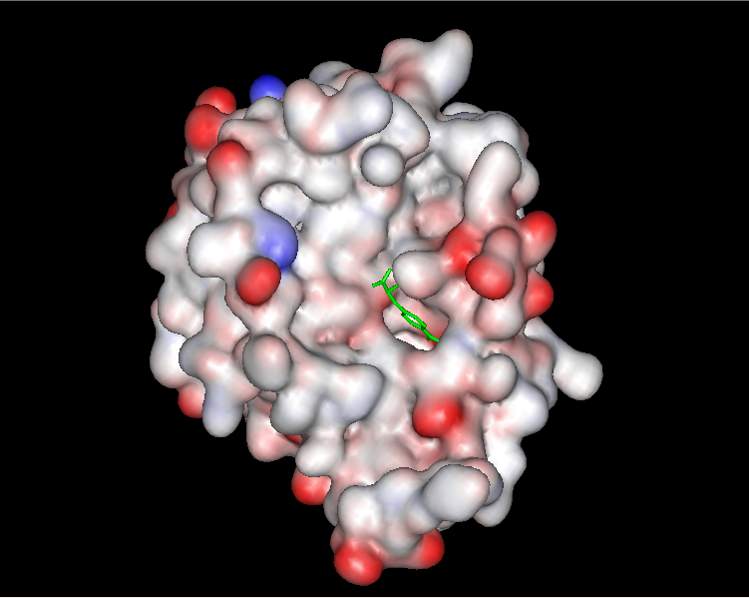

Protein-Ligand Docking
Virtual Screening
A basic introduction to drugs, drug targets and intermolecular interactions
Notes:
Personalized medicine is the ability to offer medicines according to the patient’s specific genotype. The detailed account of genetic information from the individual will help prevent adverse events, allow for appropriate dosages, and create maximum efficacy with drug prescriptions.
Having the genetic content of an individual will allow better guided decisions in determining the source of the disease and thus treating it or preventing its progression. This will be extremely useful for diseases like Alzheimer’s or cancers that are thought to be linked to certain mutations in our DNA.
In addition to specific treatment, personalized medicine can greatly aid the advancements of preventive care. For instance, many women are already being genotyped for certain mutations in the BRCA1 and BRCA2 gene if they are predisposed because of a family history of breast cancer or ovarian cancer.[

Slide 16
Scoring Functions for Molecular Docking
Scoring Functions → approximate the free energy of binding of a small molecule binding to a target
The algorithm performs a conformational search in the binding pocket of the target
Some of the ligand conformations are rejected because of high-energy clashes with the protein
The remainder conformations have to be assessed or ranked
Different Ligands have to be ranked relative to each other
Scoring Functions
(approximate free energy of binding)
ΔG _{bind} = ΔG_{solv.} + ΔG_{conf.} + ΔG_{int.} + ΔG_{rot.} + ΔG_{t/r} + ΔG_{vib.}
Notes:
Personalized medicine is the ability to offer medicines according to the patient’s specific genotype. The detailed account of genetic information from the individual will help prevent adverse events, allow for appropriate dosages, and create maximum efficacy with drug prescriptions.
Having the genetic content of an individual will allow better guided decisions in determining the source of the disease and thus treating it or preventing its progression. This will be extremely useful for diseases like Alzheimer’s or cancers that are thought to be linked to certain mutations in our DNA.
In addition to specific treatment, personalized medicine can greatly aid the advancements of preventive care. For instance, many women are already being genotyped for certain mutations in the BRCA1 and BRCA2 gene if they are predisposed because of a family history of breast cancer or ovarian cancer.[

Slide 17
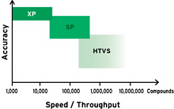
Scoring Functions for Molecular Docking
SP
ΔG _{bind} = ΔG₀ + ΔG_{hbond}Σ f(ΔR,Δα)
+ ΔG_{ionic} Σ f(ΔR,Δα) + ΔG_{lipo} A_{lipo} + ΔG_{rot}N_{rot}
XP
XP GScore = E_{coul} + E_{vdW} + E_{bind} + E_{penalty}
E_{bind} = E _{phobic_pair} + E_{hyd_enclosure} + E _{hb_nn_motif} + E _{hb_cc_motif} + E _{hb_pair} +E_{PI}
E_{penalty} = E_{desolv} + E _{ligand strain}
Parameters in scoring functions are being estimated based on training sets
Friesner, R.A.,., et al (2004) J Med Chem, 47, pp. 1739-1749
Friesner, R.A., et al., (2006) J Med Chem, 49, pp. 6177-6196
Notes:
Personalized medicine is the ability to offer medicines according to the patient’s specific genotype. The detailed account of genetic information from the individual will help prevent adverse events, allow for appropriate dosages, and create maximum efficacy with drug prescriptions.
Having the genetic content of an individual will allow better guided decisions in determining the source of the disease and thus treating it or preventing its progression. This will be extremely useful for diseases like Alzheimer’s or cancers that are thought to be linked to certain mutations in our DNA.
In addition to specific treatment, personalized medicine can greatly aid the advancements of preventive care. For instance, many women are already being genotyped for certain mutations in the BRCA1 and BRCA2 gene if they are predisposed because of a family history of breast cancer or ovarian cancer.[

Slide 18
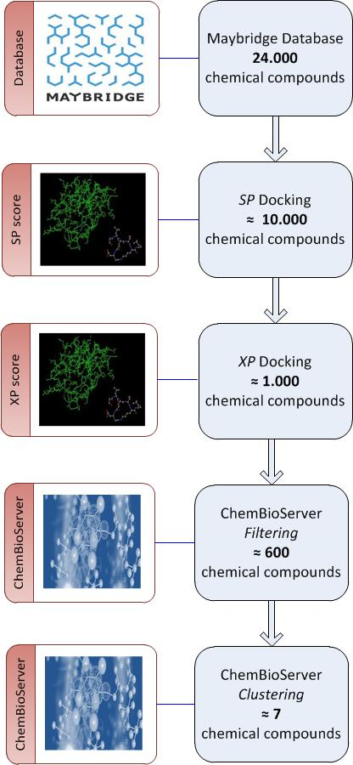
How are compounds selected for assaying?
van der Waals
toxicity
unwanted moieties
Clustering
Affinity Propagation
Notes:
Personalized medicine is the ability to offer medicines according to the patient’s specific genotype. The detailed account of genetic information from the individual will help prevent adverse events, allow for appropriate dosages, and create maximum efficacy with drug prescriptions.
Having the genetic content of an individual will allow better guided decisions in determining the source of the disease and thus treating it or preventing its progression. This will be extremely useful for diseases like Alzheimer’s or cancers that are thought to be linked to certain mutations in our DNA.
In addition to specific treatment, personalized medicine can greatly aid the advancements of preventive care. For instance, many women are already being genotyped for certain mutations in the BRCA1 and BRCA2 gene if they are predisposed because of a family history of breast cancer or ovarian cancer.[

Slide 19
How are compounds selected for assaying?
Estimation of binding affinity through docking score
Conformation of ligand inside the protein (binding pose):
-Look out for bad van der Waals contacts
-Cis-trans amides
-E-Z esters
Identification of unwanted or toxic moieties on a compound
Identification of metabolic liabilities (benzylic hydrogens, p- position on benzene, sites of glucuronidation, etc…)
Calculation of physicochemical properties (lipophilicity, cell permeability, solubility, etc). Choose molecules with drug-like Pchem profile.
Clustering
Chemical intuition
Notes:
Personalized medicine is the ability to offer medicines according to the patient’s specific genotype. The detailed account of genetic information from the individual will help prevent adverse events, allow for appropriate dosages, and create maximum efficacy with drug prescriptions.
Having the genetic content of an individual will allow better guided decisions in determining the source of the disease and thus treating it or preventing its progression. This will be extremely useful for diseases like Alzheimer’s or cancers that are thought to be linked to certain mutations in our DNA.
In addition to specific treatment, personalized medicine can greatly aid the advancements of preventive care. For instance, many women are already being genotyped for certain mutations in the BRCA1 and BRCA2 gene if they are predisposed because of a family history of breast cancer or ovarian cancer.[

Slide 20
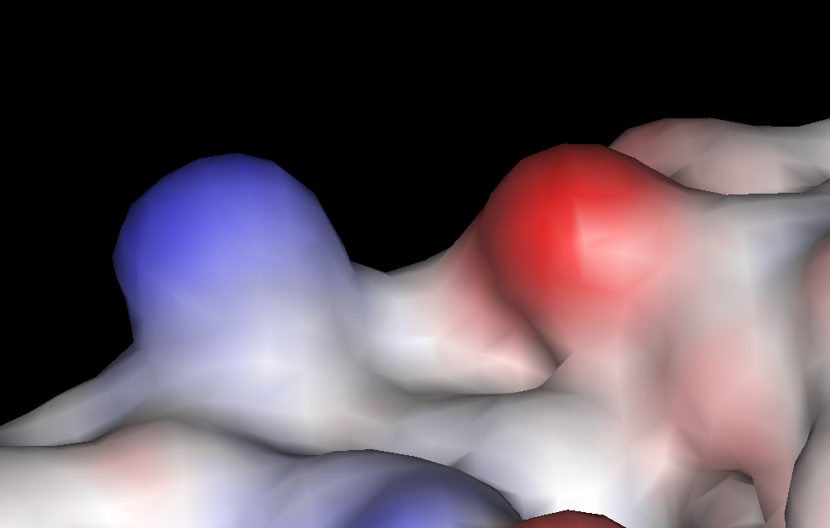
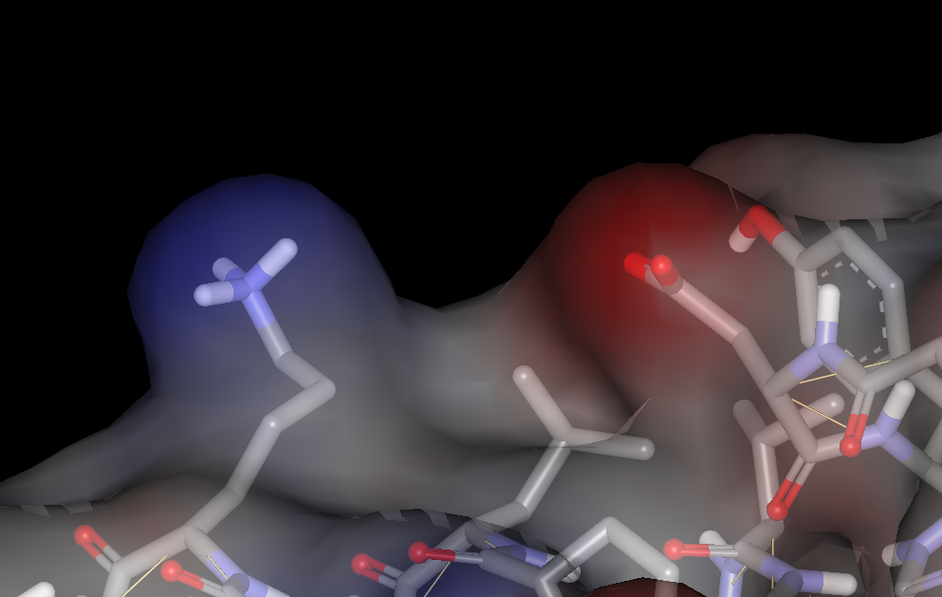
De novo drug design with ligand-growing algorithm
Design of inhibitors from scratch based on 3D structure of protein
With a ligand-growing program analogs are built inside protein binding site
Notes:
Personalized medicine is the ability to offer medicines according to the patient’s specific genotype. The detailed account of genetic information from the individual will help prevent adverse events, allow for appropriate dosages, and create maximum efficacy with drug prescriptions.
Having the genetic content of an individual will allow better guided decisions in determining the source of the disease and thus treating it or preventing its progression. This will be extremely useful for diseases like Alzheimer’s or cancers that are thought to be linked to certain mutations in our DNA.
In addition to specific treatment, personalized medicine can greatly aid the advancements of preventive care. For instance, many women are already being genotyped for certain mutations in the BRCA1 and BRCA2 gene if they are predisposed because of a family history of breast cancer or ovarian cancer.[

Slide 21
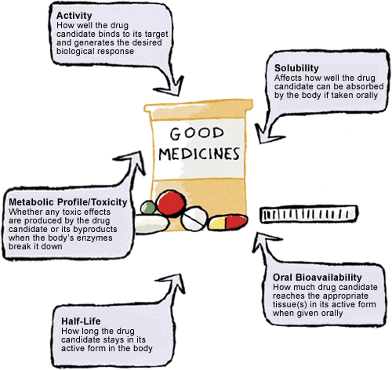
Successful Drugs
ADME: Absorption, Distribution, Metabolism, Excretion
Notes:
Personalized medicine is the ability to offer medicines according to the patient’s specific genotype. The detailed account of genetic information from the individual will help prevent adverse events, allow for appropriate dosages, and create maximum efficacy with drug prescriptions.
Having the genetic content of an individual will allow better guided decisions in determining the source of the disease and thus treating it or preventing its progression. This will be extremely useful for diseases like Alzheimer’s or cancers that are thought to be linked to certain mutations in our DNA.
In addition to specific treatment, personalized medicine can greatly aid the advancements of preventive care. For instance, many women are already being genotyped for certain mutations in the BRCA1 and BRCA2 gene if they are predisposed because of a family history of breast cancer or ovarian cancer.[

Slide 22
Hands-on Exercises
Protein preparation
Virtual Screening
Chemical Intuition
Selection
Toxicity Filtering
Physicochemical
Properties
Notes:
Personalized medicine is the ability to offer medicines according to the patient’s specific genotype. The detailed account of genetic information from the individual will help prevent adverse events, allow for appropriate dosages, and create maximum efficacy with drug prescriptions.
Having the genetic content of an individual will allow better guided decisions in determining the source of the disease and thus treating it or preventing its progression. This will be extremely useful for diseases like Alzheimer’s or cancers that are thought to be linked to certain mutations in our DNA.
In addition to specific treatment, personalized medicine can greatly aid the advancements of preventive care. For instance, many women are already being genotyped for certain mutations in the BRCA1 and BRCA2 gene if they are predisposed because of a family history of breast cancer or ovarian cancer.[

Slide 23
Anaplastic Lymphoma Kinase (ALK)
Responsible mainly for 3% of lung cancers
Xalkori (crizotinib), produced by Pfizer is a specific ALK inhibitor
Paraskevi Gkeka and Zoe Cournia
Notes:
Personalized medicine is the ability to offer medicines according to the patient’s specific genotype. The detailed account of genetic information from the individual will help prevent adverse events, allow for appropriate dosages, and create maximum efficacy with drug prescriptions.
Having the genetic content of an individual will allow better guided decisions in determining the source of the disease and thus treating it or preventing its progression. This will be extremely useful for diseases like Alzheimer’s or cancers that are thought to be linked to certain mutations in our DNA.
In addition to specific treatment, personalized medicine can greatly aid the advancements of preventive care. For instance, many women are already being genotyped for certain mutations in the BRCA1 and BRCA2 gene if they are predisposed because of a family history of breast cancer or ovarian cancer.[

Slide 24

Maestro
Project - > Change Directory
Documents-> UIMK-Workshop->Maestro
Import -> Choose 2XP2.pdb
Click “Open”
Notes:
Personalized medicine is the ability to offer medicines according to the patient’s specific genotype. The detailed account of genetic information from the individual will help prevent adverse events, allow for appropriate dosages, and create maximum efficacy with drug prescriptions.
Having the genetic content of an individual will allow better guided decisions in determining the source of the disease and thus treating it or preventing its progression. This will be extremely useful for diseases like Alzheimer’s or cancers that are thought to be linked to certain mutations in our DNA.
In addition to specific treatment, personalized medicine can greatly aid the advancements of preventive care. For instance, many women are already being genotyped for certain mutations in the BRCA1 and BRCA2 gene if they are predisposed because of a family history of breast cancer or ovarian cancer.[

Slide 25

Maestro
To rotate the protein -> hold and press the scroll button and move the mouse
To zoom in and out -> scroll
To translate -> right click and move the mouse
Notes:
Personalized medicine is the ability to offer medicines according to the patient’s specific genotype. The detailed account of genetic information from the individual will help prevent adverse events, allow for appropriate dosages, and create maximum efficacy with drug prescriptions.
Having the genetic content of an individual will allow better guided decisions in determining the source of the disease and thus treating it or preventing its progression. This will be extremely useful for diseases like Alzheimer’s or cancers that are thought to be linked to certain mutations in our DNA.
In addition to specific treatment, personalized medicine can greatly aid the advancements of preventive care. For instance, many women are already being genotyped for certain mutations in the BRCA1 and BRCA2 gene if they are predisposed because of a family history of breast cancer or ovarian cancer.[

Slide 26

Maestro
Paraskevi Gkeka and Zoe Cournia

Slide 27
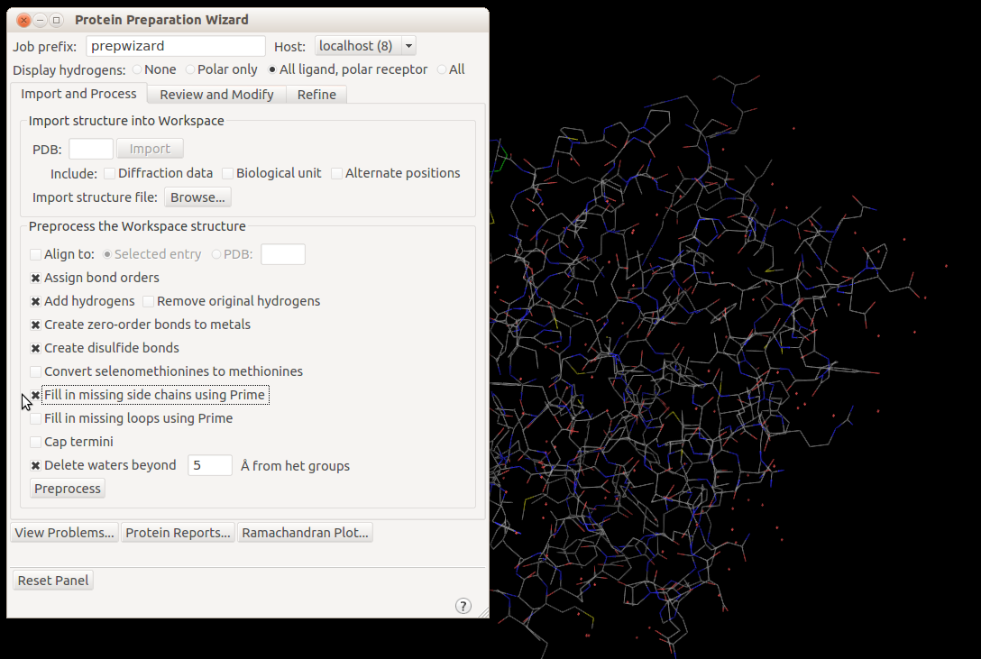
Maestro
Paraskevi Gkeka and Zoe Cournia

Slide 28
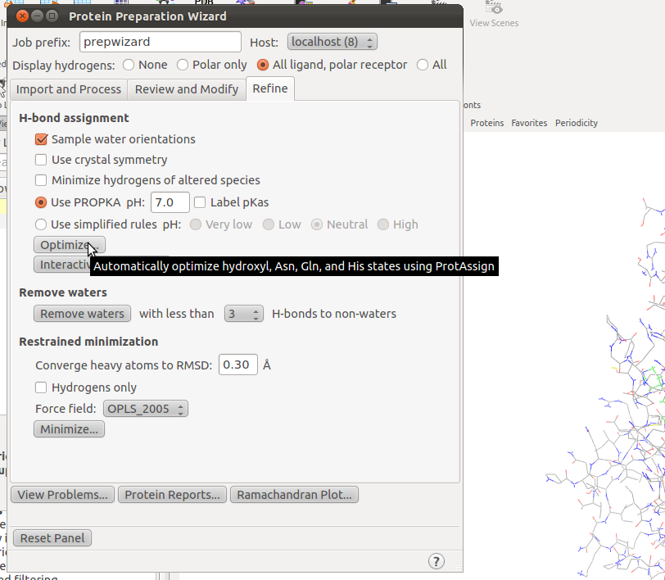
Maestro
Paraskevi Gkeka and Zoe Cournia

Slide 29
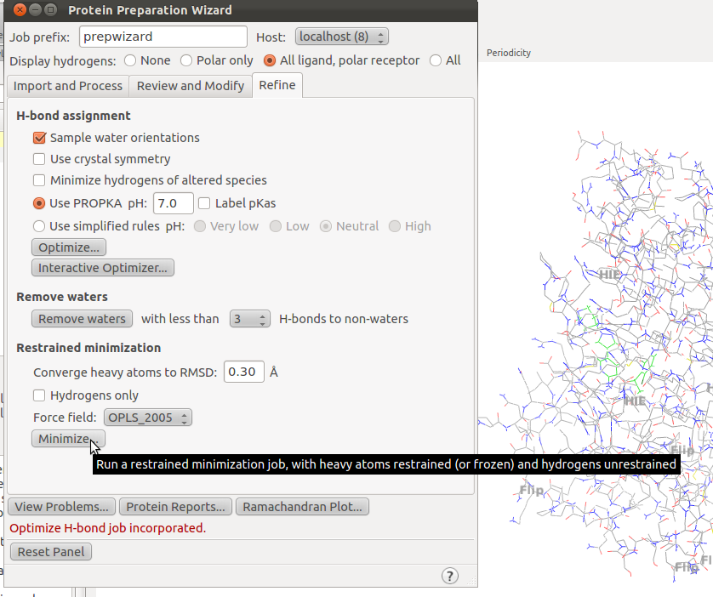
Paraskevi Gkeka and Zoe Cournia

Slide 30
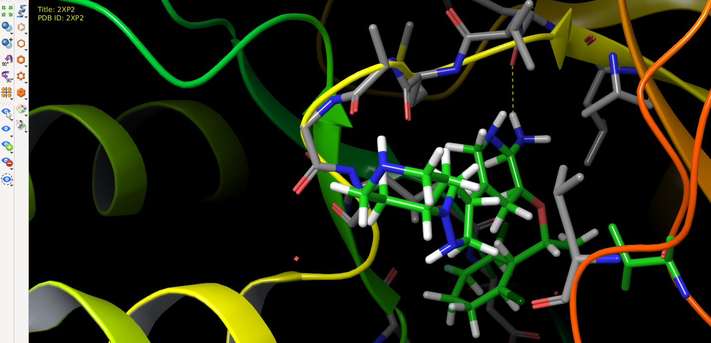
Maestro: View – Workspace - Display atoms – Representation
Show ribbons for all Residues
Select Licorice (press the button continuously)-> Ligands
Eye -> Display only -> Ligands,
Kyklos +4A
Press “L” to focus on the ligand
Ligand interaction diagram
Contacts -> Good, ligand-receptor
Double click “Draw bonds in tube”
Notes:
Personalized medicine is the ability to offer medicines according to the patient’s specific genotype. The detailed account of genetic information from the individual will help prevent adverse events, allow for appropriate dosages, and create maximum efficacy with drug prescriptions.
Having the genetic content of an individual will allow better guided decisions in determining the source of the disease and thus treating it or preventing its progression. This will be extremely useful for diseases like Alzheimer’s or cancers that are thought to be linked to certain mutations in our DNA.
In addition to specific treatment, personalized medicine can greatly aid the advancements of preventive care. For instance, many women are already being genotyped for certain mutations in the BRCA1 and BRCA2 gene if they are predisposed because of a family history of breast cancer or ovarian cancer.[

Slide 31
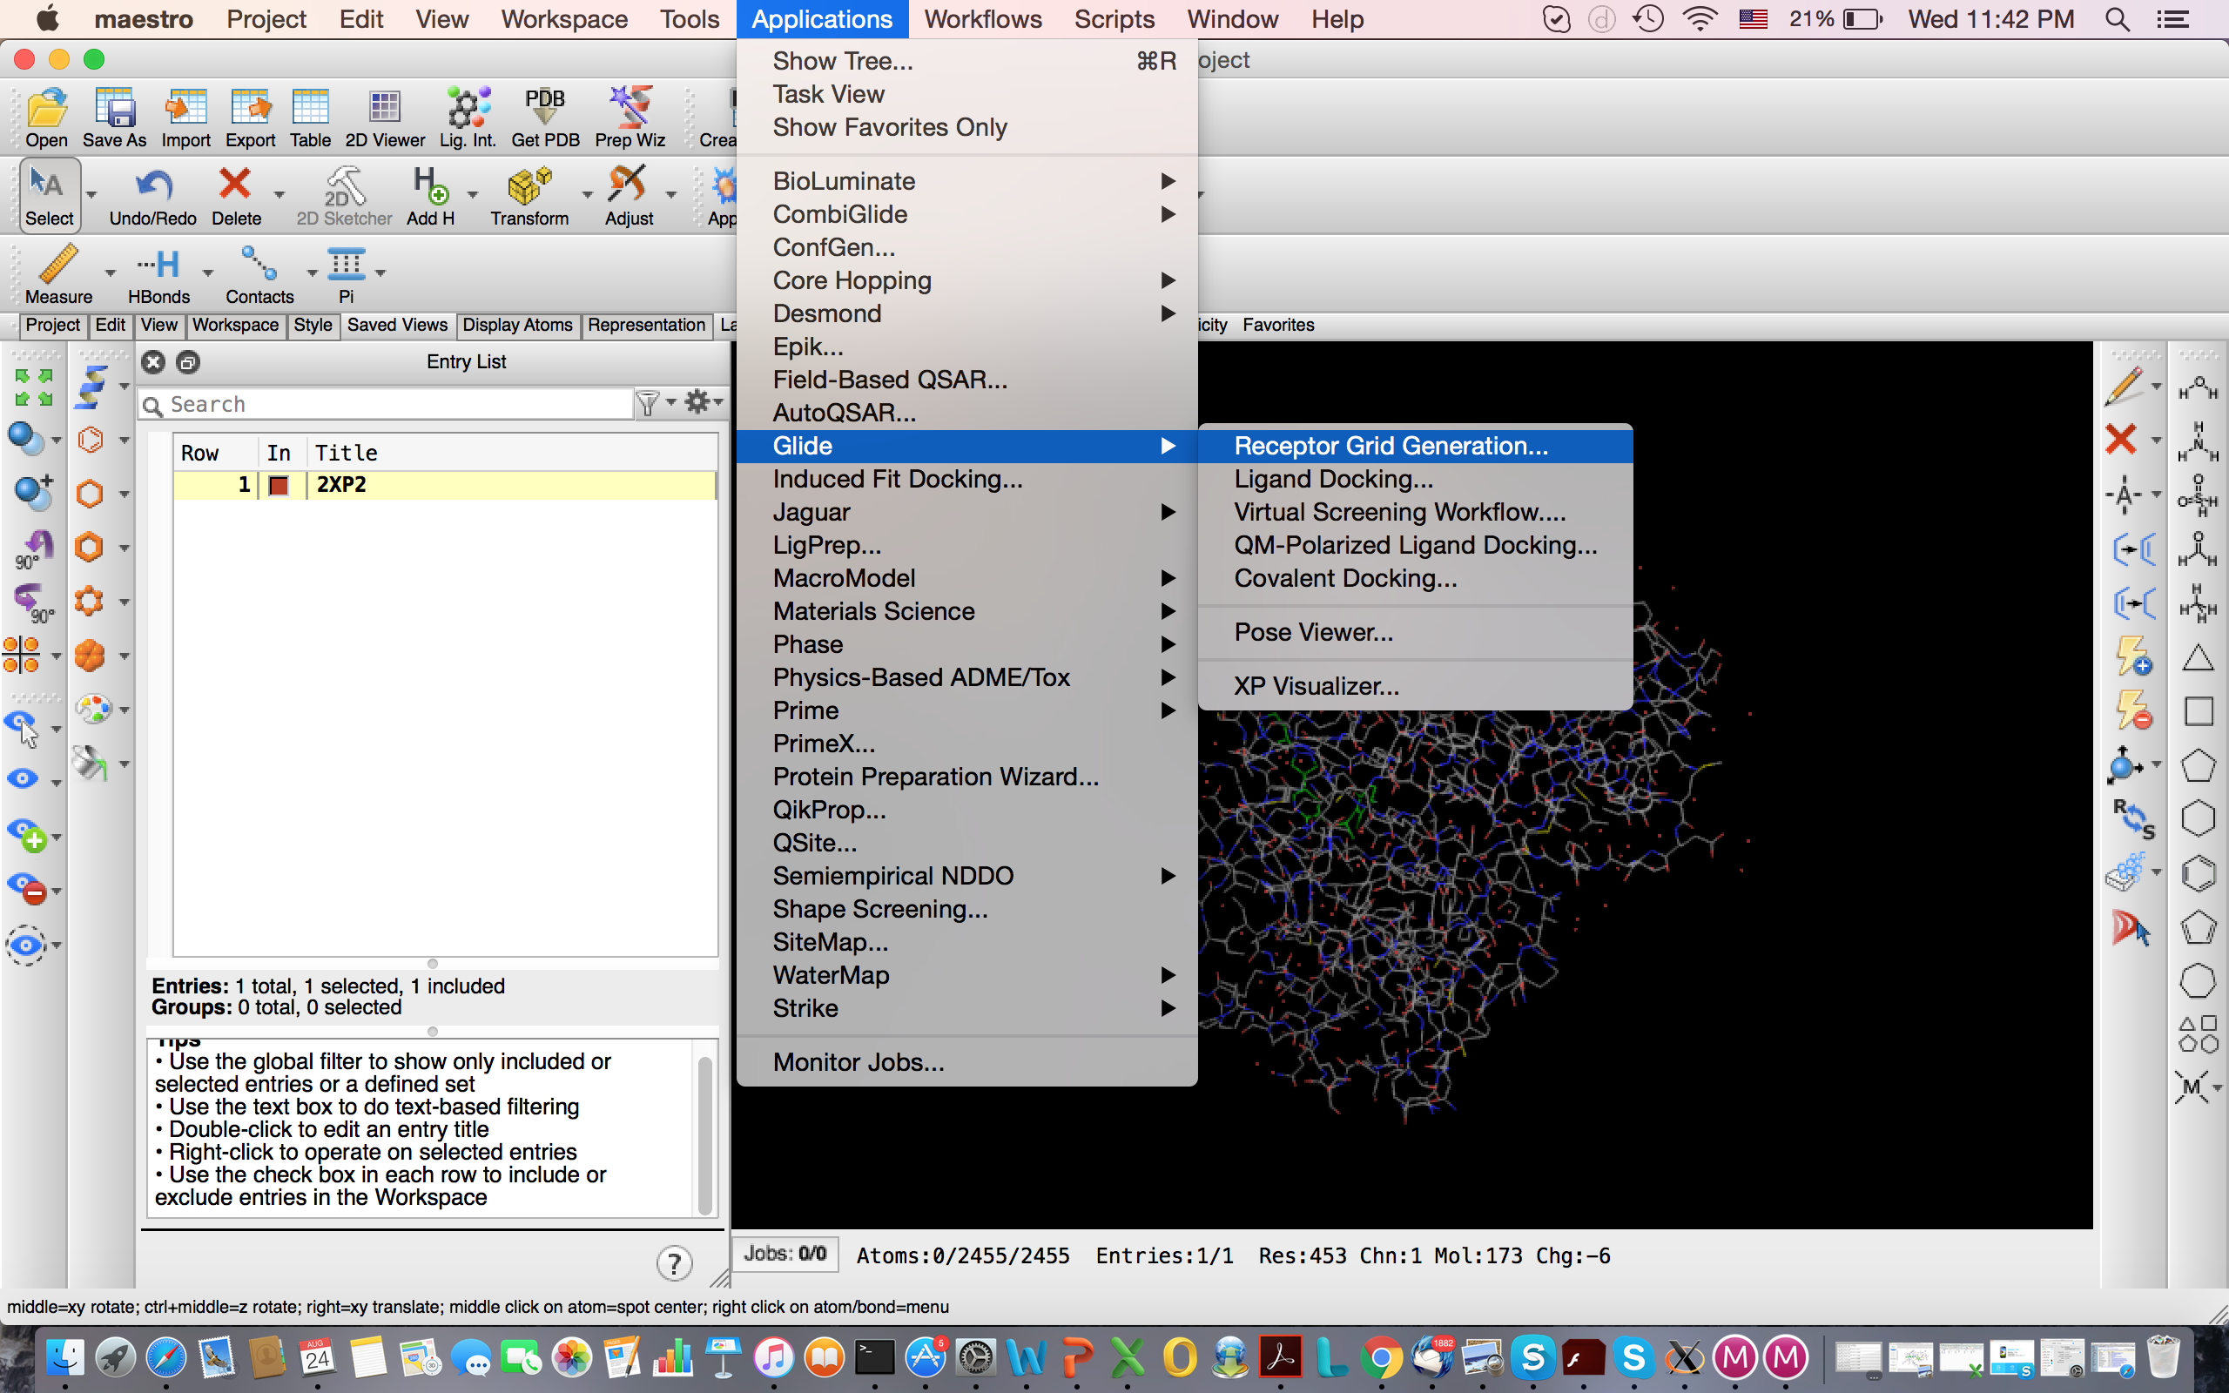
Notes:
Personalized medicine is the ability to offer medicines according to the patient’s specific genotype. The detailed account of genetic information from the individual will help prevent adverse events, allow for appropriate dosages, and create maximum efficacy with drug prescriptions.
Having the genetic content of an individual will allow better guided decisions in determining the source of the disease and thus treating it or preventing its progression. This will be extremely useful for diseases like Alzheimer’s or cancers that are thought to be linked to certain mutations in our DNA.
In addition to specific treatment, personalized medicine can greatly aid the advancements of preventive care. For instance, many women are already being genotyped for certain mutations in the BRCA1 and BRCA2 gene if they are predisposed because of a family history of breast cancer or ovarian cancer.[

Slide 32
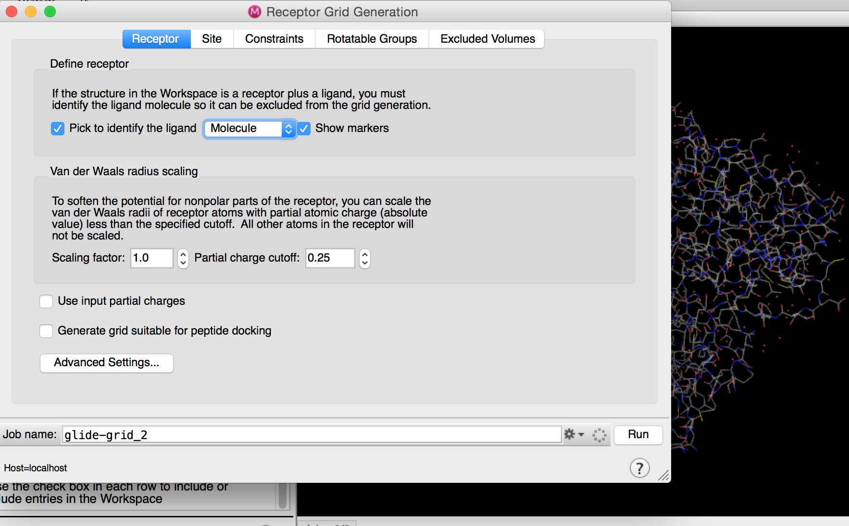
Maestro: Grid Generation
Notes:
Personalized medicine is the ability to offer medicines according to the patient’s specific genotype. The detailed account of genetic information from the individual will help prevent adverse events, allow for appropriate dosages, and create maximum efficacy with drug prescriptions.
Having the genetic content of an individual will allow better guided decisions in determining the source of the disease and thus treating it or preventing its progression. This will be extremely useful for diseases like Alzheimer’s or cancers that are thought to be linked to certain mutations in our DNA.
In addition to specific treatment, personalized medicine can greatly aid the advancements of preventive care. For instance, many women are already being genotyped for certain mutations in the BRCA1 and BRCA2 gene if they are predisposed because of a family history of breast cancer or ovarian cancer.[

Slide 33
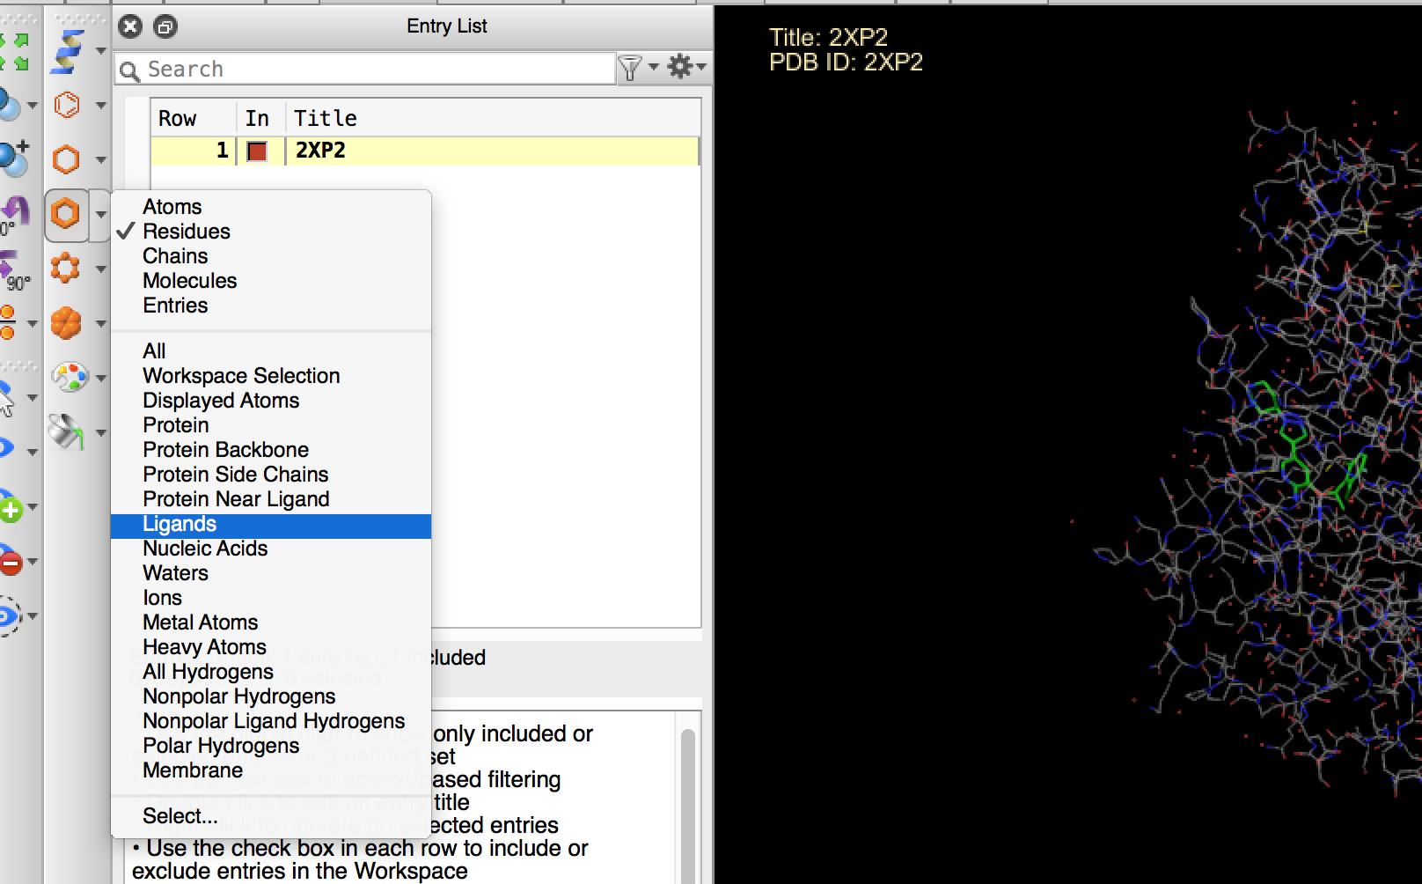
Notes:
Personalized medicine is the ability to offer medicines according to the patient’s specific genotype. The detailed account of genetic information from the individual will help prevent adverse events, allow for appropriate dosages, and create maximum efficacy with drug prescriptions.
Having the genetic content of an individual will allow better guided decisions in determining the source of the disease and thus treating it or preventing its progression. This will be extremely useful for diseases like Alzheimer’s or cancers that are thought to be linked to certain mutations in our DNA.
In addition to specific treatment, personalized medicine can greatly aid the advancements of preventive care. For instance, many women are already being genotyped for certain mutations in the BRCA1 and BRCA2 gene if they are predisposed because of a family history of breast cancer or ovarian cancer.[

Slide 34
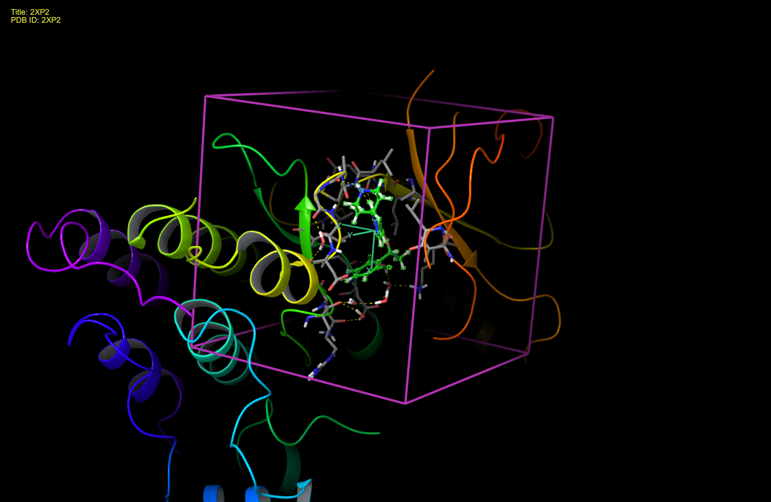
Notes:
Personalized medicine is the ability to offer medicines according to the patient’s specific genotype. The detailed account of genetic information from the individual will help prevent adverse events, allow for appropriate dosages, and create maximum efficacy with drug prescriptions.
Having the genetic content of an individual will allow better guided decisions in determining the source of the disease and thus treating it or preventing its progression. This will be extremely useful for diseases like Alzheimer’s or cancers that are thought to be linked to certain mutations in our DNA.
In addition to specific treatment, personalized medicine can greatly aid the advancements of preventive care. For instance, many women are already being genotyped for certain mutations in the BRCA1 and BRCA2 gene if they are predisposed because of a family history of breast cancer or ovarian cancer.[

Slide 35
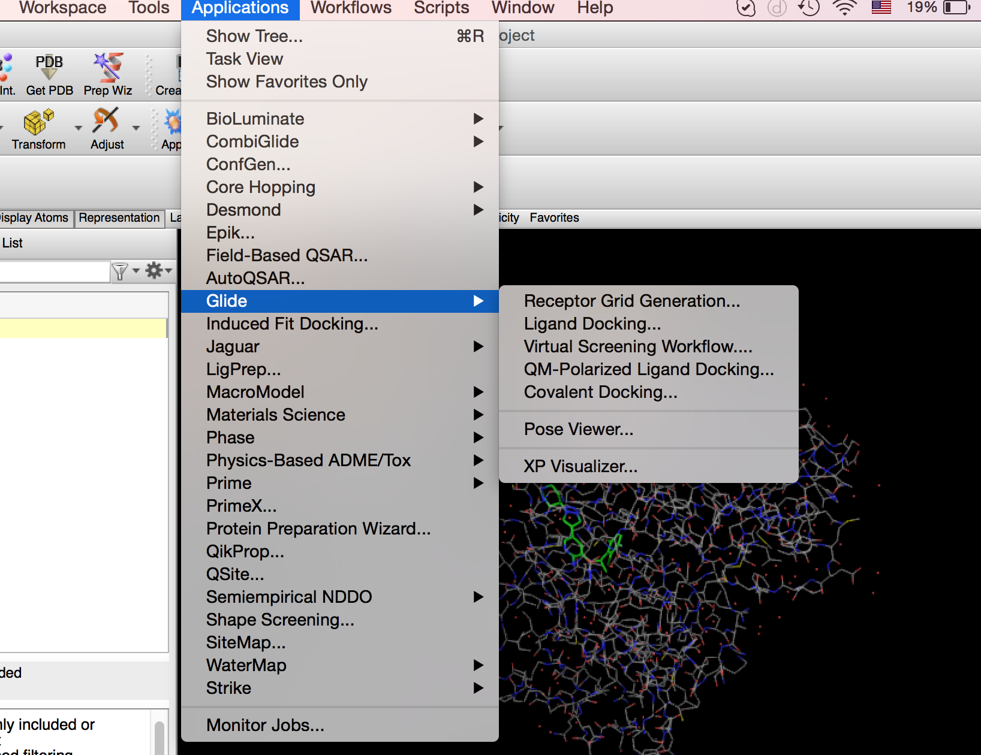
Notes:
Personalized medicine is the ability to offer medicines according to the patient’s specific genotype. The detailed account of genetic information from the individual will help prevent adverse events, allow for appropriate dosages, and create maximum efficacy with drug prescriptions.
Having the genetic content of an individual will allow better guided decisions in determining the source of the disease and thus treating it or preventing its progression. This will be extremely useful for diseases like Alzheimer’s or cancers that are thought to be linked to certain mutations in our DNA.
In addition to specific treatment, personalized medicine can greatly aid the advancements of preventive care. For instance, many women are already being genotyped for certain mutations in the BRCA1 and BRCA2 gene if they are predisposed because of a family history of breast cancer or ovarian cancer.[

Slide 36
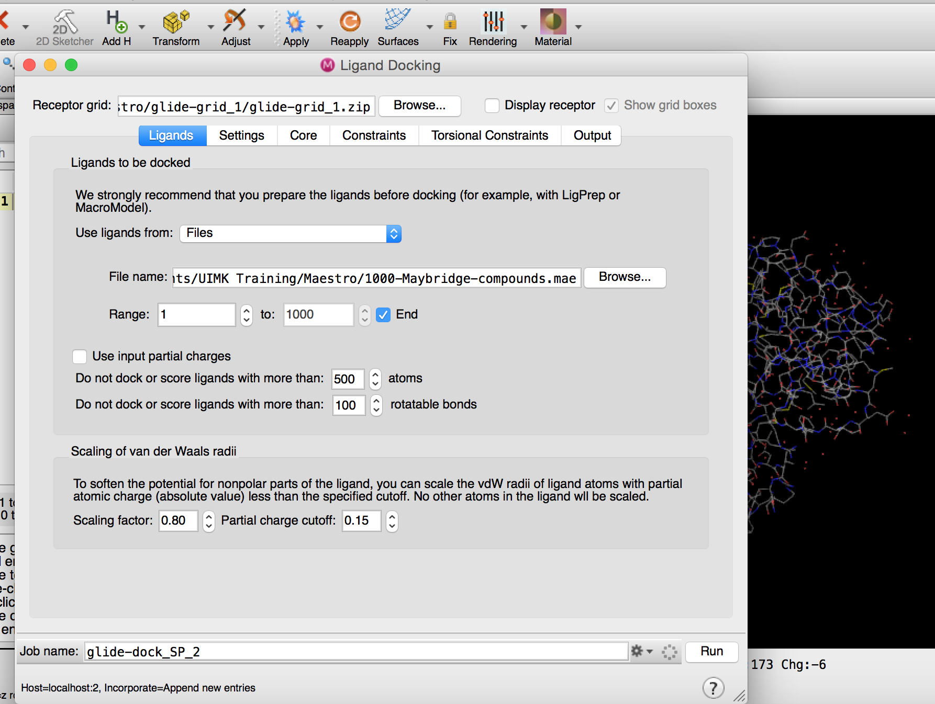
Notes:
Personalized medicine is the ability to offer medicines according to the patient’s specific genotype. The detailed account of genetic information from the individual will help prevent adverse events, allow for appropriate dosages, and create maximum efficacy with drug prescriptions.
Having the genetic content of an individual will allow better guided decisions in determining the source of the disease and thus treating it or preventing its progression. This will be extremely useful for diseases like Alzheimer’s or cancers that are thought to be linked to certain mutations in our DNA.
In addition to specific treatment, personalized medicine can greatly aid the advancements of preventive care. For instance, many women are already being genotyped for certain mutations in the BRCA1 and BRCA2 gene if they are predisposed because of a family history of breast cancer or ovarian cancer.[

Slide 37
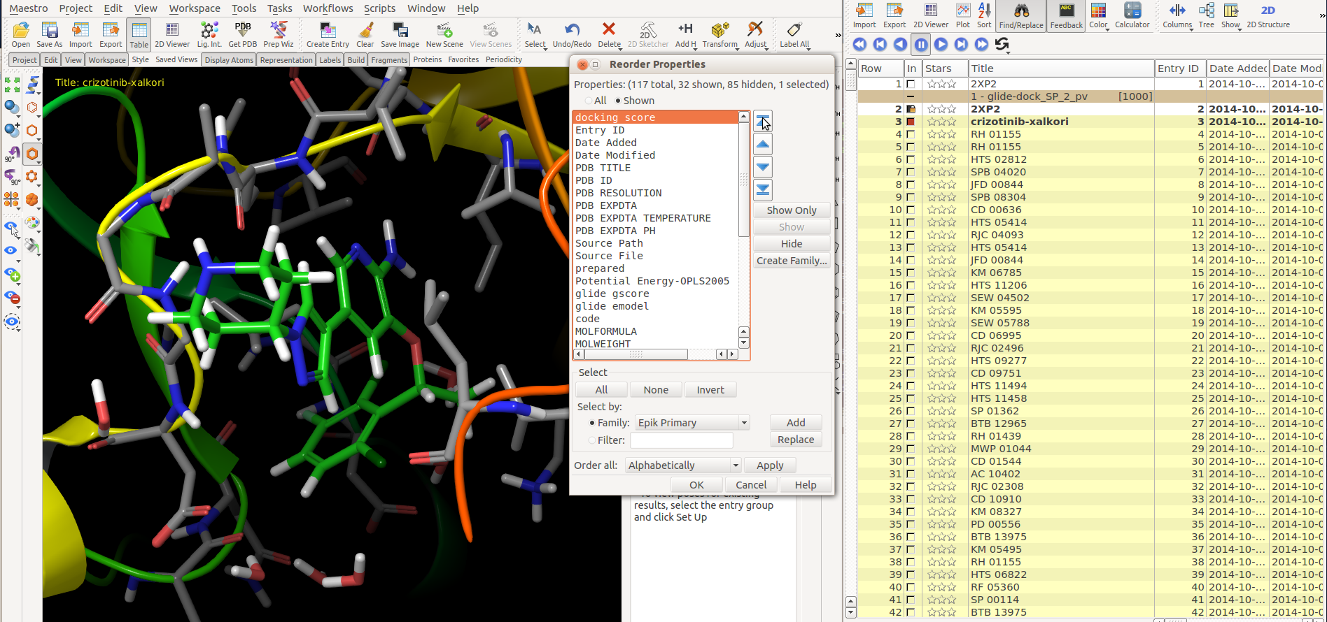
Ligand Visualization
Project -> Project table
Columns -> Reorder – Select Docking score Press up arrow, move selected properties on top of the list
Notes:
Personalized medicine is the ability to offer medicines according to the patient’s specific genotype. The detailed account of genetic information from the individual will help prevent adverse events, allow for appropriate dosages, and create maximum efficacy with drug prescriptions.
Having the genetic content of an individual will allow better guided decisions in determining the source of the disease and thus treating it or preventing its progression. This will be extremely useful for diseases like Alzheimer’s or cancers that are thought to be linked to certain mutations in our DNA.
In addition to specific treatment, personalized medicine can greatly aid the advancements of preventive care. For instance, many women are already being genotyped for certain mutations in the BRCA1 and BRCA2 gene if they are predisposed because of a family history of breast cancer or ovarian cancer.[

Slide 38
How are compounds selected for assaying?
van der Waals
toxicity
unwanted moieties
Clustering
Affinity Propagation
Notes:
Personalized medicine is the ability to offer medicines according to the patient’s specific genotype. The detailed account of genetic information from the individual will help prevent adverse events, allow for appropriate dosages, and create maximum efficacy with drug prescriptions.
Having the genetic content of an individual will allow better guided decisions in determining the source of the disease and thus treating it or preventing its progression. This will be extremely useful for diseases like Alzheimer’s or cancers that are thought to be linked to certain mutations in our DNA.
In addition to specific treatment, personalized medicine can greatly aid the advancements of preventive care. For instance, many women are already being genotyped for certain mutations in the BRCA1 and BRCA2 gene if they are predisposed because of a family history of breast cancer or ovarian cancer.[

Slide 39
How are compounds selected for assaying?
Estimation of binding affinity through docking score
Conformation of ligand inside the protein (binding pose):
-Look out for bad van der Waals contacts
-Cis-trans amides
-E-Z esters
Identification of unwanted or toxic moieties on a compound
Identification of metabolic liabilities (benzylic hydrogens, p- position on benzene, sites of glucuronidation, etc…)
Calculation of physicochemical properties (lipophilicity, cell permeability, solubility, etc). Choose molecules with drug-like Pchem profile.
Clustering
Chemical intuition
Notes:
Personalized medicine is the ability to offer medicines according to the patient’s specific genotype. The detailed account of genetic information from the individual will help prevent adverse events, allow for appropriate dosages, and create maximum efficacy with drug prescriptions.
Having the genetic content of an individual will allow better guided decisions in determining the source of the disease and thus treating it or preventing its progression. This will be extremely useful for diseases like Alzheimer’s or cancers that are thought to be linked to certain mutations in our DNA.
In addition to specific treatment, personalized medicine can greatly aid the advancements of preventive care. For instance, many women are already being genotyped for certain mutations in the BRCA1 and BRCA2 gene if they are predisposed because of a family history of breast cancer or ovarian cancer.[

Slide 40

ChemBioServer
Uploading and Browsing Compounds in 2D and 3D
Filtering of compounds based on physicochemical properties
Substructure filtering of compounds based on custom sdf files
Van der Waals filtering using distance and energy tests
Toxicity filtering using specific organic toxic roots
Hierarchical clustering with 4 different distances
Affinity Propagation clustering, providing exemplars for each cluster
Creating custom pipeline filtering
Visualization of compounds' properties
Athanasiadis, Cournia, Spyrou (2012) Bioinformatics
Notes:
Personalized medicine is the ability to offer medicines according to the patient’s specific genotype. The detailed account of genetic information from the individual will help prevent adverse events, allow for appropriate dosages, and create maximum efficacy with drug prescriptions.
Having the genetic content of an individual will allow better guided decisions in determining the source of the disease and thus treating it or preventing its progression. This will be extremely useful for diseases like Alzheimer’s or cancers that are thought to be linked to certain mutations in our DNA.
In addition to specific treatment, personalized medicine can greatly aid the advancements of preventive care. For instance, many women are already being genotyped for certain mutations in the BRCA1 and BRCA2 gene if they are predisposed because of a family history of breast cancer or ovarian cancer.[

Slide 41

Filtering of compounds
Computational methods can predict important physicochemical properties.
- LogP, a lipophilicity measure
- Solubility
- Permeability
Conformation of ligand inside the protein (e.g. bad van der Waals contacts)
Identification of unwanted or toxic moieties on a compound
Notes:
Personalized medicine is the ability to offer medicines according to the patient’s specific genotype. The detailed account of genetic information from the individual will help prevent adverse events, allow for appropriate dosages, and create maximum efficacy with drug prescriptions.
Having the genetic content of an individual will allow better guided decisions in determining the source of the disease and thus treating it or preventing its progression. This will be extremely useful for diseases like Alzheimer’s or cancers that are thought to be linked to certain mutations in our DNA.
In addition to specific treatment, personalized medicine can greatly aid the advancements of preventive care. For instance, many women are already being genotyped for certain mutations in the BRCA1 and BRCA2 gene if they are predisposed because of a family history of breast cancer or ovarian cancer.[

Slide 42


Physicochemical Properties
ChemBioServer Performs filtering to discard molecules with undesired physicochemical properties
Notes:
Personalized medicine is the ability to offer medicines according to the patient’s specific genotype. The detailed account of genetic information from the individual will help prevent adverse events, allow for appropriate dosages, and create maximum efficacy with drug prescriptions.
Having the genetic content of an individual will allow better guided decisions in determining the source of the disease and thus treating it or preventing its progression. This will be extremely useful for diseases like Alzheimer’s or cancers that are thought to be linked to certain mutations in our DNA.
In addition to specific treatment, personalized medicine can greatly aid the advancements of preventive care. For instance, many women are already being genotyped for certain mutations in the BRCA1 and BRCA2 gene if they are predisposed because of a family history of breast cancer or ovarian cancer.[

Slide 43





Bad van der Waals contacts
Notes:
Personalized medicine is the ability to offer medicines according to the patient’s specific genotype. The detailed account of genetic information from the individual will help prevent adverse events, allow for appropriate dosages, and create maximum efficacy with drug prescriptions.
Having the genetic content of an individual will allow better guided decisions in determining the source of the disease and thus treating it or preventing its progression. This will be extremely useful for diseases like Alzheimer’s or cancers that are thought to be linked to certain mutations in our DNA.
In addition to specific treatment, personalized medicine can greatly aid the advancements of preventive care. For instance, many women are already being genotyped for certain mutations in the BRCA1 and BRCA2 gene if they are predisposed because of a family history of breast cancer or ovarian cancer.[

Slide 44


Bad van der Waals contacts
ChemBioServer Performs filtering to discard molecules with steric clashes by means of van der Waals energy and radii tolerance (OPLS parameters*)
* Jorgensen et al., JACS, 1996.
Notes:
Personalized medicine is the ability to offer medicines according to the patient’s specific genotype. The detailed account of genetic information from the individual will help prevent adverse events, allow for appropriate dosages, and create maximum efficacy with drug prescriptions.
Having the genetic content of an individual will allow better guided decisions in determining the source of the disease and thus treating it or preventing its progression. This will be extremely useful for diseases like Alzheimer’s or cancers that are thought to be linked to certain mutations in our DNA.
In addition to specific treatment, personalized medicine can greatly aid the advancements of preventive care. For instance, many women are already being genotyped for certain mutations in the BRCA1 and BRCA2 gene if they are predisposed because of a family history of breast cancer or ovarian cancer.[

Slide 45




Toxicity Filtering
ChemBioServer Performs filtering to discard molecules with undesired toxic moieties
Athanasiadis, Cournia, Spyrou (2012) Bioinformatics
Notes:
Personalized medicine is the ability to offer medicines according to the patient’s specific genotype. The detailed account of genetic information from the individual will help prevent adverse events, allow for appropriate dosages, and create maximum efficacy with drug prescriptions.
Having the genetic content of an individual will allow better guided decisions in determining the source of the disease and thus treating it or preventing its progression. This will be extremely useful for diseases like Alzheimer’s or cancers that are thought to be linked to certain mutations in our DNA.
In addition to specific treatment, personalized medicine can greatly aid the advancements of preventive care. For instance, many women are already being genotyped for certain mutations in the BRCA1 and BRCA2 gene if they are predisposed because of a family history of breast cancer or ovarian cancer.[

Slide 46
Clustering and Molecular Similarity
THEORY
Similar Property Principle – Molecules having similar structures and properties should also exhibit similar activity. (Often but not always true)
Thus, molecules that are located closely together in chemical reference space are often considered to be functionally related.
APPLICATION
We want to…
Select different compounds from a given population
Evenly populate a given chemical space with candidate molecules
Dissimilarity : Inverse of molecular similarity
Dissimilarity analysis plays a major role in the pharmaceutical industry
Notes:
Personalized medicine is the ability to offer medicines according to the patient’s specific genotype. The detailed account of genetic information from the individual will help prevent adverse events, allow for appropriate dosages, and create maximum efficacy with drug prescriptions.
Having the genetic content of an individual will allow better guided decisions in determining the source of the disease and thus treating it or preventing its progression. This will be extremely useful for diseases like Alzheimer’s or cancers that are thought to be linked to certain mutations in our DNA.
In addition to specific treatment, personalized medicine can greatly aid the advancements of preventive care. For instance, many women are already being genotyped for certain mutations in the BRCA1 and BRCA2 gene if they are predisposed because of a family history of breast cancer or ovarian cancer.[

Slide 47


Clustering and Molecular Similarity
How?
Check for similar structure, properties and characteristics
Molecular descriptors
Notes:
Personalized medicine is the ability to offer medicines according to the patient’s specific genotype. The detailed account of genetic information from the individual will help prevent adverse events, allow for appropriate dosages, and create maximum efficacy with drug prescriptions.
Having the genetic content of an individual will allow better guided decisions in determining the source of the disease and thus treating it or preventing its progression. This will be extremely useful for diseases like Alzheimer’s or cancers that are thought to be linked to certain mutations in our DNA.
In addition to specific treatment, personalized medicine can greatly aid the advancements of preventive care. For instance, many women are already being genotyped for certain mutations in the BRCA1 and BRCA2 gene if they are predisposed because of a family history of breast cancer or ovarian cancer.[

Slide 48
Molecular Similarity
How to calculate it?
Quantitative assessment of similarity/dissimilarity of structures
need a numerically tractable form
molecular descriptors, fingerprints, structural keys
Sequences/vectors of bits, or numeric values that can be compared by distance functions, similarity metrics.
E= Euclidean distance T = Tanimoto index
Notes:
Personalized medicine is the ability to offer medicines according to the patient’s specific genotype. The detailed account of genetic information from the individual will help prevent adverse events, allow for appropriate dosages, and create maximum efficacy with drug prescriptions.
Having the genetic content of an individual will allow better guided decisions in determining the source of the disease and thus treating it or preventing its progression. This will be extremely useful for diseases like Alzheimer’s or cancers that are thought to be linked to certain mutations in our DNA.
In addition to specific treatment, personalized medicine can greatly aid the advancements of preventive care. For instance, many women are already being genotyped for certain mutations in the BRCA1 and BRCA2 gene if they are predisposed because of a family history of breast cancer or ovarian cancer.[

Slide 49
Molecular Descriptors
Chemical fingerprint
hashed binary fingerprint
encodes topological properties of the chemical graph: connectivity, edge label (bond type), node label (atom type)
allows the comparison of two molecules with respect to their chemical structure
Construction
find all 0, 1, …, n step walks in the chemical graph
generate a bit array for each walks with given number of bits set
merge the bit arrays with logical OR operation
Notes:
Personalized medicine is the ability to offer medicines according to the patient’s specific genotype. The detailed account of genetic information from the individual will help prevent adverse events, allow for appropriate dosages, and create maximum efficacy with drug prescriptions.
Having the genetic content of an individual will allow better guided decisions in determining the source of the disease and thus treating it or preventing its progression. This will be extremely useful for diseases like Alzheimer’s or cancers that are thought to be linked to certain mutations in our DNA.
In addition to specific treatment, personalized medicine can greatly aid the advancements of preventive care. For instance, many women are already being genotyped for certain mutations in the BRCA1 and BRCA2 gene if they are predisposed because of a family history of breast cancer or ovarian cancer.[

Slide 50


Molecular Similarity
Example: chemical fingerprint
0100010100010100010000000001101010011010100000010100000000100000
0100010100010100010000000001101010011010100000000100000000100000
Notes:
Personalized medicine is the ability to offer medicines according to the patient’s specific genotype. The detailed account of genetic information from the individual will help prevent adverse events, allow for appropriate dosages, and create maximum efficacy with drug prescriptions.
Having the genetic content of an individual will allow better guided decisions in determining the source of the disease and thus treating it or preventing its progression. This will be extremely useful for diseases like Alzheimer’s or cancers that are thought to be linked to certain mutations in our DNA.
In addition to specific treatment, personalized medicine can greatly aid the advancements of preventive care. For instance, many women are already being genotyped for certain mutations in the BRCA1 and BRCA2 gene if they are predisposed because of a family history of breast cancer or ovarian cancer.[

Slide 51

Clustering and molecular similarity
600 compounds
Approximately 20
representative clusters
Hierarchical Clustering
1
2
3
…
20
Affinity Propagation Clustering for each cluster 200 Candidate drugs
7 Compounds
Notes:
Personalized medicine is the ability to offer medicines according to the patient’s specific genotype. The detailed account of genetic information from the individual will help prevent adverse events, allow for appropriate dosages, and create maximum efficacy with drug prescriptions.
Having the genetic content of an individual will allow better guided decisions in determining the source of the disease and thus treating it or preventing its progression. This will be extremely useful for diseases like Alzheimer’s or cancers that are thought to be linked to certain mutations in our DNA.
In addition to specific treatment, personalized medicine can greatly aid the advancements of preventive care. For instance, many women are already being genotyped for certain mutations in the BRCA1 and BRCA2 gene if they are predisposed because of a family history of breast cancer or ovarian cancer.[

Slide 52

Back to the example…
Notes:
Personalized medicine is the ability to offer medicines according to the patient’s specific genotype. The detailed account of genetic information from the individual will help prevent adverse events, allow for appropriate dosages, and create maximum efficacy with drug prescriptions.
Having the genetic content of an individual will allow better guided decisions in determining the source of the disease and thus treating it or preventing its progression. This will be extremely useful for diseases like Alzheimer’s or cancers that are thought to be linked to certain mutations in our DNA.
In addition to specific treatment, personalized medicine can greatly aid the advancements of preventive care. For instance, many women are already being genotyped for certain mutations in the BRCA1 and BRCA2 gene if they are predisposed because of a family history of breast cancer or ovarian cancer.[

Slide 53

Notes:
Personalized medicine is the ability to offer medicines according to the patient’s specific genotype. The detailed account of genetic information from the individual will help prevent adverse events, allow for appropriate dosages, and create maximum efficacy with drug prescriptions.
Having the genetic content of an individual will allow better guided decisions in determining the source of the disease and thus treating it or preventing its progression. This will be extremely useful for diseases like Alzheimer’s or cancers that are thought to be linked to certain mutations in our DNA.
In addition to specific treatment, personalized medicine can greatly aid the advancements of preventive care. For instance, many women are already being genotyped for certain mutations in the BRCA1 and BRCA2 gene if they are predisposed because of a family history of breast cancer or ovarian cancer.[

Slide 54

Notes:
Personalized medicine is the ability to offer medicines according to the patient’s specific genotype. The detailed account of genetic information from the individual will help prevent adverse events, allow for appropriate dosages, and create maximum efficacy with drug prescriptions.
Having the genetic content of an individual will allow better guided decisions in determining the source of the disease and thus treating it or preventing its progression. This will be extremely useful for diseases like Alzheimer’s or cancers that are thought to be linked to certain mutations in our DNA.
In addition to specific treatment, personalized medicine can greatly aid the advancements of preventive care. For instance, many women are already being genotyped for certain mutations in the BRCA1 and BRCA2 gene if they are predisposed because of a family history of breast cancer or ovarian cancer.[

Slide 55

Notes:
Personalized medicine is the ability to offer medicines according to the patient’s specific genotype. The detailed account of genetic information from the individual will help prevent adverse events, allow for appropriate dosages, and create maximum efficacy with drug prescriptions.
Having the genetic content of an individual will allow better guided decisions in determining the source of the disease and thus treating it or preventing its progression. This will be extremely useful for diseases like Alzheimer’s or cancers that are thought to be linked to certain mutations in our DNA.
In addition to specific treatment, personalized medicine can greatly aid the advancements of preventive care. For instance, many women are already being genotyped for certain mutations in the BRCA1 and BRCA2 gene if they are predisposed because of a family history of breast cancer or ovarian cancer.[

Slide 56

Notes:
Personalized medicine is the ability to offer medicines according to the patient’s specific genotype. The detailed account of genetic information from the individual will help prevent adverse events, allow for appropriate dosages, and create maximum efficacy with drug prescriptions.
Having the genetic content of an individual will allow better guided decisions in determining the source of the disease and thus treating it or preventing its progression. This will be extremely useful for diseases like Alzheimer’s or cancers that are thought to be linked to certain mutations in our DNA.
In addition to specific treatment, personalized medicine can greatly aid the advancements of preventive care. For instance, many women are already being genotyped for certain mutations in the BRCA1 and BRCA2 gene if they are predisposed because of a family history of breast cancer or ovarian cancer.[

Slide 57

Notes:
Personalized medicine is the ability to offer medicines according to the patient’s specific genotype. The detailed account of genetic information from the individual will help prevent adverse events, allow for appropriate dosages, and create maximum efficacy with drug prescriptions.
Having the genetic content of an individual will allow better guided decisions in determining the source of the disease and thus treating it or preventing its progression. This will be extremely useful for diseases like Alzheimer’s or cancers that are thought to be linked to certain mutations in our DNA.
In addition to specific treatment, personalized medicine can greatly aid the advancements of preventive care. For instance, many women are already being genotyped for certain mutations in the BRCA1 and BRCA2 gene if they are predisposed because of a family history of breast cancer or ovarian cancer.[

Slide 58
ADME Predictions of Drug Candidates
QikProp: evaluates pharmaceutically relevant properties
The Advantages of ADME Properties Prediction
Nearly 40% of drug candidates fail in clinical trials due to poor ADME (absorption, distribution, metabolism, and excretion) properties
Reduce the amount of wasted time and resources
Eliminate unnecessary testing on compounds that will ultimately fail
Focus lead optimization efforts to enhance the desired properties of a given compound
Notes:
Personalized medicine is the ability to offer medicines according to the patient’s specific genotype. The detailed account of genetic information from the individual will help prevent adverse events, allow for appropriate dosages, and create maximum efficacy with drug prescriptions.
Having the genetic content of an individual will allow better guided decisions in determining the source of the disease and thus treating it or preventing its progression. This will be extremely useful for diseases like Alzheimer’s or cancers that are thought to be linked to certain mutations in our DNA.
In addition to specific treatment, personalized medicine can greatly aid the advancements of preventive care. For instance, many women are already being genotyped for certain mutations in the BRCA1 and BRCA2 gene if they are predisposed because of a family history of breast cancer or ovarian cancer.[

Slide 59
The era of personalized medicine
Proceed with the visual inspection of the filtered compounds
Notes:
Personalized medicine is the ability to offer medicines according to the patient’s specific genotype. The detailed account of genetic information from the individual will help prevent adverse events, allow for appropriate dosages, and create maximum efficacy with drug prescriptions.
Having the genetic content of an individual will allow better guided decisions in determining the source of the disease and thus treating it or preventing its progression. This will be extremely useful for diseases like Alzheimer’s or cancers that are thought to be linked to certain mutations in our DNA.
In addition to specific treatment, personalized medicine can greatly aid the advancements of preventive care. For instance, many women are already being genotyped for certain mutations in the BRCA1 and BRCA2 gene if they are predisposed because of a family history of breast cancer or ovarian cancer.[

Slide 60
THANK YOU!
Notes:
Lista me datasets, pte tha xreiastoun, amesa mesoprothesma I makroprothesma

