Slide 1
Introduction to HPC
(High Performance Computing)
Iakovos Panourgias, GRNET
ipanourgias@grnet.gr

Slide 2
Agenda (I)
Introduction
  What is HPC and Why It Matters (today)
  How HPC Systems Work
  Scale of HPC
Accessing and Using HPC
  Typical HPC system architecture
  SSH Basics
  File Systems and Data Handling
Job Scheduling & Resource Management
  Slurm
  Writing and submitting job scripts

Slide 3
Agenda (II)
Parallel Programming Models
  Concept of parallel programming
  Python / Jupyter Notebook (Open On Demand)
  OpenMP
  MPI
  Containers
Wrap-up
  Security
  Ethics

Slide 4
1. Introduction to High Performance Computing
What is HPC and why it matters today
How HPC Systems
Real-world applications
HPC energy consumption and datacentre scale
Scale of HPC
Example video: HPC simulation in action

Slide 5
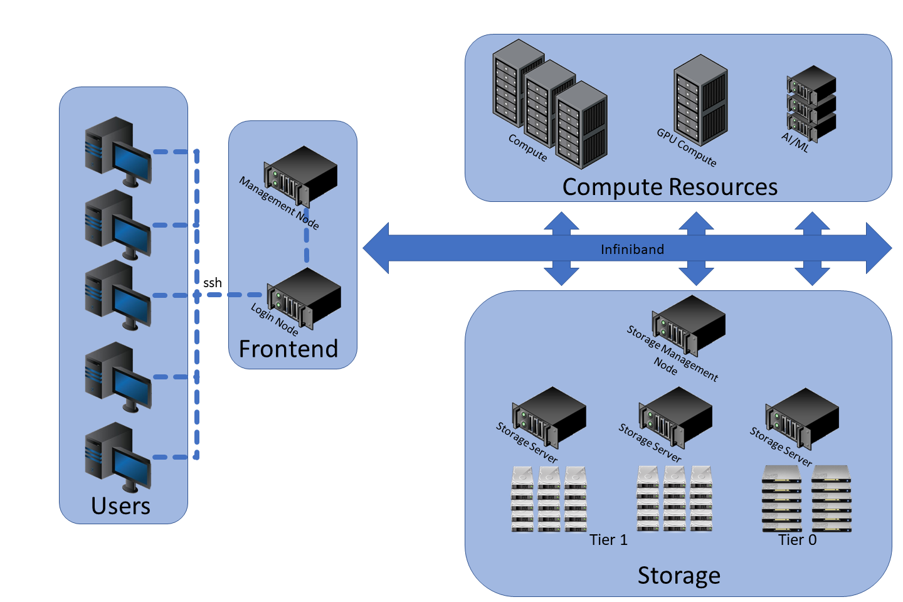
Intro: What is HPC and why it matters today
Parallel processing (many CPUs/GPUs working together)
Specialized computing resources (clusters, supercomputers)
Very fast interconnects (networks)
Very large and fast and resilient storage
Main goal? Handle computations
too big or slow for a single desktop.
Why today? Explosion of data in AI,
simulations, and research demands HPC.
https://www.marquette.edu/high-performance-computing/architecture.php

Slide 6

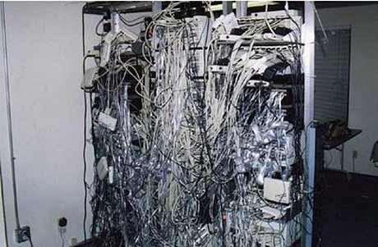
Intro: What is not HPC
https://serverfault.com/questions/420877/ive-inherited-a-rats-nest-of-cabling-what-now
https://www.comptoir-hardware.com/actus/processeurs/37712-des-core-ix-9000u-reperes-chez-lenovo-whiskey-lake-9e-generation-.html

Slide 7
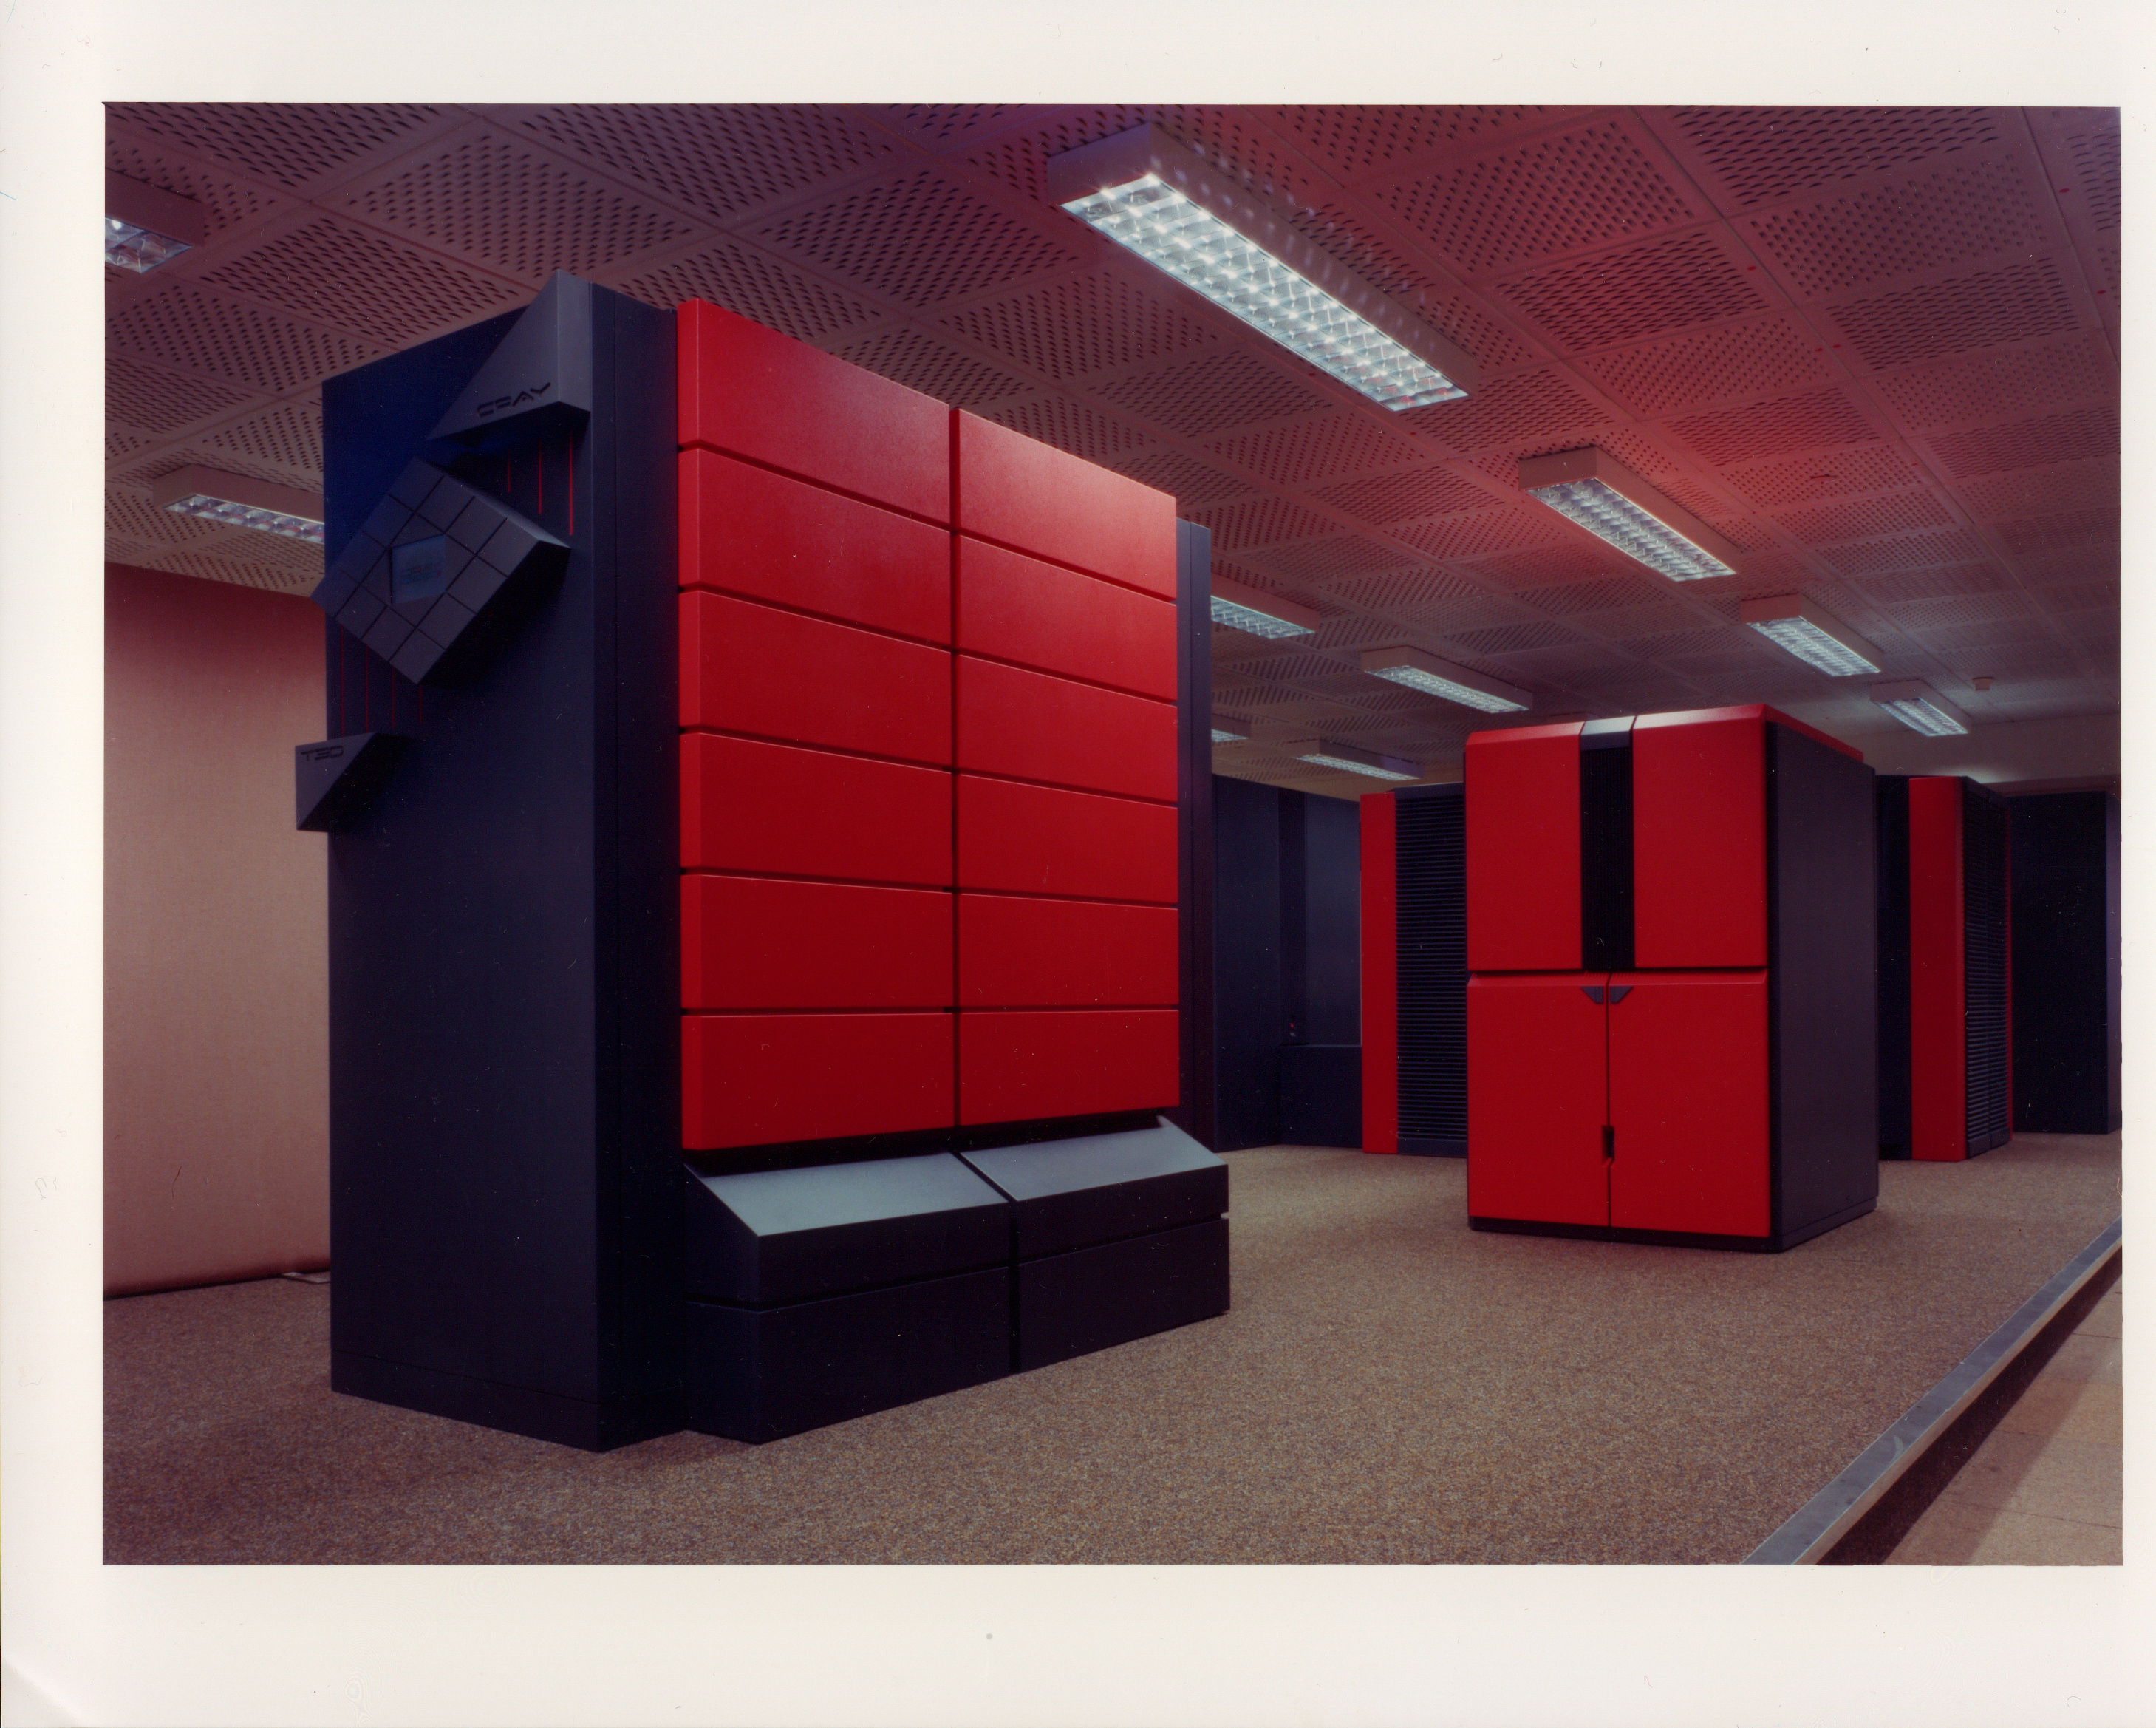
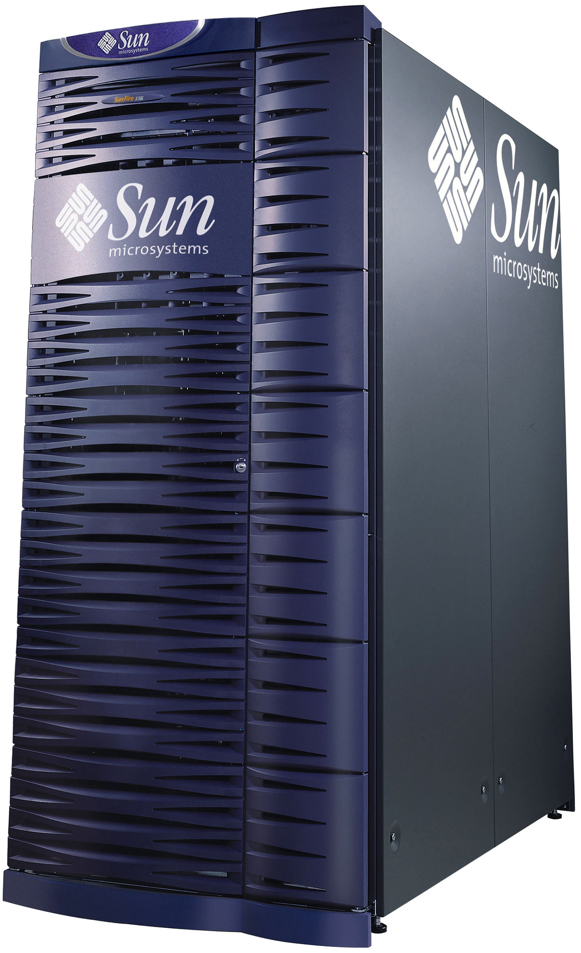
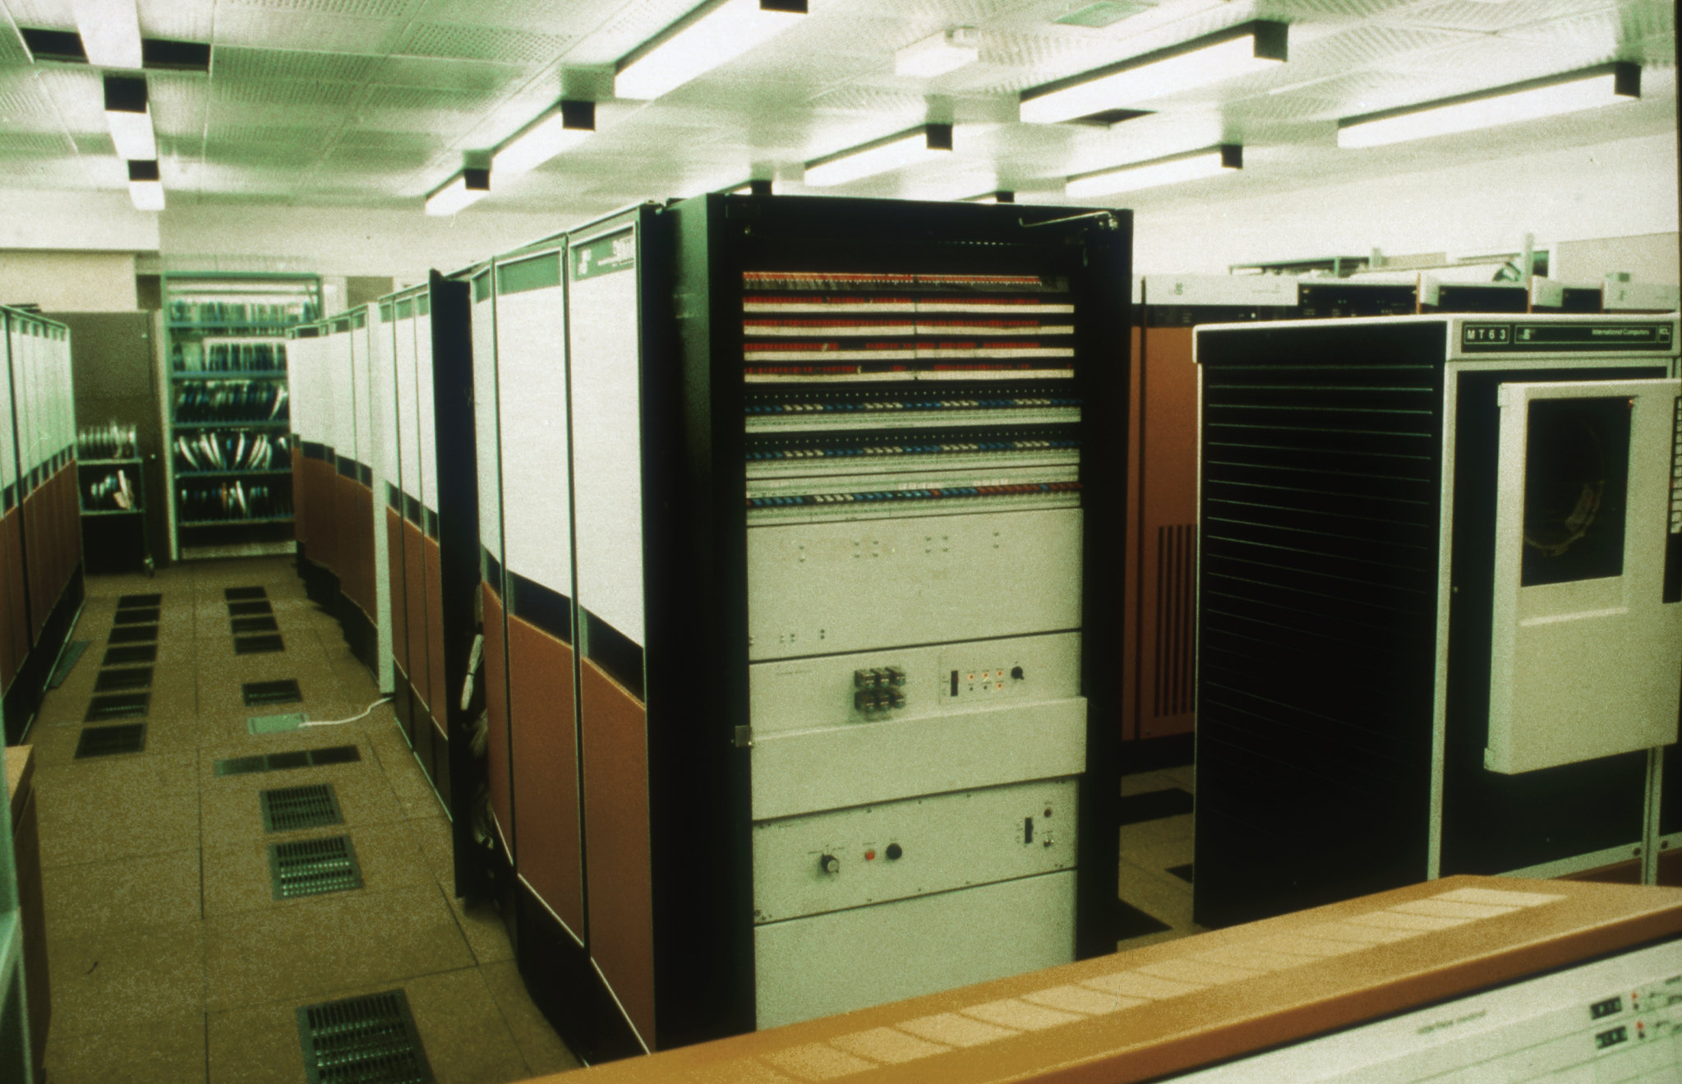
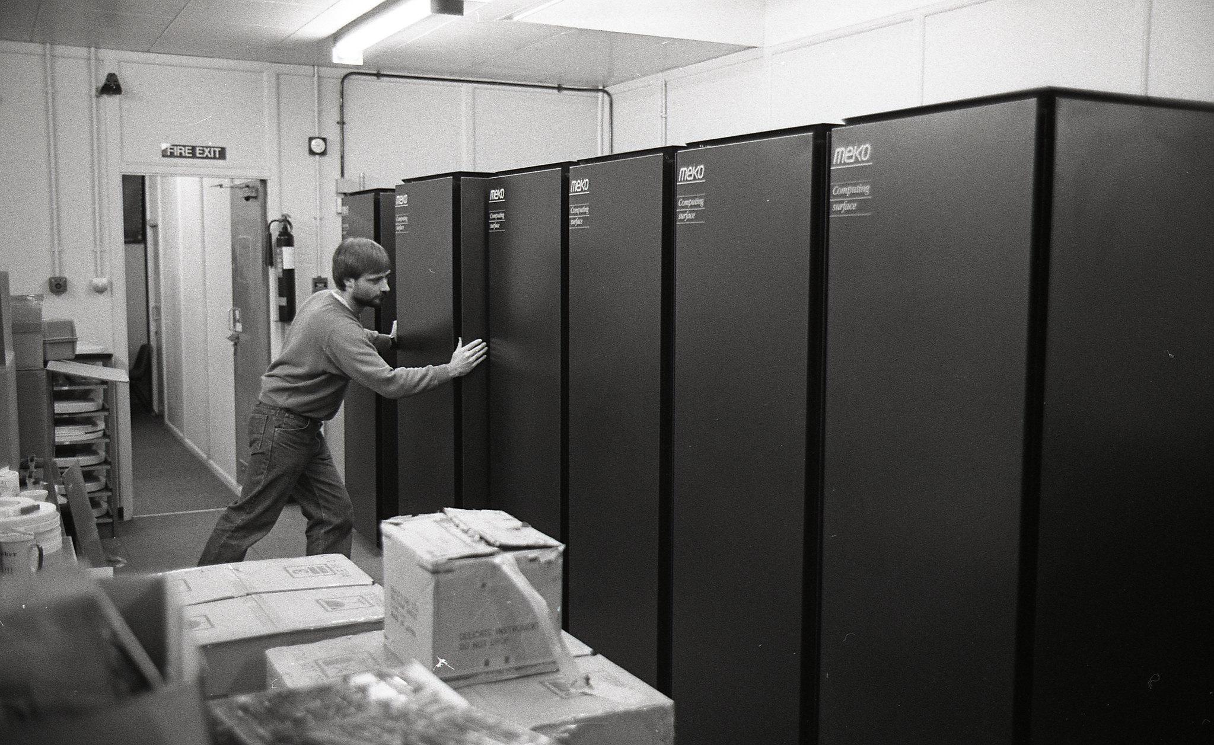
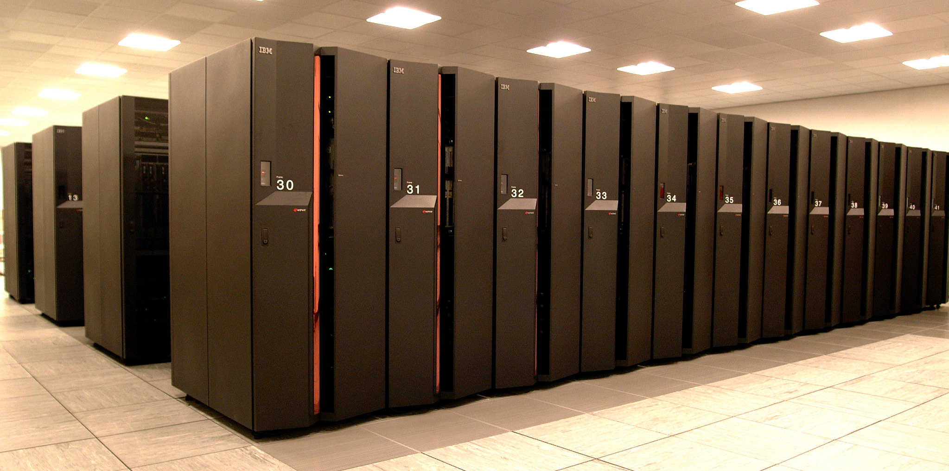

Intro: What is HPC and why it matters today
Short history lesson (from EPCC)
1982: ICL DAPS
30 MFLOPS
0.00000003 PFLOPS
1986: Meiko T800 CS-1
400 MFLOPS
0.0000004 PFLOPS
1994: Cray T3D
76 GFLOPS
0.000076 PFLOPS
2007: Sun Fire E15K
94 GFLOPS
0.000094 PFLOPS
2010: HPCx
15.4 TFLOPS
0.0154 PFLOPS
2020: ARCHER
2.55 PFLOPS
current: ARCHER2
28 PFLOPS
https://www.archer2.ac.uk/community/outreach/materials/history_of_machines

Slide 8
Intro: What is HPC and why it matters today
Applications:
  Climate modelling
  Drug discovery
  Financial forecasting and risk modelling
  Movie effects.
  physics simulations)
  Healthcare and genomics
  Artificial Intelligence & Machine Learning
  Engineering & design (CFD, structural analysis)
  National security and weather forecasting
Dramatically faster time-to-result
Capability to solve problems previously not possible

Slide 9

Intro: What is HPC and why it matters today
Simulate weather for 1 day:
  Laptop:24 hours, HPC: 5-10 minutes
DNA sequencing:
  Laptop: Weeks (or not possible), HPC: minutes
Train large AI models:
  Laptop: Not Possible, HPC: days/weeks
https://insidehpc.com/2019/03/video-how-deep-learning-could-predict-weather-events/

Slide 10
Intro: How HPC Systems Work
Login nodes
Compute nodes
  Thin nodes:
    normal memory (0.5 to 1 TBs)
  Fat memory nodes:
    more memory (1 to 4 TBs or more)
  Fat CPU nodes:
    lots of CPUs (256 to 512 CPUs)
  GPU nodes:
    with GPU accelerators
  FPGA nodes:
    with FPGA accelerators
Storage nodes
  You don’t really see them; but there are a lot of them and handle PBs of data
Network nodes
  You don’t really see them; but there are a lot of them
https://www.marquette.edu/high-performance-computing/architecture.php

Slide 11
Intro: How HPC Systems Work
You use SSH to login to the Login node(s)
  Don’t run anything here; they are just for preparing and submitting jobs
Prepare a script (you don’t want to be stuck in front of your monitor for days)
  The script will copy data
  Pre-process the data (if needed)
  Run your application
Submit the script to the Job Scheduler (Slurm)
Your script becomes a Job and waits in the Queue
Once resources (Compute or GPU nodes) are available; your Job starts running
When your jobs ends; you get notified
Check the results

Slide 12
Intro: How HPC Systems Work
No Graphical User Interface (GUI) on the compute nodes (usually).
Compute nodes are not connected to the Internet (for security).
  Copy everything that you will need before hand on the shared storage.
Resources are shared
On an HPC system you don’t get a machine (unless you can pay for it); you get access to time and resources.

Slide 13
Intro: How HPC Systems Work
Why is it running faster??
Network:
  InfiniBand/other implementation can handle and maintain super fast speeds (~200 Gbps per port/ 30-280 TB/s across the whole network).
  Special network cards with dedicated FPGAs to detect congestion and resolving it in real-time
  3D Torus design; which means each compute node is 3 hops away from everything else
Storage:
  Huge arrays of disks in RAID0 with extremely fast network interconnects:
    700 GB/s (5.6 Tbps) write bandwith vs ~7 GB/s of local NVME
    1270 GB/s (10.16 Tbps) read bandwidth vs ~7 GB/s of local NVME

Slide 14
Intro: Real-World Applications: HPC is everywhere
Genomics: Sequencing DNA to fight diseases (e.g., cancer research simulations).
Astrophysics: Modelling black holes or galaxy formations (like NASA's use of HPC).
Molecular Dynamics: Protein folding, drug interactions
Physics: Particle simulations at CERN to understand the universe.
Weather Forecasting: WRF models predict storms/hurricanes
Engineering: CFD simulations for car/aerospace design
Oil & Gas Exploration: Seismic surveys and reservoir modelling
Other fields: Materials science (new batteries) and environmental modelling (climate change).
AI/ML: Training models like ChatGPT on huge datasets.
Emerging: Autonomous vehicles, personalized medicine, and big data analytics.
Fusion Energy Research: Reactor modelling, plasma simulations

Slide 15
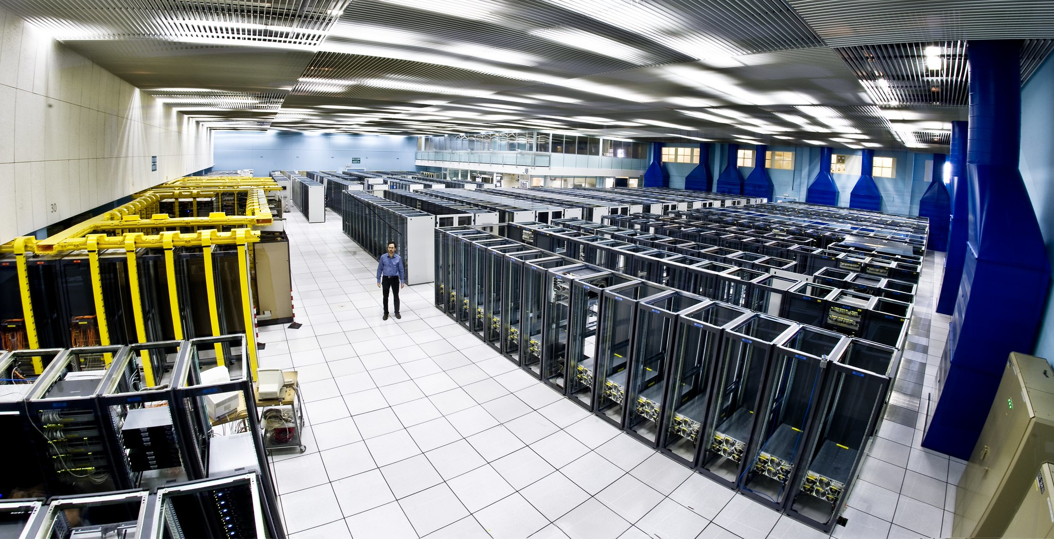
Intro: HPC Energy Consumption and Datacentre Scale
Big
  Warehouse size for small systems and growing as the system increases in size
Power hungry
  Dozens of megawatts
  (MW) of power
  Cooling is ~30%-40%
  of the power usage
https://www.flickr.com/photos/arselectronica/6032157177

Slide 16
Intro: What is a FLOP
Floating point operations per second: measures performance
Laptop: 100 GFLOPS (0.0001 PFLOPS )
High end Gaming PC: 10 TFLOPS (0.0100 PFLOPS )
Mid-tier HPC (Daedalus): 80 PFLOPS (80 PFLOPS )
Fastest HPC (El Capitan): 1742 PFLOPS (1742 PFLOPS )
If 100 GFLOPS is the Earth-Moon distance
10 TFLOPS is Earth to Venus
80 PFLOPS is around Uranus
1742 PFLOPS is outer Kuiper Belt / beyond Pluto

Slide 17
Intro: Video

Slide 18
Agenda (I)
Introduction
  What is HPC and Why It Matters (today)
  How HPC Systems Work
  Scale of HPC
Accessing and Using HPC
  Typical HPC system architecture
  SSH Basics
  File Systems and Data Handling
Job Scheduling & Resource Management
  Slurm
  Writing and submitting job scripts

Slide 19
Accessing and Using HPC
Typical HPC system architecture
SSH Basics - Hands-On
Basic Linux commands recap
File Systems and Data Handling
Good data management practices (copying, quotas, cleanup)
File transfer basics

Slide 20
Typical HPC system architecture
Login nodes
Compute nodes
  Thin nodes:
    normal memory (0.5 to 1 TBs)
  Fat memory nodes:
    more memory (1 to 4 TBs or more)
  Fat CPU nodes:
    lots of CPUs (256 to 512 CPUs)
  GPU nodes:
    with GPU accelerators
  FPGA nodes:
    with FPGA accelerators
Storage nodes
  You don’t really see them; but there are a lot of them and handle PBs of data
Network nodes
  You don’t really see them; but there are a lot of them
https://www.marquette.edu/high-performance-computing/architecture.php

Slide 21
SSH Basics
SSH: Secure Shell
Standard method for connecting to remote systems (available for Windows, WSL, Unix, Linux, Mac, Solaris, Irix, everything)
Encrypted communication
PuTTY (simple for Windows), MobaXterm (feature-rich), OpenSSH (built-in for Linux/Mac and in WSL).
  MobaXterm also has an X11 Server if you want to use Graphics. No need to run your own X11 server.
  WSL also provides X11 functionality.
  Don’t expect lighting fast graphics. X11 has been around since the early 1980s.

Slide 22
SSH Basics
For secure systems; a private/public key is used (with or without a passphrase and/or a password).
Never, ever, ever share your private key.
  To make it harder OpenSSH private keys start with:
  -----BEGIN OPENSSH PRIVATE KEY-----
A passphrase protects your private key in case it gets copied/taken.
  If it happens; your passphrase is probably also copied. So, change your key everywhere.
A password could be used as well (when connecting to the remote server).
You may already have a public/private key pair; but let’s create a new one.
Always, always use “ed25519”. Looking ahead and into the Post Quantum Security challenges; even ed25519 will not be safe.

Slide 23
SSH Basics
$ ssh-keygen -t ed25519 -C "hpc@example.com" -f ~/.ssh/hpc_training
Generating public/private ed25519 key pair.
Enter passphrase (empty for no passphrase):
Enter same passphrase again:
Your identification has been saved in /home/YYYYY/.ssh/hpc_training
Your public key has been saved in /home/ YYYYY/.ssh/hpc_training.pub
The key fingerprint is:
SHA256:XXXXXYYYYYYYYYYYYYYXXXXXXXXXX hpc@example.com
The key's randomart image is:
+--[ED25519 256]--+
XXXXXXXXXXXXXXXXXXXXXXXXXXXXXXX
YYYYYYYYYYYYYYYYYYYYYYYYYYYYYYYY
+----[SHA256]-----+

Slide 24
SSH Basics
You can also use Putty (puttygen.exe) for a GUI experience
Careful where you download it from. There are many fakes!!!
Don’t forget to convert the Putty Key format to OpenSSH
MobaXterm also supports creating a key pair
https://servicedesk.surf.nl/wiki/spaces/WIKI/pages/37388673/Creating+and+using+an+SSH+key+pair+with+MobaXterm

Slide 25
SSH Basics
Now, lets connect to our HPC infrastructure:
$ ssh -p 6222 MYUSERNAME@localhost
(enter your password and verify that you can login)
$ ssh-copy-id -p 6222 MYUSERNAME@localhost
(enter your password)
$ ssh -p 6222 MYUSERNAME@localhost
(you should login without entering your password)

Slide 26
Basic Linux commands
Unix (and Linux) are the main Operating Systems of HPC infrastructures
Some basic commands include:
  pwd = print working directory (the full path to help you find your way)
  ls = list (list of files or directories)
  cd = change directory
  cp = copy a file (or you can also recursively copy files or directories)
  rm = remove (careful with this one. No questions are asked. The file will be gone. Or the files. Or the directories. Or all the directories if you use recursion.) CAREFUL.
  mv = move a file (or a directory)
  cat != dog. Cat shows you the contents of a file
There are many more. You can check online

Slide 27
File Systems and Data Handling
HPC infrastructures have many filesystems.
The implementation of the FS is not important (it can be Lustre, BeeGFS, ZFS, other).
The main point is how to use it.
Most HPC infrastructures have:
  /home
  /work
  /scratch
  /local or /tmp

Slide 28
File Systems and Data Handling
/home : The one that you land when you login. Your $HOME. Sometimes it’s not visible by the nodes. So, anything you have here is not useable when you run your jobs. You need to copy the data. Where?? To “work”. You can read and write to the home and work FS from the login nodes.
/work : The FS that is usually visible by the nodes. Fine tuned to provide extremely fast I/O for hundreds or thousands or millions requests per second. The nodes that run your jobs have access to this FS. The nodes might not have access to the $HOME FS.
/scratch : An even faster FS. Smaller in size; but full of potential due to the NVMEs or other lighting fast storage. Use it and profit (if your jobs are struggling with I/O).
/local or /tmp : Local space on each node. Usually, resides in RAM (so, extremely fast). But the more you use it the less RAM you have. Anything that you copy here will be lost when the job ends (so copy it back out). If your workload has heavy but small in size I/O do use it. You will be amazed.

Slide 29
Good data management practices
Use names that you can understand (if you can’t understand it, then all hope is lost). This applies to directories and file names.
Think about your quota. Quota is the limit of the size of your files and of the number of your files. You have been given one (there are several ways of checking your limits). If you copy more data (in size) or more files (in number) you will start receiving strange error messages from the I/O system.
Try to delete temporary files. The system will try to cleanup each node after you are done; but every little helps.

Slide 30
File transfer basics
You now have access to an HPC infrastructure.
You have your keys ready, and you have uploaded your PUBLIC key.
You just need to copy 100 Tbytes of data.
Time to use “rsync” (or other similar tools).
You need something that:
  Can handle interruptions
  Can resume connections
  Can open more than one connection
  Can hash and verify that the uploaded file is identical to the one that you send
  Can compress (sometimes it speeds up transfer, other times not so much)

Slide 31
Agenda (I)
Introduction
  What is HPC and Why It Matters (today)
  How HPC Systems Work
  Scale of HPC
Accessing and Using HPC
  Typical HPC system architecture
  SSH Basics
  File Systems and Data Handling
Job Scheduling & Resource Management
  Slurm
  Writing and submitting job scripts

Slide 32
3. Job Scheduling & Resource Management
What is a job scheduler and why we need it
Introduction to Slurm
Slurm Basics - Hands-On
Writing and submitting job scripts - Hands-On
Interpreting job output and errors - Hands-On
Best practices: job sizing, node/core requests, monitoring - Hands-On
Introduction to Open OnDemand
Running Jupyter Notebooks on HPC - Hands-On

Slide 33
What is a job scheduler and why we need it
Software that manages and allocates resources on shared HPC systems.
Resources can be:
  Nodes
  CPUs
  GPUs
  Memory
  Storage
  Licenses
  Bandwidth
  Other

Slide 34
What is a job scheduler and why we need it
A Job scheduler must:
  Prioritizes jobs based on policies (e.g., user limits, priorities). [FAIR]
  Optimizes resource use—avoids idle nodes or conflicts. [EFFICIENT]
  Handles thousands of jobs on large clusters. [SCALABLE]
Benefits for Users:
  Faster turnaround
  Predictable access—no "first-come, first-served" fights.
  Hogging nodes is not a viable strategy (unless you have unlimited quota)
Benefits for the infrastructure:
  No idle nodes
  Metrics that can help convince management to buy new hardware/equipment

Slide 35
Introduction to Slurm
Slurm is the main job scheduler in the HPC domain
SGE, PBS, Torque and others had a considerable share of the market; however, most of them are now gone.
All schedulers share the same basic commands:
  Run a job (interactively)
  Submit a script/job to be run when there are available nodes
  Query the system about your job
  Query the system about statistics
  Cancel one of your jobs
  Manages users and accounts and groups

Slide 36
Slurm Basics - Hands-On
We will now run a small interactive session and submit our first script.
Let’s login to our HPC infrastructure:
$ ssh -p 6222 MYUSERNAME@localhost
And see what it has to offer:
$ sinfo
PARTITION AVAIL TIMELIMIT NODES STATE NODELIST
compute* up 5-00:00:00 2 idle cpn[01-02]
debug up 5-00:00:00 2 idle cpn[01-02]

Slide 37
Slurm Basics - Hands-On
Let’s run a small test:
$ srun --nodes=2 /bin/hostname
srun: error: Unable to allocate resources: Invalid account or account/partition combination specified

Slide 38
Slurm Basics - Hands-On
Let’s login to our HPC infrastructure:
$ ssh -p 6222 hpcadmin@localhost
Password: ilovelinux
$ sacctmgr add user MYUSERNAME account=sfoster
(type Y)
$ exit

Slide 39
Slurm Basics - Hands-On
Let’s login to our HPC infrastructure:
$ ssh -p 6222 MYUSERNAME@localhost
$ srun --nodes=2 /bin/hostname
cpn02
cpn01
$ srun --nodes=1 --ntasks=2 /bin/hostname
cpn01
$ srun --nodes=2 --ntasks=1 /bin/hostname
srun: warning: can't run 1 processes on 2 nodes, setting nnodes to 1
cpn01

Slide 40
Slurm Basics - Hands-On
$ srun --nodes=2 --ntasks=4 /bin/hostname
cpn02
cpn01
cpn02
cpn01
$ srun --nodes=1 --ntasks=4 /bin/hostname
cpn01
cpn01
cpn01
cpn01

Slide 41
Slurm Basics - Hands-On
We can use several filters or options (there are many more):
  time
  nodes
  tasks
  tasks-per-node (if we want to be specific)
  mem
  mem-per-task
  mem-per-node
  mem-per-cpu
  tmp (to ask for local storage)
  contiguous (ask for a contiguous range of nodes to improve network bandwidth) (but it may take a loooooong time to get them)
  gpu(s)

Slide 42
Writing and submitting job scripts - Hands-On
We can also submit a script. Slurm scripts look like normal Unix/Linux scripts. But they use Slurm directives:
#!/bin/bash
#SBATCH --job-name=my_job_name # Job name
#SBATCH --output=output_%j.txt # Standard output file using the JobID
#SBATCH --error=error_%j.txt # Standard error file using the JobID
#SBATCH --partition=compute # Partition or queue name
#SBATCH --nodes=2 # Number of nodes
#SBATCH --ntasks-per-node=1 # Number of tasks per node
#SBATCH --cpus-per-task=2 # Number of CPU cores per task
#SBATCH --time=1:00:00 # Maximum runtime (D-HH:MM:SS)
#SBATCH --mail-type=END # Send email at job completion
#SBATCH --mail-user=your@example.com # Email address for notifications
#Load necessary modules (if needed)
#Your job commands go here
sleep 30 # To give us time to see what is happening
srun /bin/hostname
# Cleanup

Slide 43
Writing and submitting job scripts - Hands-On
Save the previous file as ai_train.sh
Submit it using:
$ sbatch ai_train.sh
Quickly run:
$ sinfo
PARTITION AVAIL TIMELIMIT NODES STATE NODELIST
compute* up 5-00:00:00 2 mix cpn[01-02]
debug up 5-00:00:00 2 mix cpn[01-02]
$ squeue
JOBID PARTITION NAME USER ST TIME NODES NODELIST(REASON)
15 compute ai_train.sh XXXX R 0:12 2 cpn[01-02]

Slide 44
Writing and submitting job scripts - Hands-On
Finally, check the output (NUMBER is the JobID):
$ cat output_A_NUMBER.txt
cpn01
cpn02
Congratulations, you run your first interactive and batch jobs using Slurm.
You will follow the same steps on a real exaflop HPC machine.

Slide 45
Writing and submitting job scripts - Hands-On
Final example. Run the following batch script (very condensed; we just need to understand what is happening):
#!/bin/bash
#SBATCH --job-name=my_job_name # Job name
#SBATCH --output=output_%j.txt # Standard output file using the JobID
#SBATCH --error=error_%j.txt # Standard error file using the JobID
#SBATCH --partition=compute # Partition or queue name
#SBATCH --nodes=2 # Number of nodes
#SBATCH --ntasks=2 # Number of tasks
srun /bin/hostname
echo “---------”
/bin/hostname

Slide 46
Interpreting job output and errors - Hands-On
Check the output and you will see something like this:
cpn01
cpn02
-----
cpn01
The first output is from the “srun” command. The second comes from when you run “/bin/hostname” by itself.
Only the command run with “srun” was executed on multiple nodes.
If you plan to run something on more than one nodes or with more than one threads; use “srun”.
If you want to run something like a normal command; then don’t use “srun”.

Slide 47
Interpreting job output and errors - Hands-On
For example, if you want to copy something using “cp” don’t run:
$ srun cp my_input_directory/ my_running_directory/
Slurm will happily run the same command N*np times (Nodes * tasks-per-node)
Similarly, don’t run:
$ ./my_super_long_simulation
Slurm is not involved and your application will run on a single node (you will still pay for all the nodes that you requested).

Slide 48
Best practices: job sizing, node/core requests, monitoring - Hands-On
Understand your application and only request (and pay for) the resources that you need.
No GPU support; don’t request for a GPU node.
No MPI (multiple nodes) support; ask for a single node.
No OpenMP (threaded) support; don’t ask for more than 1 thread per core.
No MPI or OpenMP support; ask for the serial partition (sometimes it’s free).
Need a lot of RAM; ask for the fat node partition.

Slide 49
Best practices: job sizing, node/core requests, monitoring - Hands-On
Slurm provides tons of metrics. Some of them are:
JobID JobIDRaw JobName Partition MaxVMSize MaxVMSizeNode MaxVMSizeTask AveVMSize MaxRSS MaxRSSNode MaxRSSTask AveRSS MaxPages MaxPagesNode MaxPagesTask AvePages MinCPU MinCPUNode MinCPUTask AveCPU NTasks AllocCPUS Elapsed State ExitCode AveCPUFreq ReqCPUFreqMin ReqCPUFreqMax ReqCPUFreqGov ReqMem ConsumedEnergy MaxDiskRead MaxDiskReadNode MaxDiskReadTask AveDiskRead MaxDiskWrite MaxDiskWriteNode MaxDiskWriteTask AveDiskWrite ReqTRES AllocTRES TRESUsageInAve TRESUsageInMax TRESUsageInMaxNode TRESUsageInMaxTask TRESUsageInMin TRESUsageInMinNode TRESUsageInMinTask TRESUsageInTot TRESUsageOutMax TRESUsageOutMaxNode TRESUsageOutMaxTask TRESUsageOutAve TRESUsageOutTot

Slide 50
Best practices: job sizing, node/core requests, monitoring - Hands-On
Run sacct on your job and find out:
$ sacct --jobs YOUR_JOB_ID
JobID JobName Partition Account AllocCPUS State ExitCode
------------ ---------- ---------- ---------- ---------- ---------- --------
15 test.sh compute sfoster 2 COMPLETED 0:0
15.batch batch sfoster 1 COMPLETED 0:0
15.0 hostname sfoster 2 COMPLETED 0:0

Slide 51
Agenda (II)
Parallel Programming Models
  Concept of parallel programming
  Python / Jupyter Notebook (Open On Demand)
  OpenMP
  MPI
  Containers
Wrap-up
  Security
  Ethics

Slide 52
4. Parallel Programming Models
Concept of parallel programming
Python - Hands-On
Jupyter - Hands-On
OpenMP - Hands-On
MPI - Hands-On
Containers / Singularity / apptainer - Hands-On

Slide 53
What is Parallel Programming?
Writing code that runs multiple tasks simultaneously across CPUs/cores/nodes.
Breaks problems into smaller parts for concurrent execution.
Shared-memory (OpenMP on one node) vs. distributed (MPI across nodes).

Slide 54
Why Parallel Programming Matters
Speed and Efficiency:
  Solves big problems faster (hours instead of days) by using multiple resources.
Scalability:
  Handles growing data/complexity—key for AI, simulations, and big data.
Resource Optimization:
  Maximizes HPC hardware (idle cores waste power; parallelism uses them fully).
Real Benefit:
  Enables breakthroughs (e.g., faster climate models or drug discoveries) without superhuman coding.

Slide 55
Types of Parallel Programming
Task parallelism:
  Different tasks run independently
    Run 100 simulations with different inputs
Data parallelism:
  Same task over many data chunks
    Split image dataset across CPU cores
Shared vs. Distributed memory:
  One machine vs many working together
    OpenMP (shared), MPI (distributed)

Slide 56
When should you use Parallel Programming
You are processing lots of data (images, simulations, calculations)
You need results faster (real-time forecasts)
You want to scale up to bigger problems
Don’t use when:
Your script runs in seconds or minutes
You’re debugging something basic
You’re just reading/writing small data

Slide 57
Open OnDemand
Web portal for HPC, integrating with Slurm for job scheduling.
It makes life different (some would say "easier") for the user.
You can (in theory) create and submit your script from the browser.
You can follow your job.
You can use it to get an SSH terminal via the browser.
You can use it to start Jupyter notebooks. (you can also use a terminal)

Slide 58
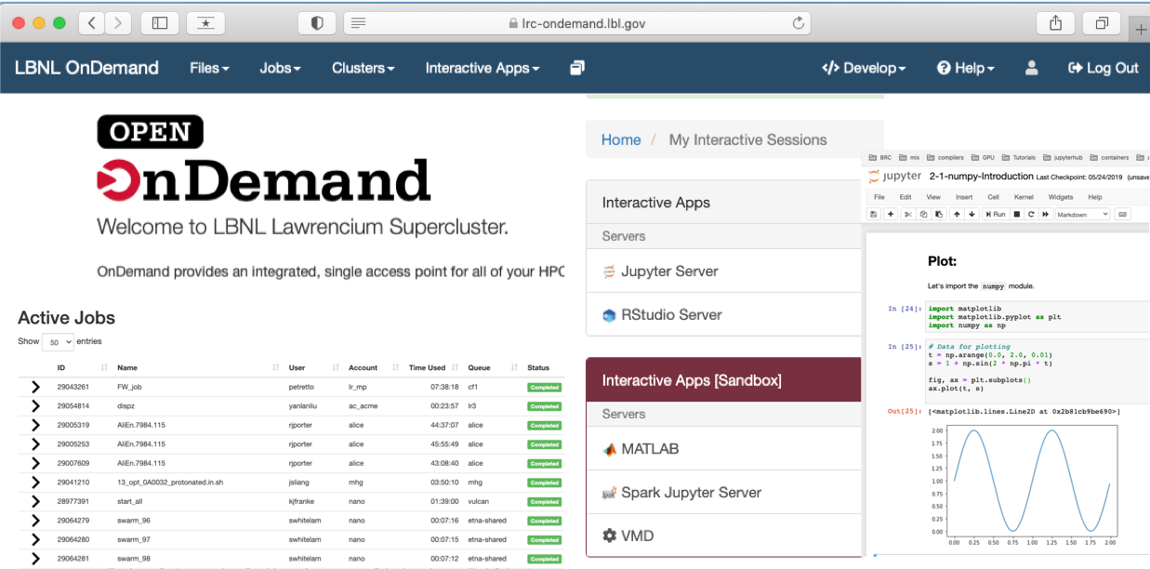
Open OnDemand

Slide 59
Open OnDemand - Hands-On
Let's connect on OOD on our own HPC infrastructure.
Open your browser and go to:
https://localhost:3443/
Use your MYUSERNAME and password

Slide 60
Python / Jupyter
A Jupyter Notebook is an interactive interface
  Mixes code, text, and plots in one place
The notebook runs on a compute node
  Not on your laptop
  Not on the login node
Each notebook uses allocated resources
  CPUs, memory, GPUs, and walltime
  Just like a Slurm job
Closing your browser does not stop the job
  The session continues until stopped or expires

Slide 61
Python / Jupyter
Choose resources carefully
  Start small (few CPUs, limited memory)
  Scale up only when needed
Use notebooks for exploration
  Data inspection, prototyping, visualization
  Move heavy or long runs to batch jobs
Save work regularly
  Outputs and variables live in memory
  Restarting the kernel clears everything
Always shut down when finished
  Stop kernels and close sessions in OOD
  Frees resources for other users

Slide 62
Python / Jupyter – What not to do
Don’t run heavy computations forever
  Notebooks are interactive, not production batch jobs.
  If it's a long running job; use Slurm.
Don’t request huge resources “just in case”
  Start small; scale up only when needed
Don’t use notebooks as storage
  Memory is temporary; when you restart you will lose everything
Don’t leave notebooks running unattended
  Always shut down kernels and sessions
Don’t run compute-intensive code on login nodes
  Always start notebooks via Open OnDemand

Slide 63
OpenMP (Shared-Memory Parallelism)
OpenMP = Open Multi-Processing: Standard for parallel programming on shared-memory systems.
We add simple directives (e.g., #pragma omp parallel) to code—compiler handles threading across cores.
Forks code into threads that share memory, ideal for loops or tasks that can run concurrently.
Easy to add to existing C/C++/Fortran code; no need for network communication.

Slide 64
OpenMP (Shared-Memory Parallelism)
Simple to implement (minimal code changes), portable across compilers, scales well on single nodes.
Image processing, scientific simulations (e.g., matrix operations), or data analysis where data fits in one machine's memory.
Limited to one node (extend to multiple nodes using MPI).
We'll compile a simple OpenMP program and run it via Slurm (using different Slurm options for thread count).

Slide 65
OpenMP (Shared-Memory Parallelism)
OpenMP uses the Fork-Join model:
Program starts with one thread (master)
When it hits a parallel region, it forks into multiple threads
Threads work simultaneously on different parts of the task
Threads join back together when done

Slide 66
OpenMP (Shared-Memory Parallelism)
#!/bin/bash -l
#SBATCH --job-name=openmp # Job name
#SBATCH --output=openmp.%j.out # Stdout (%j expands to jobId)
#SBATCH --error=openmp.%j.err # Stderr (%j expands to jobId)
#SBATCH --ntasks=1 # Total number of tasks
#SBATCH --nodes=1 # Total number of nodes requested
#SBATCH --ntasks-per-node=1 # Tasks per node
#SBATCH --cpus-per-task=2 # Threads per task
#SBATCH --mem=1000 # Memory per job in MB
#SBATCH -t 00:30:00 # Run time (hh:mm:ss)
#SBATCH --partition=compute # Submit queue
#SBATCH -A MYUSERNAME # Accounting project
# Load any necessary modules
# Launch the executable
srun ./openmp.exe

Slide 67
OpenMP (Shared-Memory Parallelism)
Simplest example:
#include <omp.h> // OpenMP header
#include <stdio.h>
#include <stdlib.h>
int main(int argc, char* argv[])
{
// Beginning of parallel region
#pragma omp parallel
{
printf("Hello World... from thread = %d\n", omp_get_thread_num());
}
// Ending of parallel region
}

Slide 68
OpenMP – Hands-On
Write a simple OpenMP application
Compile it
Run it locally (in your WSL2, Mac prompt)
Run it on our cluster
Use different number of threads (ask Slurm to give more or less CPUs)

Slide 69
OpenMP – Application – Hands-On
#define _GNU_SOURCE
#include <stdio.h>
#include <sched.h>
#include <omp.h>
#include <sys/types.h>
#include <unistd.h>
int main() {
#pragma omp parallel
{
pid_t pid = getpid();
int thread_num = omp_get_thread_num();
int cpu_num = sched_getcpu();
printf("Process %d : Thread %3d is running on CPU %3d\n", pid, thread_num, cpu_num);
}
return 0;
}

Slide 70
OpenMP – Compile – Hands-On
Compile it:
  If you didn’t name your file as openmp.c ; just change the filename:
####gcc -g3 -O2 -Wall -Wextra -fsanitize=address,undefined openmp.c -o openmp.exe –fopenmp
$ gcc -g3 -O2 -Wall -Wextra openmp.c -o openmp.exe -fopenmp

Slide 71
OpenMP – Run it locally – Hands-On
Run it locally:
$ OMP_PROC_BIND=false OMP_NUM_THREADS=4 ./openmp.exe | sort
Process 122314 Thread 0 is running on CPU 9
Process 122314 Thread 1 is running on CPU 6
Process 122314 Thread 2 is running on CPU 1
Process 122314 Thread 3 is running on CPU 2
$ OMP_PROC_BIND=true OMP_NUM_THREADS=4 ./openmp.exe | sort
Thread 0 is running on CPU 0
Thread 1 is running on CPU 1
Thread 2 is running on CPU 2
Thread 3 is running on CPU 3

Slide 72
OpenMP – Run it on the Cluster – Hands-On
Create your Slurm batch script
#!/bin/bash
#SBATCH --job-name=my_job_name # Job name
#SBATCH --output=omp_n1_nt1_cpt2_%j.txt # Standard output file using the JobID
#SBATCH --error=omp_n1_nt1_cpt2_%j_e.txt # Standard error file using the JobID
#SBATCH --partition=compute # Partition or queue name
#SBATCH --nodes=1 # Number of nodes
#SBATCH --ntasks=1 # Number of tasks
#SBATCH --cpus-per-task 2 # Number of threads
export OMP_NUM_THREADS=$SLURM_CPUS_PER_TASK
srun ./openmp.exe | sort

Slide 73
OpenMP – Run it on the Cluster – Hands-On
Submit your Slurm batch script:
$ sbatch your_script.sh
Check the output:
$ cat omp_n1_nt1_cpt2_YOUR_JOB_ID.txt
Process 516 : Thread 0 is running on CPU 4
Process 516 : Thread 1 is running on CPU 1

Slide 74
OpenMP – Run it on the Cluster – Hands-On
Create your Slurm batch script
#!/bin/bash
#SBATCH --job-name=my_job_name # Job name
#SBATCH --output=omp_n1_nt2_cpt2_%j.txt # Standard output file using the JobID
#SBATCH --error=omp_n1_nt2_cpt2_%j_e.txt # Standard error file using the JobID
#SBATCH --partition=compute # Partition or queue name
#SBATCH --nodes=1 # Number of nodes
#SBATCH --ntasks=2 # Number of tasks
#SBATCH --cpus-per-task 2 # Number of threads
export OMP_NUM_THREADS=$SLURM_CPUS_PER_TASK
export OMP_PROC_BIND=true
srun ./openmp.exe | sort

Slide 75
OpenMP – Run it on the Cluster – Hands-On
Submit your Slurm batch script:
$ sbatch openmp_n1_nt2_cpt2.sbatch
Check the output:
$ cat omp_n1_nt2_cpt2_YOUR_JOB_ID.txt
Process 583 : Thread 0 is running on CPU 0
Process 583 : Thread 1 is running on CPU 1
Process 584 : Thread 0 is running on CPU 0
Process 584 : Thread 1 is running on CPU 1

Slide 76
OpenMP – Run it on the Cluster – Hands-On
Create your Slurm batch script
#!/bin/bash
#SBATCH --job-name=my_job_name # Job name
#SBATCH --output=omp_n1_nt2_cpt4_%j.txt # Standard output file using the JobID
#SBATCH --error=omp_n1_nt2_cpt4_%j_e.txt # Standard error file using the JobID
#SBATCH --partition=compute # Partition or queue name
#SBATCH --nodes=1 # Number of nodes
#SBATCH --ntasks=2 # Number of tasks
#SBATCH --cpus-per-task 4 # Number of threads
export OMP_NUM_THREADS=$SLURM_CPUS_PER_TASK
export OMP_PROC_BIND=true
srun ./openmp.exe | sort

Slide 77
OpenMP – Run it on the Cluster – Hands-On
Submit your Slurm batch script:
$ sbatch openmp_n1_nt2_cpt4.sbatch
sbatch: error: Batch job submission failed: Requested node configuration is not available

Slide 78
MPI
MPI = Message Passing Interface
Works on many nodes (but also on one).
Uses external libraries with functions to send/receive data between separate processes
Works with C, C++, and Fortran (available for Python, maybe)
Distributed memory model: All processes access different memory spaces; you need explicit communication to share data
You add complex code to communicate between processes

Slide 79
MPI
MPI uses a distributed approach:
Program starts one every node
Each application (called a rank) connects to all the others for the startup
The problem is distributed (decomposed) across the ranks
Each rank works autonomously
Every so often each rank exchanges data with neighbors or everyone exchanges data with a broadcast

Slide 80
MPI
Massively scalable: All major applications that scale to hundreds of thousands nodes/CPUs use MPI.
Every major provider (network, compiler, math libraries, etc) actively support MPI
More complex than OpenMP to setup; less complex conceptually since MPI involves packets (easy for humans to understand) vs random memory access for OpenMP.

Slide 81
MPI
Write a simple MPI application
Compile it
Run it locally (in your WSL2, Mac prompt)
Run it on our cluster
Use different number of nodes (ask Slurm)

Slide 82
MPI – Application – Hands-On
#include <mpi.h>
#include <stdio.h>
int main(int argc, char** argv) {
MPI_Init(NULL, NULL); // Initialize the MPI environment
int world_size; // Get the number of processes
MPI_Comm_size(MPI_COMM_WORLD, &world_size);
int world_rank; // Get the rank of the process
MPI_Comm_rank(MPI_COMM_WORLD, &world_rank);
char processor_name[MPI_MAX_PROCESSOR_NAME]; // Get the name of the processor
int name_len;
MPI_Get_processor_name(processor_name, &name_len);
printf("Hello world from processor %s, rank %d out of %d processors\n", processor_name, world_rank, world_size); // Print off a hello world message
MPI_Finalize(); // Finalize the MPI environment.
}

Slide 83
MPI – Compile – Hands-On
Compile it:
  If you didn’t name your file as mpi.c ; just change the filename:
$ module load mpi/openmpi-x86_64
#######mpicc -g3 -O2 -Wall -Wextra -fsanitize=address,undefined mpi.c -o mpi.exe
$ mpicc -g3 -O2 -Wall mpi.c -o mpi.exe

Slide 84
MPI – Run it on the Cluster – Hands-On
Create your Slurm batch script
#!/bin/bash
#SBATCH --job-name=my_job_name # Job name
#SBATCH --output=mpi_n1_nt2_%j.txt # Standard output file using the JobID
#SBATCH --error=mpi_n1_nt2_%j_e.txt # Standard error file using the JobID
#SBATCH --partition=compute # Partition or queue name
#SBATCH --nodes=1 # Number of nodes
#SBATCH --ntasks=2 # Number of tasks
export PSM3_DEVICES=self
module load mpi/openmpi-x86_64
srun --mpi=pmix ./mpi.exe | sort

Slide 85
MPI – Run it on the Cluster – Hands-On
Submit your Slurm batch script:
$ sbatch your_script.sh
Check the output:
$ cat mpi_n1_nt2_YOUR_JOB_ID.txt
Hello world from processor cpn01, rank 0 out of 2 processors
Hello world from processor cpn01, rank 1 out of 2 processors

Slide 86
MPI – Run it on the Cluster – Hands-On
Create your Slurm batch script
#!/bin/bash
#SBATCH --job-name=my_job_name # Job name
#SBATCH --output=mpi_n2_nt1_%j.txt # Standard output file using the JobID
#SBATCH --error=mpi_n2_nt1_%j_e.txt # Standard error file using the JobID
#SBATCH --partition=compute # Partition or queue name
#SBATCH --nodes=2 # Number of nodes
#SBATCH --ntasks=1 # Number of tasks
export PSM3_DEVICES=self
module load mpi/openmpi-x86_64
srun --mpi=pmix ./mpi.exe | sort

Slide 87
MPI – Run it on the Cluster – Hands-On
Submit your Slurm batch script:
$ sbatch your_script.sh
sbatch: warning: can't run 1 processes on 2 nodes, setting nnodes to 1
Submitted batch job 25
Check the output:
$ cat mpi_n2_nt1_YOUR_JOB_ID.txt
Hello world from processor cpn01, rank 0 out of 1 processors

Slide 88
MPI – Run it on the Cluster – Hands-On
Create your Slurm batch script
#!/bin/bash
#SBATCH --job-name=my_job_name # Job name
#SBATCH --output=mpi_n2_nt4_%j.txt # Standard output file using the JobID
#SBATCH --error=mpi_n2_nt4_%j_e.txt # Standard error file using the JobID
#SBATCH --partition=compute # Partition or queue name
#SBATCH --nodes=2 # Number of nodes
#SBATCH --ntasks=4 # Number of tasks
export PSM3_DEVICES=self
module load mpi/openmpi-x86_64
srun --mpi=pmix ./mpi.exe | sort

Slide 89
MPI – Run it on the Cluster – Hands-On
Submit your Slurm batch script:
$ sbatch your_script.sh
Check the output:
$ cat mpi_n2_nt4 _YOUR_JOB_ID.txt
Hello world from processor cpn01, rank 0 out of 4 processors
Hello world from processor cpn01, rank 1 out of 4 processors
Hello world from processor cpn01, rank 2 out of 4 processors
Hello world from processor cpn02, rank 3 out of 4 processors

Slide 90
MPI – Run it on the Cluster – Hands-On
Create your Slurm batch script
#!/bin/bash
#SBATCH --job-name=my_job_name # Job name
#SBATCH --output=mpi_n2_nt1_%j.txt # Standard output file using the JobID
#SBATCH --error= mpi_n2_nt1_%j_e.txt # Standard error file using the JobID
#SBATCH --partition=compute # Partition or queue name
#SBATCH --nodes=2 # Number of nodes
#SBATCH --ntasks=4 # Number of tasks
export PSM3_DEVICES=self
module load mpi/openmpi-x86_64
srun --mpi=pmix ./mpi.exe | sort

Slide 91
MPI – Run it on the Cluster – Hands-On
Submit your Slurm batch script:
$ sbatch your_script.sh
Check the output:
$ cat output_mpi_YOUR_JOB_ID.txt
Hello world from processor cpn01, rank 0 out of 8 processors
Hello world from processor cpn01, rank 1 out of 8 processors
Hello world from processor cpn01, rank 2 out of 8 processors
Hello world from processor cpn01, rank 3 out of 8 processors
Hello world from processor cpn02, rank 4 out of 8 processors
Hello world from processor cpn02, rank 5 out of 8 processors
Hello world from processor cpn02, rank 6 out of 8 processors
Hello world from processor cpn02, rank 7 out of 8 processors

Slide 92
Containers / Singularity / apptainer
Lets you run software in a self-contained environment
Ensures your application behaves the same on your laptop and the HPC cluster
Designed specifically for scientific computing, unlike Docker
Works without needing admin privileges on shared systems

Slide 93
Containers / Singularity / apptainer
Why people use containers:
No more “why is it not working here??" issues/questions
Run complex software stacks easily
Share reproducible research environments
Safe and isolated from the main HPC system
Use newer/different software stacks

Slide 94
Containers / Singularity / apptainer – Install
For Ubuntu (WSL and native Linux) install the following:
$ sudo apt install software-properties-common
$ sudo add-apt-repository -y ppa:apptainer/ppa
$ sudo apt update
$ sudo apt install -y apptainer

Slide 95
Containers / Singularity / apptainer – Create
$ cat ubuntu_2404.def
Bootstrap: docker
From: ubuntu:24.04
%post
apt-get -y update
apt-get -y install cowsay lolcat gcc build-essential
%environment
export LC_ALL=C
export PATH=/usr/games:$PATH
%runscript
date | cowsay | lolcat

Slide 96
Containers / Singularity / apptainer – Create
$ apptainer build --fakeroot ubuntu_2404.sif ubuntu_2404.def
INFO: User not listed in /etc/subuid, trying root-mapped namespace
INFO: The %post section will be run under the fakeroot command
INFO: Starting build...
INFO: Fetching OCI image...
28.3MiB / 28.3MiB [======================================] 100 % 10.4 MiB/s 0s
INFO: Extracting OCI image...
INFO: Inserting Apptainer configuration...
INFO: Running post scriptlet
…..
INFO: Adding environment to container
INFO: Adding runscript
INFO: Creating SIF file...
[================================================================================================] 100 % 0s
INFO: Build complete: ubuntu_2404.sif
$ ls –lh ubuntu_2404.sif
-rwxr-xr-x 1 guest guest 189M Dec 11 18:39 ubuntu_2404.sif

Slide 97
Containers / Singularity / apptainer – Use
Local (your laptop)
$ apptainer shell ubuntu_2404.sif
Apptainer> ldd --version
ldd (Ubuntu GLIBC 2.39-0ubuntu8.6) 2.39
Apptainer> exit
Copy the image to ARIS:
$ scp ubuntu_2404.sif aris_login_6:~/container

Slide 98
Containers / Singularity / apptainer – Use
#define _GNU_SOURCE
#include <pthread.h>
#include <time.h>
#include <stdio.h>
int main() {
pthread_cond_t cond = PTHREAD_COND_INITIALIZER;
pthread_mutex_t lock = PTHREAD_MUTEX_INITIALIZER;
struct timespec ts = {0, 0};
pthread_mutex_lock(&lock);
pthread_cond_clockwait(&cond, &lock, CLOCK_MONOTONIC, &ts); // VERY VERY new; requires recent glibc!!!!!
pthread_mutex_unlock(&lock);
printf("Done\n");
return 0;
}

Slide 99
Containers / Singularity / apptainer – Use
Connect to ARIS:
$ ssh aris_login_6
Try to build the application:
$ gcc -pthread -o runme.exe test.c
/tmp/ccBKqh0N.o: In function `main':
test.c:(.text+0x7d): undefined reference to `pthread_cond_clockwait'
collect2: error: ld returned 1 exit status
Get a shell in the apptainer:
$ singularity shell ubuntu_2404.sif
Singularity ubuntu_2404.sif:~/container> gcc -pthread -o runme.exe test.c
Singularity ubuntu_2404.sif:~/container> ./runme.exe
Done
Singularity ubuntu_2404.sif:~/container> exit
Try running the application from the login node:
$ $ ./runme.exe
./runme.exe: /lib64/libc.so.6: version `GLIBC_2.34' not found (required by ./runme.exe)

Slide 100
Agenda (II)
Parallel Programming Models
  Concept of parallel programming
  Python / Jupyter Notebook (Open On Demand)
  OpenMP
  MPI
  Containers
Wrap-up
  Security
  Ethics

Slide 101
5. Wrap-up
Security
Ethics
Documentation

Slide 102
Security
Your HPC account is your responsibility
  Actions performed with your account are assumed to be yours
Use SSH keys, not passwords
  Keep your private key secure and never share it
  Protect keys with a passphrase whenever possible
Never, ever share credentials
  No password sharing, no shared SSH keys
Use secure machines
  Avoid logging in from public or untrusted computers
  Lock your screen and keep your OS up to date

Slide 103
Security
Store sensitive data carefully
  Assume cluster storage is not encrypted
  Follow project and institutional data policies
Be cautious with software
  Prefer centrally installed or approved software
  Understand what downloaded scripts and binaries do
Clean up after yourself
  Remove unused files, temporary data, and old jobs
Report issues
  Unexpected behavior, security concerns, or mistakes

Slide 104
Ethics - Responsible Use of Shared Resources
HPC systems are shared
  Fair usage ensures everyone gets access
Request only what you need
  CPUs, GPUs, memory, and walltime should match your job
Use the scheduler properly
  Always submit jobs through Slurm
  No long computations on login nodes
Test small, scale later
  Debug and validate with small jobs before large runs

Slide 105
Documentation
https://doc25.aris.grnet.gr

Slide 106
Local HPC installation
Instructions
Troubleshooting

Slide 107
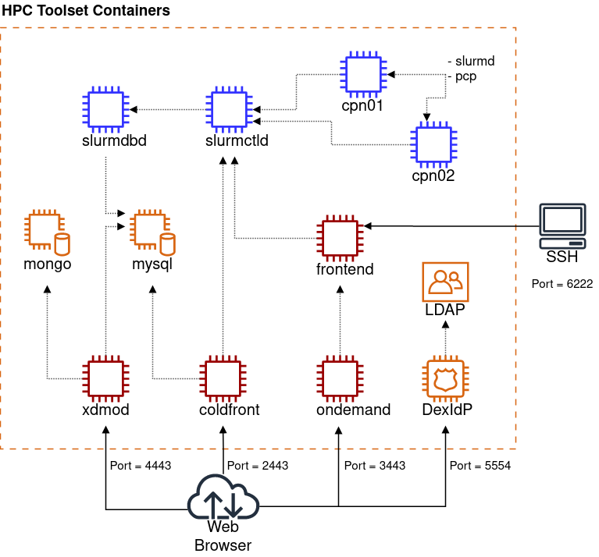

Slide 108
Local HPC installation (I)
Requirements:
  25GB of free disk space
  git 2.17+
  docker engine version 20.10.12+
  docker-compose 2.6.0+
WSL, Linux or Mac (don’t use Docker Desktop on Windows; it’s not tested)
https://github.com/ubccr/hpc-toolset-tutorial

Slide 109
Local HPC installation (II)
Install docker: https://docs.docker.com/engine/install/
For Ubuntu (WSL or native):
# Add Docker's official GPG key:
sudo apt-get update
sudo apt-get install ca-certificates curl
sudo install -m 0755 -d /etc/apt/keyrings
sudo curl -fsSL https://download.docker.com/linux/ubuntu/gpg -o /etc/apt/keyrings/docker.asc
sudo chmod a+r /etc/apt/keyrings/docker.asc
# Add the repository to Apt sources:
echo \
"deb [arch=$(dpkg --print-architecture) signed-by=/etc/apt/keyrings/docker.asc] https://download.docker.com/linux/ubuntu \
$(. /etc/os-release && echo "${UBUNTU_CODENAME:-$VERSION_CODENAME}") stable" | \
sudo tee /etc/apt/sources.list.d/docker.list > /dev/null
sudo apt-get update
Verify working Docker: docker info

Slide 110
Local HPC installation (III)
Login / start your Linux session (WSL or Native) and run:
$ cd
$ git clone https://github.com/ubccr/hpc-toolset-tutorial.git
$ cd hpc-toolset-tutorial
$ sed -i 's/stress/stress openmpi-devel pmix-devel lua-devel lua/' slurm/install.sh
$ sed -i 's|=/etc/slurm|=/etc/slurm --with-pmix --with-lua|' slurm/install.sh
$ sed -i 's/astewart"/astewart MYUSERNAME"/' base/base.config
$ sed -i 's/astewart"/astewart MYUSERNAME"/' ldap/base.config
$ echo 'PASSWD_MYUSERNAME="test123"' >> base/base.config
$ echo 'PASSWD_MYUSERNAME="test123"' >> ldap/base.config
$ sed -i 's/Stewart"/Stewart" [MYUSERNAME]="First Last"/' ldap/install.sh
$ sed -i 's/5-1/5/' .env
$ sed -i 's/RealMemory=1000/CPUs=4 RealMemory=4000/' slurm/slurm.conf

Slide 111
Local HPC installation (IV)
Login / start your Linux session (WSL or Native) and run:
$ cd
$ cd hpc-toolset-tutorial
$ git status
modified: .env
modified: base/base.config
modified: ldap/base.config
modified: ldap/install.sh
modified: slurm/install.sh
modified: slurm/slurm.conf

Slide 112
Local HPC installation (V)
Login / start your Linux session (WSL or Native) and run:
$ cd
$ cd hpc-toolset-tutorial
$ docker compose pull ⬅ Wait for 4-8 minutes
$ docker image ls
REPOSITORY TAG IMAGE ID CREATED SIZE
mongo 7.0 ad5e46b29e1a 5 weeks ago 834MB
ubccr/hpcts xdmod-2025.02 2d401aacef1e 8 months ago 6.3GB
ubccr/hpcts ondemand-2025.02 c94231f9a0cb 8 months ago 5.96GB
ubccr/hpcts coldfront-2025.02 abffc25bc4ff 8 months ago 5.15GB
ubccr/hpcts slurm-2025.02 324f0ab493cd 8 months ago 4.87GB
ubccr/hpcts base-2025.02 f324d0d0496f 9 months ago 426MB
ubccr/hpcts ldap-2025.02 69bc15680160 9 months ago 257MB
mariadb 10.11.11 ba7defb864a8 9 months ago 326MB

Slide 113
Local HPC installation (VI)
Login / start your Linux session (WSL or Native) and run:
$ cd && cd hpc-toolset-tutorial
$ docker compose build --no-cache base
$ docker compose build --no-cache --parallel ldap slurmdbd
(This will take ~12 minutes)
$ docker image ls -a
REPOSITORY TAG IMAGE ID CREATED SIZE
ubccr/hpcts slurm-2025.02 27a48a4786b9 30 seconds ago 5.19GB
ubccr/hpcts base-2025.02 ed27f8089460 24 minutes ago 426MB
ubccr/hpcts ldap-2025.02 865f85ba44fe 25 minutes ago 257MB
mongo 7.0 ad5e46b29e1a 5 weeks ago 834MB
ubccr/hpcts xdmod-2025.02 2d401aacef1e 8 months ago 6.3GB
ubccr/hpcts ondemand-2025.02 c94231f9a0cb 8 months ago 5.96GB
ubccr/hpcts coldfront-2025.02 abffc25bc4ff 8 months ago 5.15GB
ubccr/hpcts <none> 324f0ab493cd 8 months ago 4.87GB
ubccr/hpcts <none> f324d0d0496f 9 months ago 426MB
ubccr/hpcts <none> 69bc15680160 9 months ago 257MB
mariadb 10.11.11 ba7defb864a8 9 months ago 326MB

Slide 114
Local HPC installation (VII)
Login / start your Linux session (WSL or Native) and run:
$ cd
$ cd hpc-toolset-tutorial
$ docker image rm 324f0ab493cd f324d0d0496f 69bc15680160
To bring up the cluster:
$ docker compose up -d --no-build
To bring down the cluster:
$ docker compose down

Slide 115
Local HPC installation (VIII)
Login / start your Linux session (WSL or Native) and run:
$ ssh -p 6222 MYUSERNAME@localhost
(your password is test123 or whatever you used in the previous slides)
$ hostname
localhost
$ sinfo
PARTITION AVAIL TIMELIMIT NODES STATE NODELIST
compute* up 5-00:00:00 2 idle cpn[01-02]
debug up 5-00:00:00 2 idle cpn[01-02]
$ srun --nodes=2 /bin/hostname
srun: error: Unable to allocate resources: Invalid account or account/partition combination specified

Slide 117
Local HPC installation: Troubleshooting (I)
Run the 'destroy' option of the helper script to shut everything down and remove all volumes:
$ ./hpcts destroy
$ docker container list (Should show no HPC containers)
$ docker volume list (Should show no HPC volumes)
If either of the above do, you should run the corresponding remove command:
$ docker container rm [ContainerID]
$ docker volume rm [VolumeName]

Slide 118
Local HPC installation: Troubleshooting (II)
To completely start over and re-download all images, run the cleanup script and then startup script:$ ./hpcts destroy
$ ./hpcts cleanup
$ docker image list
$ docker image rm [IMAGE IDs for mongo and mariadb images]
$ ./hpcts start

