Slide 1
Twitter user ranking
Petar Jovanovic
HPC Admin
Institute of Physics Belgrade

Slide 2
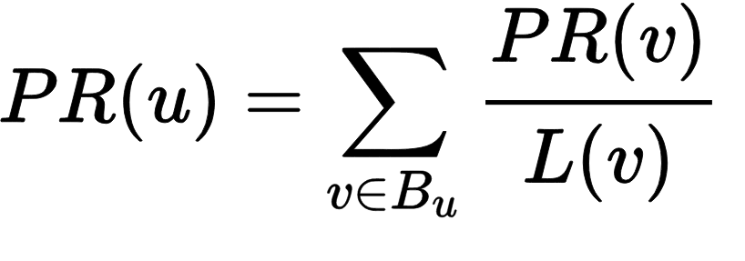
Twitter user ranking (1)
Goal: find influential Twitter users
Simple PageRank algorithm:
PR(u) - page rank of u
L(v) - number of out edges of v
Bu - set of nodes adjacent to u
u & v - any two distinct nodes
In our case: L(v) is the number of people v is following, Bu are all the people u is following.
Introduction to Hadoop – WebEx Online Meeting, 24 Jun 2016 ‹#›

Slide 3
Twitter user ranking (2)
Input data:
Text file: /user/petarj/twitter_rv.net (26 GB)
Each line contains 2 numbers separated by tabs
First column is id of a user, second column is an id of his follower
Two map-reduce steps needed to perform the analysis:
Convert data from edge list to adjacency list and set initial PageRank
Compute the PageRank approximation
Running multiple reducers
Introduction to Hadoop – WebEx Online Meeting, 24 Jun 2016 ‹#›

Slide 4
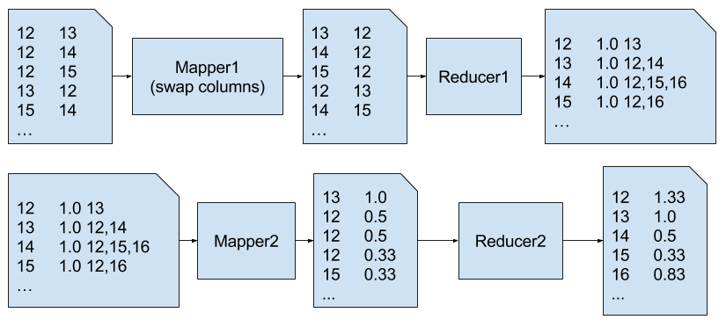
Twitter user ranking (3)
STEP 1
STEP 2
Introduction to Hadoop – WebEx Online Meeting, 24 Jun 2016 ‹#›

Slide 5
Demo
Getting the code
$ git clone https://code.vi-seem.eu/petarj/hadoop-training.git
Executing $ cd hadoop-training/twitterrank $ hadoop jar $HADOOP_HOME/share/hadoop/tools/lib/hadoop-streaming-2.7.2.jar \ -D mapreduce.job.reduces=20 -files=mapper1.py,reducer1.py \ -mapper mapper1.py \ -reducer reducer1.py \ -input /user/petarj/twitter_rv.net -output twrank_step1 $ hadoop jar $HADOOP_HOME/share/hadoop/tools/lib/hadoop-streaming-2.7.2.jar \ -D mapreduce.job.reduces=6 -files=mapper2.py,reducer2.py \ -mapper mapper2.py \ -reducer reducer2.py \ -input twrank_step1 -output twrank_step2
Introduction to Hadoop – WebEx Online Meeting, 24 Jun 2016 ‹#›

