Slide 1

Access to IPB Hadoop Cluster
Vladimir Slavnić
Research Assistant
Institute of Physics Belgrade

Slide 2
Agenda
Demo accounts and SSH access
GitLab usage
HDFS
Hadoop job control

Slide 3
Demo accounts and SSH access
Use the ssh command to access login node of IPB Hadoop Cluster:
$ ssh demo17@hadoop.ipb.ac.rs
Node hadoop.ipb.ac.rs is used for preparing and submitting MapReduce jobs and copying data back and to HDFS file system
To logout from hadoop.ipb.ac.rs, you can use the Ctrl-D command, or command exit
Secure copy (scp) can be used to transfer data to or from hadoop.ipb.ac.rs

Slide 4
Demo accounts and SSH access - Hands-On
Each participant has received his own username and password to access the IPB Hadoop Cluster
Login to Hadoop cluster
$ ssh demo17@hadoop.ipb.ac.rs
Try to transfer some files to and from hadoop.ipb.ac.rs node
$ scp test.tgz demo17@hadoop.ipb.ac.rs:
$ scp demo17@hadoop.ipb.ac.rs:test.tgz .
Credentials will be valid for another week (until July 1st 2016)

Slide 5
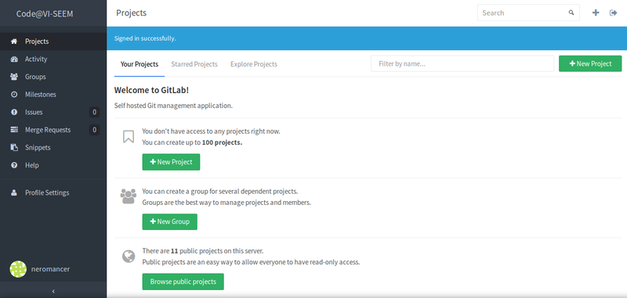
VI-SEEM Source Code Repository
Vi-SEEM source code repository is available at https://code.vi-seem.eu
Git is used as a versioning system for VI-SEEM
GitLab on top of git provides web based UI for project management and repository control
Guide is available at http://wiki.vi-seem.eu/index.php/Source_Code_Repository

Slide 6
GitLab - common usage
Adding SSH key to the profile
Creating new project
Cloning the project
$ git clone git@code.vi-seem.eu:USERNAME/PROJECTNAME.git
$ git clone https://code.vi-seem.eu/USERNAME/PROJECTNAME.git
Importing an existing project to the repository
$ git push git@code.vi-seem.eu:USERNAME/PROJECTNAME.git master
Standard workflow:
Pulling changes from a remote repository
$ git pull
Adding changes to a commit
$ git add .
$ git status
Committing changes
$ git commit -m 'some brief description of the changes made’
Pushing changes to a remote repository
$ git push

Slide 7
GitLab usage - Hands On
Git package is installed at the hadoop.ipb.ac.rs node
For this training we will only need clone command that clones remote project to your workspace:
$ git clone git@code.vi-seem.eu:USERNAME/PROJECTNAME.git
$ git clone https://code.vi-seem.eu/username/projectname.git
Training project is publicly accessible so no need for registration (we will be using HTTPS)
Login to IPB Hadoop Cluster
Perform git clone command that uses HTTPS:
$ git -c http.sslVerify=false clone https://code.vi-seem.eu/petarj/hadoop-archetype.git
Now hadoop-archetype folder is available in your home directory

Slide 8
Hadoop Distributed File System (HDFS) (1)
Distributed file system designed to run on commodity (low-cost ) hardware
Highly fault-tolerant
Suitable for applications that have large data sets
A typical file in HDFS is gigabytes to terabytes in size
Tuned to support large files
Write-once-read-many access model for files
Appending the content to the end of the files is supported
Moving computation to data

Slide 9
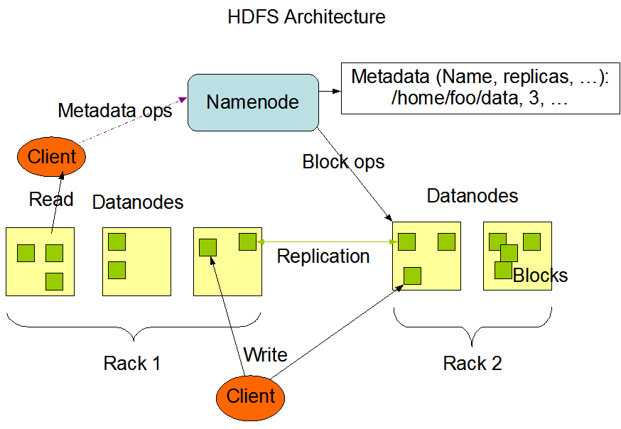
Hadoop Distributed File System (HDFS) (2)

Slide 10
File System shell (1)
To interact with HDFS user can use hadoop fs (general command) or hdfs dfs (synonym when HDFS is being used) and additional options (similar to standard Linux commands):
ls - Lists files and directories in HDFS
Usage: hadoop fs -ls [-d] [-h] [-R] <args>
mkdir - Creates directories
Usage: hadoop fs -mkdir [-p] <paths>
put - Copy files and folders from local file system to HDFS
Usage: hadoop fs -put <localsrc> ... <dst>
get - Copy files to the local file system
Usage: hadoop fs -get [-ignorecrc] [-crc] <src> <localdst>
rm - Delete files
Usage: hadoop fs -rm [-f] [-r |-R] [-skipTrash] URI [URI ...]

Slide 11
File System shell (2)
HDFS commands continued:
mv - Moves files (moving files across file systems is not permitted)
Usage: hadoop fs -mv URI [URI ...] <dest>
cp - Copy files
Usage: hadoop fs -cp [-f] [-p | -p[topax]] URI [URI ...] <dest>
cat - Copies source to stdout
Usage: hadoop fs -cat URI [URI ...]
du - Displays sizes of files and directories
Usage: hadoop fs -du [-s] [-h] URI [URI ...]
chmod - Change the permissions of files
Usage: hadoop fs -chmod [-R] <MODE[,MODE]... | OCTALMODE> URI [URI ...]
See File System Shell documentation on Hadoop web site for more

Slide 12
HDFS Hands-On (1)
Login to IPB Hadoop Cluster
Each user has its HDFS folder created in /user/username
Create folder training in your home HDFS folder
$ hadoop fs -mkdir /user/demo17/training
Create (or transfer from remote machine) some file on local file system
Copy that file to HDFS in /user/username/training folder
$ hadoop fs -put test_file.txt /user/demo17/training
List contents of the directory using -ls command
$ hadoop fs -ls /user/demo17/training
Try -ls command for some other paths (/, /user)
Copy/Download file from HDFS to the local file system
$ hadoop fs -get /user/demo17/training/test_file.txt test_file2.txt

Slide 13
HDFS Hands-On (2)
Print HDFS file content on the standard output
$ hadoop fs -cat /user/demo17/training/test_file.txt
Remove file from the HDFS
$ hadoop fs -rm /user/demo17/training/test_file.txt

Slide 14
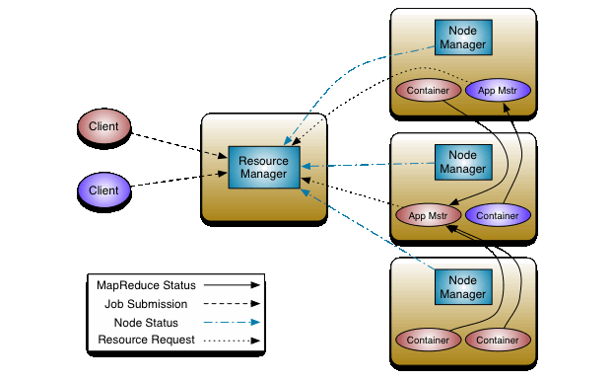
Hadoop job control (1)
YARN Architecture

Slide 15
Hadoop job control (2)
Common way to submit MapReduce jobs to Hadoop Cluster:
$ hadoop jar jarFile [mainClass] args...
In addition to hadoop command, there is also a mapred job command for interaction with MapReduce jobs:
Usage: mapred job <command> <args>
Checking the status of a job
$ mapred job -status <job-id>
Listing current running jobs
$ mapred job –list [all]
Killing an active MapReduce job
$ mapred job –kill <job-id>
Printing job details
$ mapred job –history <jobHistoryFile>

Slide 16
MapReduce jobs - Hands-On (1)
Hadoop distribuition comes with JAR with a number of examples:
/opt/hadoop/hadoop/share/hadoop/mapreduce/hadoop-mapreduce-examples-2.7.2.jar
Login to IPB Cluster
Run PI estimation example from the Hadoop examples JAR:
$ hadoop jar /opt/hadoop/hadoop/share/hadoop/mapreduce/hadoop-mapreduce-examples-2.7.2.jar pi 10 1000
Check the status of your job
$ mapred job -status <job-id>
Listing current running jobs
$ mapred job -list
Print job details after it is finished
$ mapred job -history <jobHistoryFile>
You can find job history file (jhist) in /tmp/hadoop-yarn/staging/history/done/2016/06/24/000000/ HDFS folder

Slide 17
MapReduce jobs - Hands-On (2)
For the next, WordCount example, we will get some input data
Copy folder input with download books in TXT format from Project Gutenberg from /home/slavnic folder:
$ cp -r /home/slavnic/input /home/demo17
Transfer that folder to HDFS
$ hadoop fs -put /home/demo17/input/ input_dataset
Check content of HDFS folder
$ hadoop fs -ls /user/demo17/input_dataset
Run WordCount example that is available in Hadoop examples JAR:
$ hadoop jar /opt/hadoop/hadoop/share/hadoop/mapreduce/hadoop-mapreduce-examples-2.7.2.jar wordcount /user/demo17/input_dataset /user/demo17/output
Last two arguments are input dataset location and results location

Slide 18
MapReduce jobs - Hands-On (3)
When job is finished check its output:
$ hadoop fs -ls /user/demo17/output
Print the content of the output file
$ hadoop fs -cat output/part-r-00000
Try to see all current running jobs
$ mapred job -list

