Slide 1

Hadoop MapReduce
Petar Jovanovic
HPC Admin
Institute of Physics Belgrade

Slide 2
Agenda
Maven project archetype
MapReduce
Word count example

Slide 3
Maven project archetype
Download & install:
$ git clone https://code.vi-seem.eu/petarj/hadoop-archetype.git
$ cd hadoop-archetype
$ mvn clean install
Usage:
$ mvn archetype:generate \
-DarchetypeGroupId=eu.viseem.code \
-DarchetypeArtifactId=hadoop-archetype \
-DarchetypeVersion=1.0-SNAPSHOT \
-DgroupId target.group.id \
-DartifactId=test

Slide 4
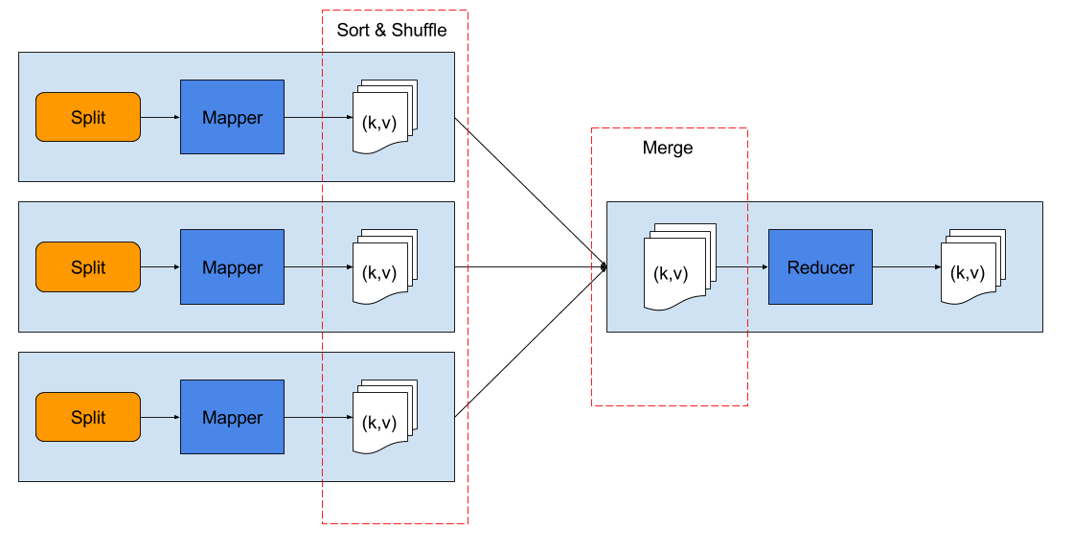
MapReduce - Basic
Introduction to Hadoop – WebEx Online Meeting, 24 Jun 2016 ‹#›

Slide 5
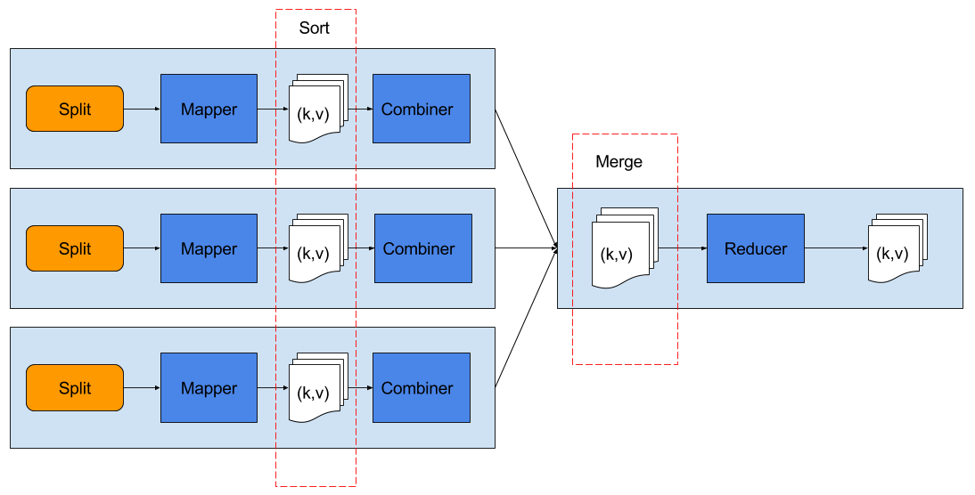
MapReduce - with combiner
Introduction to Hadoop – WebEx Online Meeting, 24 Jun 2016 ‹#›

Slide 6
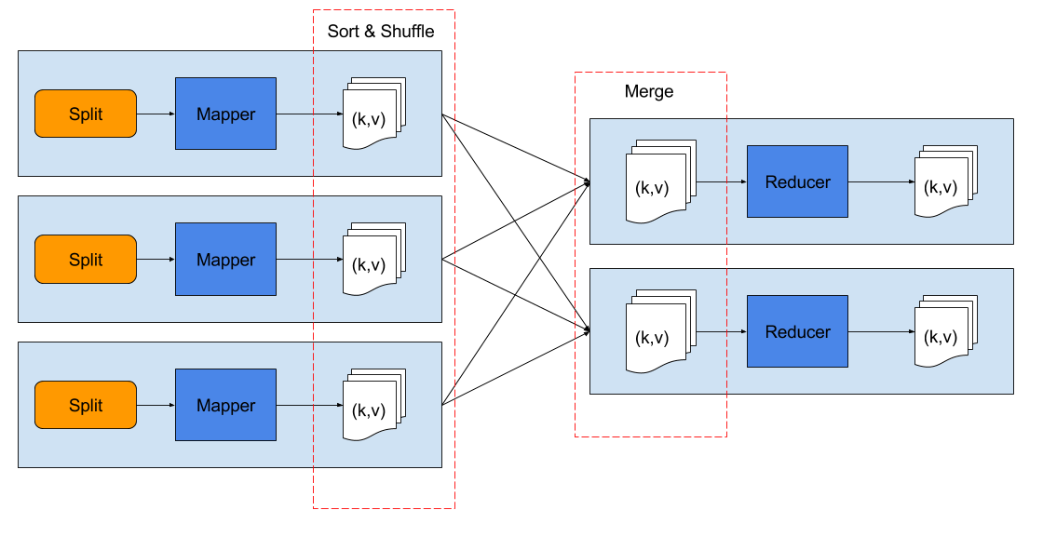
MapReduce - multiple reducers
Introduction to Hadoop – WebEx Online Meeting, 24 Jun 2016 ‹#›

Slide 7
Word count example
Mapper
  split input lines into words
  add 1 as initial count of each word
Reducer
  for each word (key), sum its counts (value)
Combiner
  same as reducer, but runs locally on mapper outputs
  commutative and associative operation
  useful when it can reduce the mapper output

Slide 8
Word count example
DEMO

