Slide 1

DICOM Network application
Updating DICOM Network Architecture for its Integration at International Level
Golubev Alexandr, MAGIC project 2016

Slide 2
Contents
System Overview
Beneficiary benefits
Information System Architecture
User interface: “DICOM Portal” component
Equipment integration: “DICOM Server”
Image Visualization: “DICOM Viewer”
Monitoring System: “DICOM Monitoring”
Security and personal data protection: “DICOM Audit” Module
What Next?
Resources
Conclusions
Questions Session

Slide 3
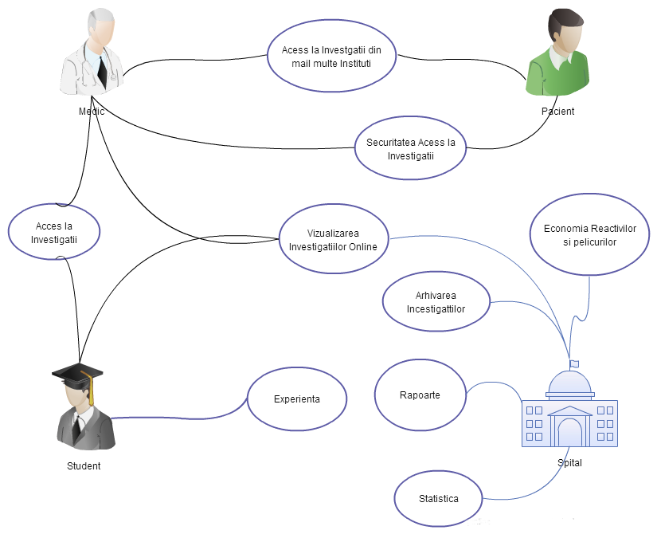
System Overview
«DICOM Network» Informational System was planed and developed for Medical and Diagnostically Institutions for collections, processing and visualization of medical images.
This system covers all the workflow for processing and documentation of medical investigations from collecting images from equipment to archiving investigation in the patient medical record.
«DICOM Network» offers necessary functionality for quality medical management and secure investigation access in ONLINE mode. This helps doctors, specialists and penitents to access, save and document Medical Imaging Investigations and help institutions to reduce investigation costs, enchasing quality of service.

Slide 4
Beneficiary benefits
Investigations prime cost reduce
No need for Investigation Print consumables
No need for CD/DVD archive
No need for third party software support
Increase Quality of Service
Online Investigations Access by specialists, doctors, patients
Investigations exchange between institutions.
Online Consultations, reduce paper documents, etc…
Statistics Enhancement
Quality Statistics services available 24/7
Advanced Reporting
Sophisticated reporting system
Archive
Secure and Stable Archive for investigatins.

Slide 5
Numbers
1’st put into operation information system working in the RM, which offers distributed data collection, processing, access and archiving of medical images
7 Medical equipment's were connected to the “DICOM Network”.
16 Doctors from radiology section are working in “DICOM Network” system 24/7.
200 Investigations average per day are collected by the system now.
400 Investigations per day are expected by the end of the year when all equipment will be connected to the system.
496 Doctors have access to their patients investigations from their working place
2 193 Times investigations were downloaded by doctors and specialists last 2 months.
1 278 960 MDL(57 352 EUR) were spent on the print consumables for investigations printing in 2015 year and will be saved in 2016 thanking to DICOM Network.

Slide 6
Information System Architecture
Implementation of “DICOM Network” required an outstanding architecture that should cover distributed system requirements and should be flexible enough to cover all beneficiary requirements.
“DICOM Network” is an modular system, base modules are: «DICOM Data», «DICOM Server», «DICOM Portal»,«DICOM Monitoring»,«DICOM Server»-ов ,«DICOM Viewer»,«DICOM AUTH» , «DICOM Processor» , «DICOM Audit».
Data Storage and Data Processing are distributed between different processors and storages, that could be customized using specific interfaces.

Slide 7



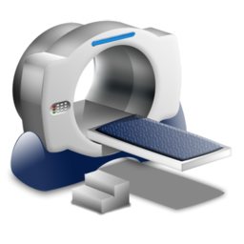
Architecture
DICOM DATA Interface
DICOM NETWORK API
????
www.dicom.md
VI-SEEM DICOM Portal
DICOM Server 1
DICOM Server 2
Public DICOM Server

Slide 9
DICOM Portal
Front End User interface
Web portal provides end-user access to the system through an Web interface. Portal offers work space for following user roles:
Patients who have access only to their investigations based on IDNP.
Doctors who have access only to their patients investigations.
Doctors radiology specialists who are working in 24/7 regime.
Users with limited time access, to get temporary access to specific research. This is necessary to ensure access to foreign experts, the legacy organizations, etc.
System Administrator that performs monitoring and configuration of the system and «DICOM Server» and regulates the level of access for other users on the system.
For administrators there are developed management console also available ONLINE.

Slide 10
DICOM Server
Equipment integration and data storage
This module provides a service of collecting data from the equipment, saving the archive of images and transmission of information on the server in the «DICOM Portal».
This service is designed for various interfaces import / export of data, depending on the beneficiary's equipment. «DICOM Server» can also be used as a PACS and provides all the necessary commands for the protocol. Thus it can be used including adherence to the side of specialized Viewer system.
This component is also responsible for the transfer of research to «DICOM Viewer» on the basis of appropriate access levels.
This component can be scalability, and be installed in different locations and organizations, allowing you to store image archive distributed without impacting the concrete infrastructure of certain organizations.

Slide 11
DICOM Viewer
Medical images Visualization
The module provides all the necessary operations on the medical image:
DICOM image visualisation. User friendly interface.
DICOM image operations : Line, Circle, Rectangle, Curve line
Area calculation and dimensions : Line, Angle, diameter, S circle, S rectangle, Zoom +/-, Zoom area, Move
File operations : Save, Print, Bulk Print
Image Visualization: Table n*n images, Negativ
Different projections : Skull, Lung, Abdomen, Mediastinum, bone, Spine, Felsenbein, Cerebral
3D Modeling

Slide 12
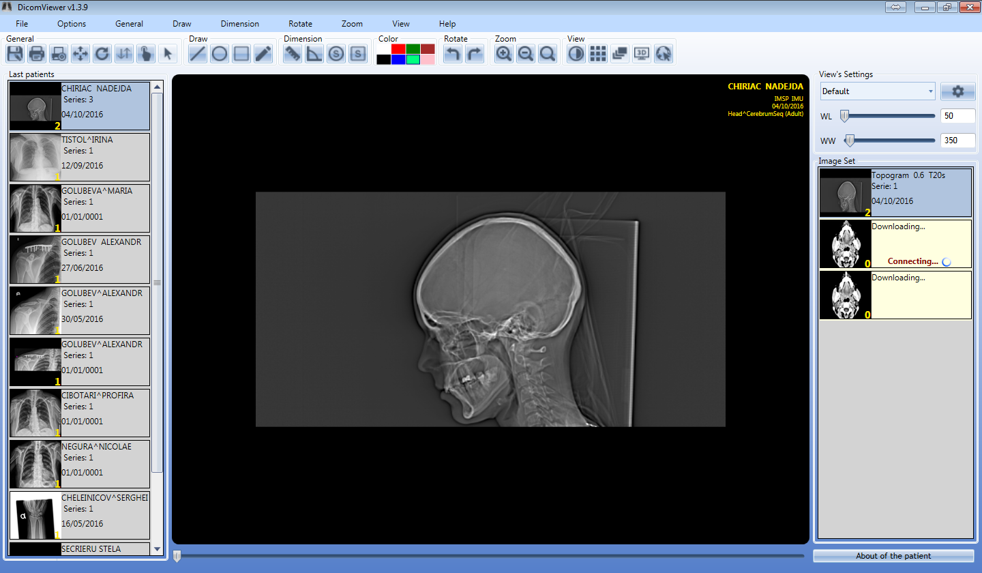
Series Screen

Slide 13
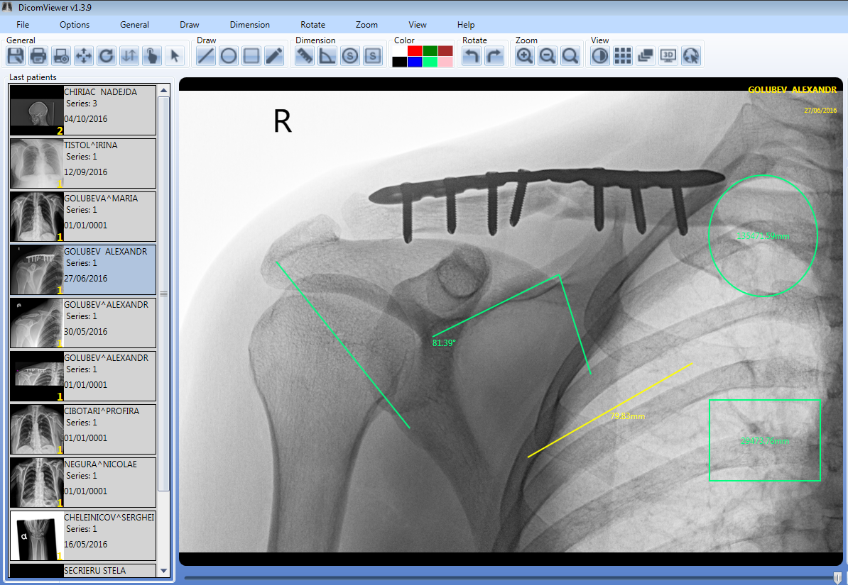
Graphical functionalities

Slide 14
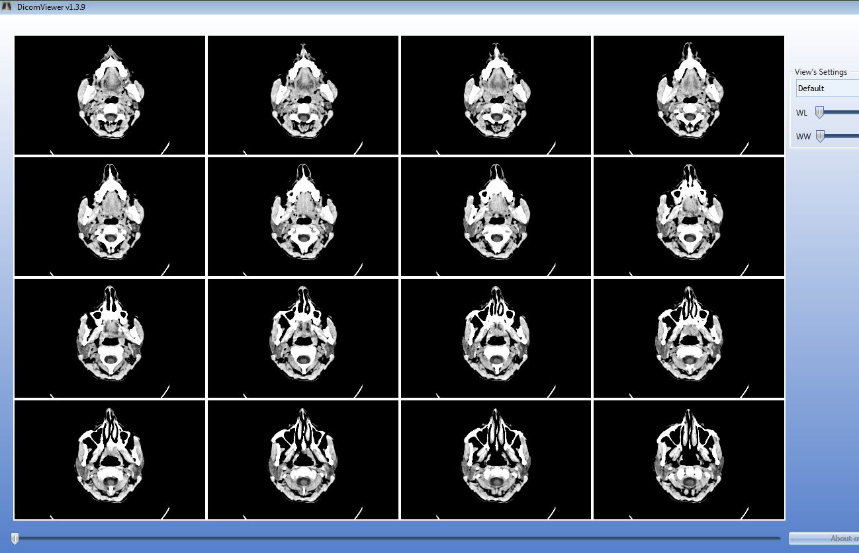
Table View

Slide 15
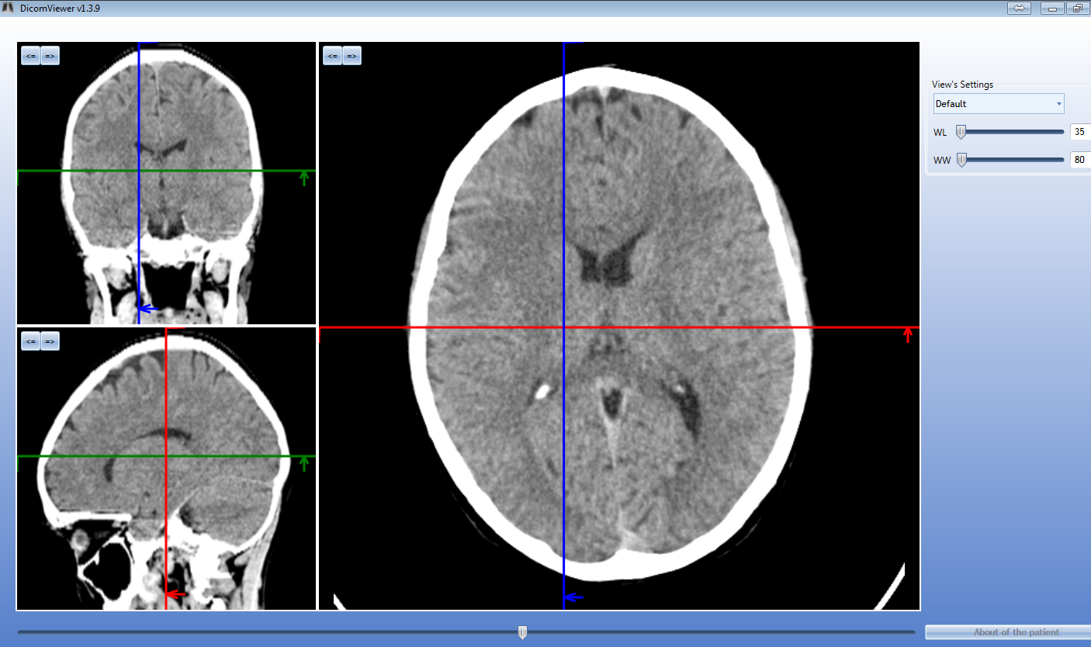
MPR - slices

Slide 16
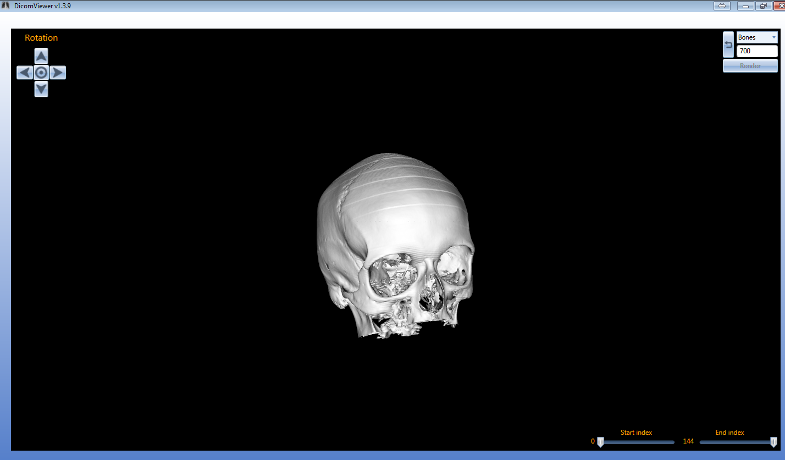
3D Modeling

Slide 17
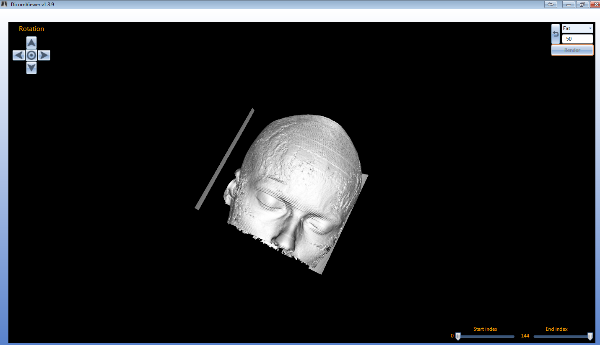
3D Modeling Projections

Slide 18
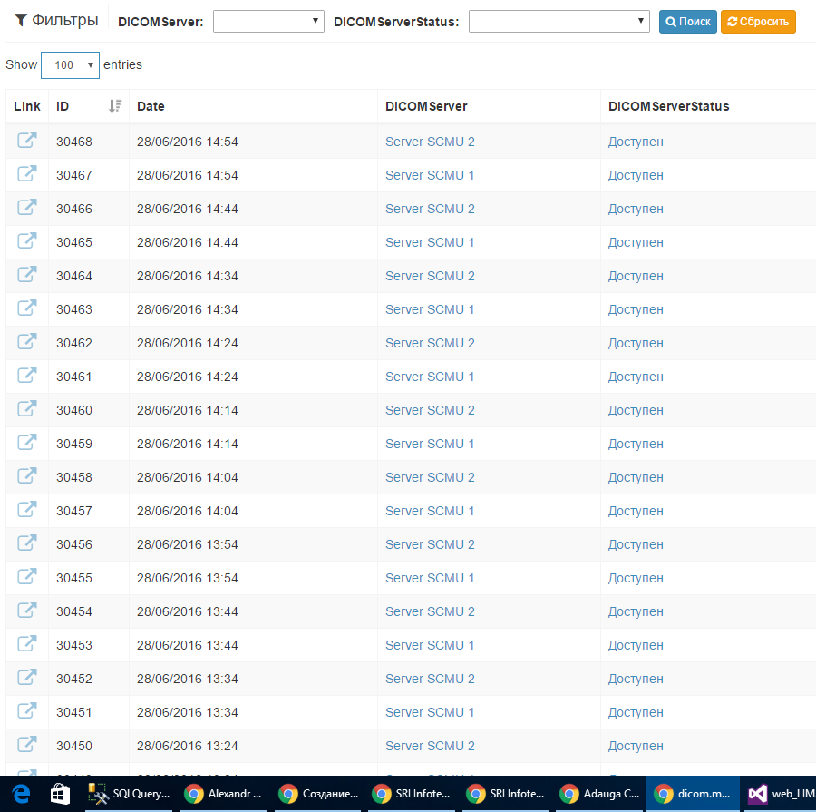
DICOM Monitoring
Equipment and services monitoring
Performance monitoring system-configured «DICOM Server» s. This system allows you to determine the failure or unavailability of equipment connection, which in turn allows us to solve problem early on and increases the resiliency of the entire system.

Slide 19

DICOM Audit
Personal data security and Investigations access.
Each Investigation is linked to an patient with its personal data.
For Each investigation there is possible to set individual access.
Each request to data access is logged and investigation workflow is tracked.

Slide 20
What Next?
Future research, activities and innovations
Even project is now in production, functionality of the “DICOM Network” can and should be enhanced. During the implementation beneficiary of this system realized necessity for additional features. In the near future it is planned to implement new features such as:
Integration MPASS and legalization of the patient's access to his research.
Connect new equipment.
Mobile version of the «DICOM Viewer»
Enhancing connectivity to VI-SEEM Platform and other international projects and platforms.
Also, the long-term plan to develop and integrate a more ambitious projects in this area:
Optimization studies archiving.
Image preprocessing and detection of anomalies.
Expert system to help doctors.
Development of the "DICOM NETWORK" on the national and international level.

Slide 21

Questions

