Slide 1
Welcome to GÉANT
GN5-1 and GN5-IC1 Project Overview
GÉANT Project Office:
Tryfon Chiotis
GRNET, 8 December 2022

Slide 2
What is GÉANT?
GÉANT is :
An organisation, GÉANT Association, the company we work for, which is an
Association containing members https://www.geant.org/about/membership/pages/maandgareps.aspx
A project:
GN4-3, GN4-3N and soon GN5-IC1 and GN5-1, offering high-speed network connectivity and related services to National Research and Education Networks (NRENs)
A (project) partnership, usually referred to as the GÉANT Partnership
A framework:
GN5-FPA Framework Partnership Agreement links participants for a seven-year programme of projects in the EC’s HorizonEurope
USE TWO WORDS WHEN INTRODUCING GÉANT TO PROVIDE CONTEXT
GÉANT services, GÉANT network, GÉANT partners …
… once context is established you can shorten to GÉANT

Slide 3

GÉANT Vision
To ensure equal network access for all scientists across Europe to the research infrastructures and the resources available to them

Slide 4




Celebrating 20 years of successful GÉANT project support
2000
Over the last 20 years, together we have:
Supported over 50 million users from a wide range of scientific and academic communities
Reached over 100 countries worldwide and helped establish Europe as the hub of global research and education
Greatly reduced the digital divide in Europe
Established TNC as the global R&E event with over 800 attendees
Enabled huge increases in network traffic: 2.8 Exabytes carried in 2019, with a peak of 1.1Tbps recorded
Expanded a range of collaboration services, including: eduroam in 100+ countries, 60+ eduGAIN federations; brought cloud services to R&E
Published over 500 deliverables (25,000+ pages)
Secured EUR952 M (costs) for network and service innovation
Scored FIVE ‘Excellent’ ratings at EC project reviews
2004
2009
2020
4

Slide 5
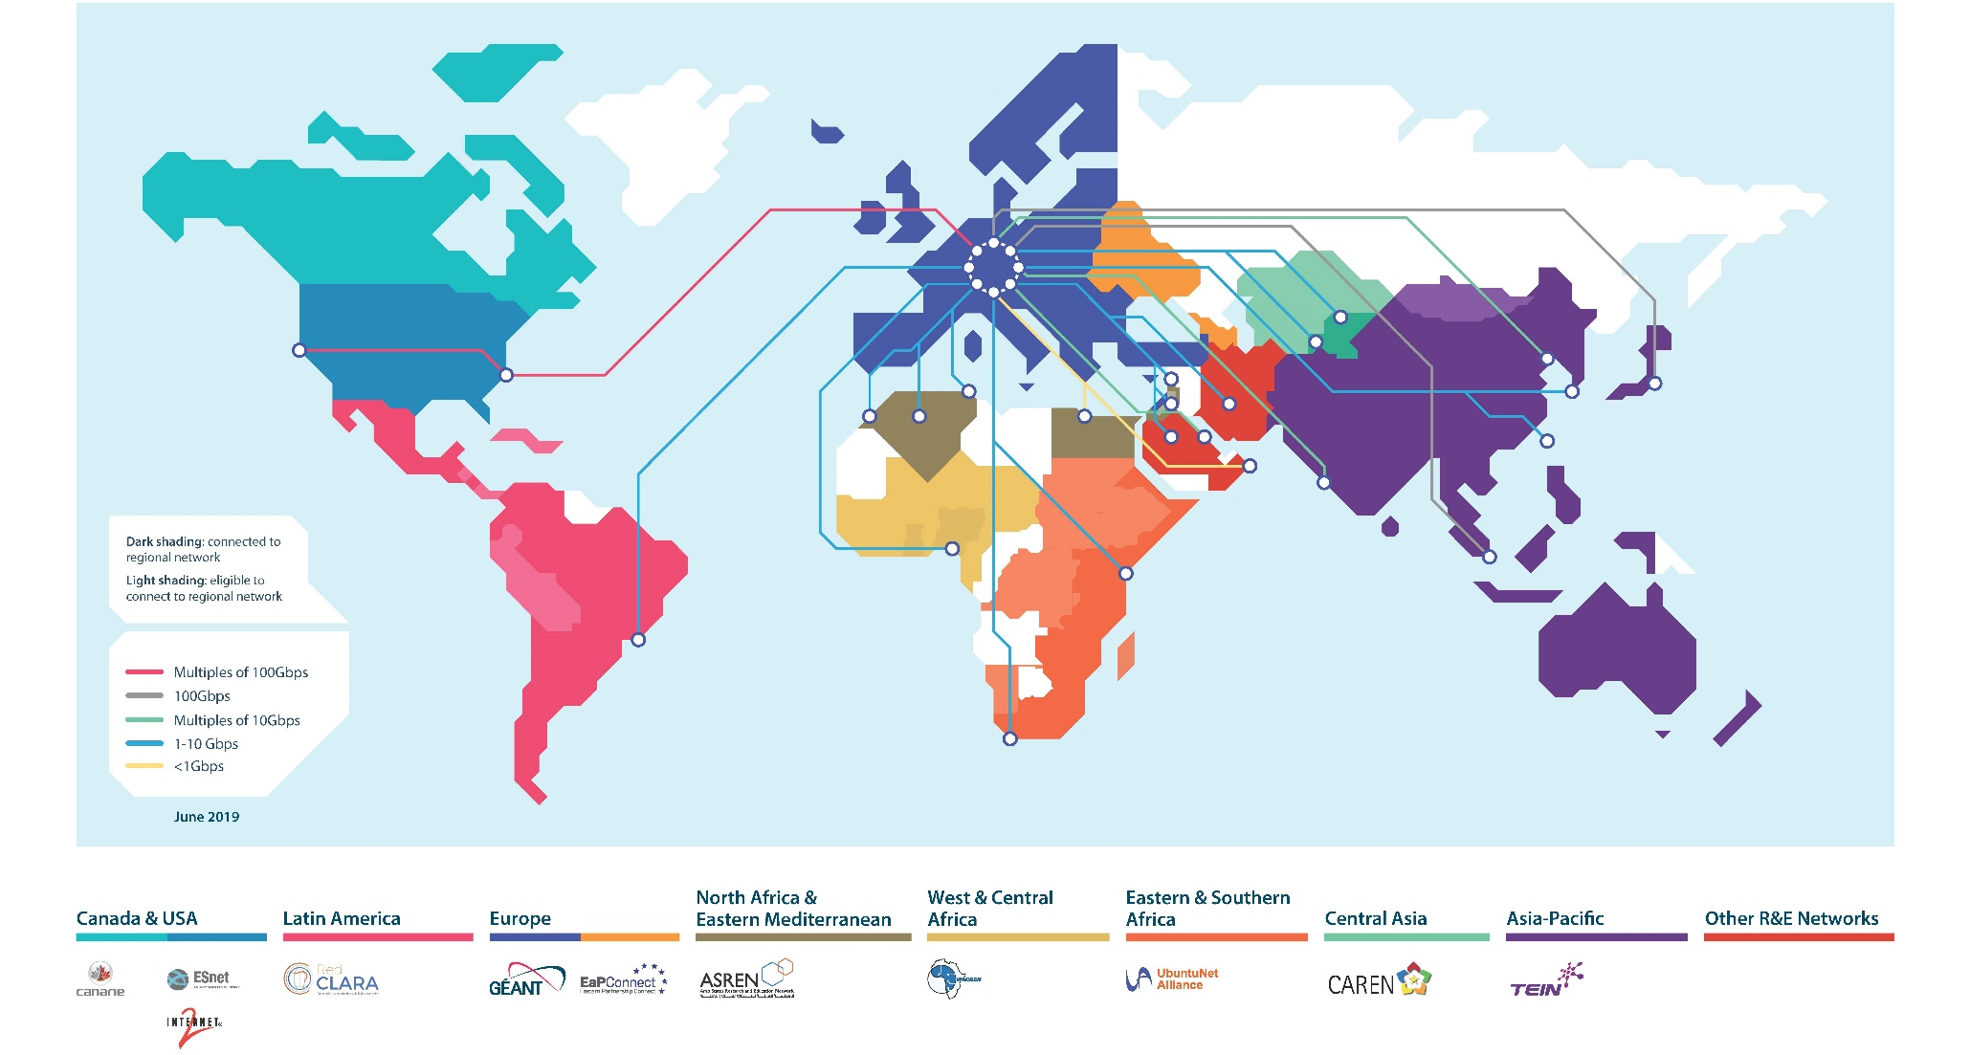
GÉANT serving research and education … worldwide See https://map.geant.org for an interactive map
New links and connectivity upgrades to North America, North Africa, Eastern Partnership countries and Asia
5

Slide 6
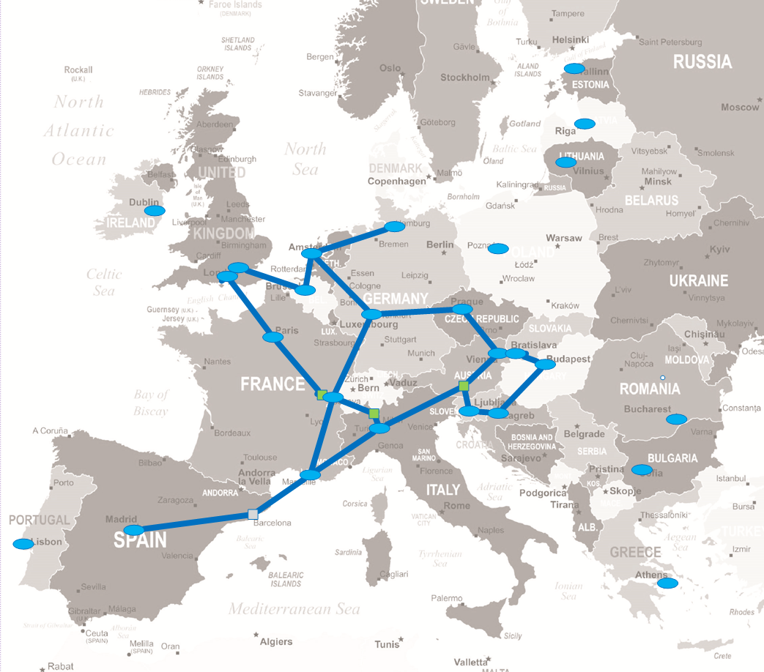

GÉANT Topology 2018
Fibre/Spectrum footprint covering 14 countries
Fibre/Spectrum lease contracts of 7 years
Rest connected by leased capacity
Links to other world regions landing at Fibre connected nodes only
Frequent procurement cycles and cost variability – years and areas

Slide 7
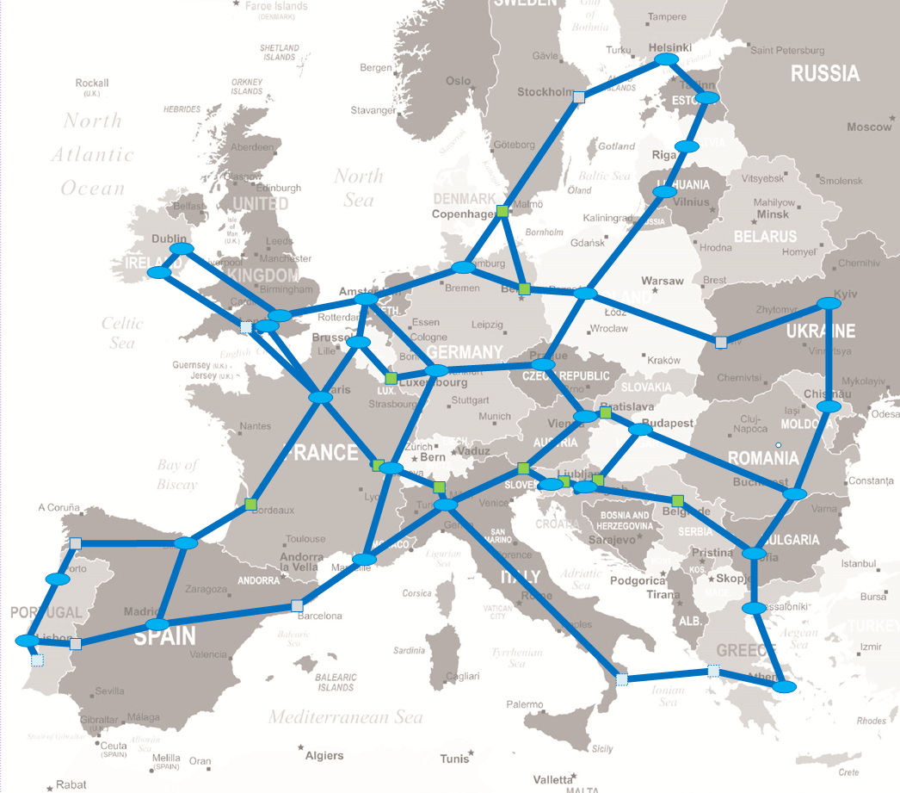
GÉANT Topology 2023
Fibre/Spectrum footprint covering 30 countries (2 as EAP)
Fibre/Spectrum IRU contracts of 15+ years
OPEX cost reduction vs 2018 >40%
NREN already providing 25% of this infrastructure 7000+Km!

Slide 8
Building Trust for Research and Education: Four years of Trust & Identity Services in GN4-3
During the last four years eduGAIN, grew from 59 to 81 federations worldwide, connecting over 5100 Identity Providers and 3600 Service Providers – an increase of over 50% in participating entities.
InAcademia has the capability to provide affiliation verification for up to 13 million students in 11 countries across Europe, with uptake and adoption continuing to grow, and provides a service to two of the largest international student discount platforms.
In four years’ time eduroam continued growing in its install base. eduroam is now available in over 106 countries at over 9500 institutions (15% growth) at over 36300 service locations (25% growth). Obviously there was a steep drop in the number of authentications during the pandemic and the respective lockdowns, but in 2022 we see a recovery to the numbers seen before the pandemic.
Since 2019 eduTEAMS evolved into a versatile platform to deliver AAI services based on the AARC Blueprint Architecture. Initially focusing on research collaborations, eduTEAMS was adopted by 12 Research Infrastructures (RIs) including 3 out 5 EOSC clusters, representing 10s of RIs. Today, eduTEAMS is being used in the context of the European Open Science Cloud and European Research Infrastructures, National Infrastructures, NRENs, High Performance Computing and the Erasmus Student Mobility programme.
8

Slide 9
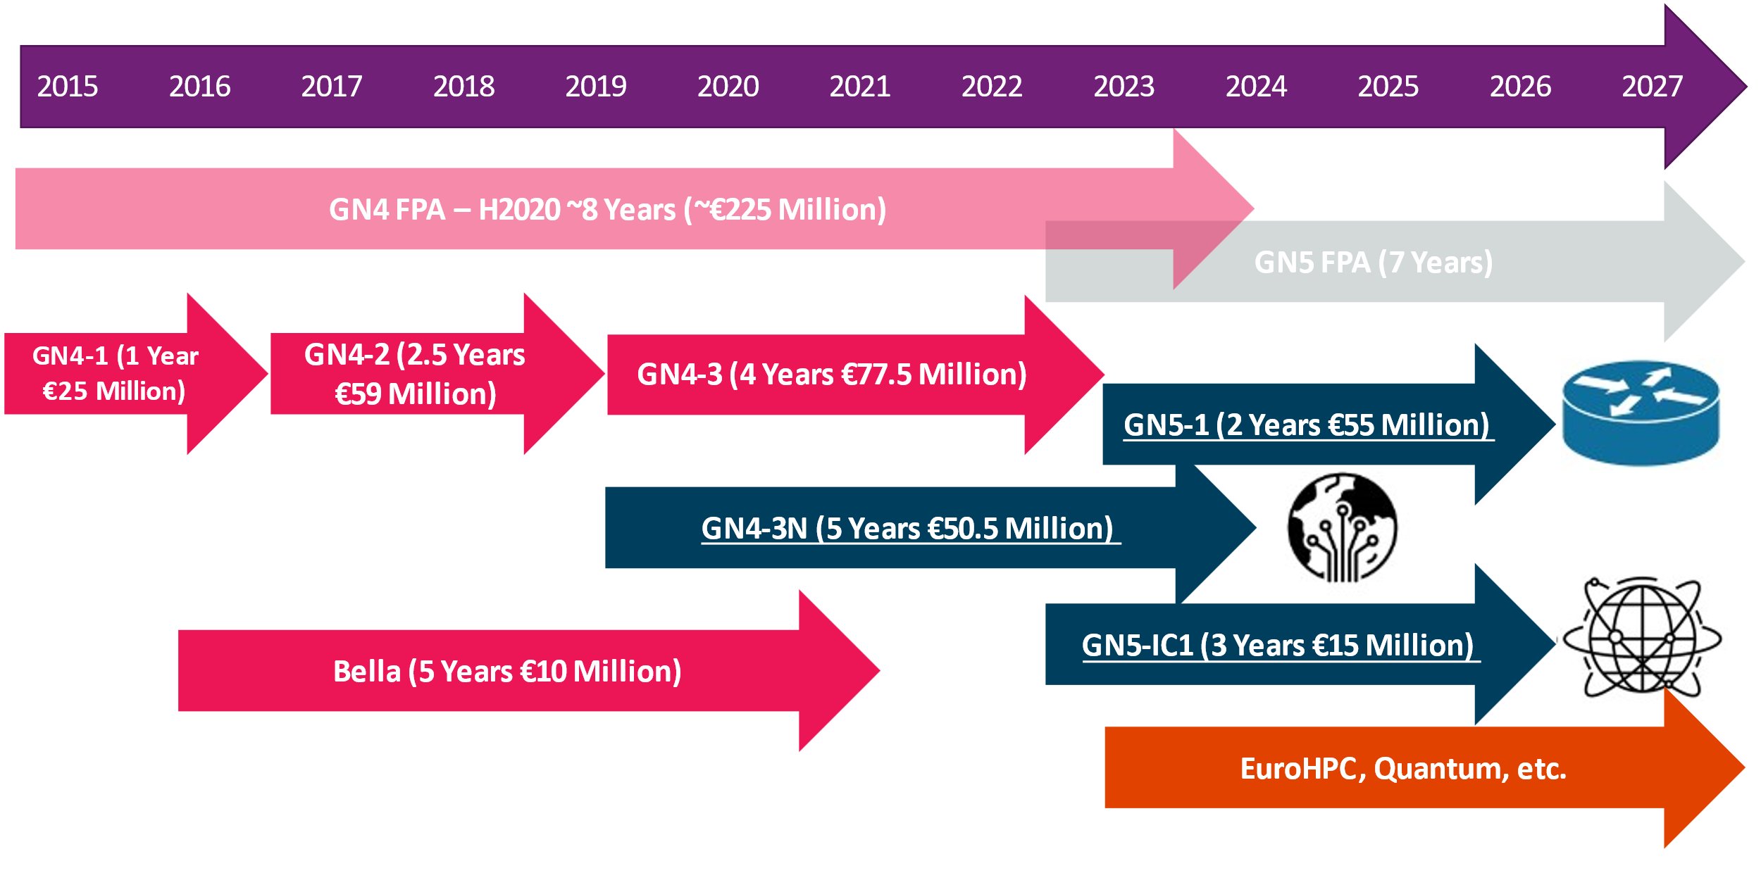
9

Slide 10
GN5-FPA Framework Partnership Agreement Horizon Europe
Action A | Understand and respond to the requirements of R&E communities.
Action B | Evolve the Communication Commons towards data-driven research and education.
Action C | Deliver state-of-the-art network connectivity and operational excellence.
Action D | Deliver interoperable and distributed trust and identity infrastructure,security and above-the-net services, and procurement.
Action E | Ensure innovation of key infrastructures and service development as an indispensable part of the GÉANT partnership.
Action F | Strengthen the collaborative ecosystem of GÉANT and the NRENs, and develop the human capital of the GÉANT partnership.
The GN5-FPA links participants in a seven-year programme:
GN5-1 | 1/12/2023 to 31/12/2024
GN5-IC1 | 1/12/2022 to 30/11/2025
10

Slide 11
GN5-1 Partners
19 | MACHBA - InterUniversity Computation Centre (IUCC) | Israel
20 | Kormányzati Informatikai Fejlesztési Ügynökség (KIFÜ) | Hungary
21 | Kauno Technologijos Universitetas (LITNET) | Lithuania
22 | Macedonian Academic and Research Network Skopje (MARnet) | Macedonia
23 | Javna Ustanova Univerziteta Crne Gore Podgorica (MREN) | Montenegro
24 | NORDUnet A/S | Denmark, Iceland, Norway, Finland , Sweden
25 | Instytut Chemii Bioorganicznej Polskiej Akademii Nauk (PSNC) | Poland
26 | Entidad pública empresarial RED.ES (RedIRIS) | Spain
27 | Research and Educational Networking Association of Moldova (RENAM) | Moldova
28 | Groupement d’intérêt public pour le réseau national de Télécommunications pour la Technologie, l’Enseignement et la Recherche (RENATER) | France
29 | Foundation RESTENA (Réseau Téléinformatique de l’Education Nationale et de la Recherche) (RESTENA) | Luxembourg
30 | Agentia de Administrare a Retelei Natinale de Informatica Pentru Educatie si Cercetare (RoEduNet) | Romania
31 | Zdruzenie Pouzivatelov Slovenskejakademickej Datovej Siete SANET (SANET) | Slovakia
32 | SURF b.v. (SURF) | Netherlands
33 | Türkiye Bilimsel ve Teknolojik Araştırma Kurumu (TUBITAK) | Turkey
34 | L-Università ta' Malta (UoM) | Malta
Associated Partners
35 | Jisc LBG (Jisc) | UK
36 | SWITCH | Switzerland
37 | Institute for the Informatics and Automation Problems of the National Academy of Sciences of the Republic of Armenia (ASNET-AM) | Armenia
38 | Qëndra Ndërinstitucionale Te Rrjetit Akademik Shqiptar (RASH) | Albania
39 | Association of Users of Ukrainian Research and Academic Network URAN (URAN) | Ukraine
GÉANT Association membership https://about.geant.org/membership/members-associates-general-assembly-representatives/
Participant No. | Participant Organisation Name | Country
1 (Coordinator) | GÉANT Vereniging (GÉANT) | Netherlands
2 | Universitaet Wien (ACOnet) | Austria
3 | Univerzitet u Beogradu (AMRES) | Serbia
4 | Akademska Raziskovalna Mreza Slovenije (ARNES) | Slovenia
5 | Institute of Information Technology of Azerbaijan National Academy of Science (AzScienceNet) | Azerbaijan
6 | BELNET BELGISCH TELEMATICA ONDERZOEKNETWERK (Belnet) | Belgium
7 | Bulgarian Research and Education Network (BREN) | Bulgaria
8 | Hrvatska Akademska I Istrazivacka Mreza Carnet (CARNET) | Croatia
9 | CESNET Zajmove sdruzeni pravnickych osob (CESNET) | Czech Republic
10 | Κυπριακο Ερευνητικο Και Ακαδημαϊκο Δικτυο (Kypriako Erevnitiko Kai Akadimaiko Diktyo) (CyNet) | Cyprus
11 | Verein zur Förderung eines Deutschen Forschungsnetzes e. V. (DFN-Verein) | Germany
12 | Fundação para a Ciência e a Tecnologia (FCT) | Portugal
13 | Consortium GARR (GARR) | Italy
14 | Georgian Research and Educational Networking Association (GRENA) | Georgia
15 | National Infrastructures for Research and Technology (GRNET) | Greece
16 | Education and Youth Board (Harno) | Estonia
17 | HEAnet CLG (HEAnet) | Ireland
18 | Latvijas Universitates Matematikas Un Informatikas Instituts (ICMS-UL) | Latvia
19 | MACHBA - InterUniversity Computation Centre (IUCC) | Israel
11

Slide 12



GN5-1 in numbers
37 Partners (including GÉANT Association), 2 Associated Partners (SWITCH, JISC), 44 Countries 200+ FTEs (average per year over project duration)
GN5-1 total costs: € 82.64 M; EC funding: € 55M
9 Work Packages, 42 Tasks 36 Deliverables 46 Milestones
12

Slide 13
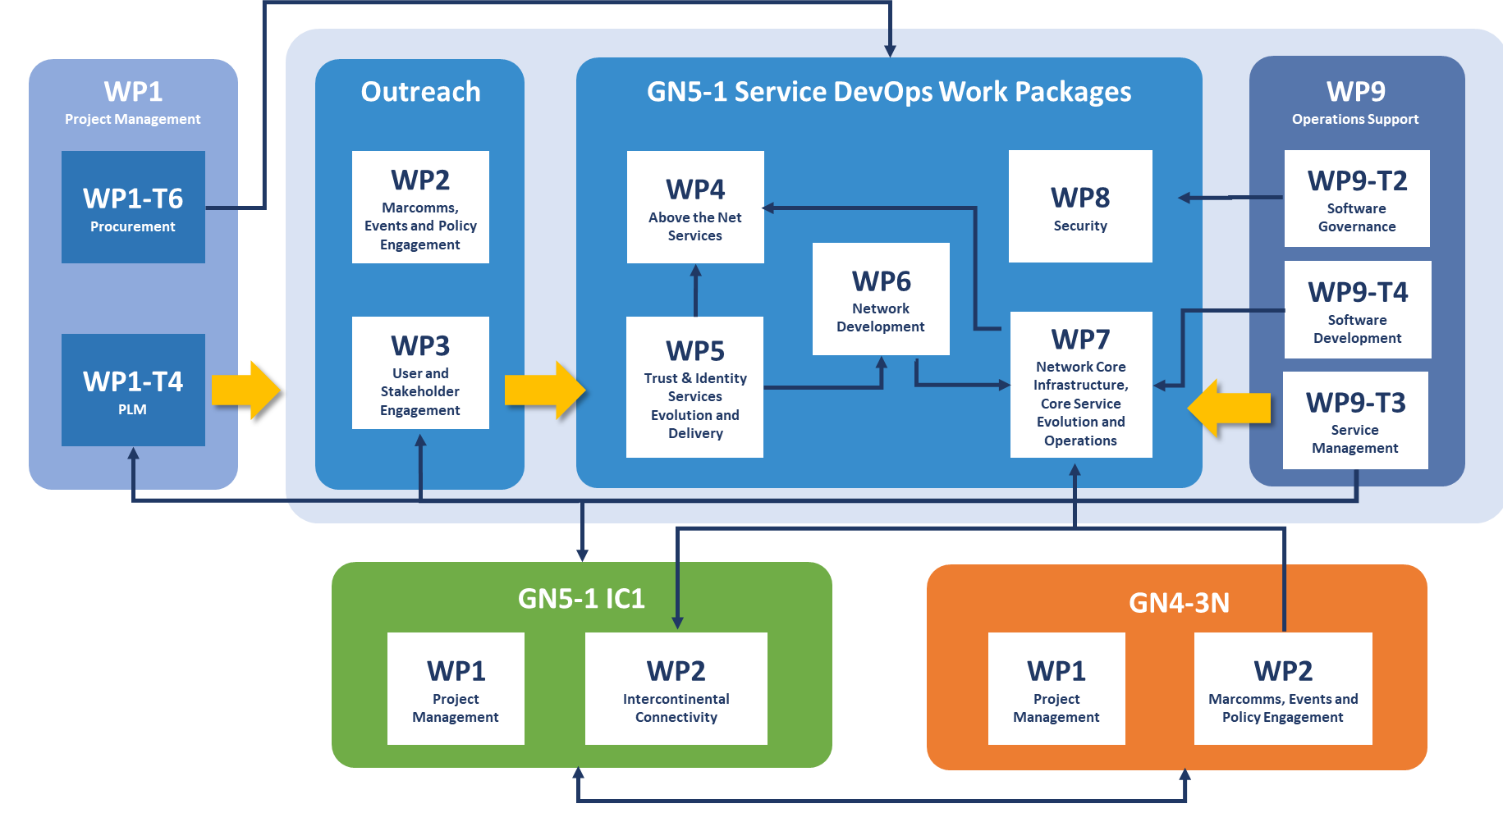
Project Components and Interdependencies
13

Slide 14
GN5-IC1 in numbers
11 Partners (including GÉANT Association and 1 Associated Partners), 14 Countries (NORDUnet =5) 6.9 FTEs (average per year over project duration)
GN5-IC1 estimated project cost: €18.4 M; EC funding: €15.0 M
2 Work Packages, 7 Tasks 7 Deliverables 13 Milestones

Slide 15
GN5-IC1 Seeks to provide global connectivity for European researchers
Secure two new network links in Asia and North America
Connectivity to Asia
Expiring Frankfurt-Beijing circuit Feb 2023
NIAC approved progression
Tender published end-September for a link to Singapore
Opportunity to interconnect with China Science and Technology Network (CSTNET)
Results expended Q1 2023
Connectivity to North Atlantic
Investigation in North Atlantic as area of focus
Market experience – capacity constraints and shortage of suppliers for long-term investments
Opportunity for ESnet collaboration
LHC readiness
Planning for connectivity in other regions in synergy with international partners, major users and other initiatives
15
Notes:
To replace/update existing infrastructure
To extend and secure GÉANT’s global reach
Extend the reach of network topology and capacity planning to a global scale, considering organic growth and demands from NRENs and research infrastructures delivered worldwide as shared resources (i.e. ITER, SKA, LHC and others)
Increase resiliency, capacity and control on end-to-end communication
Co-ordinate network infrastructure investments in partnership with global NREN peers
Make choices and decisions in context with other relevant programmes, such as the EC’s Digital Decade and NDICI, and DGs including:
department for International Partnerships (INTPA), Neighbourhood and Enlargement Negotiations (NEAR), Research and Innovation (RTD), Defence Industry and Space (DEFIS) and European External Action Service (EEAS) Regional Recovery Funds, and investments resulting from new apparatus (e.g. the Square Kilometre Array (SKA) project, ITER and EuroHPC)
Ensure financial sustainability by finding a balance between extent/reach of investments and the ongoing operational financial commitment that results

Slide 16

This Photo by Unknown Author is licensed under CC BY-SA

Slide 17
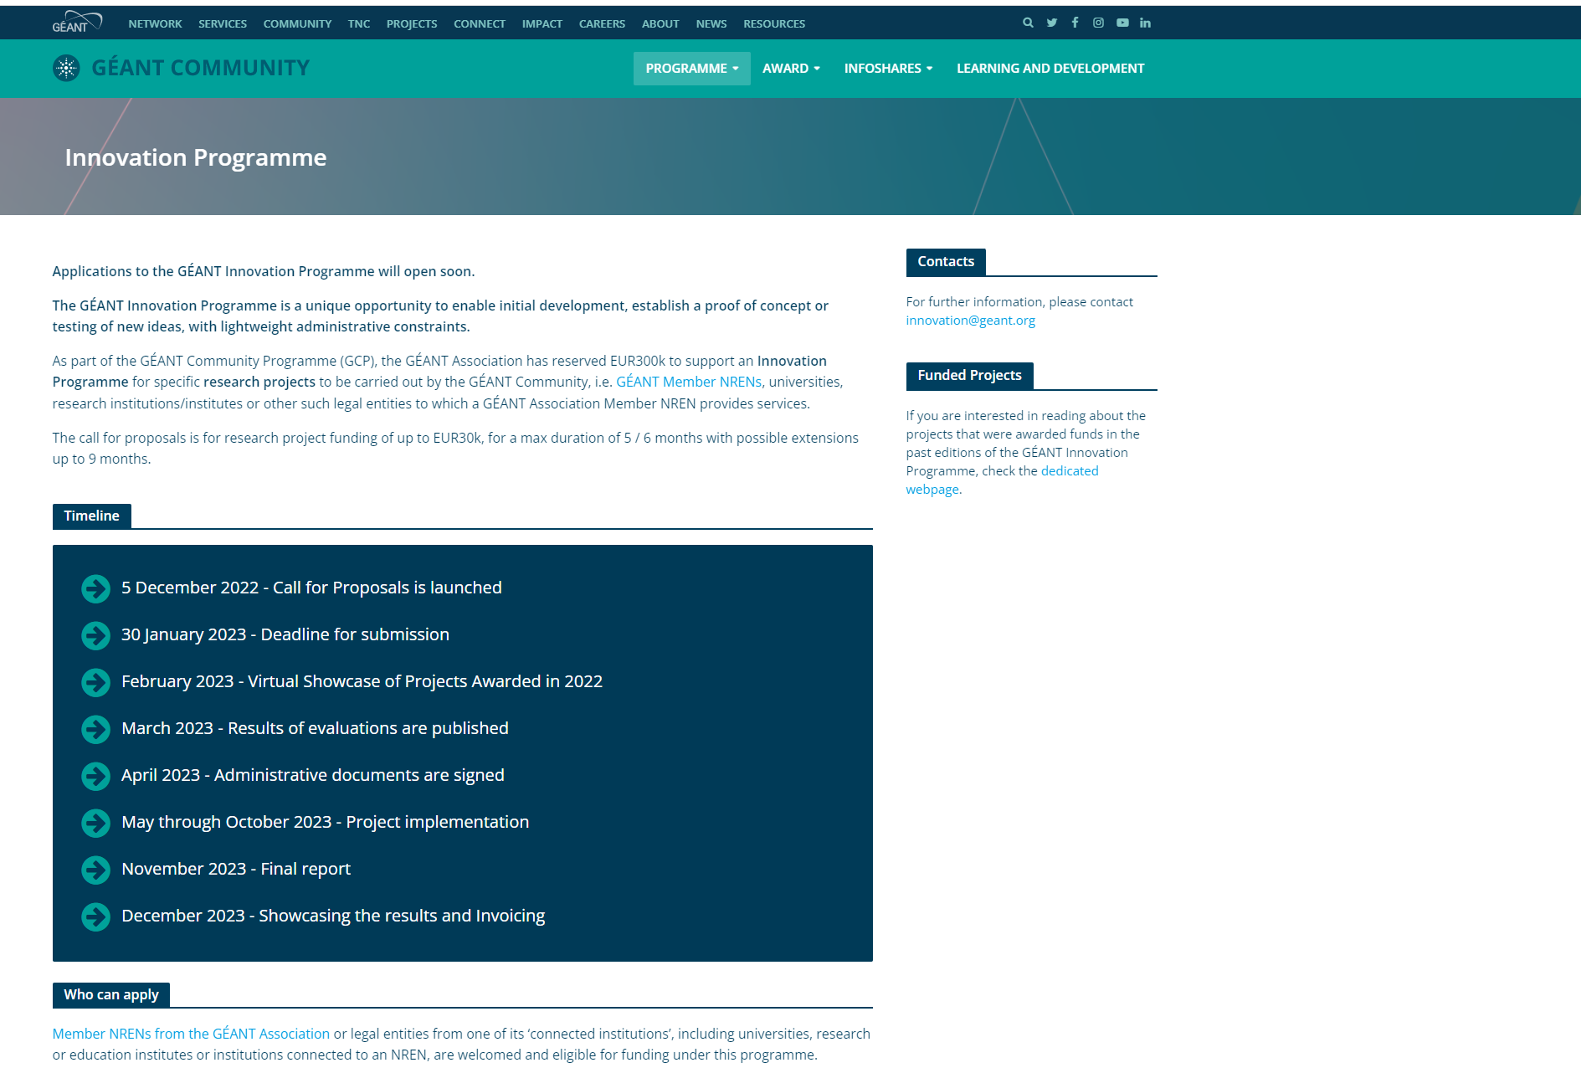
https://community.geant.org/community-programme-portfolio/innovation-programme/

Slide 18
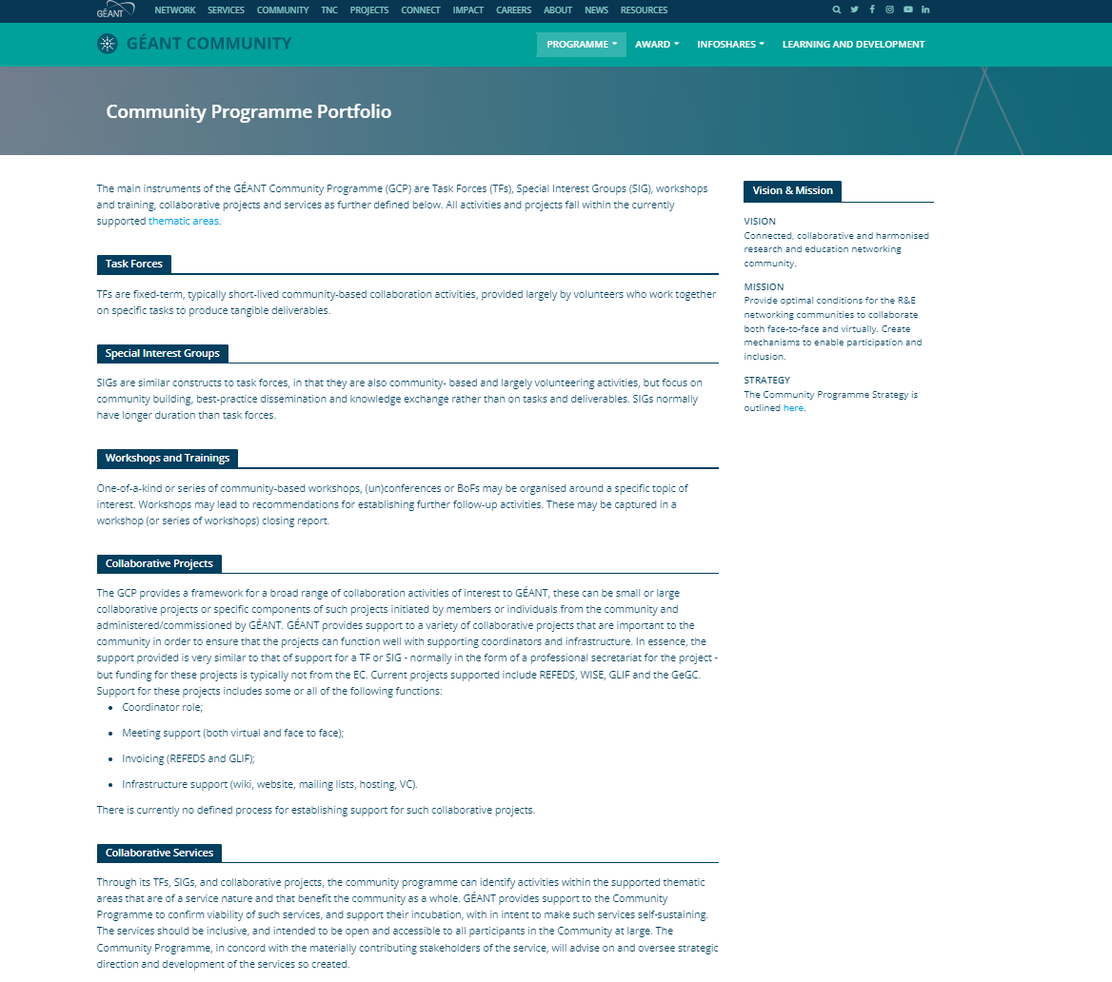

Slide 19
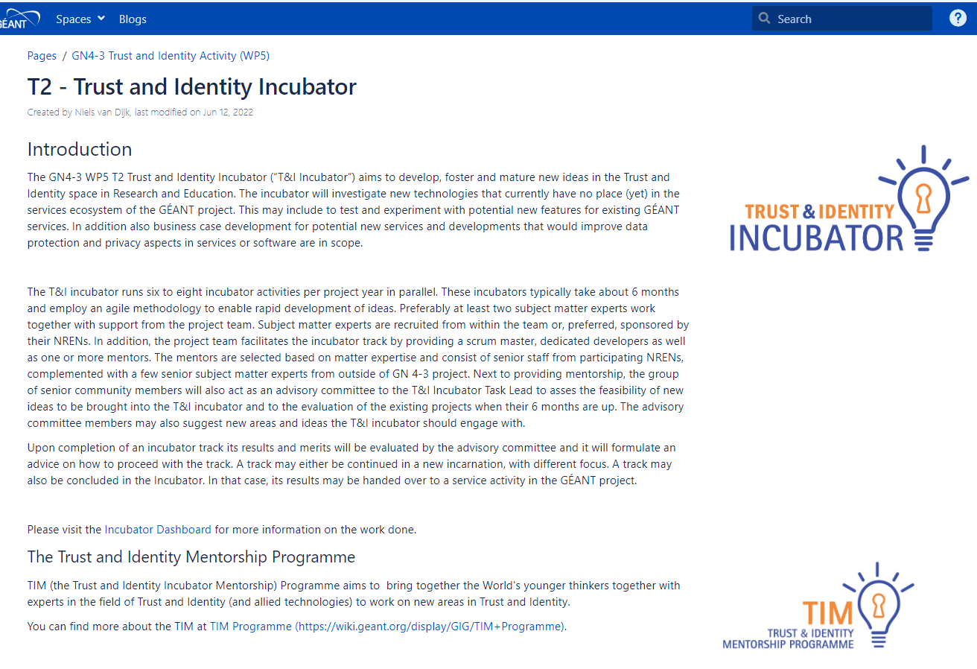
https://wiki.geant.org/display/gn43wp5/T2+-+Trust+and+Identity+Incubator

Slide 20
Learning services provided to the GN5-1/GN5-IC1 Community through GÉANT Learning and Development (GLAD)
Webinars
Training events
Bespoke programmes
eLearning
Knowledge Exchange
Website
https://learning.geant.org/
Email
glad@geant.org
Slack
gladcommunity.slack.com
eAcademy
https://e-academy.geant.org/moodle/
GLAD at a glance (video)
20

Slide 21
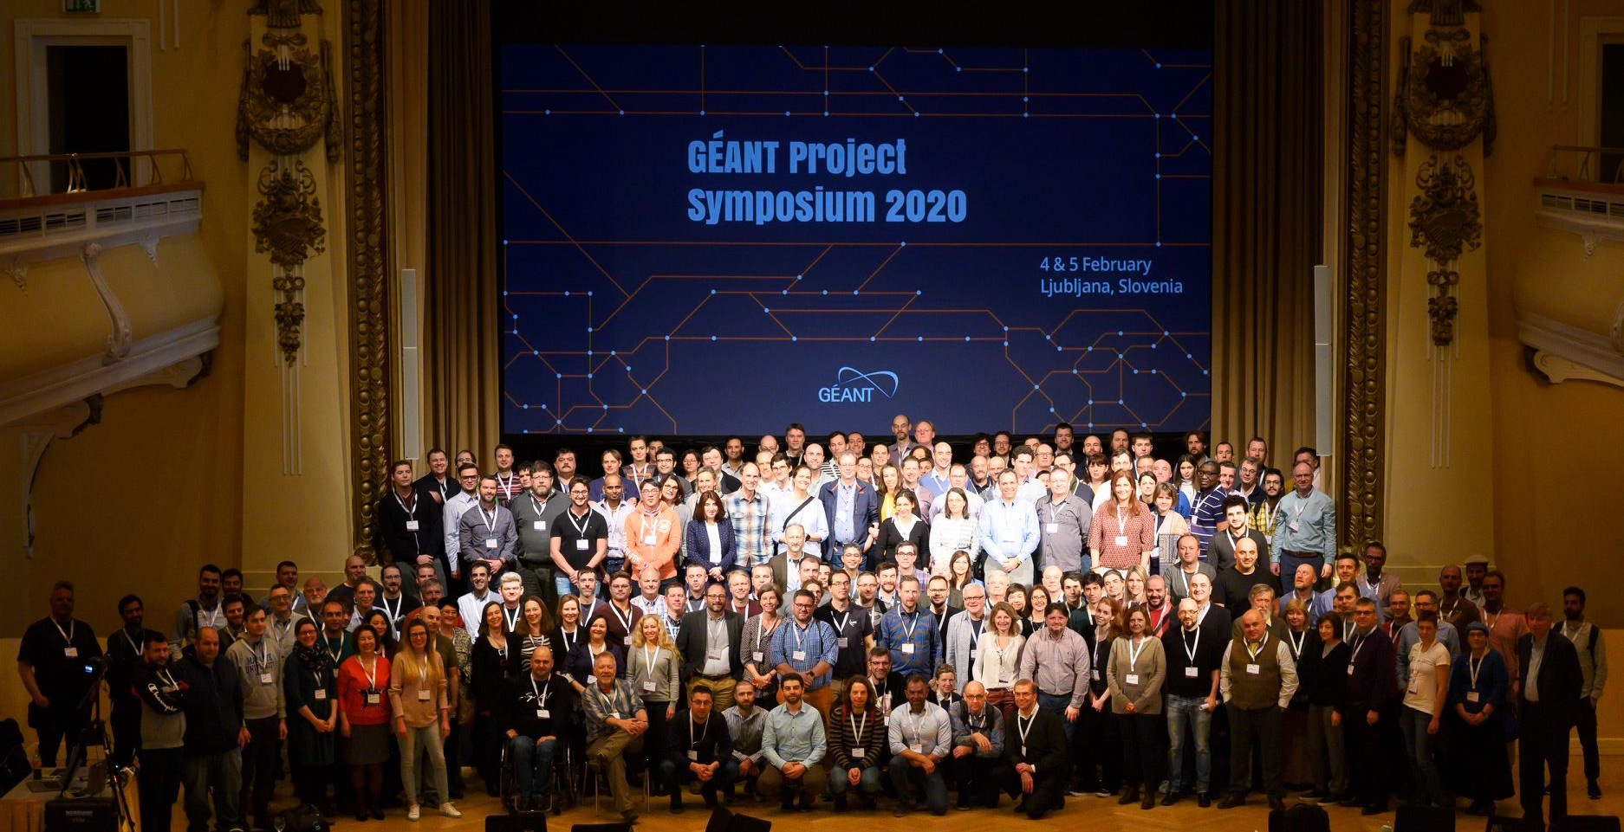
GN4-3 Symposium: 4 and 5 February 2020

Slide 22
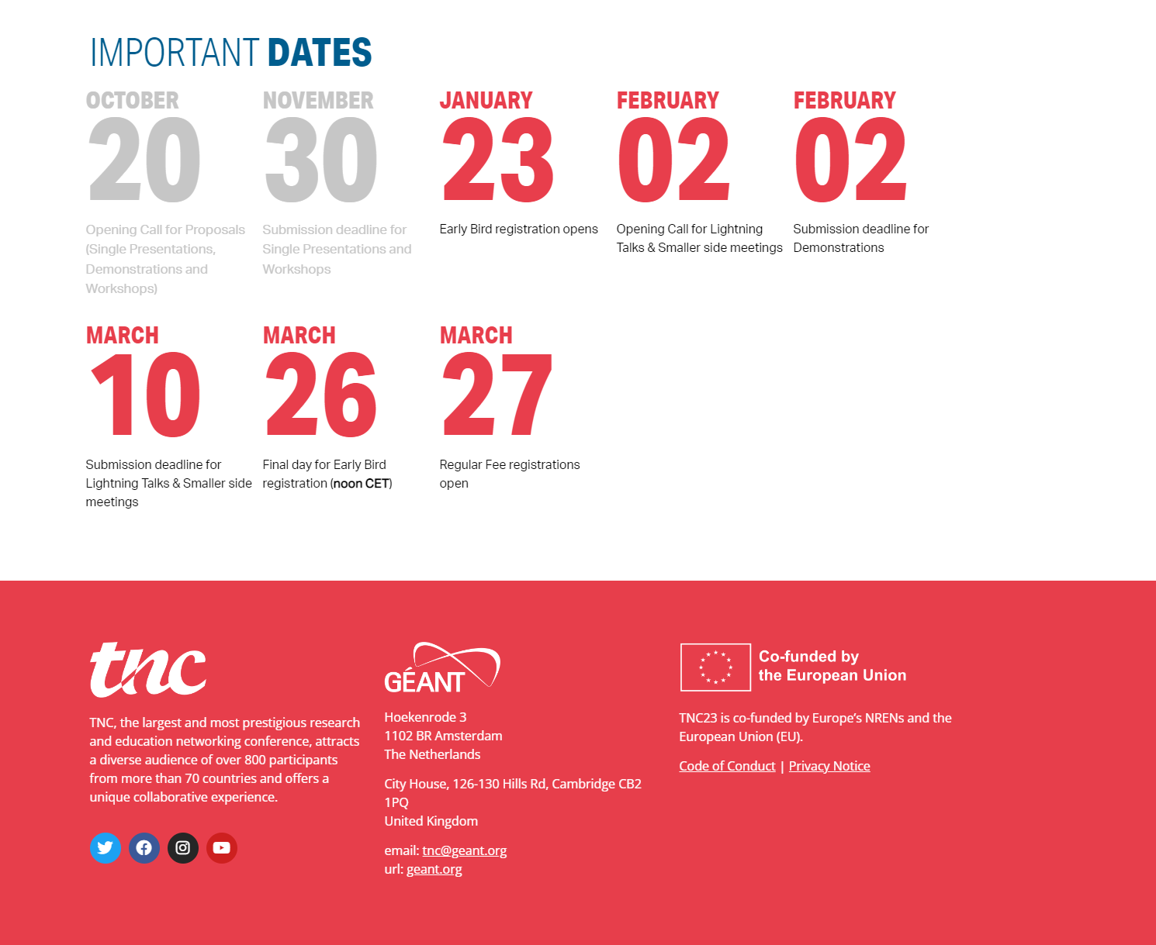

Slide 23
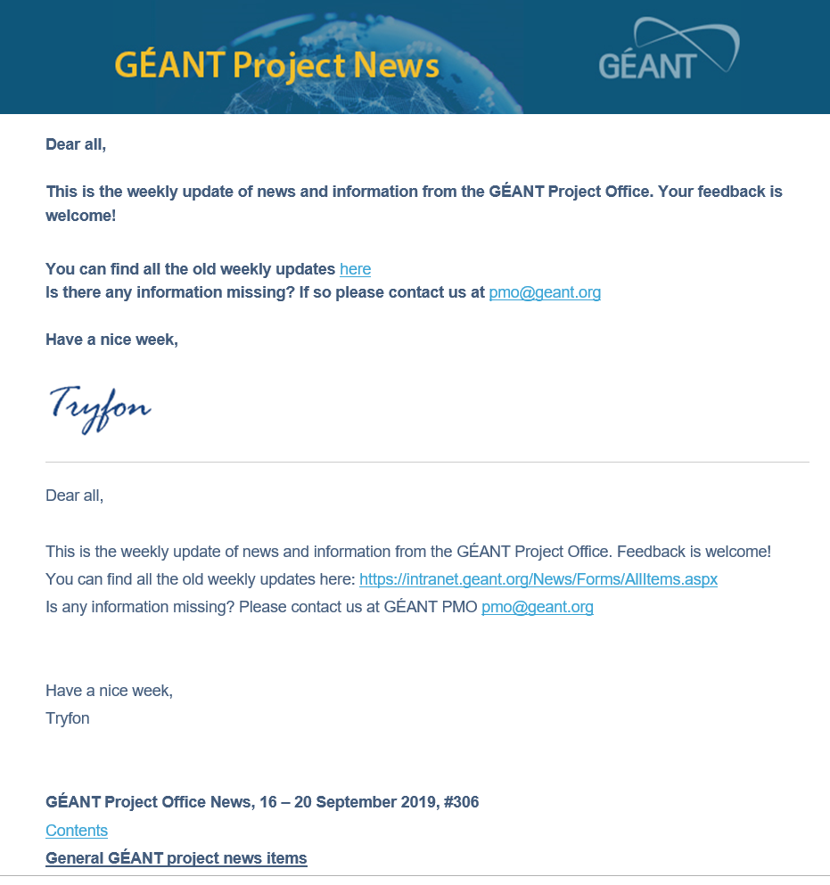
Start your week with the project news
Project newsletter is sent every Monday morning to all project participants (started in Nov 2013)
Please provide your input to Tryfon.Chiotis@geant.org by Friday afternoon
23

Slide 24
Thank you
Any questions?

